Slide 1


Department of Computer Science and Engineering
Session: 2025-26
Cybercrime Trend Analysis & Judicial Performance Evaluation in India Using Data Analytics
CA-3 Mini Project BDDC
Presented By:
Name: Shivansh Lohani
PRN : 23070521141
Name: Shreyasi Gidmare
PRN : 23070521146
Name: Sushmit Partakke
PRN: 23070521156
Under The Guidance Of
Dr. Snehlata K Wankhade

Slide 2


Introduction
India's rapid digital transformation - spanning payments, governance, and commerce - has created fertile ground for cybercriminals. Offenses including financial fraud, phishing, identity theft, and hacking are rising sharply year over year.
Digital Growth
Explosion of internet users and online platforms creates new attack surfaces.
Rising Cybercrime
Diverse and increasingly sophisticated offenses targeting individuals and institutions.
Analytics Imperative
Data-driven tools are essential to identify risk patterns and allocate law enforcement resources effectively.

Slide 3

RESEARCH OBJECTIVES
What This Study Aims to Achieve
1
2
Cybercrime Trend Analysis
Judicial Performance Evaluation
Identify temporal and geographic patterns in reported cybercrime cases across India.
Measure court efficiency — pendency rates, conviction ratios, and disposal timelines.
3
4
Predictive Modeling
Decision Support (BDDC)
Apply ML models to forecast future cybercrime volumes and judicial bottlenecks.
Provide actionable intelligence for policymakers and law enforcement through dashboards.

Slide 4

Dataset & Problem Statement
Data Sources
Core Problems Identified
Government cybercrime records (2021–2023)
National judicial performance data
State-level disaggregated datasets
📈 Accelerating Cybercrime
Year-on-year case volumes show consistent upward momentum.
Variables Tracked
Cases registered, chargesheeted, convicted
Pendency counts and disposal rates
🗂️ Judicial Backlog
Pendency has ballooned, leaving vast numbers of cases unresolved for years.
⚖️ Conviction Deficit
Conviction rates are disproportionately low relative to cases filed.

Slide 5


METHODOLOGY
Research & Analytical Framework
Data Collection
Preprocessing
Exploratory Analysis
ML Models
Visualization
Each stage builds upon the last - raw government data is cleaned and explored before being fed into predictive models, with findings surfaced through interactive dashboards designed for non-technical stakeholders.

Slide 6
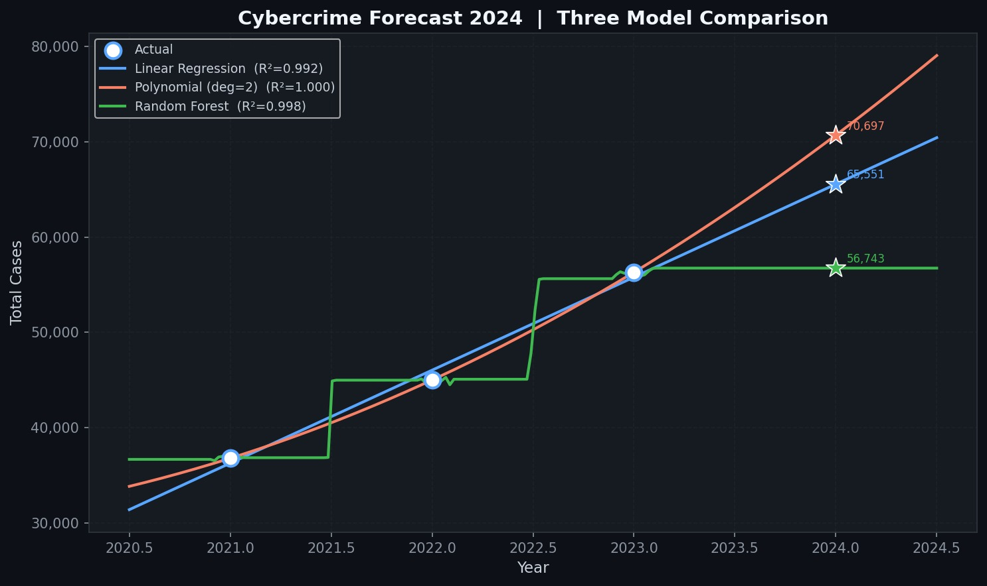

Machine Learning Models Compared
Model Evaluation Metrics
Linear Regression
Polynomial Regression
All models are benchmarked using R² Score to measure explanatory power, alongside accuracy comparisons to determine which best captures India's evolving cybercrime landscape.
Establishes baseline crime trend - simple, interpretable, useful for year-on-year projections.
Captures non-linear surges and seasonal fluctuations in cybercrime reporting.
Random Forest
Handles complex multi-variable interactions -best suited for state-level and category-level predictions.

Slide 7
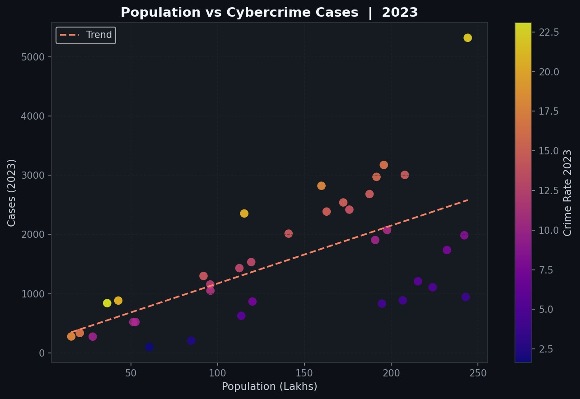

Key Findings
Steady Rise
Cybercrime cases increased consistently across all three years of the study period.
Regional Disparities
High-density digital states like Maharashtra, Karnataka, and Telangana report disproportionately higher volumes.
Low Convictions
Conviction rates remain well below 30%, highlighting systemic prosecution challenges.
Forecast
Predictive models project further acceleration in cybercrime cases without structural intervention.

Slide 8
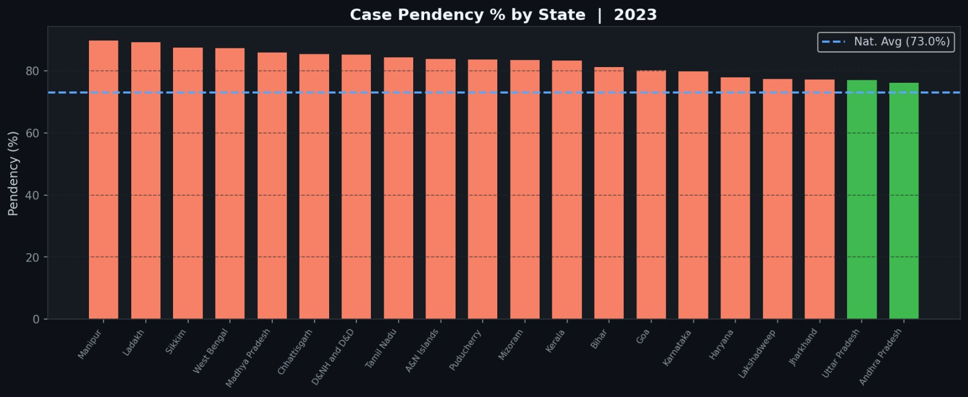
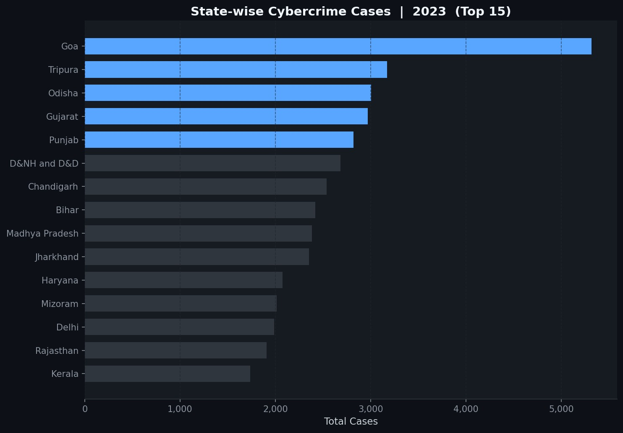


Judicial Pendency: A System Under Strain
Why the Backlog Persists
India's courts face a structural mismatch — cybercrime is growing exponentially while judicial infrastructure and digital forensics capacity expand incrementally.
Shortage of cyber-specialized judges and prosecutors
Complex digital evidence creates procedural delays
Inter-agency coordination remains weak
Pendency is not just a backlog — it erodes deterrence, delays justice, and emboldens repeat offenders.

Slide 9
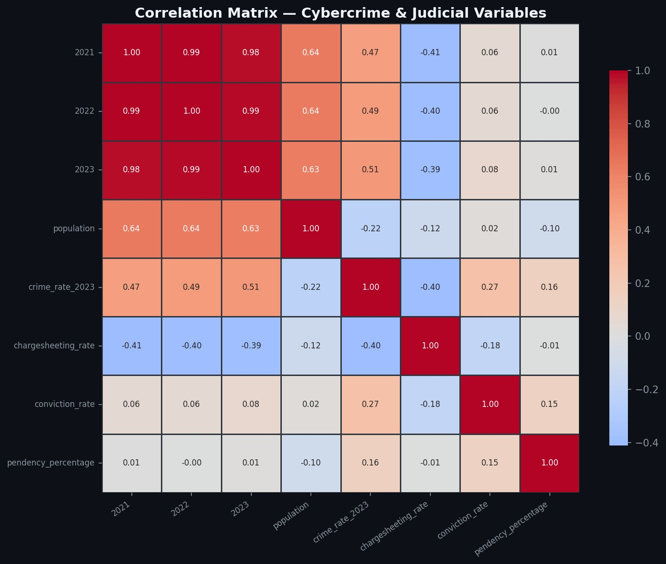

Conclusion & Recommendations
Cybercrime is one of India's fastest-growing governance challenges. This study demonstrates that predictive analytics can meaningfully support law enforcement planning and judicial resource allocation - turning raw data into actionable policy intelligence.
01
02
Invest in Real-Time Monitoring
Strengthen Judicial Capacity
Deploy dashboards for continuous cybercrime surveillance at state and national level.
Establish dedicated cyber courts and mandate digital forensics training for prosecutors.
03
Scale Data-Driven Governance
Institutionalize analytics within law enforcement agencies -move from reactive to predictive policing.

