Slide 1
Asp.net web api
Thet Lwin Oo

Slide 2
introduction
Thet Lwin Oo
Framework for building RESTful Web api
HTTP based services
REST – REpresentional State Transfer introduced by Roy Fielding

Slide 3
Rest architectural constraints
Thet Lwin Oo
Uniform interface
- Identification of Resources
- Resource Manipulation through Representation
- Self Descriptive Messages
- Hypermedia as the Engine of Application State (HATEOAS)
Client-server
- client and server are processing separately
Stateless
- each client request does not depend on any other request
Cacheable
- support cacheable and it avoids un-necessary requesting again and again
Layered System
Code on demand(optional)
References
- https://www.kennethlange.com/what-are-restful-web-services/

Slide 4
Web service vs wcf vs web api
Thet Lwin Oo
Web Service
WCF
Web Api
Based on SOAP and return XML data
Only support HTTP
Can be hosted on IIS
Same as Web service
Asmx and support protocals like TCP, HTTP, Named Pipes, MSMG
Hosted on IIS or Window service
Responses are formatted by MediaTypeFormatter into JSON, XML or whatever format you want
Based on HTTP services
Support MVC features such as routing, controllers,action result,filter
Open source
Hosted on IIS or Self-hosted
Light-weight architecture

Slide 5
Web api controller
Thet Lwin Oo
Need to extend from
- System.Http.Web.ApiController
// GET api/values
public IEnumerable<string> Get(){
return new string[] { "value1", "value2" };
}
// GET api/values/5
public string Get(int id){
return "value";
}
// POST api/values
public void Post([FromBody]string value){
}
// PUT api/values/5
public void Put(int id, [FromBody]string value) {
}
// DELETE api/values/5
public void Delete(int id)
{
}

Slide 6
Global.asax.cs
Thet Lwin Oo
Starting class
protected void Application_Start()
{
AreaRegistration.RegisterAllAreas();
GlobalConfiguration.Configure(WebApiConfig.Register);
FilterConfig.RegisterGlobalFilters(GlobalFilters.Filters);
RouteConfig.RegisterRoutes(RouteTable.Routes);
BundleConfig.RegisterBundles(BundleTable.Bundles);
}

Slide 7
WebApiConfig
Thet Lwin Oo
Configuration related with
- api routing
- authentication
public static void Register(HttpConfiguration config)
{
// Web API routes
config.MapHttpAttributeRoutes();
config.Routes.MapHttpRoute(
name: "DefaultApi",
routeTemplate: "api/{controller}/{id}",
defaults: new { id = RouteParameter.Optional }
);
}

Slide 8
Web api routing
Thet Lwin Oo
Support two types of routings
- Convention-based routing
- Attribute routing
config.Routes.MapHttpRoute(
name: "DefaultApi",
routeTemplate: "api/{controller}/{id}",
defaults: new {
id = RouteParameter.Optional
}
);
http://IPAddress:portNo/api/myvalues/listing
[Route("api/myvalues/lising")]
public IEnumerable<string> Get()
{
return new string[] { "value1", "value2" };
}

Slide 9
http verbs
Thet Lwin Oo
CRUD | Http Verbs
C - Create | Post
R - Read | Get
U - Update | Put
D - Delete | Delete

Slide 10
Http request
Thet Lwin Oo
Request Header
- additional information in request such as
- response type
- authentication
- content-type
Request Body
- especially actual data sent to server

Slide 11
Http response
Thet Lwin Oo
Response Body
- response data sent from server
Response Status Code
- status value to specify the process status
- 200 OK
- 204 No Content
- 401 Unauthorized
- 404 Resource Not Found
- 500 Internal server error

Slide 12
Application to test api
Thet Lwin Oo
Fiddler
Postman

Slide 13
Cors
Thet Lwin Oo
Cross Origin Resource Sharing
Need to install Microsoft.AspNet.WebApi.Cors
EnableCorsAttribute parameters : origins, headers, methods
Enabling CORS globally, add 2 lines in WebApiConfig.Register method
EnableCorsAttribute corsAttribute = new EnableCorsAttribute("*", "*", "*");
config.EnableCors(corsAttribute);
Enabling CORS to only some actions, add 1line in WebApiConfig.Register method
config.EnableCors();
Add attribute in Controller
[EnableCorsAttribute("*", "*", "*")]
To Disable in action
[DisableCors]

Slide 14
Get method Example
Thet Lwin Oo
//in Student api controller
public IEnumerable<Student> Get()
{
return students;
}
method -> get
url -> http://localhost:4000/api/student
//in Student api controller
public Student Get(int id)
{
return students[id];
}
method -> get
url -> http://localhost:4000/api/student/2

Slide 15
Consuming api Get from mvc controller
Thet Lwin Oo
//in MVC controller
public async Task<ActionResult> Load()
{
HttpClient client = new HttpClient();
client.BaseAddress = new Uri("http://localhost:9367/api/");
var response = client.GetAsync("student");
response.Wait();
string content;
List<Student> students=new List<Student>();
var result = response.Result;
if (result.IsSuccessStatusCode)
{
content=await result.Content.ReadAsStringAsync();
students = JsonConvert.DeserializeObject<List<Student>>(content);
}
ViewBag.Students = students;
return View();
}

Slide 16
Consuming api Get from Jquery ajax
Thet Lwin Oo
//in jQuery Ajax
$.ajax({
url: "http://localhost:9367/api/student",
method: “get”,
success: function (result) {
console.log(result);
},
error: function (result) {
alert(result);
}
});

Slide 17
post method Example
Thet Lwin Oo
method -> post
url -> http://localhost:4000/api/student
in header -> Content-Type : application/json
in body
{
id : 3,
rollNo : “2CS-135”,
name : “Bob”
}
//in Student api controller
public void Post([FromBody]Student student)
{
students.Add(student);
}

Slide 18
Consuming api post from mvc controller
Thet Lwin Oo
Neet to install Nuget Package
- System.Net.Http.Formatting.Extension
//in MVC controller
public ActionResult CallPost()
{
HttpClient client = new HttpClient();
client.BaseAddress = new Uri("http://localhost:9367/api/");
var response = client.PostAsJsonAsync<Student>("student",
new Student() { Id = 4,RollNo="4CS-400",Name="Aye Aye" });
response.Wait();
List<Student> students = new List<Student>();
var result = response.Result;
ViewBag.Msg=(result.IsSuccessStatusCode)? "OK":"NOT OK";
return View();
}

Slide 19
Consuming api post from jquery ajax
Thet Lwin Oo
var student = { 'Id':5,'RollNo':'4CS-555','Name':'David' };
$.ajax({
url: "http://localhost:9367/api/student",
method: "POST",
data: JSON.stringify(student), // for one value case use -> data : '='+'myval‘
dataType: "json",
contentType:"application/json",
success: function () { },
error: function (result) {
console.log(result);
}
});

Slide 20
put method Example
Thet Lwin Oo
method -> put
url -> http://localhost:4000/api/student/4
in header -> Content-Type : application/json
in body
{
id : 4,
rollNo : “2CS-135”,
name : “Bob”
}
//in Student api controller
public void Put(int id, [FromBody]Student student)
{
students[id]=student;
}

Slide 21
delete method Example
Thet Lwin Oo
//in Student api controller
public void Delete(int id)
{
students.RemoveAt(id);
}
method -> delete
url -> http://localhost:4000/api/student/4

Slide 22
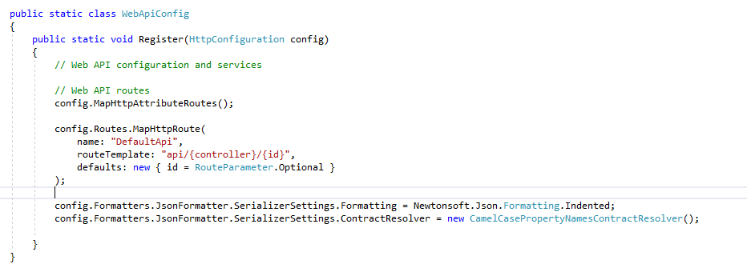
Content negotiation
Thet Lwin Oo
Accept Header
- client request -> response format [json,xml]
- json format if not specify
- can add quality factor
Add formatter in config
Accept : application/xml;q=0.7;application/json;q=0.5

Slide 23
Authorizationfilterattribute
Thet Lwin Oo
Help to filter request based on Authorization field value of request header
To customize, implement it and override its OnAuthorization method
Can be easily decorated to controller actions
Packages
System.Web.Http.Filters

Slide 24
Authorization Example
Thet Lwin Oo
public class BasicAuthorizationFilterAttribute:AuthorizationFilterAttribute
{
public override void OnAuthorization(HttpActionContext actionContext)
{
if (actionContext.Request.Headers.Authorization == null){
actionContext.Response = actionContext.Request.CreateResponse(HttpStatusCode.Unauthorized);
return;
}
string token = actionContext.Request.Headers.Authorization.Parameter;
string dcdToken=Encoding.UTF8.GetString(Convert.FromBase64String(token));
string[] values = dcdToken.Split(';');
if (values[0] != "a@gmail.com"){
actionContext.Response = actionContext.Request.CreateResponse(HttpStatusCode.Unauthorized);
return;
}
Thread.CurrentPrincipal = new GenericPrincipal(new GenericIdentity(values[0]),null);
}
}

Slide 25
Authorization Example(controller)
Thet Lwin Oo
[BasicAuthorizationFilter]
public IEnumerable<Teacher> Get()
{
string loginEmail = Thread.CurrentPrincipal.Identity.Name;
return teachers;
}

Slide 26
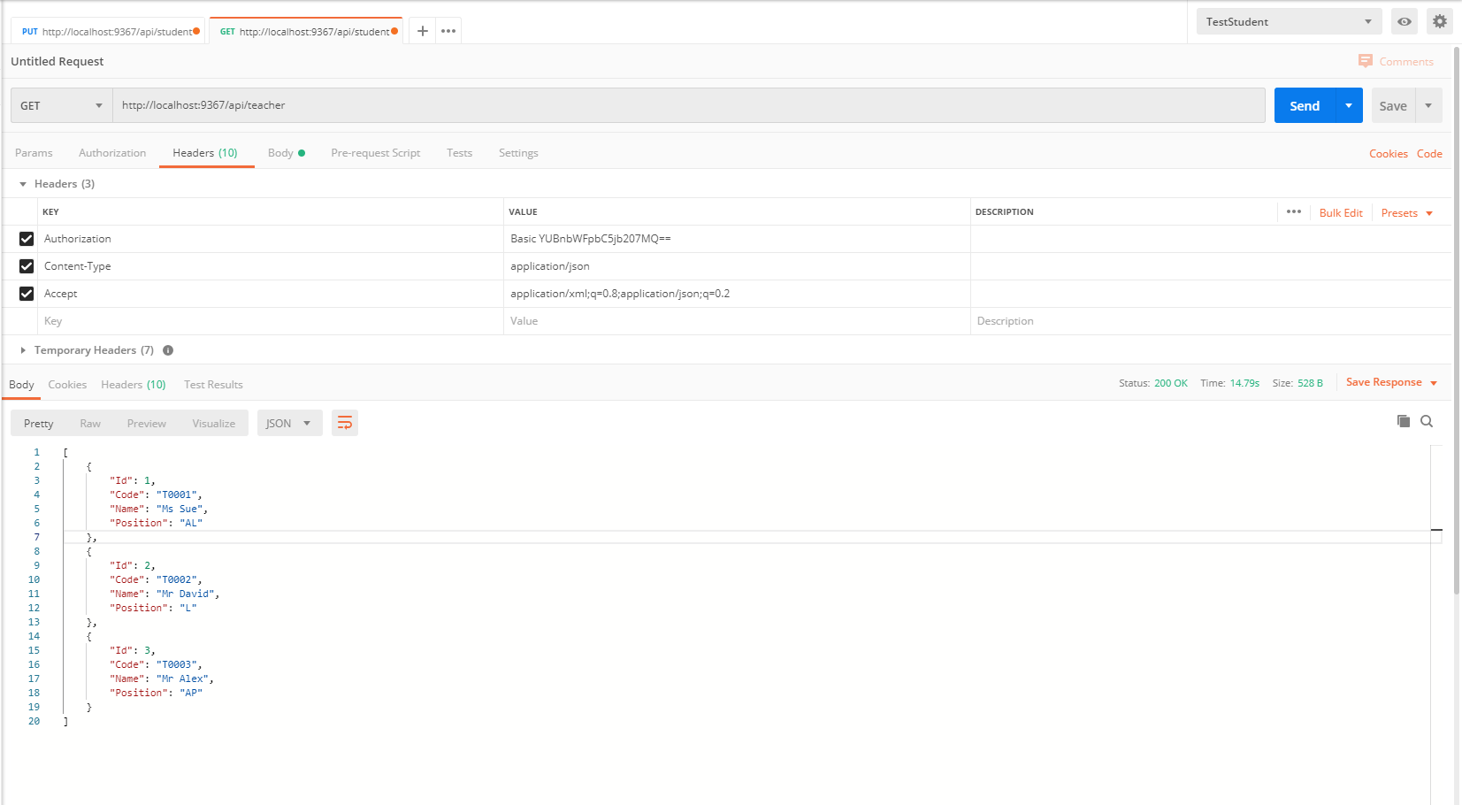
Authorization Example(postman)
Thet Lwin Oo

Slide 27
Authorization Example(mvc controller)
Thet Lwin Oo
public async Task<ActionResult> CallTeacher()
{
HttpClient client = new HttpClient();
client.BaseAddress = new Uri("http://localhost:9367/api/");
client.DefaultRequestHeaders.Authorization =new AuthenticationHeaderValue("Basic" , "YUBnbWFpbC5jb207MQ==");
var response = client.GetAsync("teacher");
response.Wait();
string content;
List<Teacher> teachers = new List<Teacher>();
var result = response.Result;
if (result.IsSuccessStatusCode) {
content = await result.Content.ReadAsStringAsync();
teachers = JsonConvert.DeserializeObject<List<Teacher>>(content);
}
ViewBag.Teachers = teachers;
return View();
}

Slide 28
Authorization Example(Jquery ajax)
Thet Lwin Oo
$.ajax({
url: "http://localhost:9367/api/teacher",
headers: {
"Authorization": "Basic " + "YUBnbWFpbC5jb207MQ=="
},
success: function (result) {
console.log(result);
},
error: function (result) {
alert(result);
}
});

Slide 29
Any questions
https://www.google.com

