Slide 1
Asp.net web api
Thet lwin oo

Slide 2
introduction
Thet Lwin Oo
Framework for building RESTful Web api
HTTP based services
REST – REpresentional State Transfer introduced by Roy Fielding

Slide 3
Rest architectural constraints
Thet Lwin Oo
Uniform interface
- Identification of Resources
- Resource Manipulation through Representation
- Self Descriptive Messages
- Hypermedia as the Engine of Application State (HATEOAS)
Client-server
- client and server are processing separately
Stateless
- each client request does not depend on any other request
Cacheable
- support cacheable and it avoids un-necessary requesting again and again
Layered System
Code on demand(optional)

Slide 4
Web service vs wcf vs web api
Thet Lwin Oo
Web Service
WCF
Web Api
Based on SOAP and return XML data
Only support HTTP
Can be hosted on IIS
Same as Web service
Asmx and support protocals like TCP, HTTP, Named Pipes, MSMG
Hosted on IIS or Window service
Responses are formatted by MediaTypeFormatter into JSON, XML or whatever format you want
Based on HTTP services
Support MVC features such as routing, controllers,action result,filter
Open source
Hosted on IIS or Self-hosted
Light-weight architecture

Slide 5
Web api controller
Thet Lwin Oo
Need to extend from
- System.Http.Web.ApiController
// GET api/values
public IEnumerable<string> Get(){
return new string[] { "value1", "value2" };
}
// GET api/values/5
public string Get(int id){
return "value";
}
// POST api/values
public void Post([FromBody]string value){
}
// PUT api/values/5
public void Put(int id, [FromBody]string value) {
}
// DELETE api/values/5
public void Delete(int id)
{
}

Slide 6
Global.asax.cs
Thet Lwin Oo
Starting class
protected void Application_Start()
{
AreaRegistration.RegisterAllAreas();
GlobalConfiguration.Configure(WebApiConfig.Register);
FilterConfig.RegisterGlobalFilters(GlobalFilters.Filters);
RouteConfig.RegisterRoutes(RouteTable.Routes);
BundleConfig.RegisterBundles(BundleTable.Bundles);
}

Slide 7
WebApiConfig
Thet Lwin Oo
Configuration related with
- api routing
- authentication
public static void Register(HttpConfiguration config)
{
// Web API routes
config.MapHttpAttributeRoutes();
config.Routes.MapHttpRoute(
name: "DefaultApi",
routeTemplate: "api/{controller}/{id}",
defaults: new { id = RouteParameter.Optional }
);
}

Slide 8
Web api routing
Thet Lwin Oo
Support two types of routings
- Convention-based routing
- Attribute routing
config.Routes.MapHttpRoute(
name: "DefaultApi",
routeTemplate: "api/{controller}/{id}",
defaults: new {
id = RouteParameter.Optional
}
);
http://IPAddress:portNo/api/myvalues/listing
[Route("api/myvalues/lising")]
public IEnumerable<string> Get()
{
return new string[] { "value1", "value2" };
}

Slide 9
http verbs
Thet Lwin Oo
CRUD | Http Verbs
C - Create | Post
R - Read | Get
U - Update | Put
D - Delete | Delete

Slide 10
Http request
Thet Lwin Oo
Request Header
- additional information in request such as
- response type
- authentication
- content-type
Request Body
- especially actual data sent to server

Slide 11
Http response
Thet Lwin Oo
Response Body
- response data sent from server
Response Status Code
- status value to specify the process status
- 200 OK
- 204 No Content
- 401 Unauthorized
- 404 Resource Not Found
- 500 Internal server error

Slide 12
Application to test api
Thet Lwin Oo
Fiddler
Postman

Slide 13
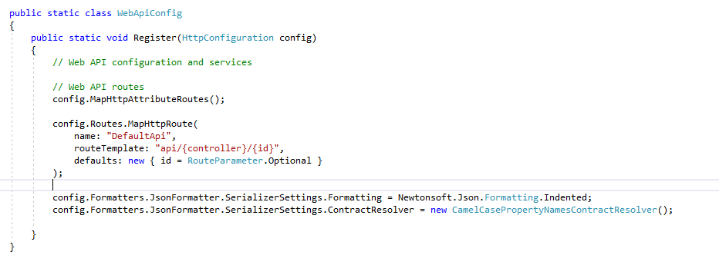
Content negotiation
Thet Lwin Oo
Accept Header
- client request -> response format [json,xml]
- json format if not specify
- can add quality factor
Add formatter in config
Accept : application/xml;q=0.7;application/json;q=0.5

Slide 14
CORS
Thet Lwin Oo
Cross Origin Resource Sharing
Need to install Microsoft.AspNet.WebApi.Cors
EnableCorsAttribute parameters : origins, headers, methods
Enabling CORS globally, add 2 lines in WebApiConfig.Register method
EnableCorsAttribute corsAttribute = new EnableCorsAttribute("*", "*", "*");
config.EnableCors(corsAttribute);
Enabling CORS to only some actions, add 1line in WebApiConfig.Register method
config.EnableCors();
Add attribute in Controller
[EnableCorsAttribute("*", "*", "*")]
To Disable in action
[DisableCors]

Slide 15
Any questions
https://www.google.com

