Slide 1

MODOS TEAM

Slide 2
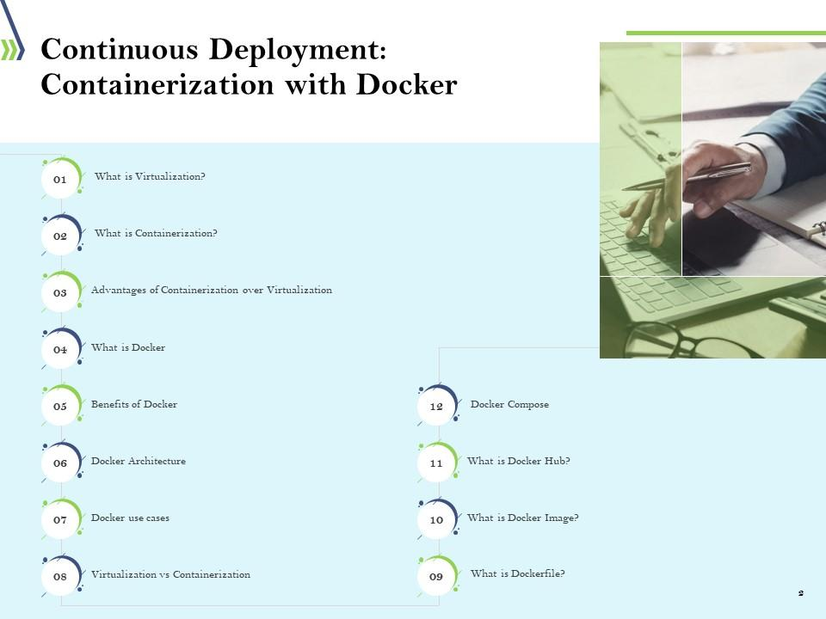

Slide 3
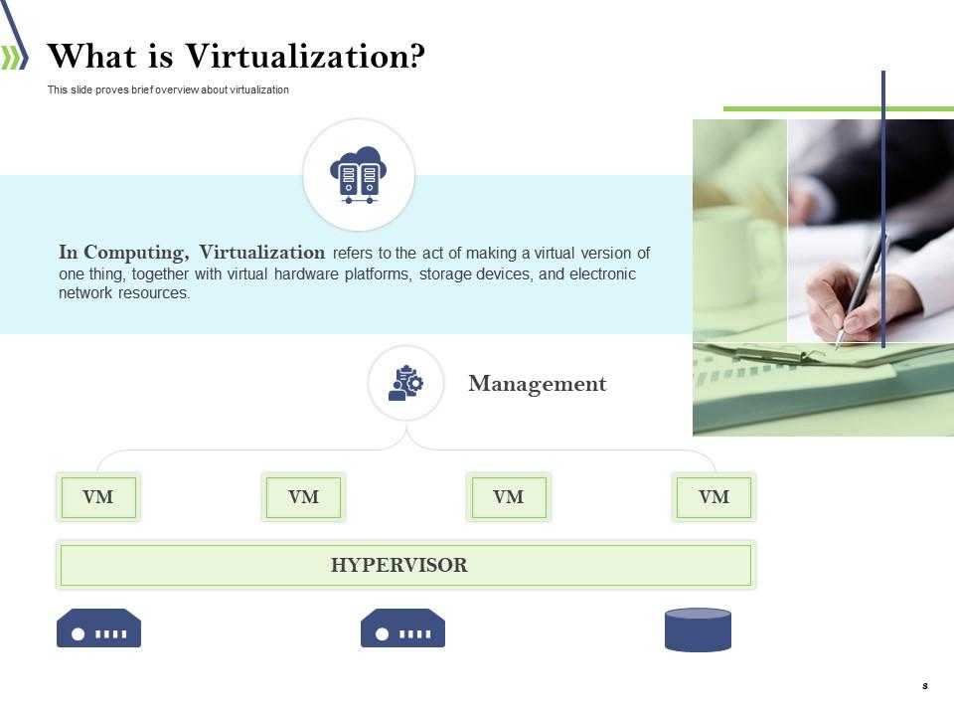

Slide 4
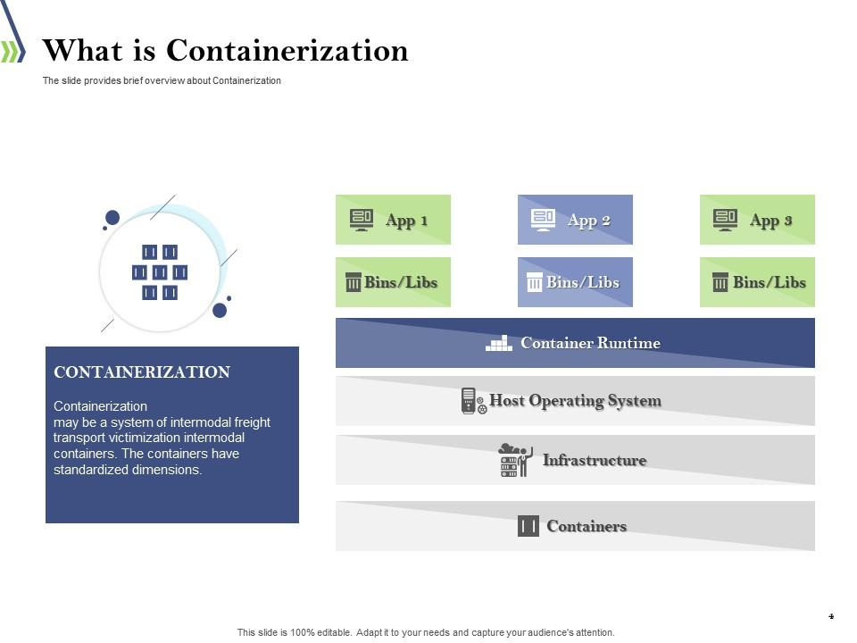

Slide 5
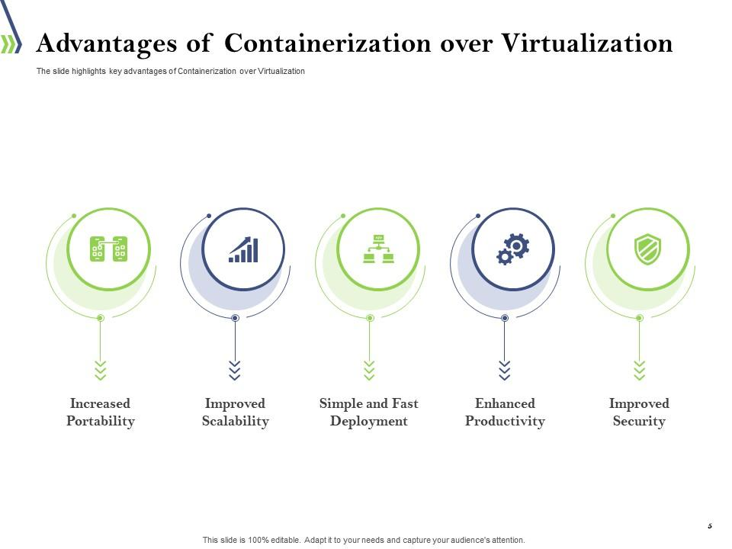

Slide 6
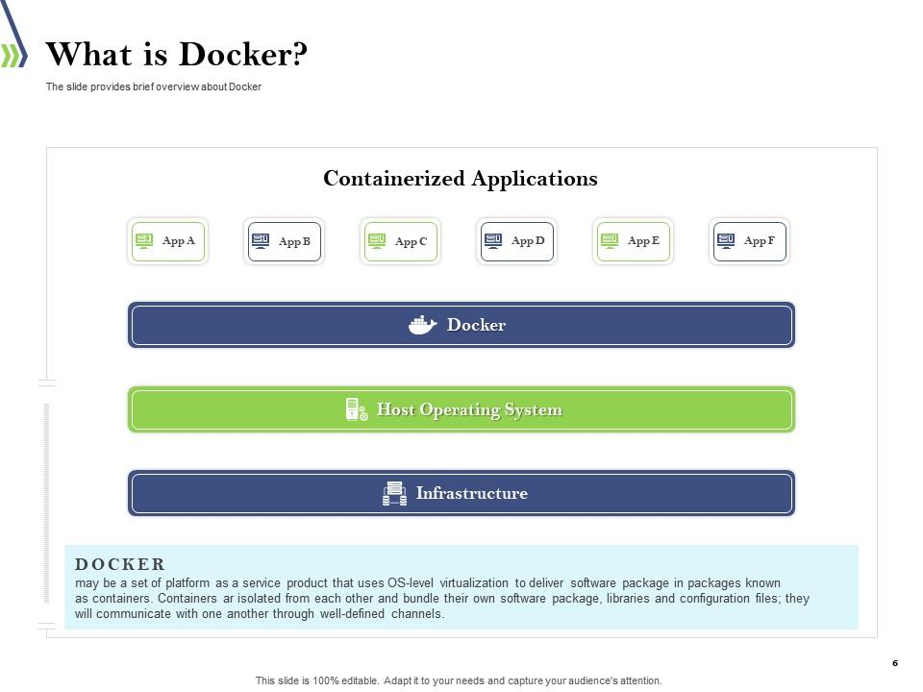

Slide 7
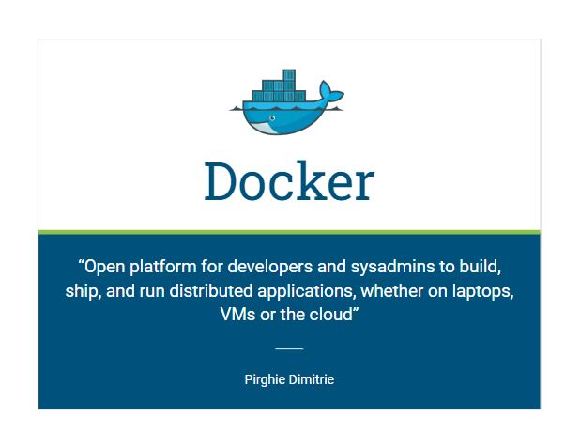

Slide 8
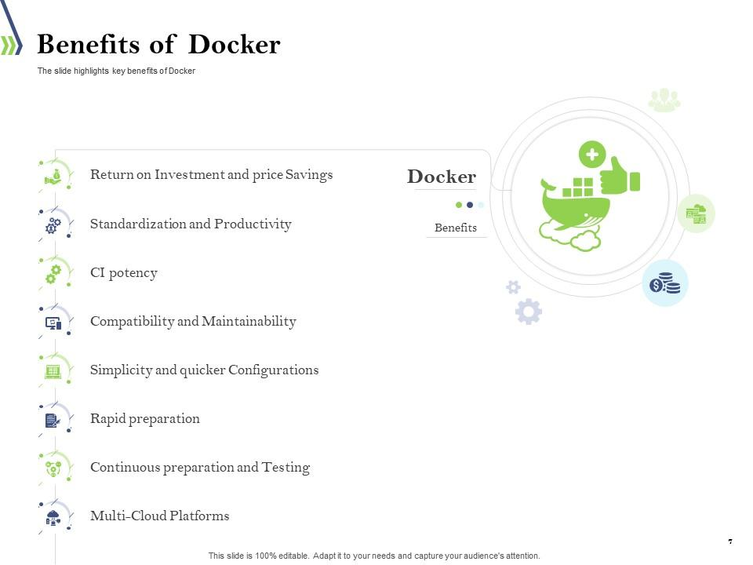

Slide 9
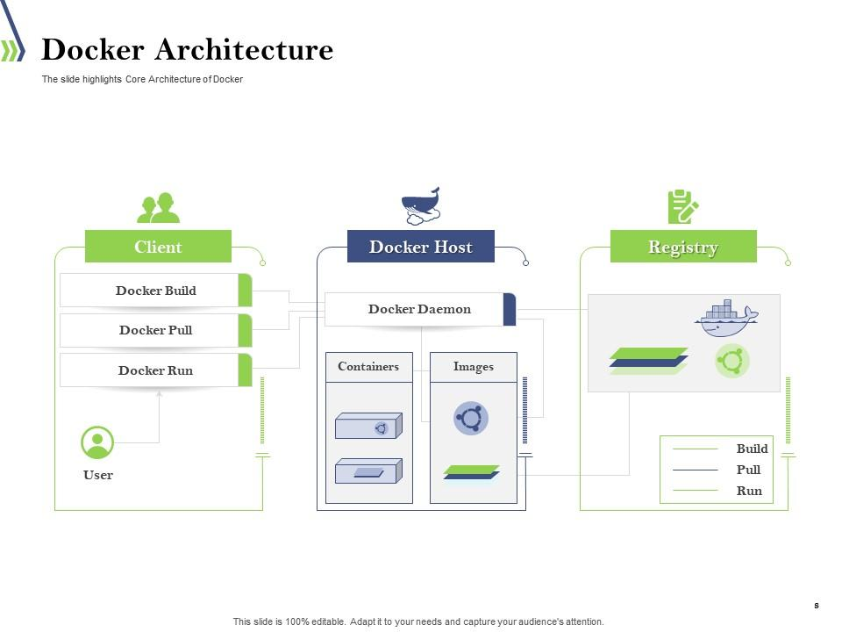

Slide 10
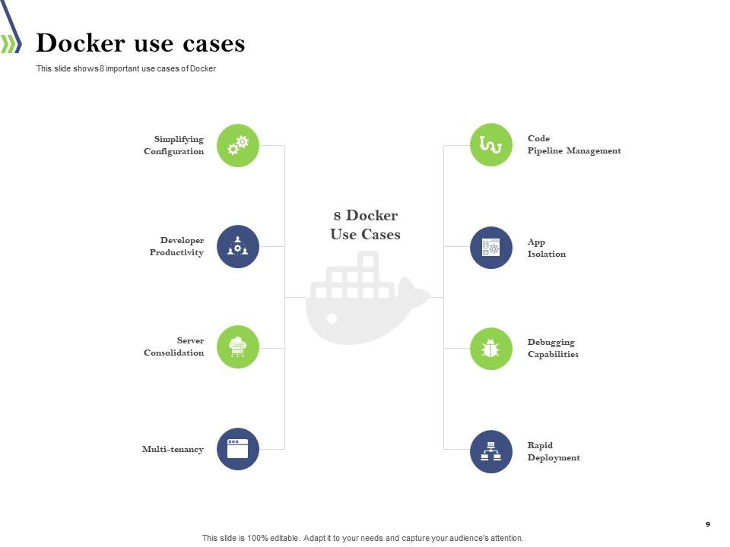

Slide 11
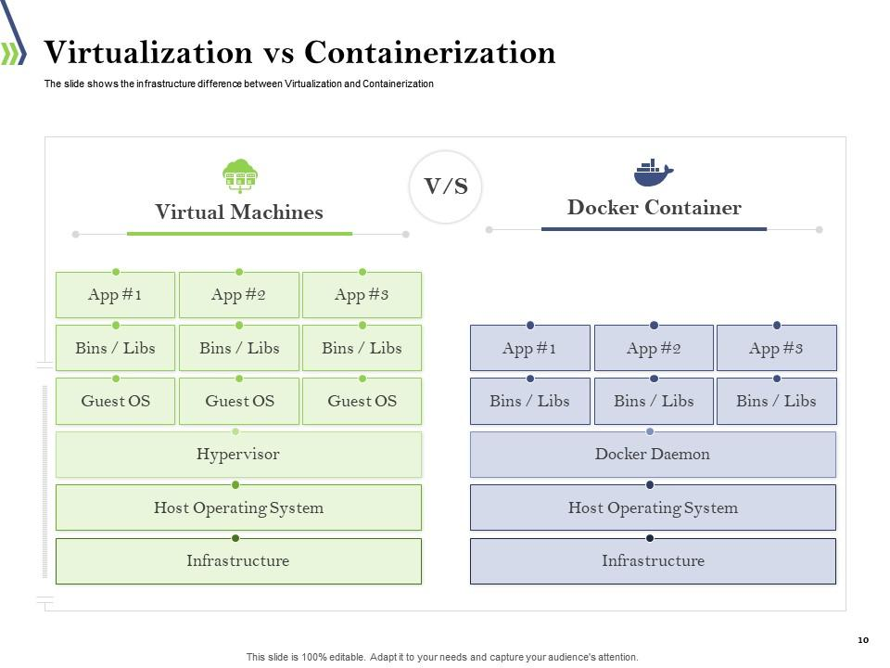

Slide 12
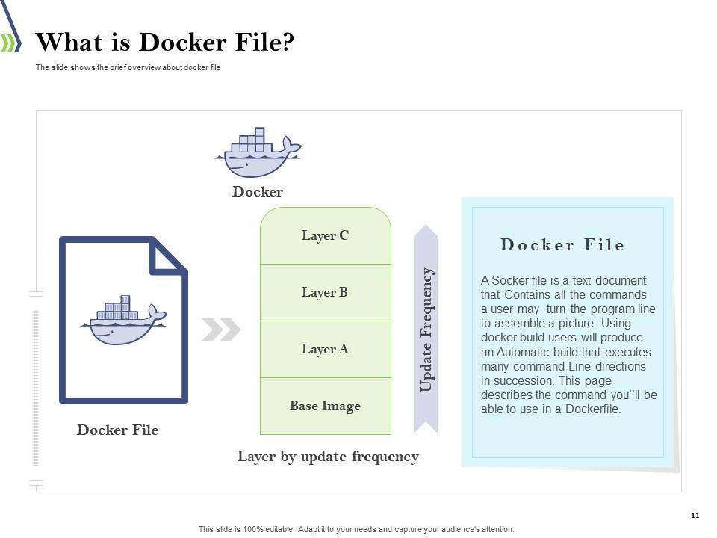

Slide 13
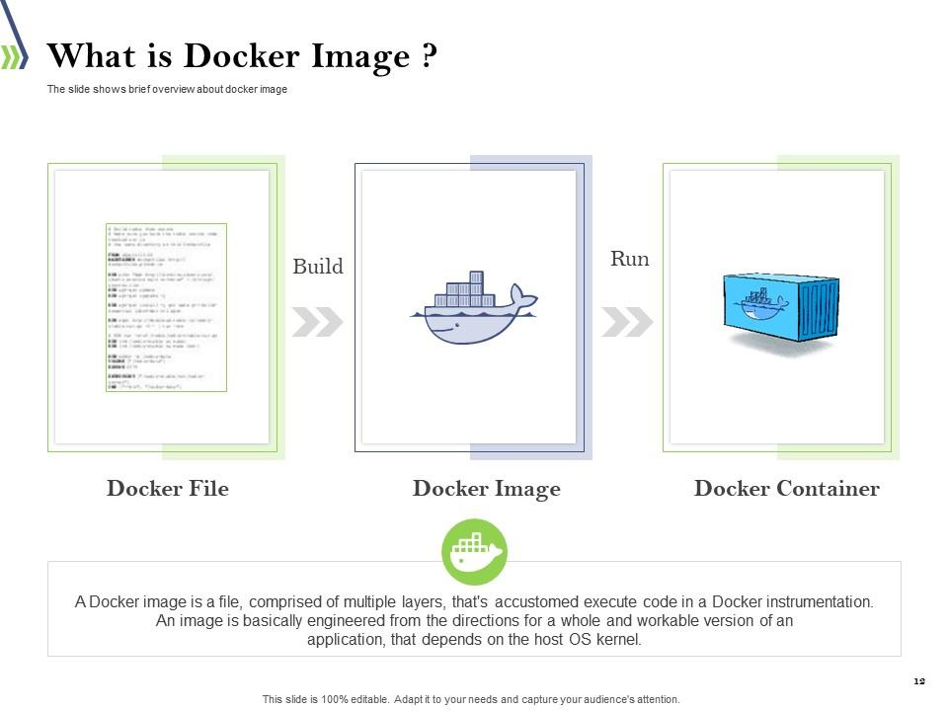

Slide 14
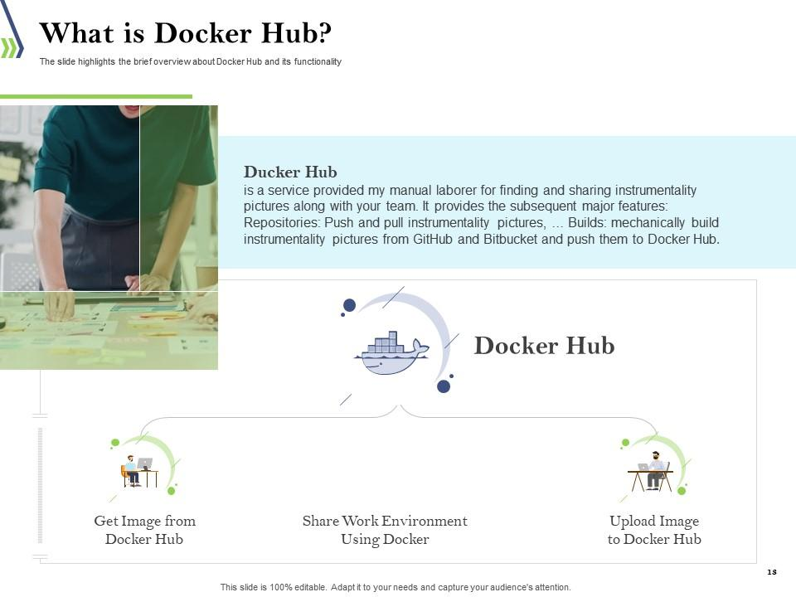

Slide 15
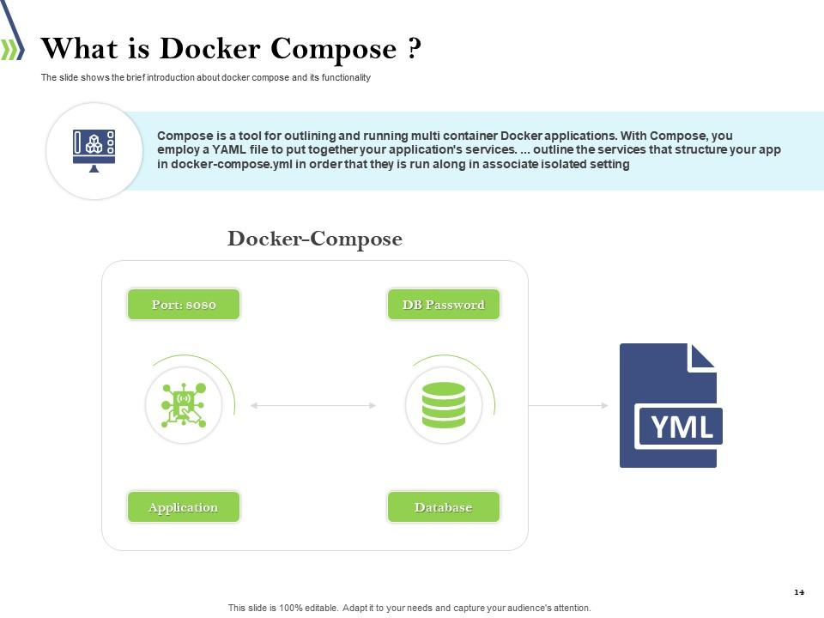

Slide 16
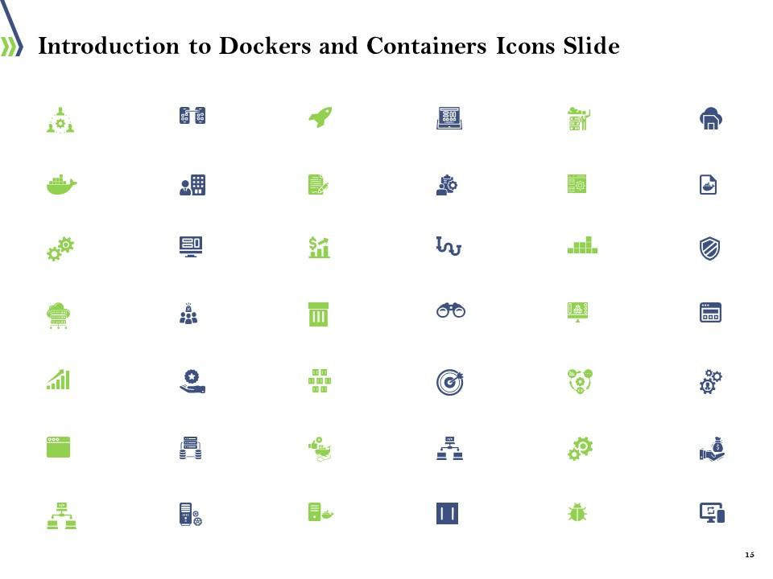

Slide 17
Break Time

Slide 18
ABOUT ZABBIX

Slide 19
1. Zabbix Introduction
1.1. Purpose of Zabbix Monitoring
What is Monitoring?
“Monitoring” is to detect the error of server, network, application and other events related system and manage the operational status of system for realize the stable operation of the system. And it delivers the events and the signs to related entities such as operator. For example, the server error can be detected by the monitoring server logs and the system resource trend of the load state is known to monitor the server resource such as CPU usage, Memory usage and Disk usage.
Why it need?
Most company’s workforce is based on their computer systems, therefore these must be capable of responding in any situation, and sometimes at any given time of the day.
Monitoring theses systems has become a fundamental task to manage all of a company’s IT infrastructure, with the following main goals in mind:
Taking maximum advantage over a company’s HW resources.
Instance prevention and problem detection.
Notifying possible issues
For physical, virtual and cloud systems alike, IT monitoring is crucial for ensuring availability and providing efficient service.

Slide 20



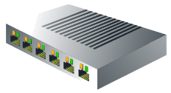


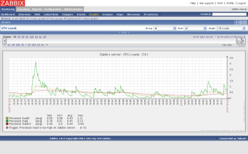
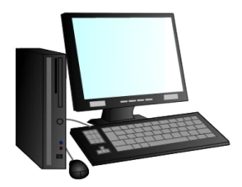

1. Zabbix Introduction
1.2. What is Zabbix?
Zabbix is an open source software application that can monitor servers, networks devices, and applications. Using Zabbix, you can easily monitor servers, network devices and applications, gathering accurate statistics and performance data.
Monitored devices
Notification
Monitoring with
SNMP
Network devices
Centralised
Control
Monitoring with
Zabbix Agent
Servers with
Zabbix Agent
Status check
Configuration
Monitoring with
ping or port check
Servers without
Zabbix Agent
Administrator

Slide 21
1. Zabbix Introduction
1.3. Zabbix Web Site (Manual Pages)
By referencing the following Zabbix’s official website, you could learn more about Zabbix with respective Zabbix’s Version. Current CBM used version 1.8.4.
Zabbix Official Documentation Website :
https://www.zabbix.com/documentation/1.8/manual

Slide 22



2. Zabbix Architecture
2.1. Zabbix Structure
Target for Monitoring
Monitoring Server
Display, Configration
Web Interface
（PHP + Appache)
Zabbix Agent
Zabbix agent installed server
Ping Monitoring
SSH Monitoring
Zabbix Server
Database
(PostgreSQL, MySQL)
System Manager
Zabbix agent not installed server
SNMP &
SNMP Trap
Notice of Incident
NW Device
Operator

Slide 23
2. Zabbix Architecture
2.2. Mechanism from data collection to detection and display
Zabbix server
Registered Host
Item collected data from Agent
Item
Collect data (depending on key) from Target host
Target Host
[Agent, Agentless, Network devices]
Event
Display the alert when evaluated value match with trigger expression
Trigger
Evaluate data which is collected by item whether it is match or not to display in event
Action
Do operation depending on certain event condition

Slide 24
2. Zabbix Architecture
Explanation about the relationship between host, item, trigger, event and action
Host - In Zabbix, a host is a logical entity that groups items. Definition of what a host is can be freely adapted to specific environment and situation. Zabbix in no way limits this choice; thus a host can be network switch, a physical server, a virtual machine, or a website.
Item - An item in Zabbix is a configuration entity that holds information on gathered metrics. It is the very basis of information flowing into Zabbix, and without items nothing can be retrieved.We collected the required data by using Item. But items can't exist in an empty space—each item has to be attached to a host.
Trigger - Item alone does nothing more than collect data. To define thresholds and what is considered a problem we have to use triggers.
Event - The event contains details of the trigger state's change—when did it happen and what the new state is.
Action - Things that tell the Zabbix server to do something upon certain conditions are called actions.

Slide 25
2. Zabbix Architecture
Example explanation about the relationship of Data flow in zabbix
Zabbix Server
Zabbix Agent
Agent
Timer
DBSyncer
poller
Zabbix Agent
Trapper
Agent
Escalation
DB
Simple
Snmp
Ssh
etc
Action
Zabbix Sender
Device
Fig : Information flow in Zabbix

Slide 26
2. Zabbix Architecture
In our Zabbix server installation we created a host (A Test Host), which contains an item (CPU Load).
A trigger references this item. Whenever the trigger expression matches current item value, the trigger switches to a PROBLEM state.
When it ceases to match, it switches back to an OK state. Each time the trigger changes its state, an event is generated. The event contains details of the trigger state's change—when did it happen and what the new state is.
When configuring an action, we can add various conditions so that only some events are acted upon. In our case, we did not add any, so all events will be matched.
Each action also contains operations, which define what exactly has to be done. In the end some course is actually carried out, which usually happens outside of the Zabbix server itself, like sending an e-mail.

Slide 27
2. Zabbix Architecture
2.3. Architecture of Several collection items
2.3.1. Passive Agent
A Zabbix server connects to a Zabbix agent, which in turn gathers the data.
Zabbix Server
Zabbix Agent
Normal or passive item
Poller
Agent
Port 10050
Response data to server

Slide 28
2. Zabbix Architecture
2.3.2. Active Agent
A Zabbix agent connects to a Zabbix server, retrieves list of things to monitor, gathers the data, and then periodically reports back to the server
Zabbix Server
Active item (retrieve list of items)
Zabbix Agent
Trapper
Port 10051
Periodically report data

Slide 29
2. Zabbix Architecture
2.3.3. Simple Check
A Zabbix server directly queries exposed network interfaces of the monitored host, no agent required.
Zabbix Server
Monitored Device
Simple check
Poller
Simple
Any port

Slide 30
2. Zabbix Architecture
2.3.4. Zabbix Trapper
This item type accepts incoming data instead of querying for it. It is most widely used for SNMP trap receiving, but useful for any data you might want to feed into Zabbix.
Zabbix Server
Accept incoming data from Agent
Zabbix Sender
Trapper

Slide 31
2. Zabbix Architecture
2.3.4. Zabbix Trapper (Zabbix Sender with Device that support SNMP)
Zabbix Server
Zabbix Sender
Device that supports SNMP.
Trapper
Bash
Script
SnmpTrap
Daemon
SNMP Trap

Slide 32
2. Zabbix Architecture
2.3.5. SNMP Agent
These three types deal with gathering SNMP data. Versions, obviously, select protocol version to use when connecting to the monitored host.
Zabbix Server
Accept incoming data from SNMP Agent
Device that supports SNMP.
Poller
SNMP

Slide 33
2. Zabbix Architecture
2.3.6. Zabbix Internal
This groups items that gather information about internal state of Zabbix.a
Collect Zabbix Server Internal information
Zabbix Server
Poller
Internal
Shared
Memory

Slide 34
2. Zabbix Architecture
2.3.7. Web
Monitoring of web pages, which have built-in support in Zabbix. We will check different sections of a webpage and monitor it for failures, and monitor download speeds, and response times.
Zabbix Server
httpd Poller
Web Site
Collect Web Page Status and Information (such as Response time,Download speed per second, Response code)

Slide 35
3. Zabbix Monitoring Registration Flow
Overall about Hosts, Users and Templates relationship
Trigger1
User1
User
Group1
Host
Group1
Host1
Item1
Trigger2
Host2
Item2
Permission
Host
Group2
Host3
Trigger1
Item1
User
Group2
User2
Trigger2
User3
Template1
Item2
Template…
Template2

Slide 36
3. Zabbix Monitoring Registration Flow
Overall about Hosts, Users and Templates relationship
Hosts manage monitored entity (host) information and are used to group basic information gathering units – items.
Users accounts in Zabbix control access to the monitored information.
Templates allow a Zabbix administrator to reduce their workload and streamline the configuration.
Relationship between Hosts, Users and Templates
Hosts manage monitored entity (host) information and are used to group basic information gathering units – items. User accounts in Zabbix control access to the monitored information. And in zabbix, User Permissions can be assigned to user groups only and Host Permissions can be granted on host groups only. Templates are gathering of items and triggers configuration and it can add Host level and also Host Groups level.
Every host should be in at least one host group and every user should be in at least one user group.

Slide 37
Q&A

Slide 38
Thank You

