Slide 1
GSL C library mini guide

Slide 2
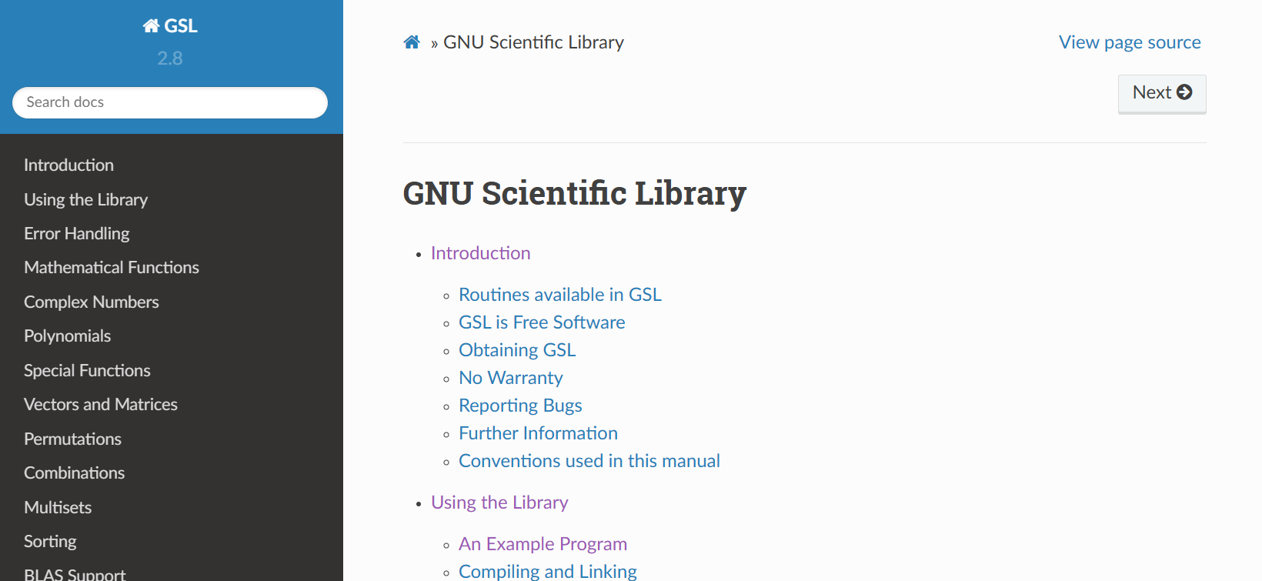
source
GNU Scientific Library — GSL 2.8 documentation

Slide 3
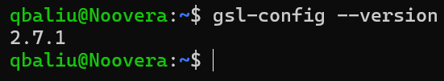
Installation

Slide 4
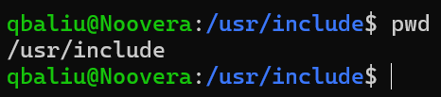
Installation
after installation a gsl/ parent directory is created, its standard location is

Slide 5
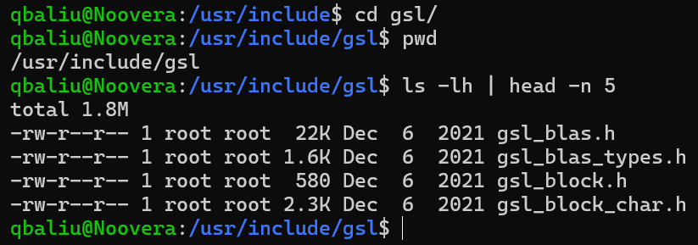
Installation
this parent directory includes all the header files for the specific mathematical functions available in the GSL library

Slide 6
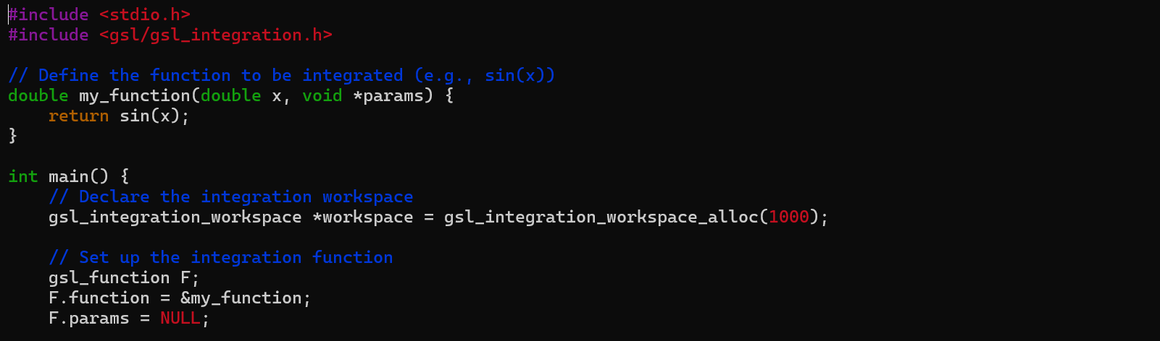
Running an example
example programme which uses the GSL library
note the header file, we must specify the specific header file, which is in the gsl/ directory
the programme itself can be in any directory (the #include statement will by default search the /usr/include/ directory)

Slide 7
Running an example
during compilation, we need to link (-l) the following libraries: gsl, cBLAS (gslcblas), math (m)

Slide 8
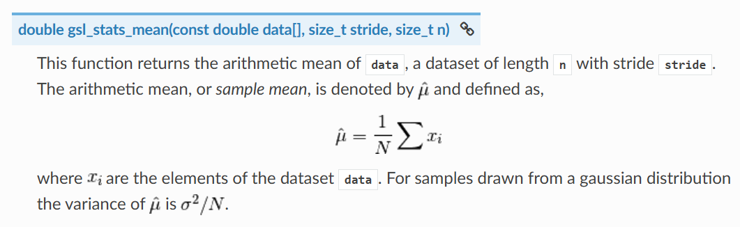
Basic statistics part I
example function notice the input and output types

Slide 9
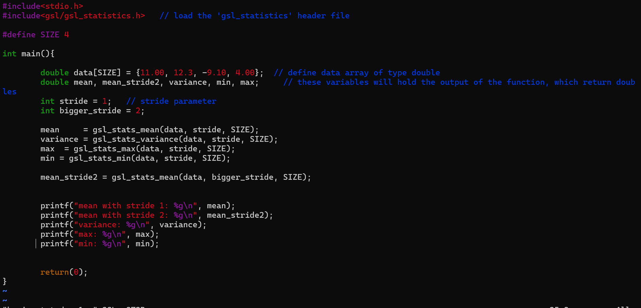
Basic statistics part I
BASIC_STATISTICS/basic_stat_demo1.c/.exe

Slide 10
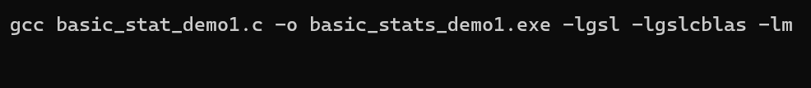
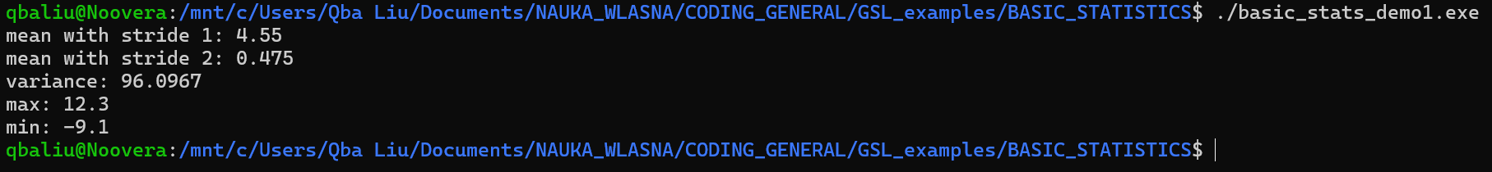
Basic statistics part I

Slide 11
Basic statistics part I
further functions (usage is analog):
Statistics — GSL 2.8 documentation

Slide 12
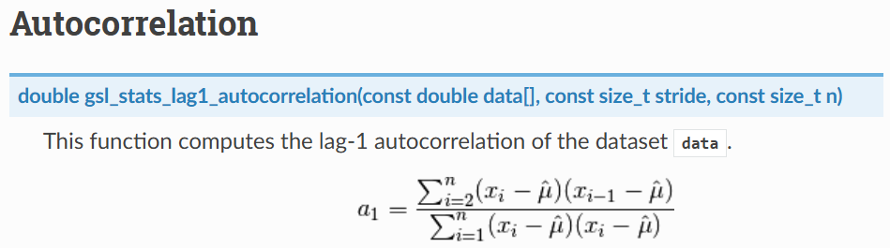
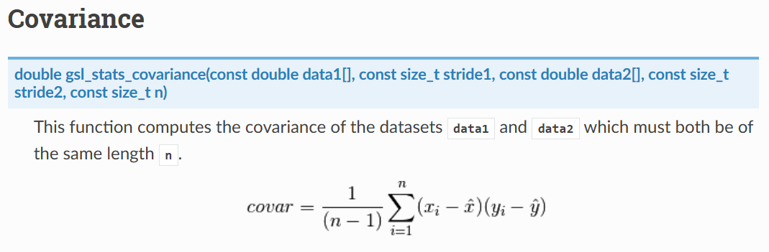
Basic statistics part II

Slide 13
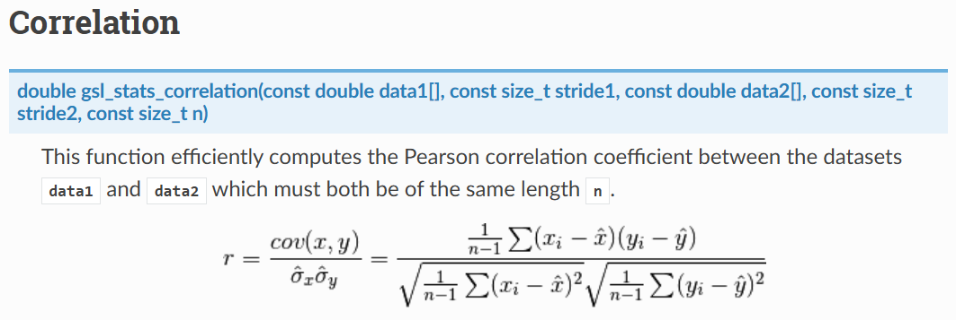
Basic statistics part II

Slide 14
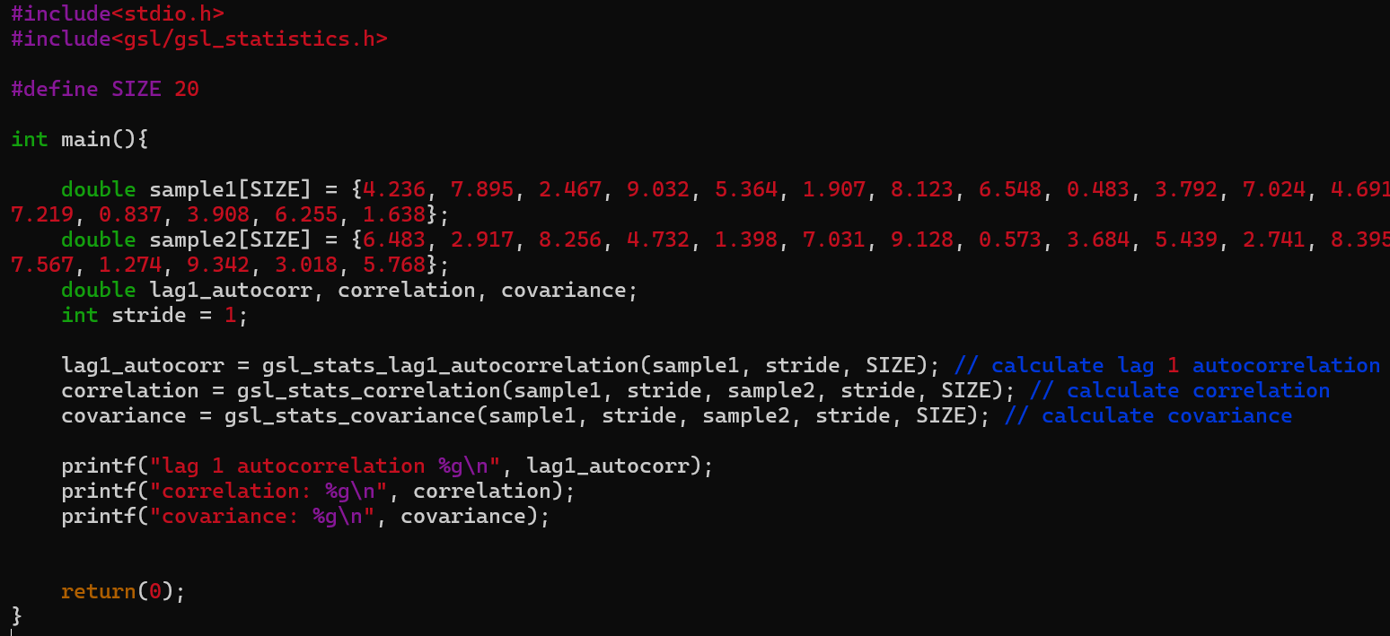

Basic statistics part II
BASIC_STATISTICS/basic_stat_demo2.c/.exe

Slide 15
Vector operations
the GSL library has its own struct for vectors
only the non-trivially implementable functions are shown
all functions:
Vectors and Matrices — GSL 2.8 documentation

Slide 16
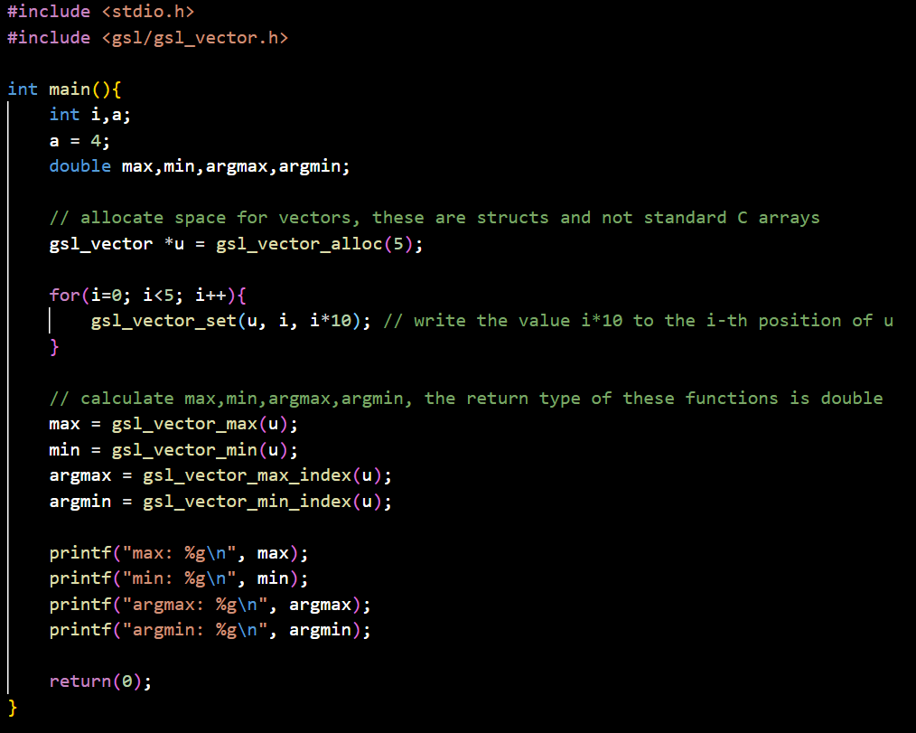

Vector operations
VECTORS/vector_examples1.c/.exe
space allocation
writing to a vector
min,max,argmin,argmax
don’t forget:

Slide 17
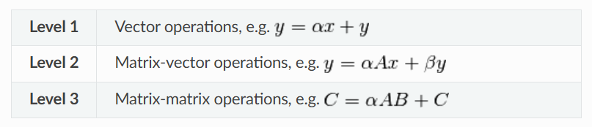
Vector operations
BLAS library support for vector operations
BLAS Support — GSL 2.8 documentation
level1 → vector operations
level2 → vector-matrix operations
level3 → matrix operations

Slide 18
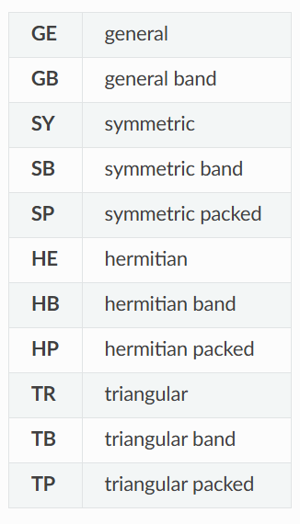
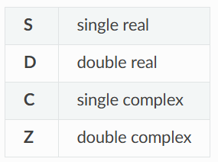
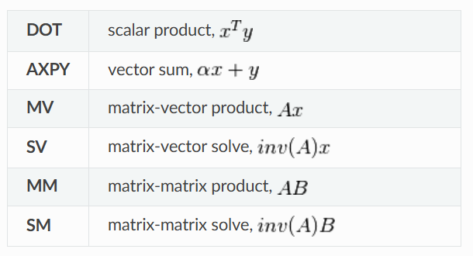
Vector operations
Function nomenclature
(not only for vectors)

Slide 19
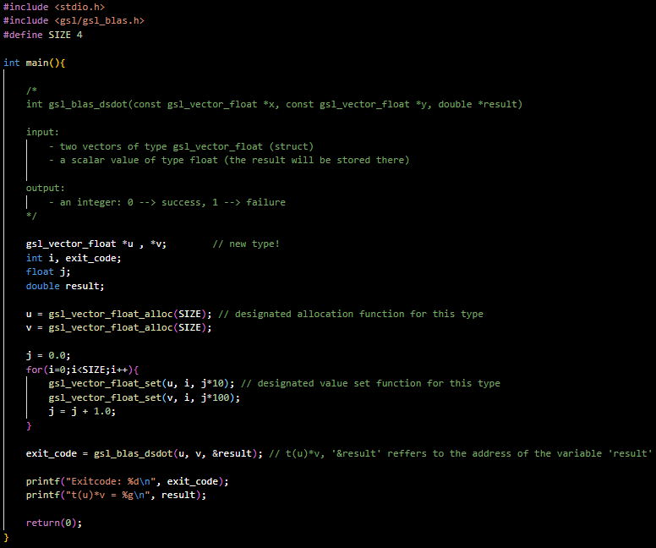
Vector operations
VECTORS/vector_examples2.c/.exe

Slide 20
Matrices
Vectors and Matrices — GSL 2.8 documentation
matrices are stored in row-major order (as in all of C, Fortran matrices are stored in column-major order)

Slide 21
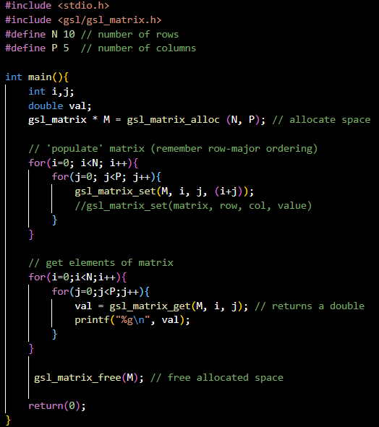
Matrices
basic matrix usage
MATRIX/matrix_example1.c/.exe

Slide 22
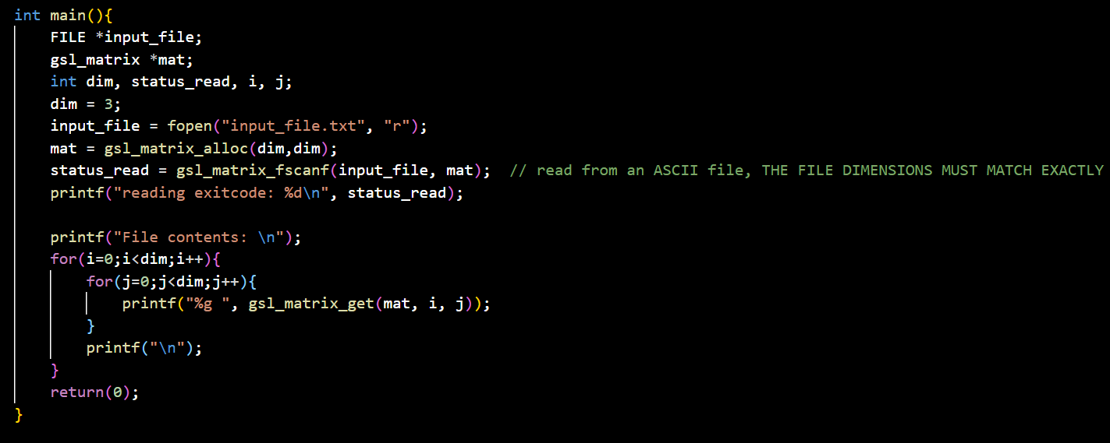
Matrices
reading a matrix from a file
MATRIX/matrix_example2.c/.exe

Slide 23
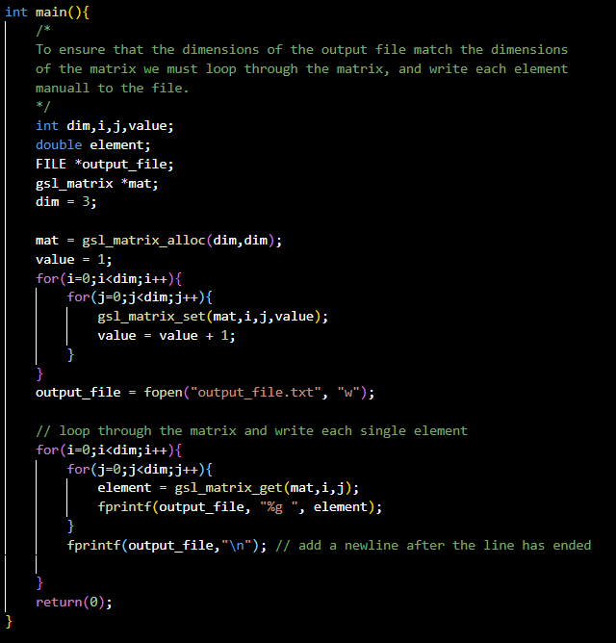
Matrices
writing matrices to a file
MATRIX/matrix_example3.c/.exe

Slide 24
Matrices (matrix views)
create matrices from standard C arrays
this is another struct (gsl_matrix_view)
Vectors and Matrices — GSL 2.8 documentation

Slide 25
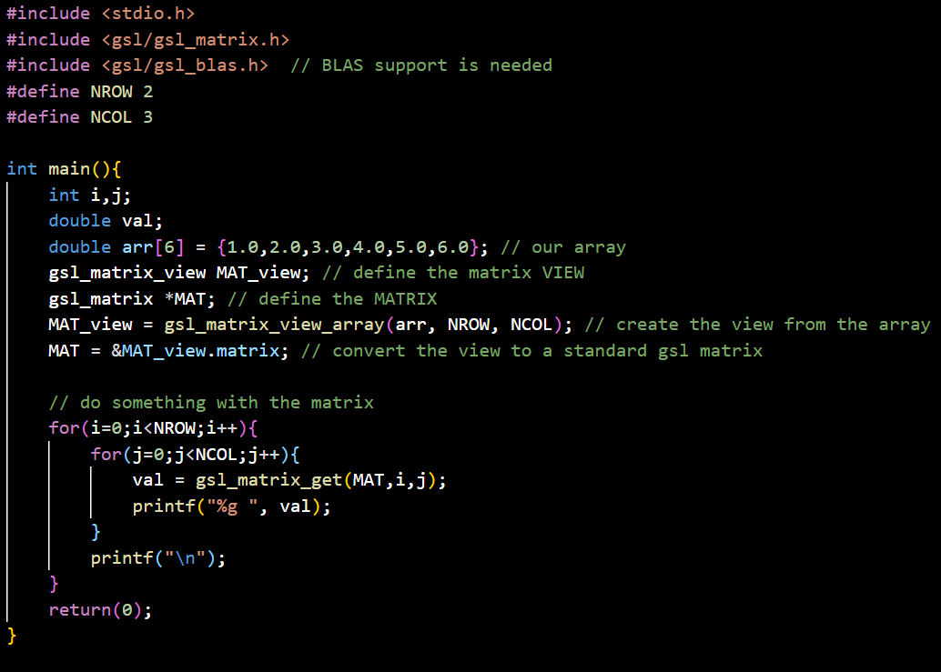
Matrices (matrix views)
MATRIX/matrix_example4.c/.exe

Slide 26
Matrix vector operations
level 2 in BLAS
BLAS Support — GSL 2.8 documentation

Slide 27
Matrix vector operations
for me the notation is weird
y: result vector, x: vector, A: matrix, alpha&beta: constants
TransA: specify if the matrix is transposed or not ( ), these are GSL constants
to get a ‘classic’ y = A*x multiplication, set alpha = 1 and beta = 0

Slide 28
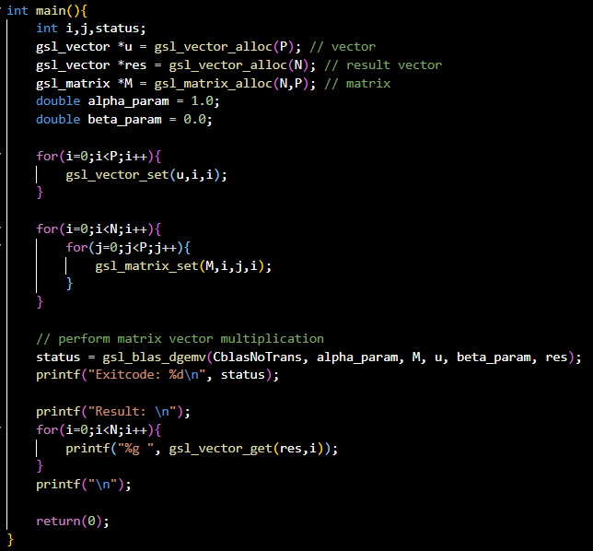
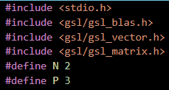
Matrix vector operations
MATRIX_VECTOR/matrix_vector_example1.c/.exe

Slide 29
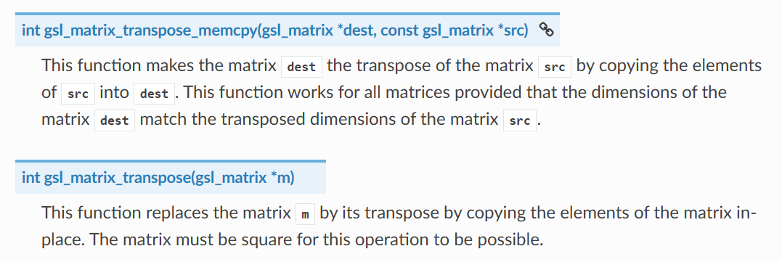


Matrix operations
transposition
could be written by hand, but not easily on the GSL structs
Vectors and Matrices — GSL 2.8 documentation

Slide 30
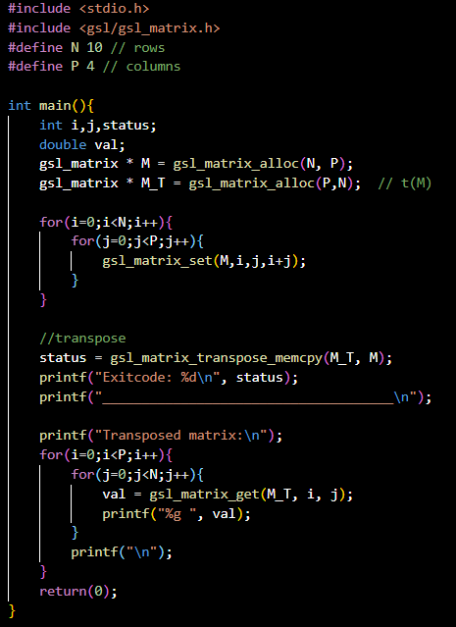
Matrix operations
MATRIX_MATRIX/matrix_matrix_example1.c/.exe

Slide 31
Matrix operations
matrix inversion
this function performs matrix transposition based on its LU decomposition
LU: the LU decomposition of our original matrix, p: permutation vector, inverse: the inverse of our matrix

Slide 32
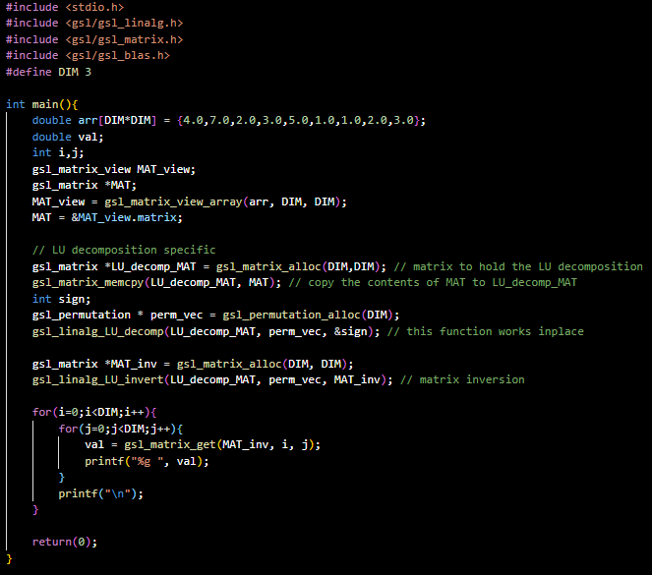
Matrix operations
MATRIX_MATRIX/matrix_matrix_example2.c/.exe

