Slide 1
Fraud Detecton
Data Overview
Data Integration
Data Cleaning
Feature Engineering
EDA
Modeling
Slalom | Case study | Zichu li | 04/28/2019

Slide 2
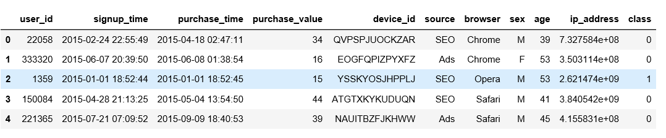
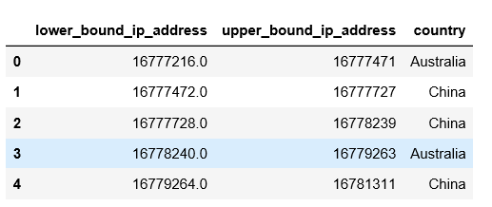
Data
Overview
Two CSV
Fraud & IP_address

Slide 3
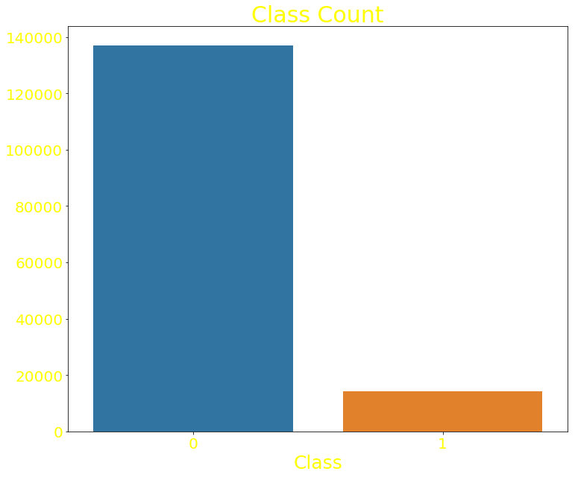
Data
Overview
Highly unbalanced problem

Slide 4
Data
Intergration
Merge two dataset by IP_address
define algorithm borrow the concept of dynamic programming.
optimize the algorithm's time complexity to O(N).

Slide 5
Data Cleaning
Only one column have missing value that is Country.
Impute with Unknow in the current verision.

Slide 6
Feature Engineering
Datetime
create new features:
time length between signup date and purchase date
weekday for signup date and purchase date
binary variable indicate weekday or weekend
parse the date into 24 hours

Slide 7
EDA
datetime
device
source
purchase_value
age
Country

Slide 8
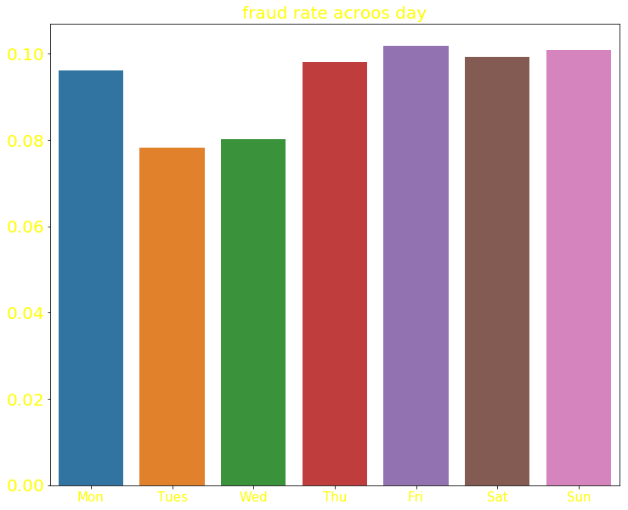
EDA
Datetime
Tuse and Wed have lower amount of fraud transation (for the signup and pruchase date) and lower fraud rate.

Slide 9
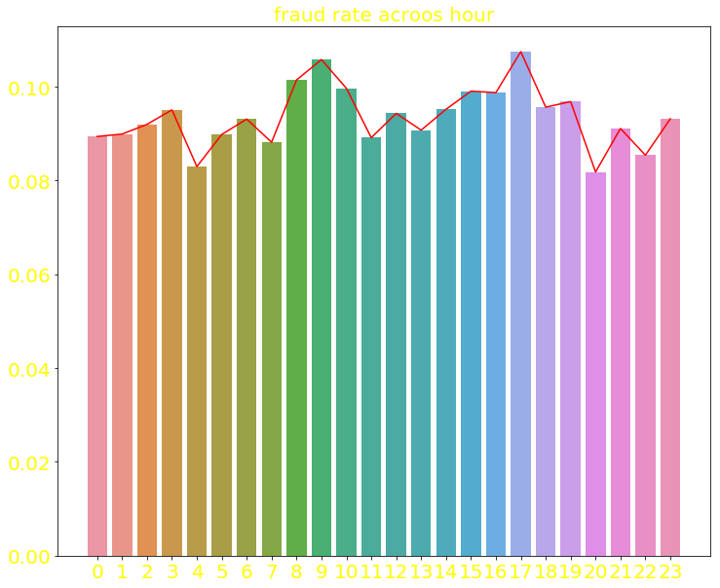
EDA
Datetime
fraud rate at peak at 9AM and 5 PM

Slide 10
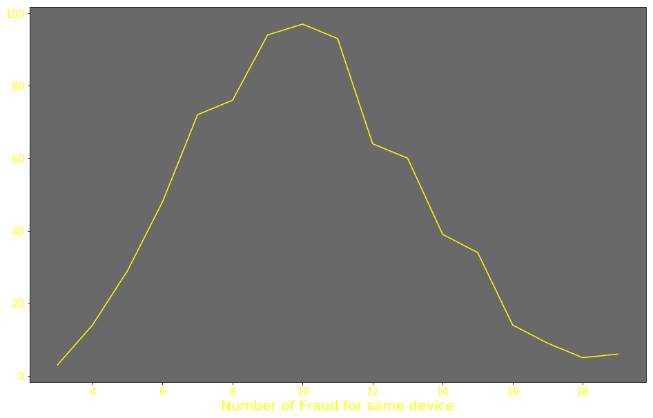
EDA
Device
most of device don't have any fraud transaction.
for the device making fraud transaction, most of them only have one time (5943 devices)
People tend to use the same device to make 8 to 12 times of fraud transactions

Slide 11
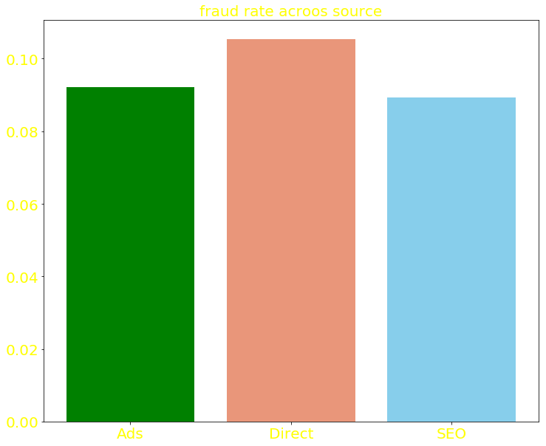
EDA
Source
There are three sources.
For the Direct source, it have high rate for the fraud.

Slide 12
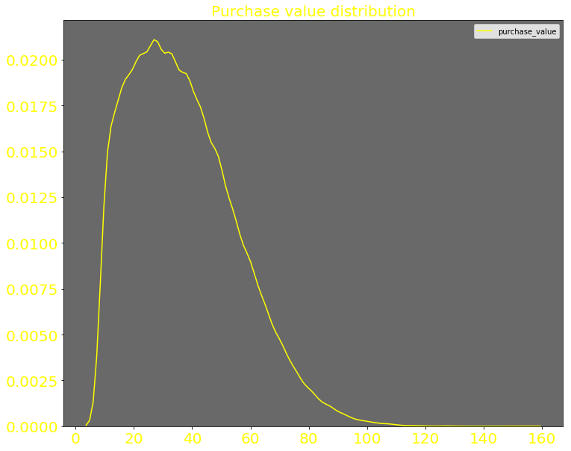
EDA
Purchase_value
For the purchase_value, it belong to skewed normal distribution.
Most of the transaction ranging from 15 to 60.

Slide 13
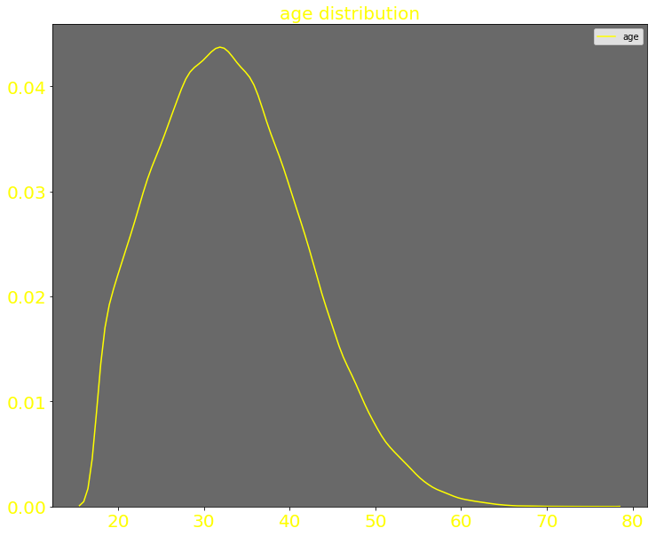
EDA
age
Most of the users are age 20 to 40

Slide 14
EDA
Country
Different country have different fraud rate.
Country such as Namibia and Sri Lanka have fraud rate amost 50%

Slide 15
Model
deal with Unbalanced problem
ROC, F1-score as metric
LR as baseline; used SVM, Bagging and Boosting
Stacking model
pickle the model and use python script to conduct online prediction

Slide 16

Model

