Slide 1
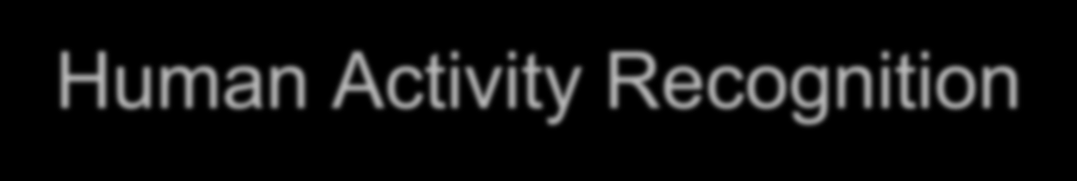
Chapter 5: AutoRegressive Integrated Moving Average (ARIMA) Models Fall 2019

Slide 2
Outline
Introduction / Motivation
RECAP: Stationarity
Linear Models
Moving Average (MA) Models
AutoRegressive (AR) Models
ARMA (AR + MA)
Incorporating Seasonality and Trend: SARIMA
Not to confuse with moving average window !

Slide 3

Introduction
In previous chapter, focus was on exponential smoothing:
weight (λ) applied to current sample
+
exponentially decaying weights (1- λ)^{t} to previous points
General assumption is that any time series data is modeling as sum of 2 components:
deterministic (signal) + stochastic (random noise)
Drawback: Exponential models consider the noise to be independently generated, i.e. not serially dependent (between neighboring time samples)

Slide 4
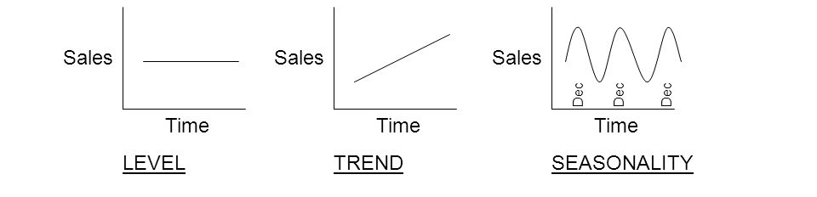
Motivation
It is possible to identify deterministic trends as well as seasonal variation and decompose a series into these components.
→ Using techniques we have learnt so far in this course
Notes:
https://www.quantstart.com/articles/Serial-Correlation-in-Time-Series-Analysis

Slide 5
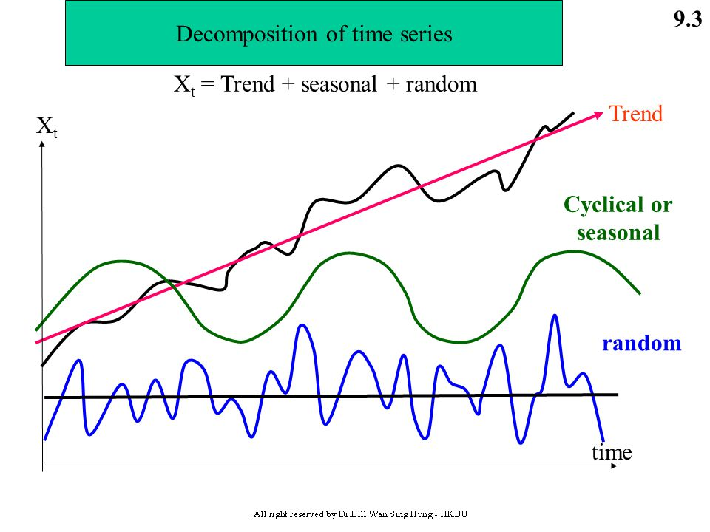
Motivation
However, once such a time series has been decomposed we are left with a random component.
Notes:
https://www.quantstart.com/articles/Serial-Correlation-in-Time-Series-Analysis

Slide 6
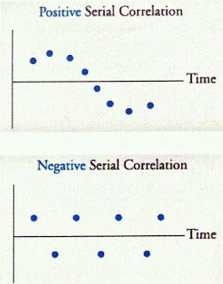
Motivation
When sequential observations of a time series are correlated, we say that serial dependence exists in the time series
Positive Serial Correlation
Positive errors for one observation increases the probability of a Positive error for another observation and vice versa.
Negative Serial Correlation
Positive error for one observation increases the probability of a Negative error for another observation and vice versa.
Residuals
Notes:
https://www.quantstart.com/articles/Serial-Correlation-in-Time-Series-Analysis
https://www.analystforum.com/article/cfa/serial-correlation

Slide 7
RECAP: Strictly Stationary Time Series
Data is strictly stationary if its properties are NOT affected by a change in time origin
The joint probability density function does not change if the time interval changes
same as

Slide 8
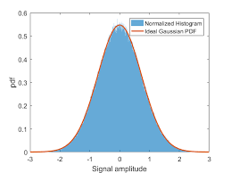
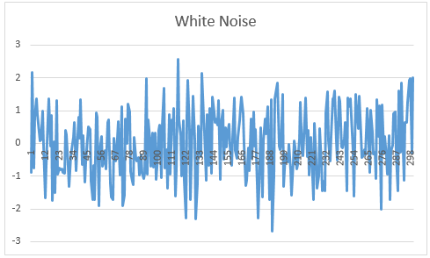
Stationarity
(Strictly) Stationary time series exhibits similar “statistical behavior” for all time…
→ constant probability distribution in time
However, in most cases, we work with weak stationarity
→ What is “weak stationarity” ?
t
t+k

Slide 9
Stationarity
the autocovariance function defined as
What is “weak stationarity” ?
Expected value of time series does not depend on time
the autocovariance function for any lag k is only a function of k and not time; that is,

Slide 10
Some Examples
Stationary
Non-Stationary

Slide 11
Stationary Time Series
Many time series do not exhibit a stationary behavior
True stationarity is in fact a rarity in real life
If the time series in not stationary, its first difference (y_{t}-y_{t-1}) will often be
Notes:
https://www.eviews.com/Learning/timeseries_c.html

Slide 12
Linear Models for Stationary Time Series
A linear filter defined as
is said to be

Slide 13
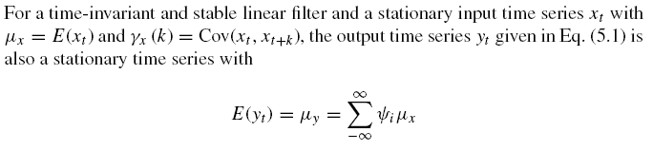

Linear Filter
Does not depend on time (t)

Slide 14
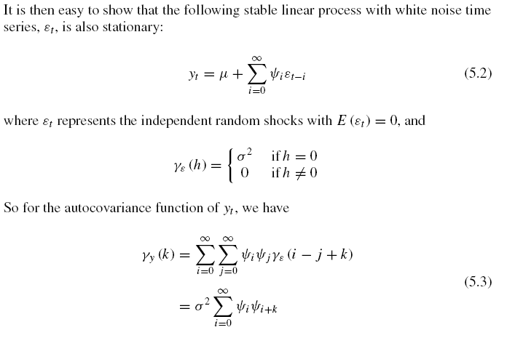
If Input is White Noise …
Zero mean, constant variance
Goal : Show that output time series is also stationary
White noise time series

Slide 15
Using the Backshift Operator

Slide 16
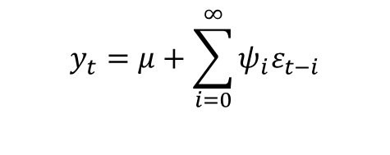
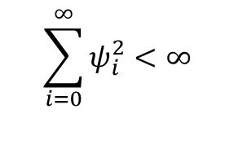
Wold’s Decomposition Theorem
Any nondeterministic weakly stationary time series can be written as an infinite sum of weighted random shocks (disturbances)
$$y_{t}=μ+\sum_{i=0}^{∞}{ψ_{i}ε_{t−i}}$$
where
$$\sum_{i=0}^{∞}{ψ_{i}^{2}<∞}$$

Slide 17
How useful is this?
Well, not so much!!!
How can we come up with “infinitely” many terms?

Slide 18
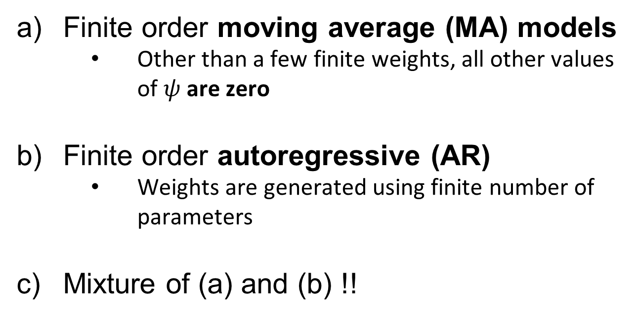
Consider some special cases of general equation:
Finite order moving average (MA) models
Other than a few finite weights, all other values of $ψ$ are zero
Finite order autoregressive (AR)
Weights are generated using finite number of parameters
Mixture of (a) and (b) !!

