Slide 1
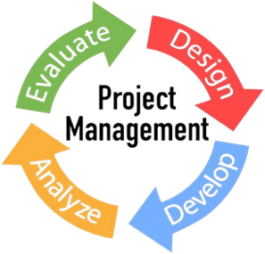
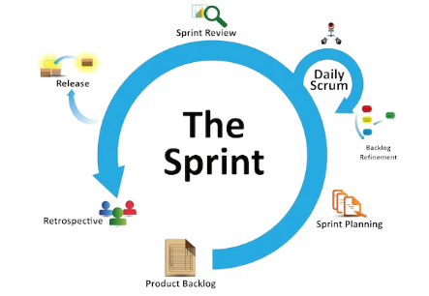
Homework 5
Sprint
A sprint is refers to a predefined span of time in which a team will work to accomplish specific goals. This period may be any length, though.

Slide 2
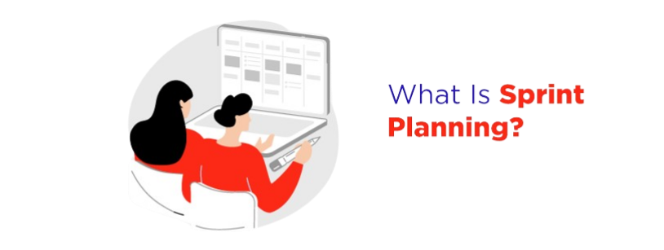
Sprint planning is an event in scrum that kicks off the sprint. It's a collaborative meeting typically involving the product owner, developers, and other stakeholders.
For example, next week I got a project about Google classroom, I have to meet with my teammates
What we need to do prepare our plan, what we need to do, the project is one month, what do we need to do to be able to complete this project.

Slide 3
What is the purpose of sprint planning?
The purpose of sprint planning is
Define what can be delivered in the sprint
How that work will be achieved.
Sprint planning is done in collaboration with the
whole scrum team.
How much time does the sprint planning take?
Typically, for a four-week sprint this meeting should
last eight hours.

Slide 4

What are the benefits of sprint planning?
Identify team capacities
Save time by managing expectations
Provide clarity and transparency
Focus on the end goal
Increased focus
Sprint meetings bring your team together
Clearly defined sprint goals
Teams produce higher quality work
Conduct the sprint review.

Slide 5

Why we need to do stand-up meeting?
A daily stand-up meeting is a short organizational meeting that is held each day. that are a common practice in Agile project management methodologies like Scrum.
All projects need to do a stand up meeting
Because stand up meetings can monitor our work
What did we do yesterday?
What we want to do today, in general, it is communication with the teamwork. To make their work success.

Slide 6
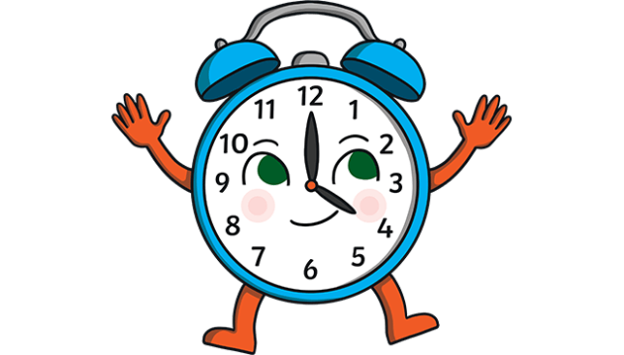
What is the purpose of stand-up meeting?
The primary purpose of stand-up meetings is
To facilitate communication during work
Coordinating issues that arise during project planning
Cooperation in development teams.
Check how far the work has progressed.
Here are some reasons why stand-up meetings are important.
How much time does the stand-up meeting take?
The meeting, generally limited to between five and 15 minutes long, is sometimes referred to as a stand-up, a morning roll-call or a daily Scrum.

Slide 7

What questions happened during stand-up meeting?
What did you do yesterday?
What are you planning to do today?
Are there any obstacles or challenges that are impeding your progress?
Do you need any support from other team members?
In general, as I went through the project with the team assigned by the school, the questions asked were:
What did you do yesterday?
What disks did you finish?
Do you need any support?

Slide 8
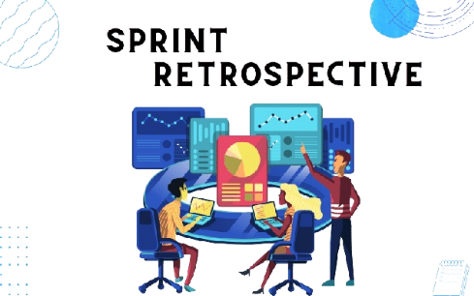
Why we need to do sprint retrospective?
A retrospective is a meeting held at the end of a project or iteration to reflect on what went well,
what could be improved, and what lessons were learned.
Sprint Retrospective meeting happens after the Sprint Review meeting. Sprint Retrospective is the
last meeting of the sprint .

Slide 9
What is the purpose of sprint retrospective?
It allows a team and individuals to highlight both the successes and failures of a project.
Identify areas that need improvement, and reflect on the project as a whole.
How much time does the sprint retrospective take?
Sprint retrospectives are limited to a maximum of three hours. The general guidance is to allow 45 minutes for each week.
Sprint retrospective is usually do before sprint review.

Slide 10
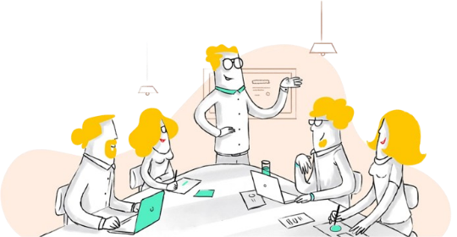
Why we need to do sprint review?
The sprint review is an informal meeting held at the end of the race during which the team presents what has been achieved while stakeholders make improvements.
sprint review to check if we have done it according to the plan that we have prepared. For example, we have set the variable name to have the correct function and we want to know if we have do follow plan or not?

Slide 11
What is the purpose of sprint review?
To inspect the increment that was developed in that sprint
Collect feedback from key stakeholders.
To inspect and improve the agile practices that were followed during the sprint.
How much time does the sprint review take?
Sprint reviews are limited to a maximum of four hours.

Slide 12
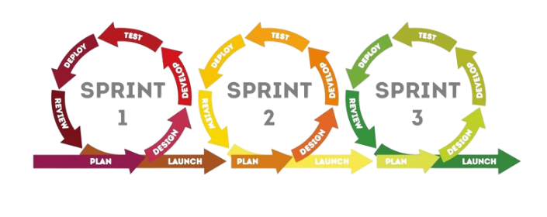
Why we need to separate project in to sprint?
Dividing a project into sprints offers benefits such as
Regular Feedback and Iteration
Transparency
Risk mitigation
Team Collaboration and Motivation
Predictability.
Resource Allocation and Efficiency
On the other hand, it supports agility, adaptation and continuous improvement that lead to project success.

