Slide 1

WHY ARE WE LEARNING?
Notes:
What is learning?
Why are we learning?
Learning is getting a degree and doing some extra curricular activities like singing
To earn money
To increase knowledge
TO PROTECT MY SELF

Slide 2
Life is a lesson learn from it

Slide 3

RowAN ATKINSON

Slide 4


Slide 5

No one knows how far it goes
No one knows how deep it goes

Slide 6
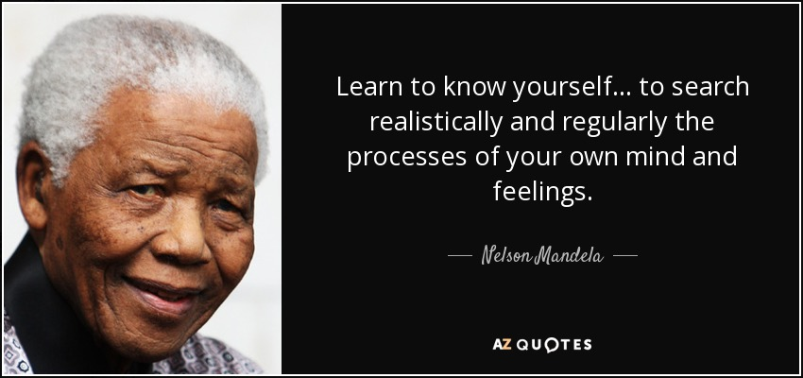

Slide 7
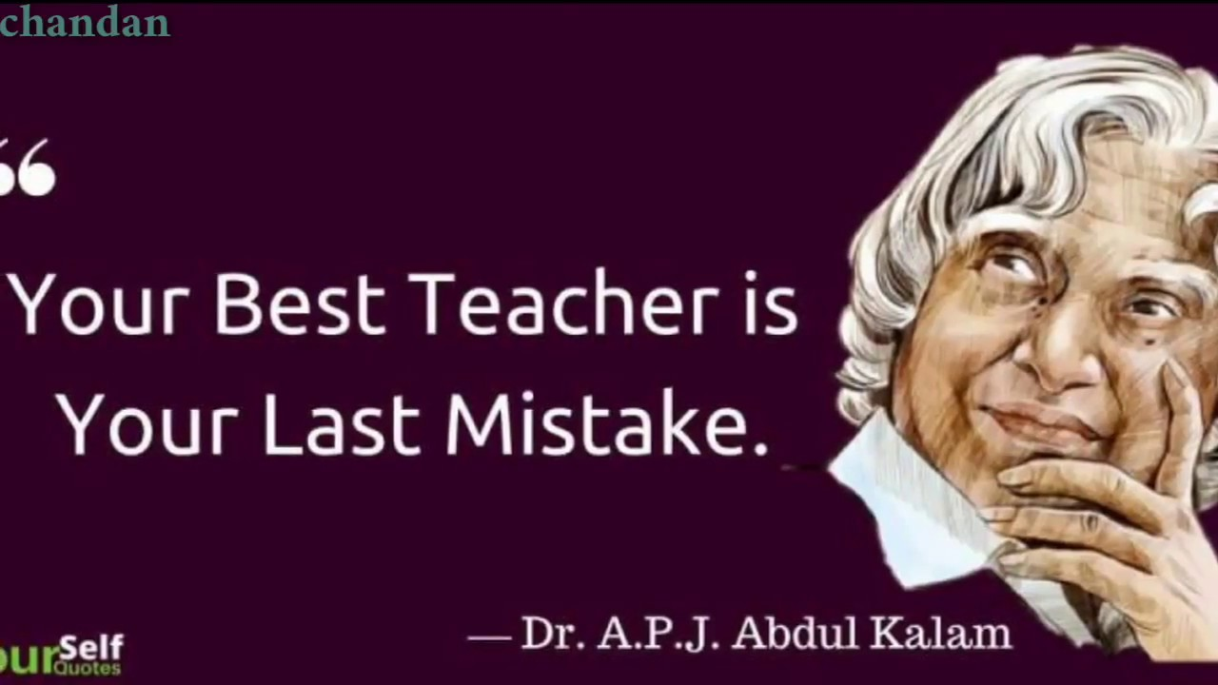

Slide 8

SLUM DOG MILLIONAIRE
Notes:
There are lots of people who can sing better than a person who learned music from beginning
I hear most of people telling that I shouldn’t have learned it. Waste of time.
But I’m sure it will help you at least some time but u won’t realize it.

Slide 9

Notes:
Because no body can take it from you

