Slide 1
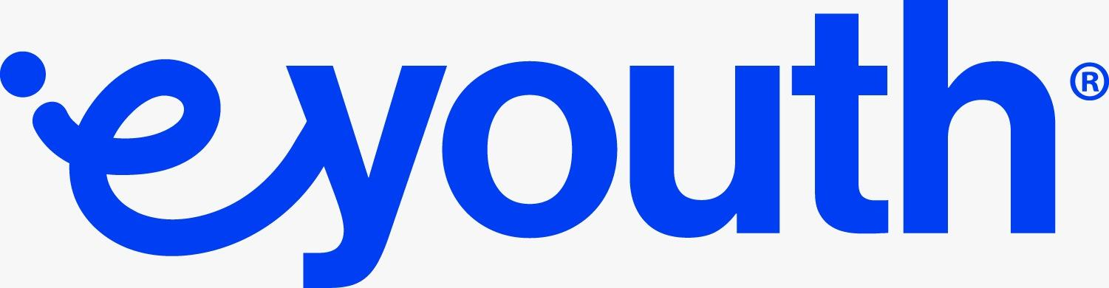

Nebras: AI Medical Chatbot
Revolutionizing healthcare access with personalized, AI-powered guidance.

Slide 2
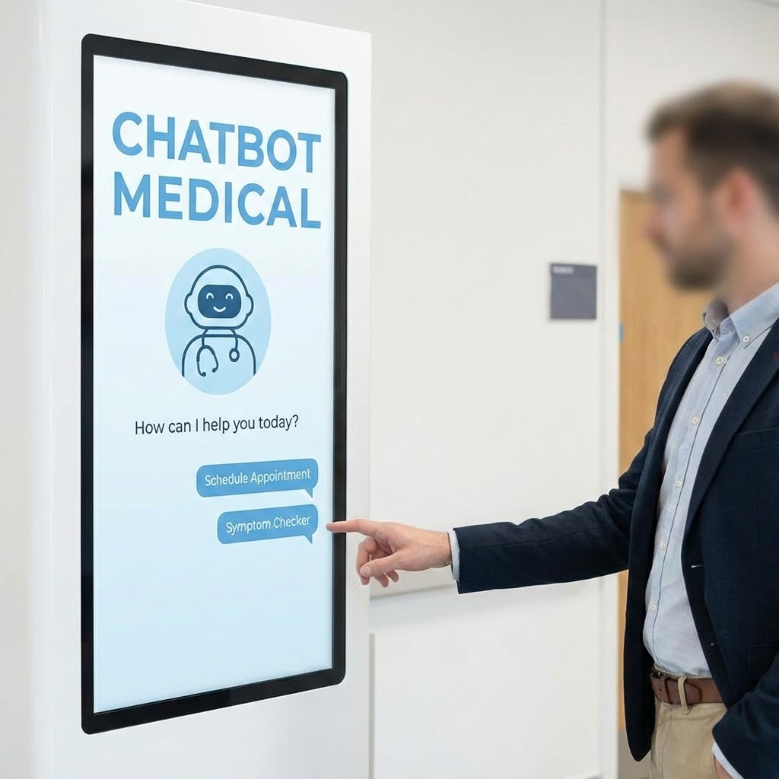
Introducing Nebras: Our Solution
Nebras is an AI-powered medical chatbot designed to provide reliable, context-aware responses to health queries, symptom checks, and general wellness information. It leverages NLP and Generative AI to simulate human-like conversations, offering instant, accurate support. Nebras acts as a smart assistant, not a doctor replacement.

Slide 3
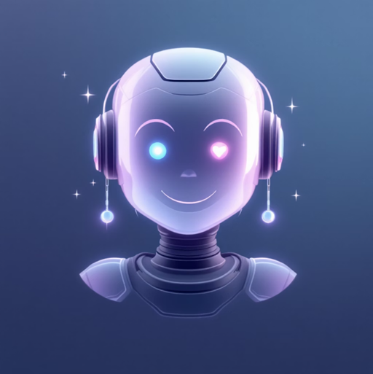

Project Idea: Bridging Healthcare Gaps
Problem: Patients face limited access to timely medical guidance due to staff shortages and long waiting times.
Our solution: "Nebras" offers personalized, AI-powered responses for health queries and symptom checks 24/7.
Unique Value: Provides instant, reliable, and empathetic information, acting as a smart assistant, not a doctor replacement.

Slide 4
Project Wireframe: User Journey
Our wireframe focuses on a seamless user experience, guiding patients from onboarding through core features like symptom checking and information retrieval.
Onboarding
Quick setup and profile creation.
Query Input
Easy text or voice input for medical questions.
Symptom Check
Guided process for symptom assessment.
Information Retrieval
Access to curated health data and wellness tips.

Slide 5
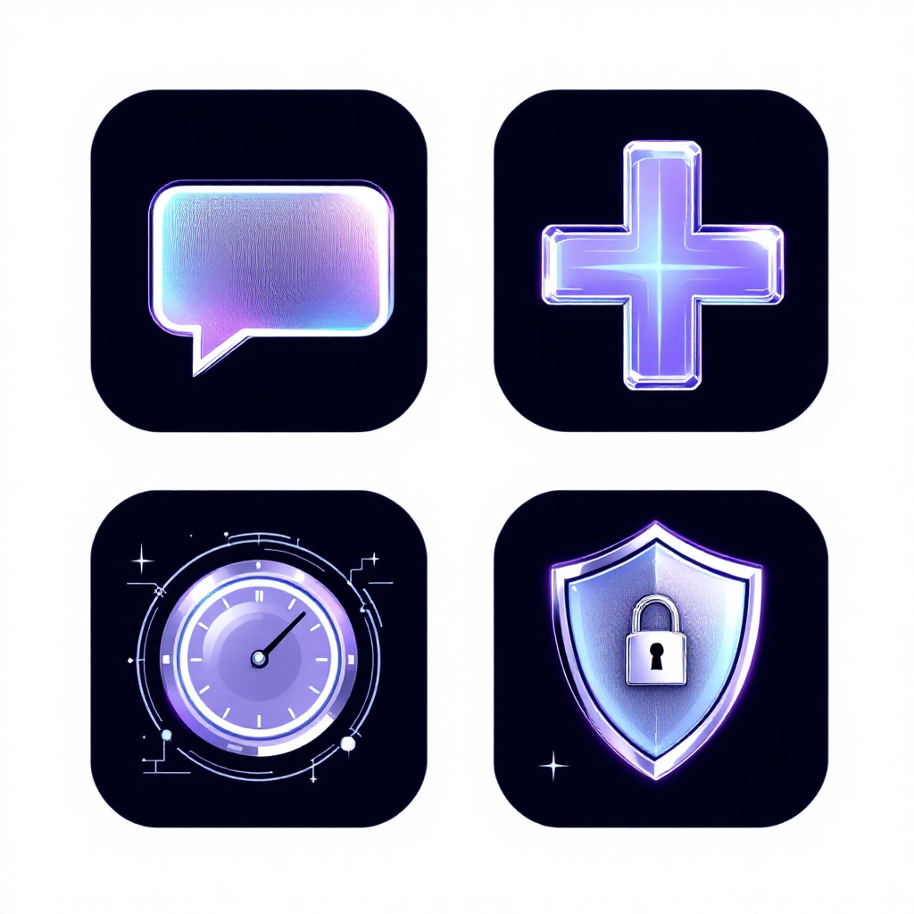

End Users + Features
Key Features
AI-driven medical inquiry answering.
24/7 automated FAQ and symptom triage.
Secure integration with JSON medical datasets.
Continuous performance improvement via feedback.
Primary User Personas
Patients seeking quick health answers.
Healthcare staff needing quick information retrieval.
Individuals interested in general wellness.

Slide 6
Programming Languages + Frameworks
Our project leverages a robust tech stack to ensure high performance, scalability, and efficient development.
Python
Primary language for AI/ML development.
Hugging Face
Transformers for advanced NLP models.
Data Structure: Secure & Integrated
Data Collection
Curated healthcare data from reliable sources.
JSON Storage
Structured storage for medical information.

Slide 7
Live Application + Testing
Unit Testing
Ensuring individual components function correctly
Integration Testing
Verifying seamless interaction between modules.
User Testing
Gathering feedback for usability and response quality.

Slide 8
Deliverables: Comprehensive Documentation
We are committed to providing thorough documentation and a fully functional application by the project's conclusion.
Final Report
Detailed overview of project, methodologies, and results.
Source Code
Well-documented and organized code repository.

Slide 9
Project Team + Roles
Nader Salama
Team Leader / Lead ML Engineer
Ahmed Hesham
Data Engineer & Backend Developer
Hamdy Waleed
Frontend & API Integration
Nada Hamoda
NLP Engineer / Model Training
Nooran Ali
Documentation & Quality Assurance
Israa Abdulmohsen
Data Preprocessing & Evaluation

Slide 10
Thank You!
Contact Us
nebras.depi@gmail.com
https://github.com/Thexunique/Nebras-your-Personalized-Chatbot

