Slide 1

Azure HDinsight
Spark - Machine Learning Demo

Slide 2
What is Azure HDInsight?
Azure HDInsight is a managed, full-spectrum, open-source analytics service in the cloud for enterprises. With HDInsight, you can use open-source frameworks such as, Apache Spark, Apache Hive, LLAP, Apache Kafka, Hadoop and more, in your Azure environment.

Slide 3
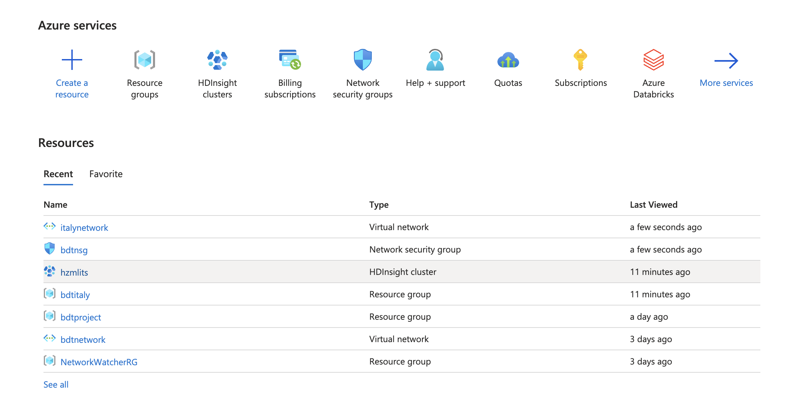
Create a Service in HDinsight

Slide 4
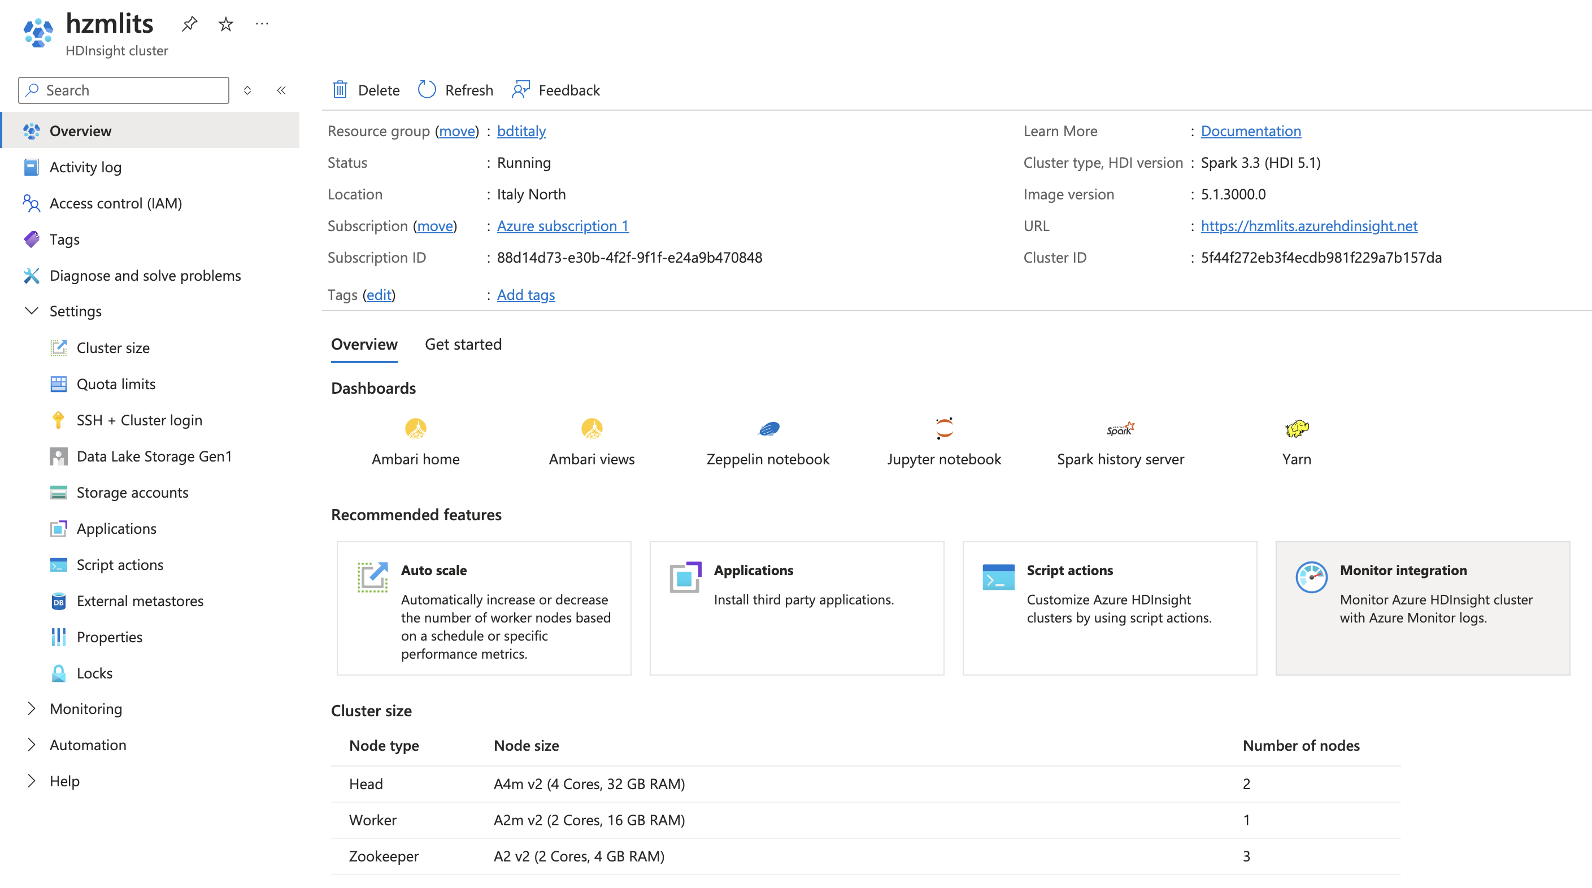
Spark Cluster Page

Slide 5
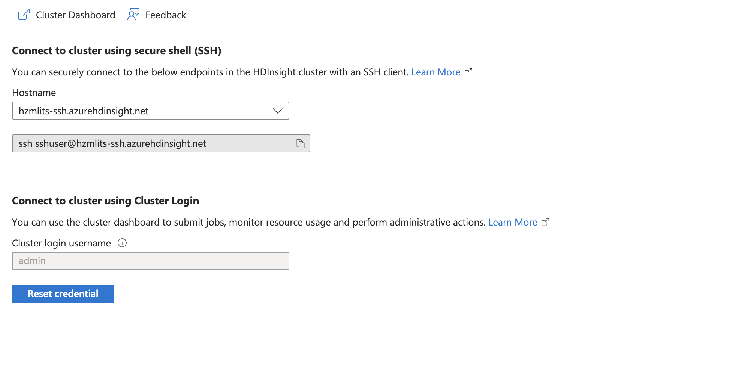
SSH Interface

Slide 6
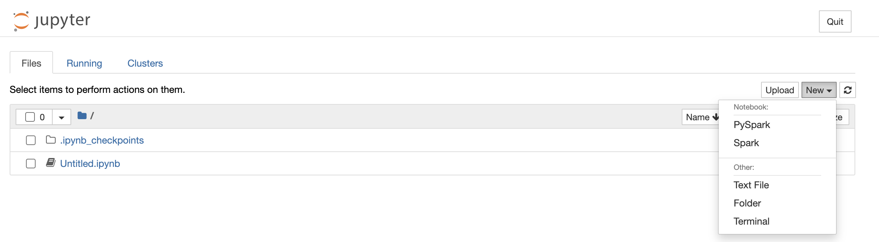
Jupyter Infterface
Jupyter in Azure Spark supports Python(PySpark) and Scala (Spark)

Slide 7
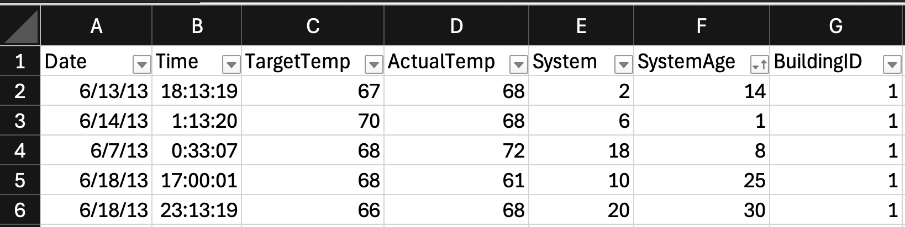
ML Demo for HVAC Heating Ventilation Air conditioner
Using ML to predict the temperature in a specific system.
The goal is using System ID and SystemAge as input parameters to predict if the system is Hot(ActualTemp > TargetTemp) or cold?

Slide 8
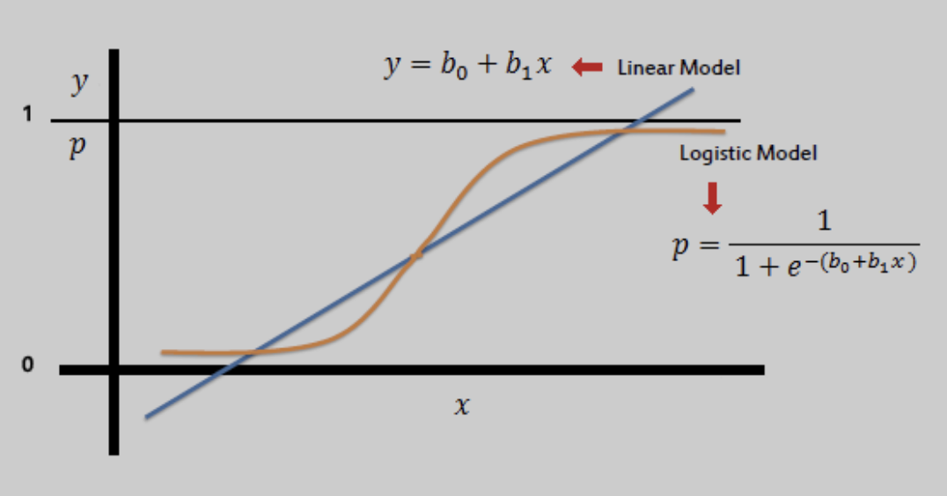
Using Logistic regression
Due to the output is binary, the output is either 0(cold) or 1(hot), we chose Logistic regression.

Slide 9
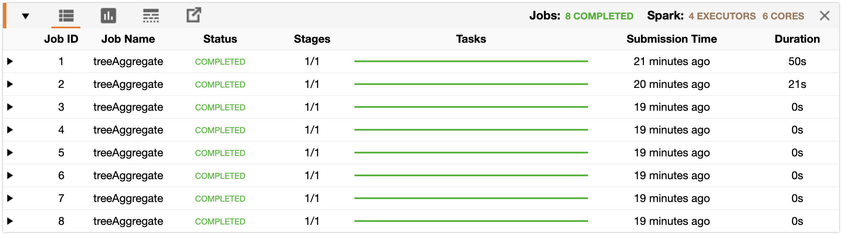
How Spark Handle ML Job
Spark divide this ML job into 8 stages

Slide 10
How to assign stages to tasks
When I created two work nodes, spark would assign the stage1 and stage2 to two different tasks. And they would start simultaneously. Although stage2 was finished much earlier than stage1, task1 still had to wait task2 until task2 finish the stage2. And then they could both run the stage 3 and stage4 at the same time.

Slide 11
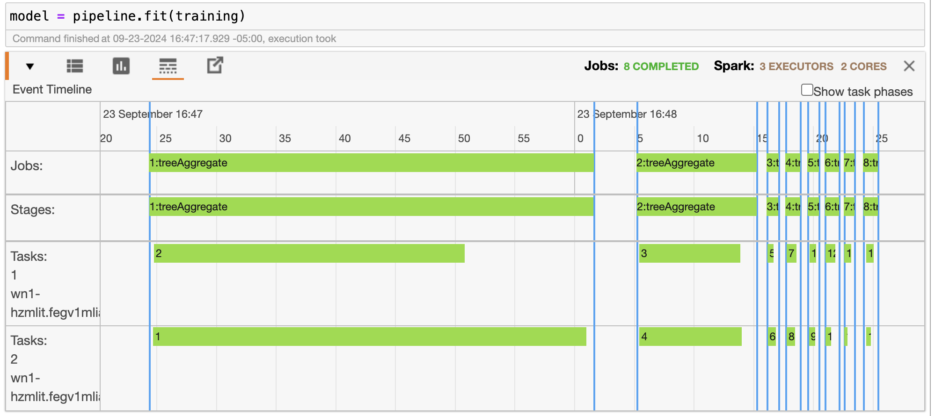
How to assign stages to tasks - cont.

Slide 12
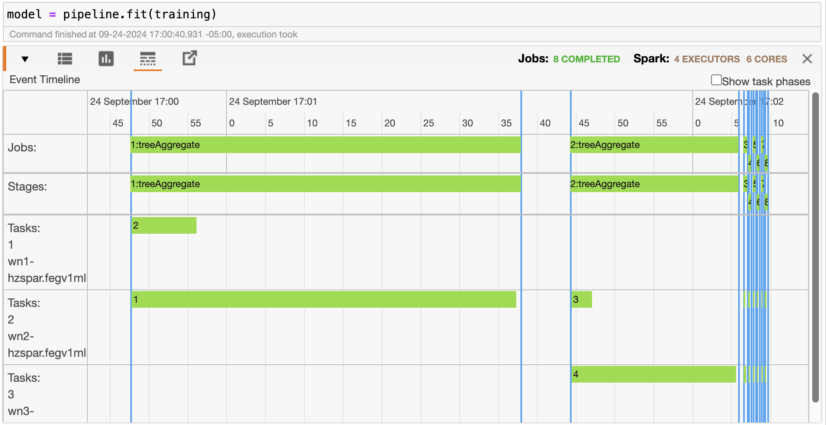
How to assign stages to tasks – cont.
Here is the screen shot, when I added the worker node of spark to 4. No additional benefits for this job!

Slide 13
Conclusion
Spark is a good framework for Machine learning Job. Spark machine learning pipeline would help developer to depart ML Jobs to multiple stages and try it best to run them parallel.

Slide 14
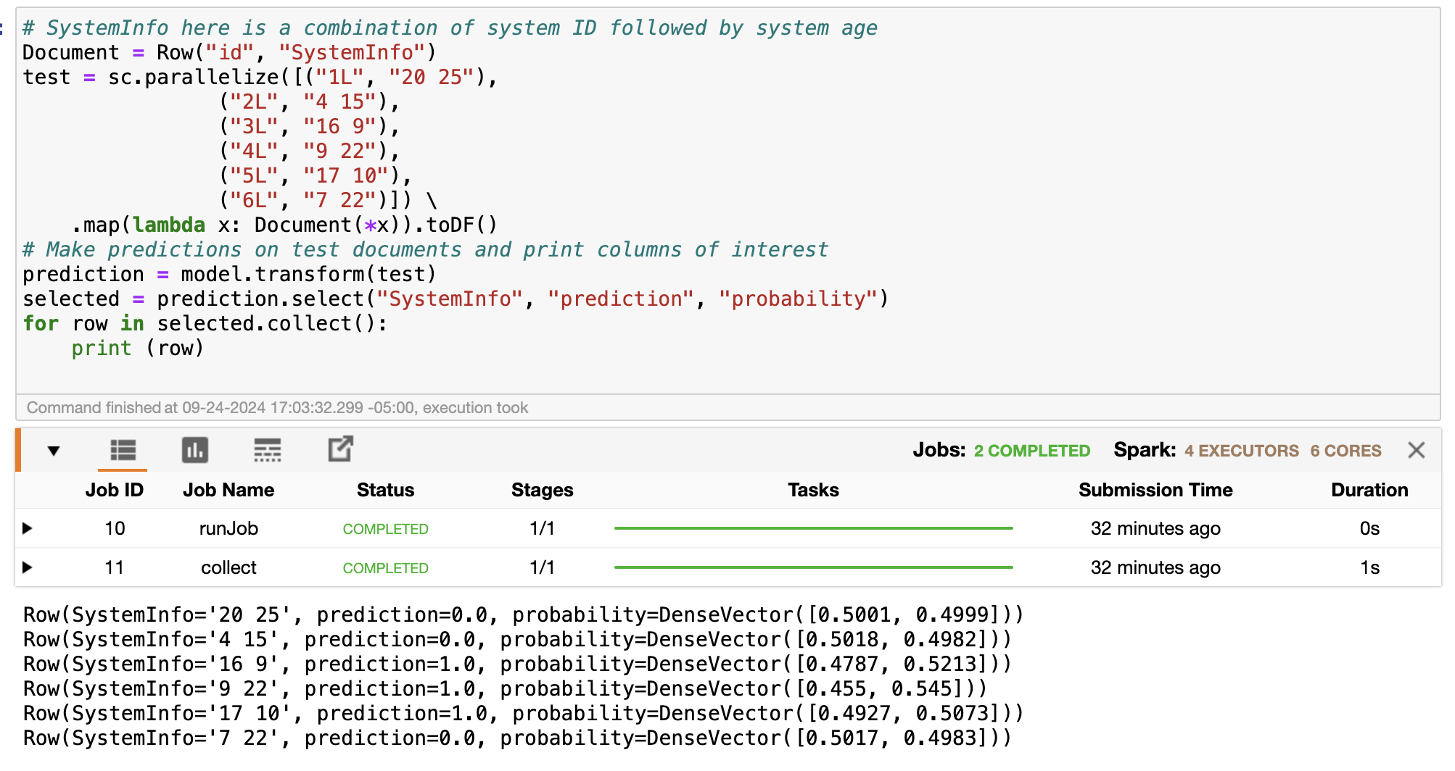
Running result of ML Job
Row(SystemInfo='20 25', prediction=0.0, probability=DenseVector([0.5001, 0.4999])) System 20 with 25 age, probability of cold is 0.5, probability of hot is 0.49. The prediction is cold.

Slide 15
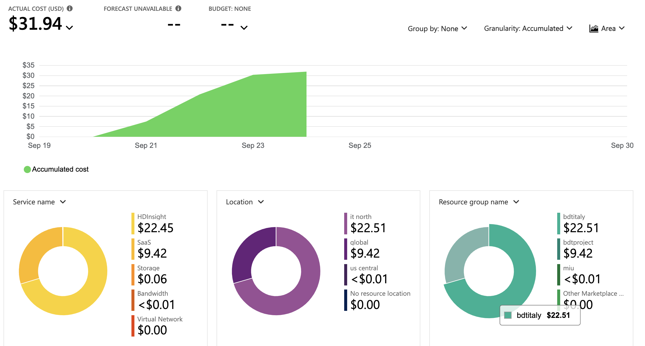
Billing of Azure

Slide 16
Early exploration in AWS
MSK: Tried to use MSK to replace the local Kafka, but MSK is not allowed to access by public network.
EMR: Easy to build, we tried to connect MSK and EMR to do some demo. However, this solution is too expensive.

Slide 17
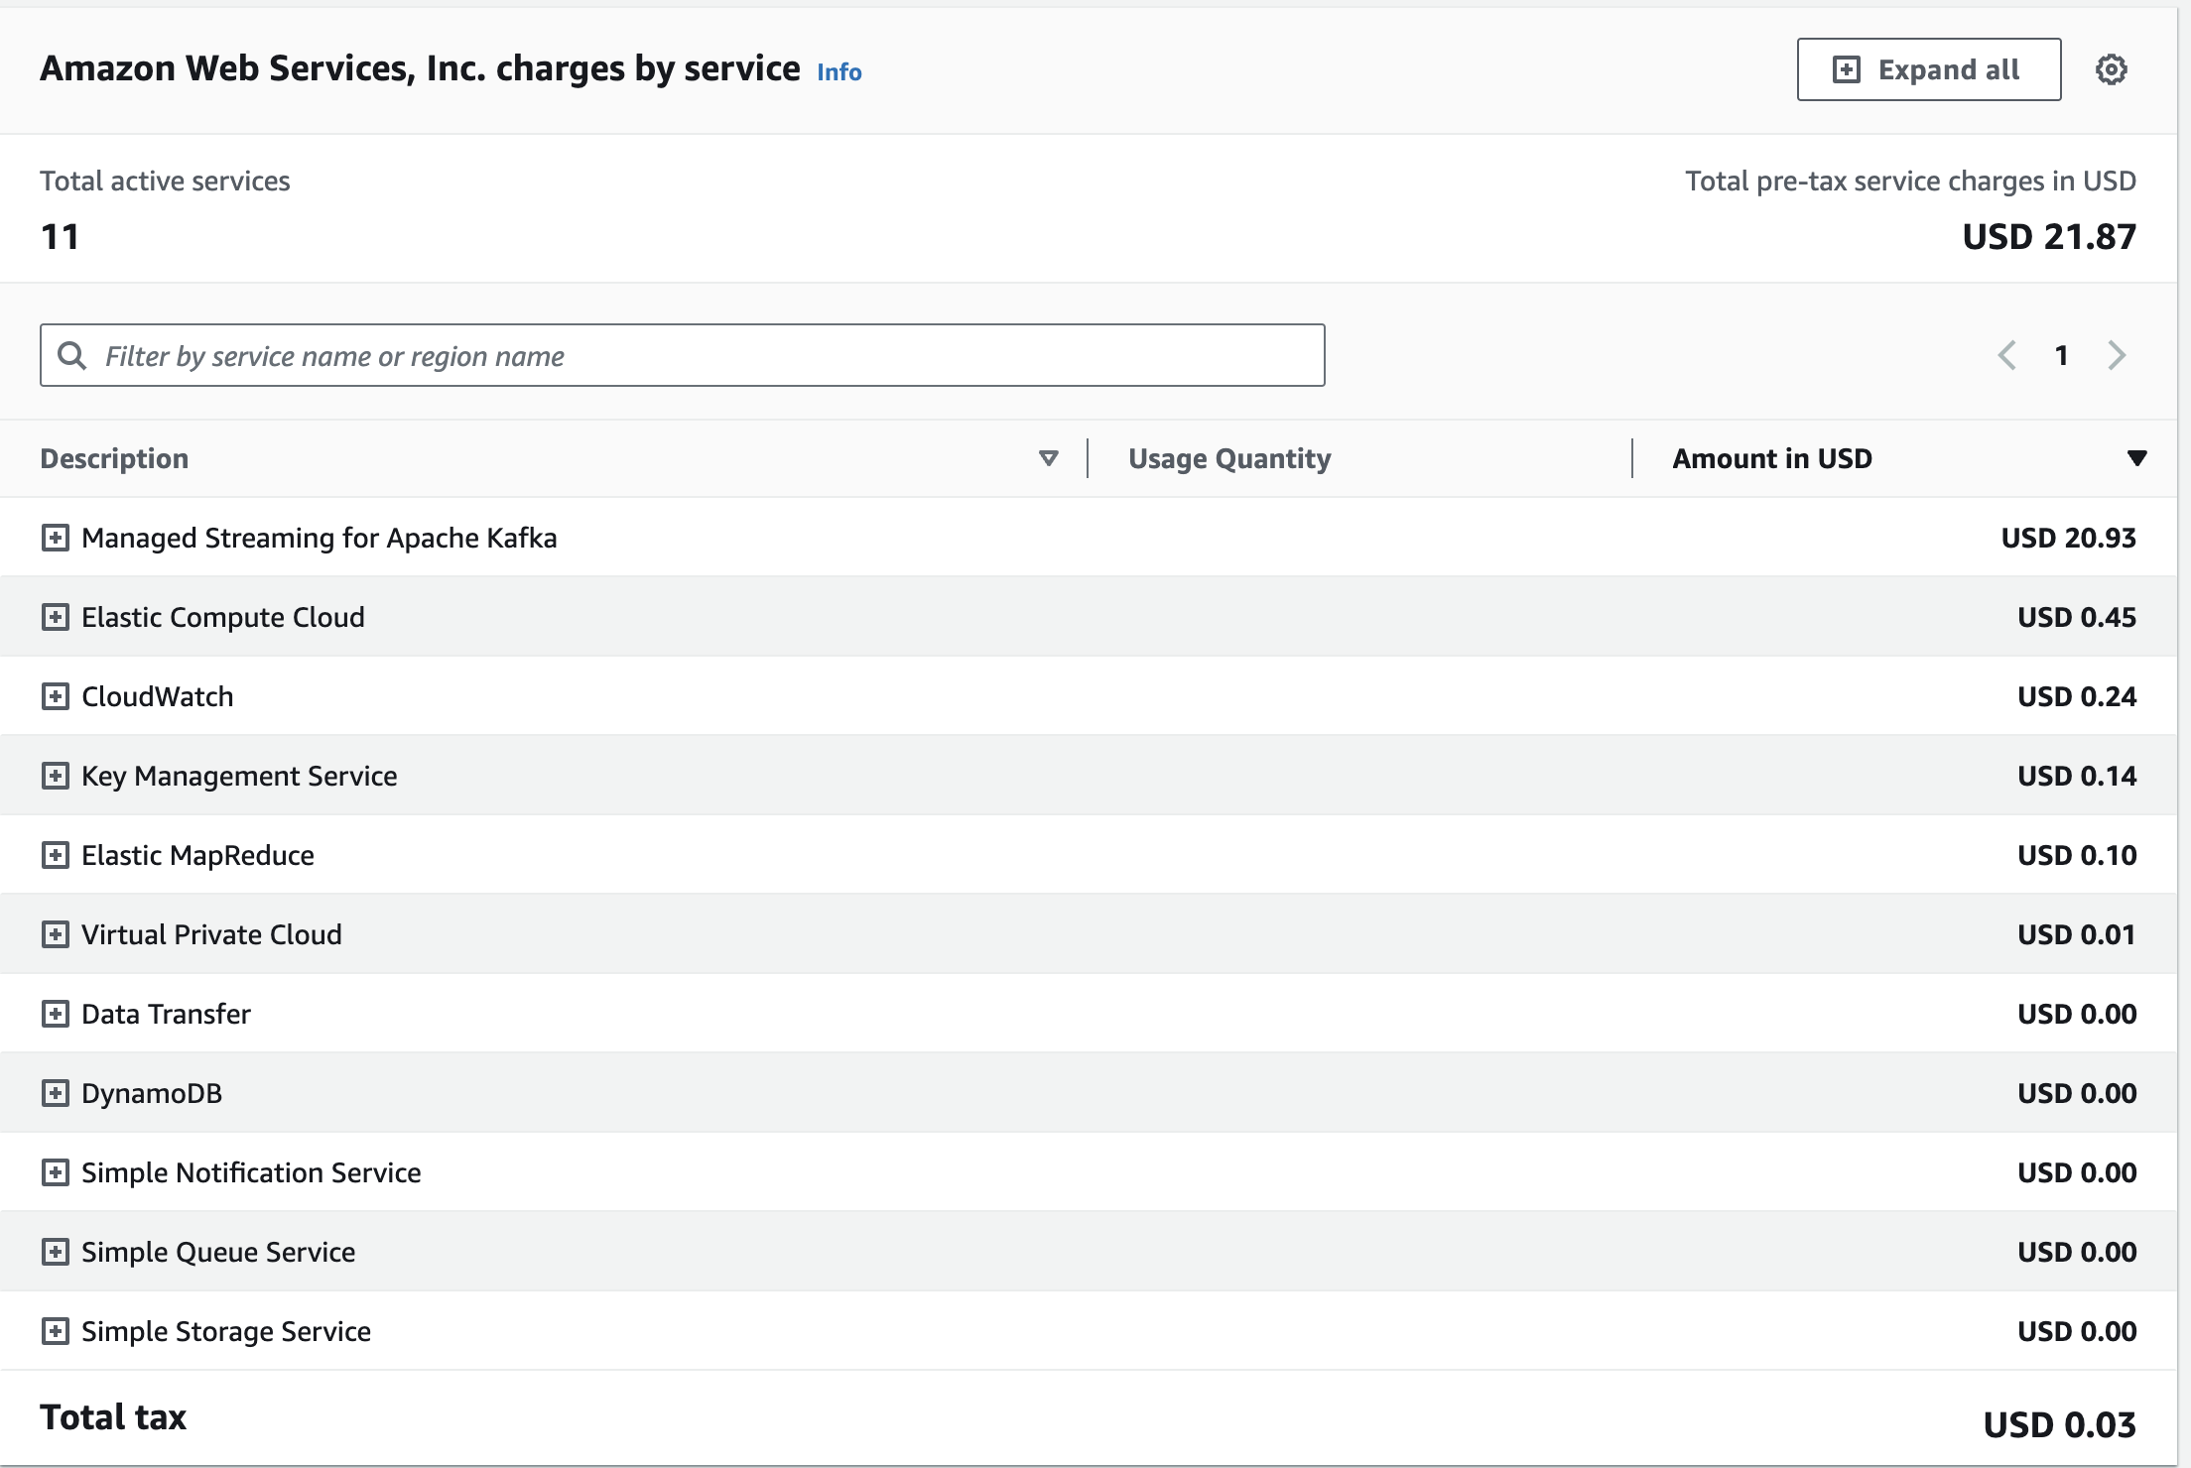
Billing of AWS

