Slide 1
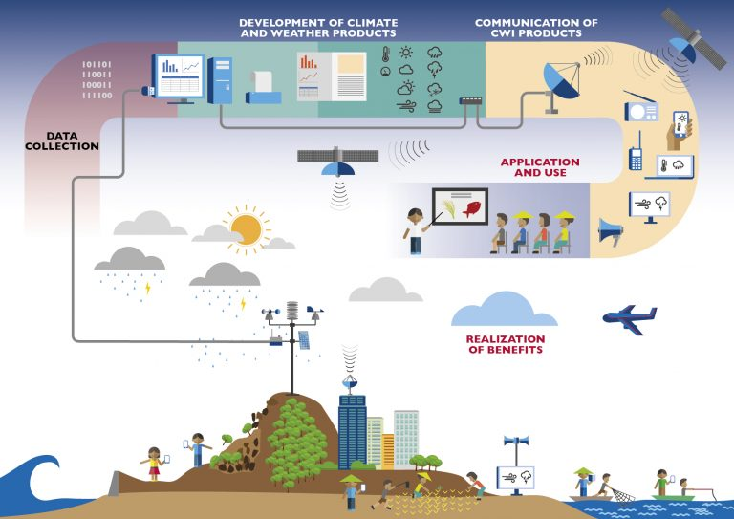
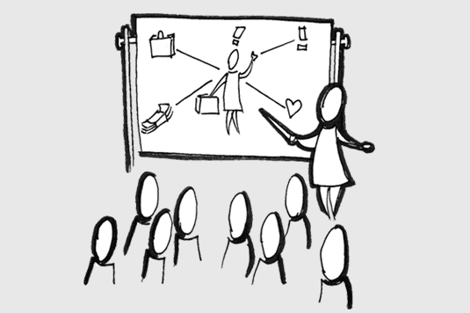
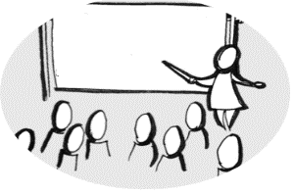





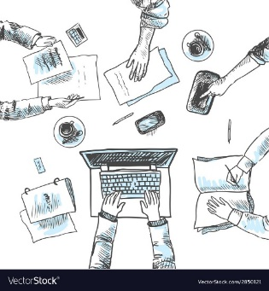



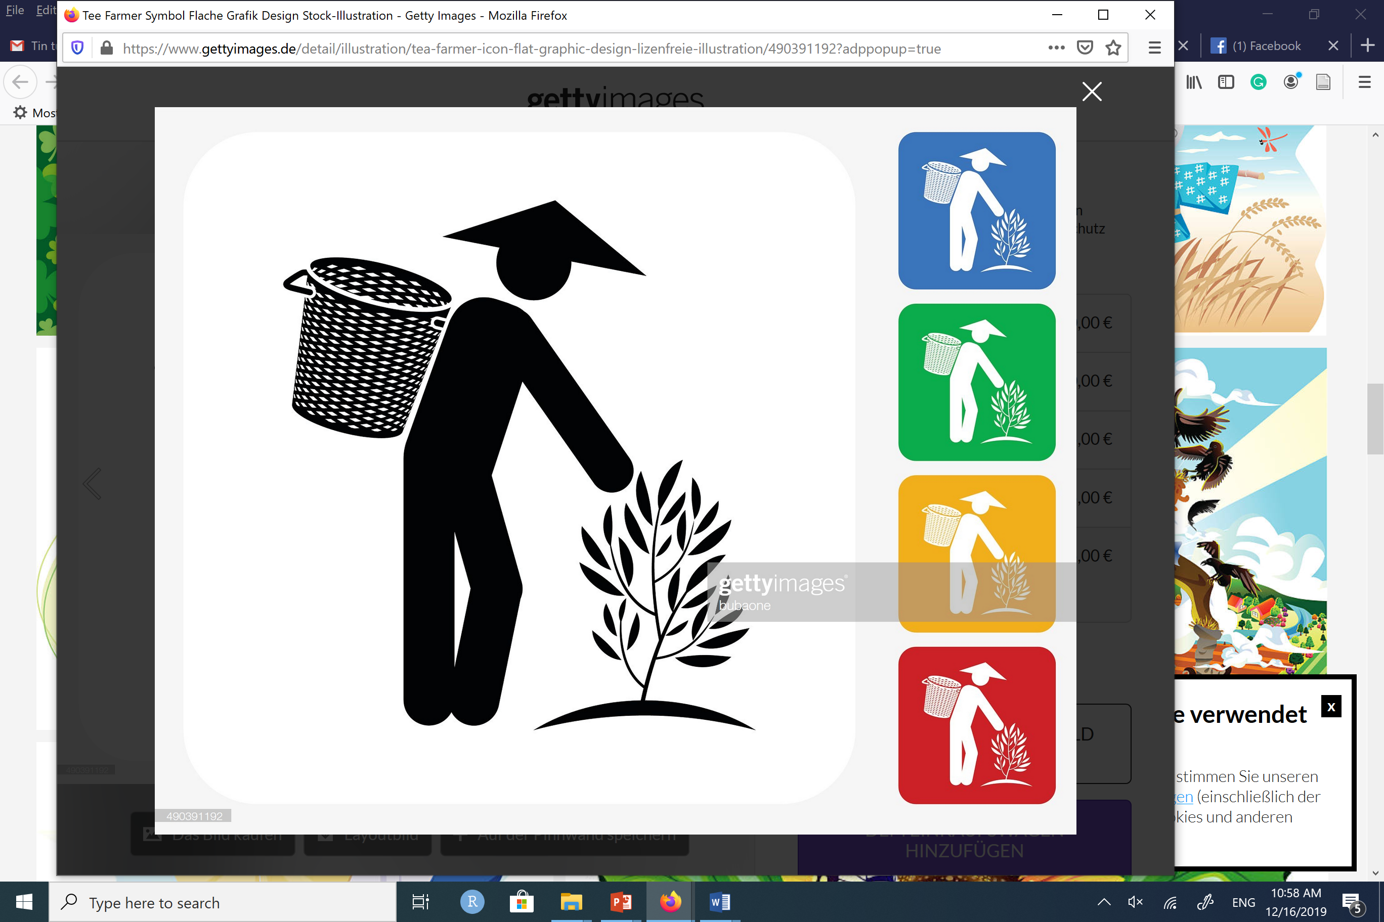




Capacity building
{Provincial Department of Agriculture and Rural Development}
New mini weather stations (1)
{Mobile operator, Commune,
Village leader }
{Provincial Met. station}
Seasonal paper bulletin
Forecasts
Advice
Weekly SMS (1,2)
Weekly SMS+loudspeaker (3)
Weekly Paper + loudspeaker (4)
Feedback
Feedback
Collect data from observation point
Forecast,
Monitor quality
Translation into advice, monitor
{Provincial Met. station}
{District technical working group at
District Agri. Service Center}
Use of information
{Women, men}
Gender reflection & dialogue (1,2)
Gender sensitiveness (3,4)
{NGO, Women Union}
Activities for all interventions
Variations for different interventions (1,2,3,4)
Engage sub-Gov Units, NGO
{Commune People Committee, extension workers, village leaders, communal Women Union, NGO}
{Stakeholder}

