Slide 1
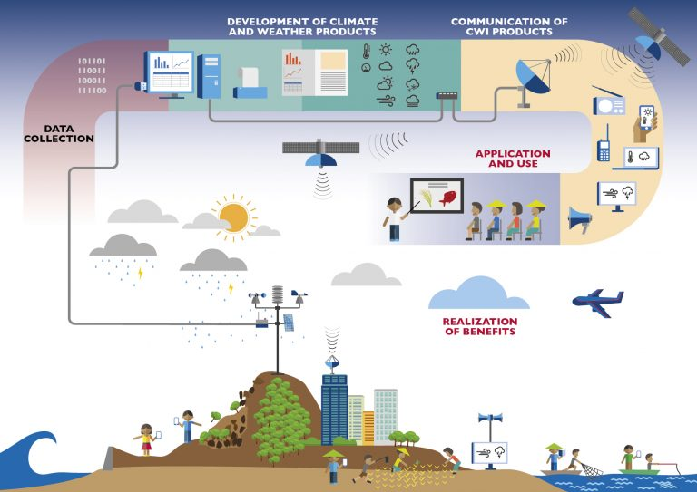

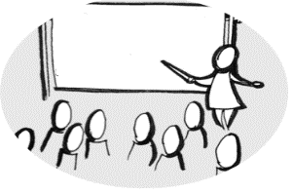





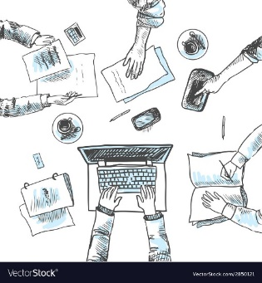



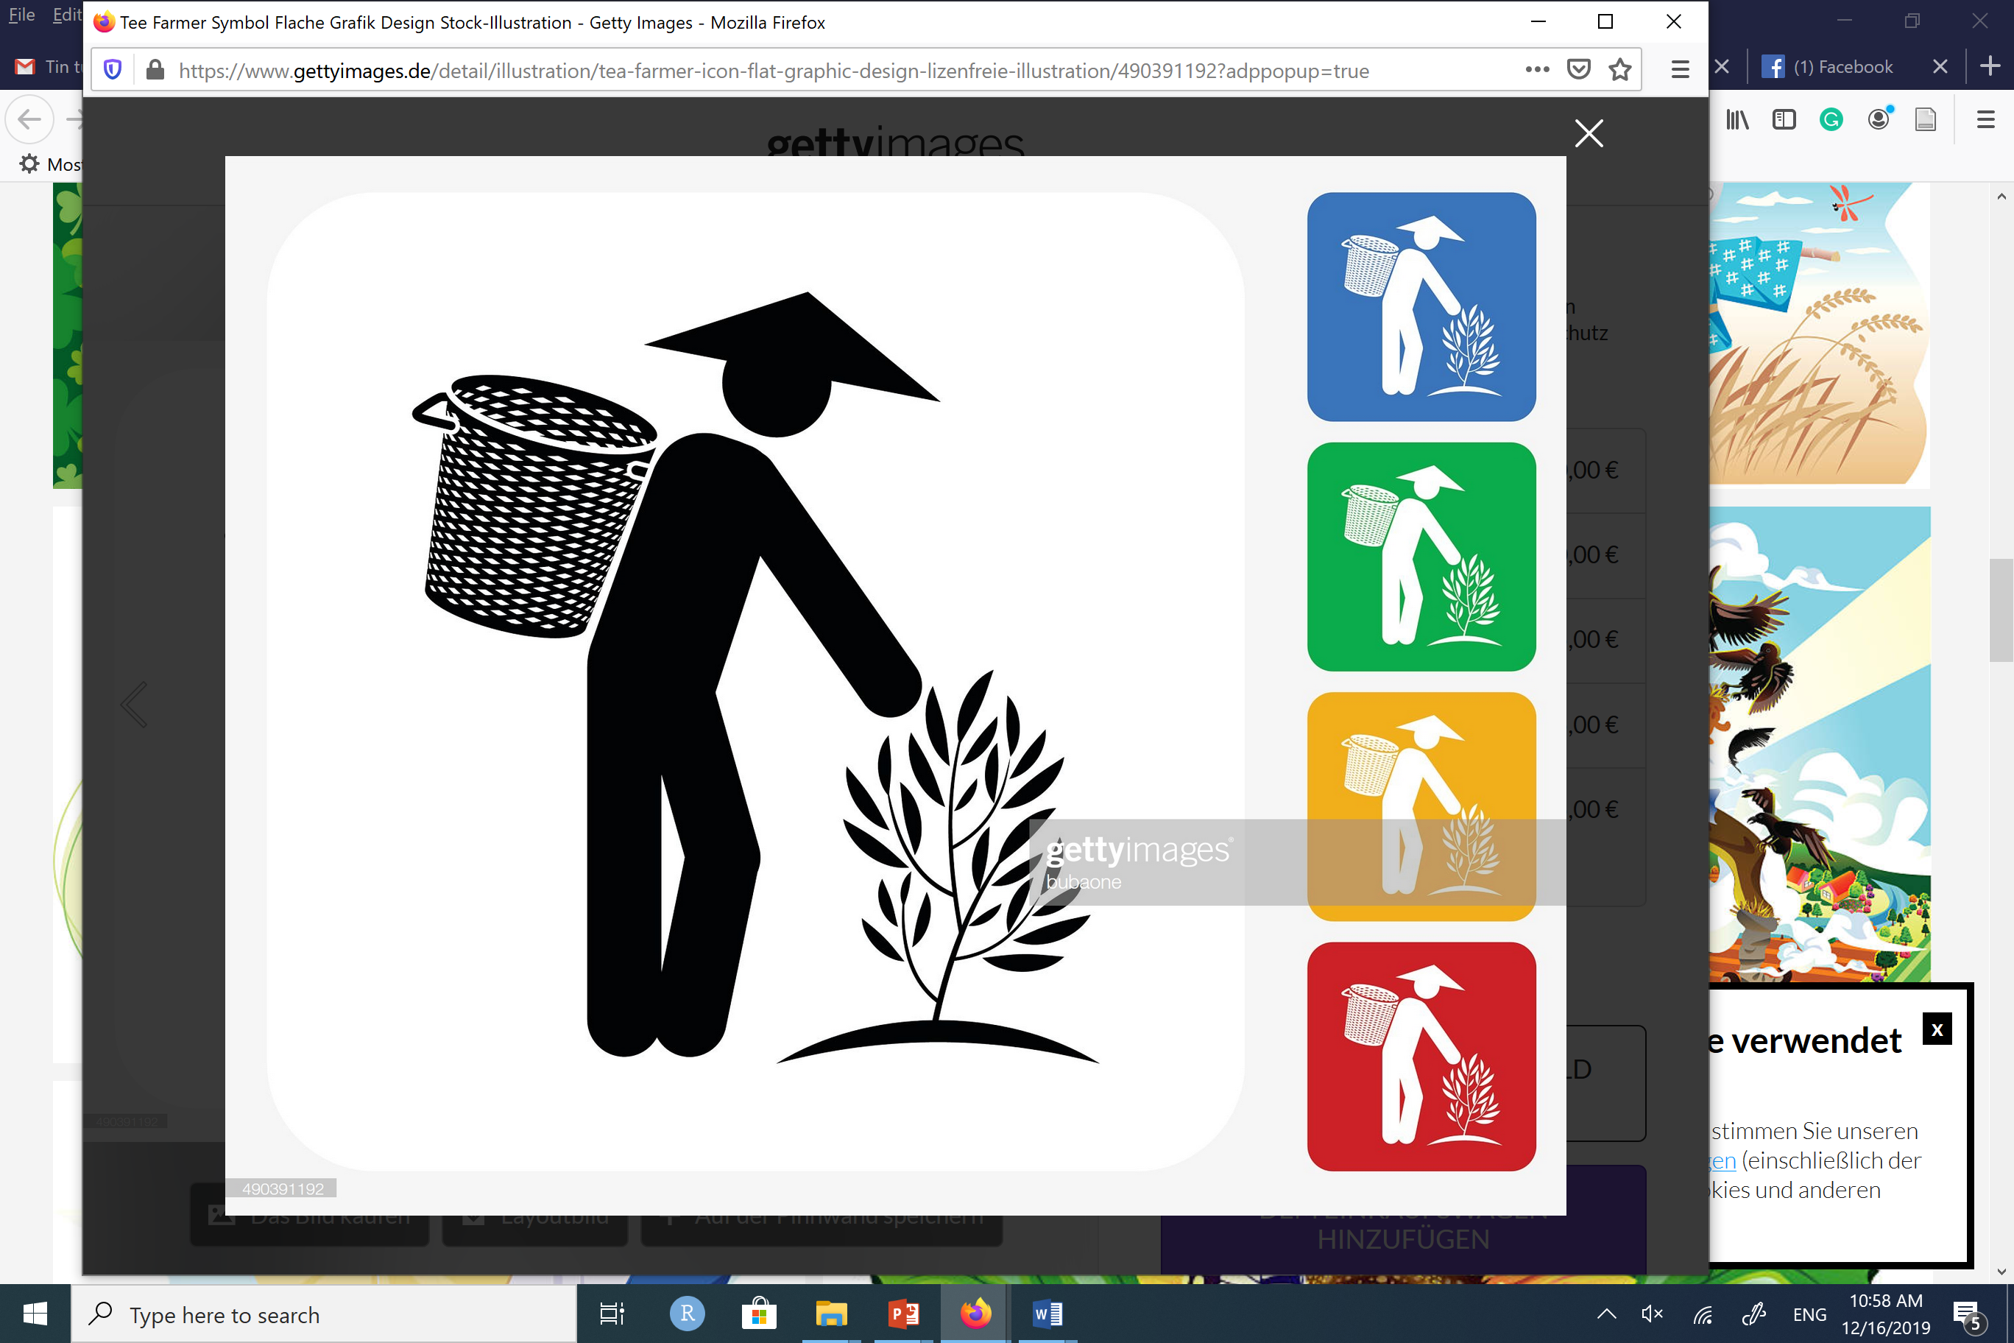




Capacity building
{Provincial Department of Agriculture and Rural Development}
New mini weather stations (1)
{Mobile operator, Commune People’s Committee, village leaders }
{Provincial Meteorological Station}
Seasonal paper bulletin
Forecasts
Advice
Weekly SMS (1,2)
Weekly SMS + loudspeaker (3)
Weekly Paper + loudspeaker (4)
Feedback
Feedback
Collect data from observation point
Forecast,
monitor quality
Translation into advice, monitoring
{Provincial Meteorological Station}
{District technical working group at
Dien Bien Agricultural Service Center}
Use of information
{women, men}
Gender reflection & dialogue (1,2)
Gender sensitiveness (3,4)
{NGO, Women’s Union}
Activities for all interventions
Variations for different interventions (1,2,3,4)
Engage sub-gov units, NGOs
{Commune People’s Committee, extension workers, village leaders, Women’s Union, NGOs}
{Stakeholder}

