Slide 1
DATA ANALYST PORTFOLIO
Campaign Targeting Intelligence
Who should be contacted when campaign capacity is limited?
Thi Vu
Data Analyst
1

Slide 2
BUSINESS QUESTION
Problem & Goal
A simple decision question with a clear operating constraint.
!
THE CHALLENGE
✓
OUR GOAL
• The team cannot contact everyone.
• Calls take time and cost money.
• A useful model should help decide who to contact first.
• Rank customers before the call.
• Use contact capacity such as Top 5%, 10%, 20% or 30%.
• Measure how many real subscribers are captured.
Success measure: capture more actual subscribers with a smaller contact list.
2
CAMPAIGN TARGETING INTELLIGENCE • DATA ANALYST PORTFOLIO

Slide 3
DATA SOURCE
Data Source & Records
SOURCE
RECORDS
INPUTS
UCI
41,188
20 inputs + outcome
Bank Marketing • CC BY 4.0
bank-additional-full.csv
May 2008 – Nov 2010
Attribution
Moro, S., Rita, P., & Cortez, P. (2014). Bank Marketing [Dataset]. UCI Machine Learning Repository. DOI: 10.24432/C5K306
3
CAMPAIGN TARGETING INTELLIGENCE • DATA ANALYST PORTFOLIO

Slide 4
DATASET
Target & Key Feature Groups
An overview of the target and key features used in the analysis.
KEY FEATURE GROUPS
y
TARGET
1
Client profile
age, job, marital, education, default, housing, loan
Term deposit subscription
2
Contact context
contact type, month, day of week
Yes = 4,640 No = 36,548
3
Campaign history
campaign, pdays, previous, poutcome
4
Macro context
employment and interest-rate indicators
Positive rate: 11.27%
"Duration" is excluded from pre-call targeting because it is known only after the call.
4
CAMPAIGN TARGETING INTELLIGENCE • DATA ANALYST PORTFOLIO

Slide 5
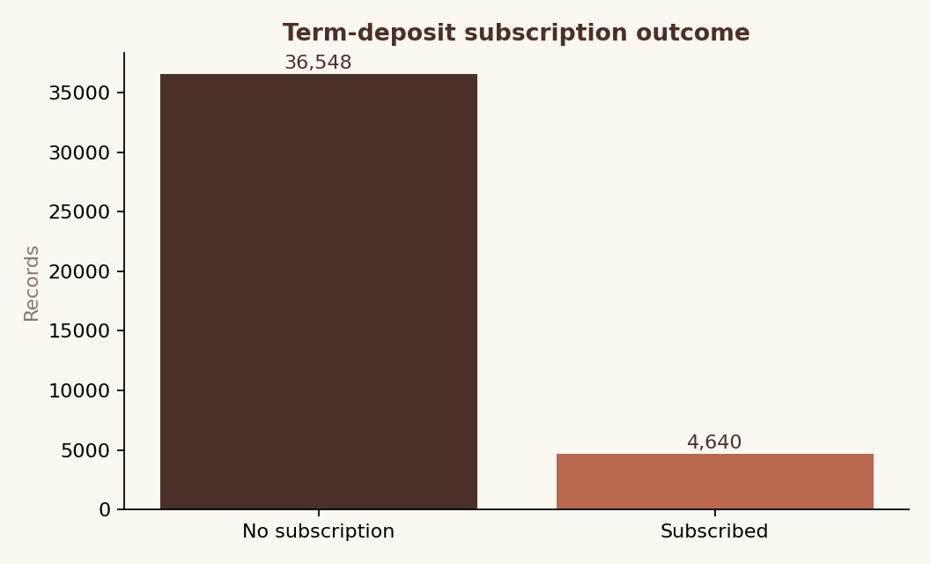
DATA AUDIT
Data Preparation & Audit
Key preparation steps before model development.
• Checked data types and source categories.
• Kept "unknown" as an explicit source category.
• One-hot encoded categorical fields.
• Scaled numeric fields for Logistic Regression.
• Removed "duration" from deployable predictors.
Imbalanced target: the positive class is the minority.
5
CAMPAIGN TARGETING INTELLIGENCE • DATA ANALYST PORTFOLIO

Slide 6
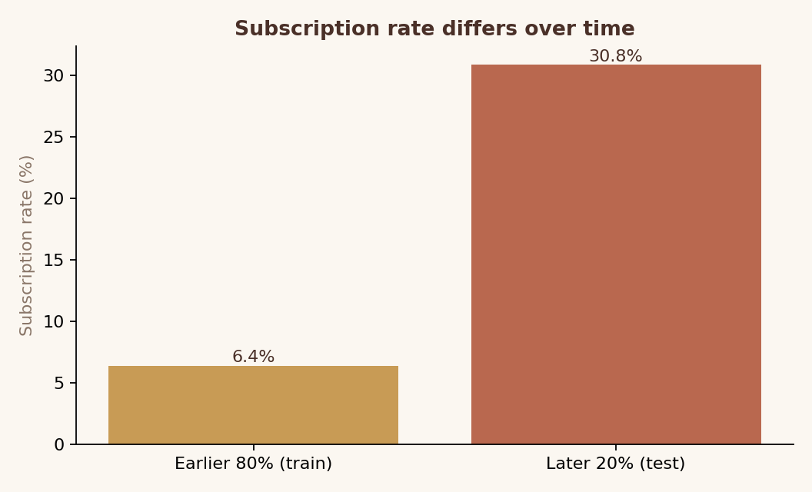
VALIDATION
Train & Test Split
A time-based split to reflect how the model would be used in practice.
WHY SPLIT BY TIME?
• The dataset is ordered by date, so a random split could mix earlier and later customer behavior.
INSIGHT?
• Subscription rate increased from 6.4% to 30.8%, showing a clear shift between the earlier and later periods.
TRAIN
TEST
32,950
8,238
Subscription Rate 6.4%
Subscription Rate 30.8%
6
CAMPAIGN TARGETING INTELLIGENCE • DATA ANALYST PORTFOLIO

Slide 7
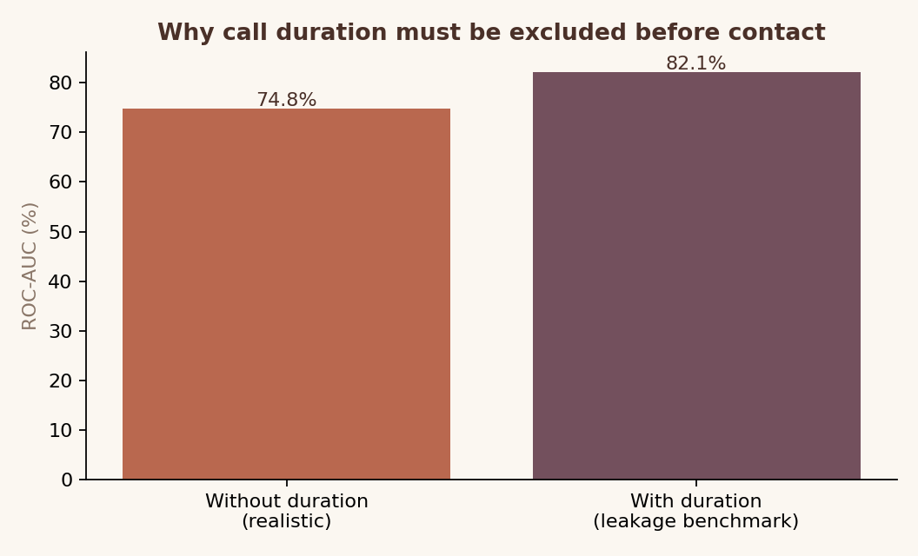
DATA LEAKAGE
Why “Duration“ Is Excluded
Call duration is only known after a call starts, so it cannot help decide who to contact first.
WHY IT MATTERS?
Including call duration improves the model score, but this information is not available when the contact list is created.
DECISION?
The final targeting model excludes “Duration” and uses only information available before contact.
7
CAMPAIGN TARGETING INTELLIGENCE • DATA ANALYST PORTFOLIO

Slide 8
MODELING
Model Development
Several models were tested to find the best way to rank customers for targeting.
1
→
2
→
3
→
4
→
5
→
6
Baseline
Imbalance
Compare
Evaluate
Rank
Activate
Logistic Regression
Class weighting
LR • RF • XGBoost
Temporal test
Predicted probability
Top-K capacity
8
CAMPAIGN TARGETING INTELLIGENCE • DATA ANALYST PORTFOLIO

Slide 9
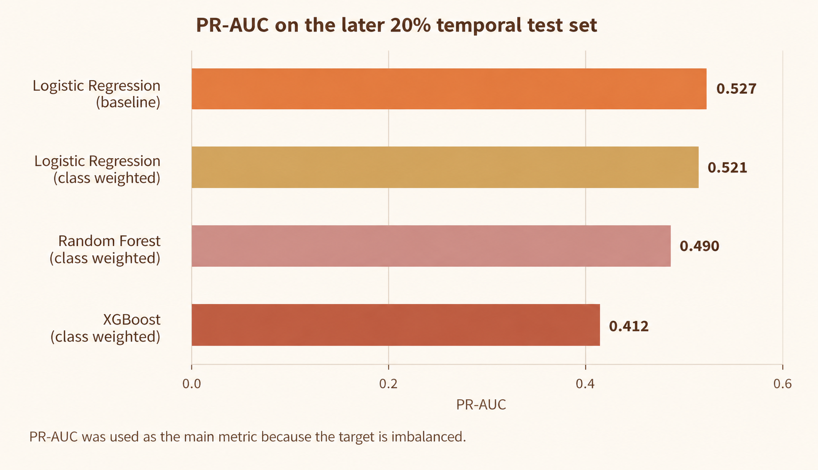
MODEL RESULTS
Model Comparison
The models were compared on the later test period using the same set of features.
WHAT I FOUND
Baseline Logistic Regression achieved the highest PR-AUC at 0.527. Class weighting and more complex models did not improve PR-AUC on the later test period.
MODEL CHOICE
Logistic Regression was selected as the final ranking model.
9
CAMPAIGN TARGETING INTELLIGENCE • DATA ANALYST PORTFOLIO

Slide 10
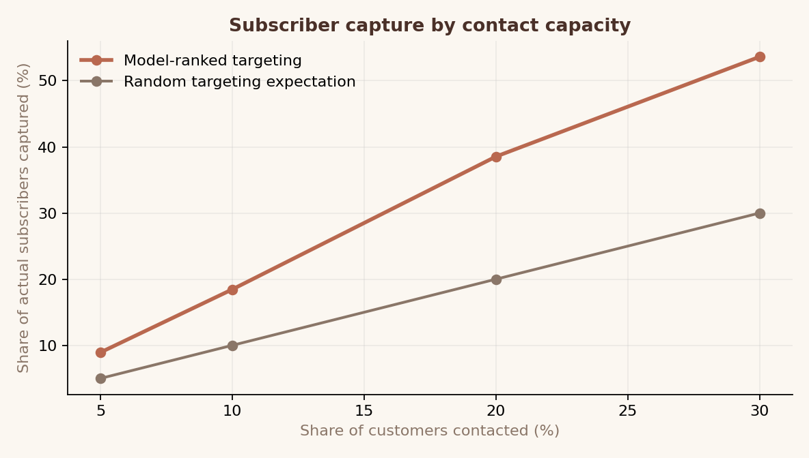
BUSINESS DECISION
Who Should We Contact First?
Customers are ranked by predicted probability, then selected based on available contact capacity.
CONTACT CAPACITY
Capacity
Customers
Captured
Cum. lift
Top 5%
411
8.9%
1.79×
Top 10%
823
18.5%
1.85×
Top 20%
1,647
38.5%
1.93×
Top 30%
2,471
53.6%
1.79×
At 20% capacity, 1,647 ranked customers capture 38.5% of subscribers.
Each row is cumulative from the top of the ranked list.
10
CAMPAIGN TARGETING INTELLIGENCE • DATA ANALYST PORTFOLIO

Slide 11
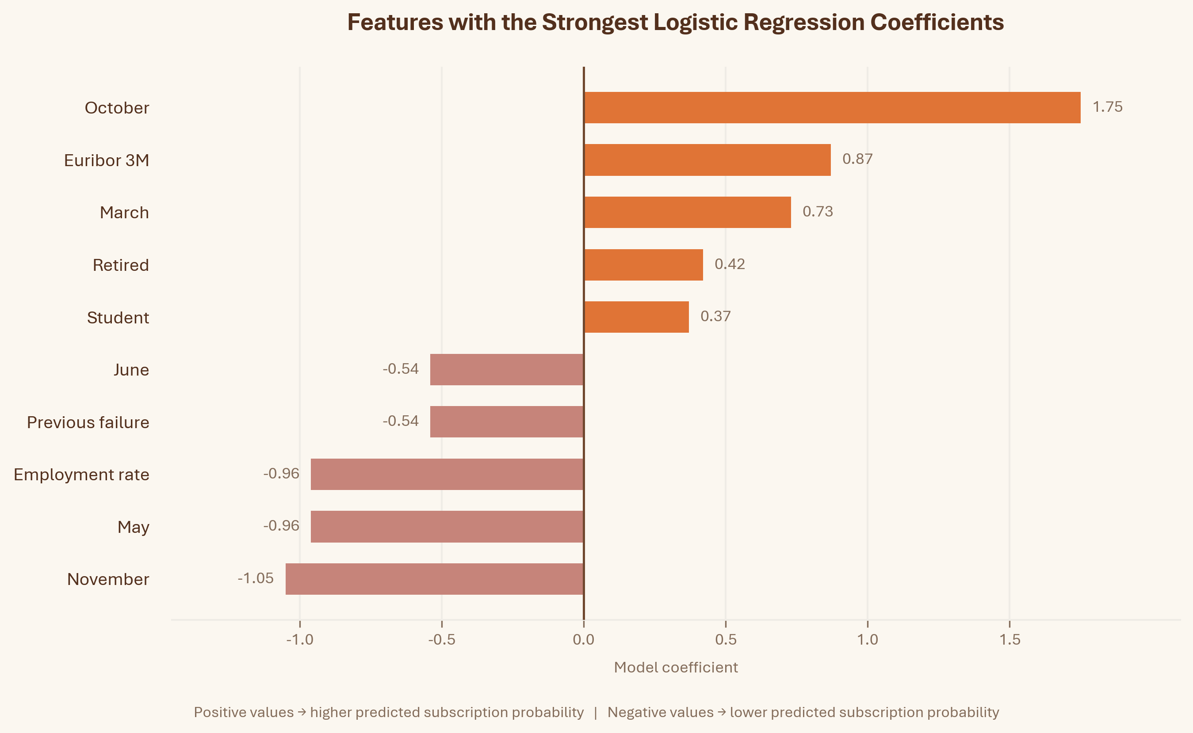
EXPLAINABILITY
What Influences the Model Score?
A closer look at the features associated with higher or lower predicted subscription probability.
HOW TO READ THIS
Positive coefficients are associated with a higher predicted subscription probability.
Negative coefficients are associated with a lower predicted subscription probability.
These coefficients explain the model score, not cause and effect.
Some macroeconomic features are highly correlated, so individual coefficients need cautious interpretation.
11
CAMPAIGN TARGETING INTELLIGENCE • DATA ANALYST PORTFOLIO

Slide 12
ACTIVATION
How the Campaign Could Use the Model
Turn customer scores into a practical contact list for the campaign team.
1
Eligibility
2
Score
3
Rank
Apply business and compliance rules
Calculate a probability for each customer
Rank customers from highest to lowest
4
Select
5
Control
6
Measure
Choose the top group based on capacity
Keep a random holdout group
Compare actual campaign results
12
CAMPAIGN TARGETING INTELLIGENCE • DATA ANALYST PORTFOLIO

Slide 13
MEASUREMENT
What the Model Can and Cannot Tell Us
A high score means a customer is more likely to subscribe. It does not prove that the campaign caused the subscription.
A
TARGET GROUP
B
CONTROL GROUP
High-ranked customers receive the campaign
A random holdout group does not receive the campaign
MEASURE INCREMENTAL IMPACT
Incremental subscription rate = Target group rate - Holdout group rate
This estimates the additional subscriptions associated with the campaign, beyond what may have happened anyway.
13
CAMPAIGN TARGETING INTELLIGENCE • DATA ANALYST PORTFOLIO

Slide 14
RECOMMENDATIONS
Business Recommendations
Use the model to prioritize customers, then improve the approach with real campaign results.
1
2
3
4
Prioritize by capacity
Use customer history
Refresh over time
Measure and improve
Start with the highest-ranked customers when contact capacity is limited.
Previous campaign results and contact history can help identify higher-priority customers.
Customer behavior changes over time, so model performance should be reviewed regularly.
Use a holdout group to measure campaign impact and improve future targeting.
14
CAMPAIGN TARGETING INTELLIGENCE • DATA ANALYST PORTFOLIO

Slide 15
LIMITATIONS
Limitations & Next Steps
What I would improve before using this approach in a live campaign.
LIMITATIONS
NEXT STEPS
• The data comes from historical bank telemarketing campaigns.
• Customer behavior changes significantly over time.
• The model predicts likelihood to subscribe, not the effect of the campaign itself.
• Campaign cost and customer value are not available in the dataset.
• Test the targeting strategy with a random holdout group.
• Add campaign cost and customer value to measure financial impact.
• Monitor model performance as customer behavior changes.
• Retrain the model when performance begins to decline.
15
CAMPAIGN TARGETING INTELLIGENCE • DATA ANALYST PORTFOLIO

Slide 16
PORTFOLIO VALUE
What This Project Shows
BUSINESS
ANALYTICS
DELIVERY
Turn a broad prediction problem into a clear targeting decision.
Compare different approaches and choose the model that works best for the decision.
Turn model scores into a contact strategy that can be measured and improved.
At 20% contact capacity, the ranked list captures 38.5% of subscribers in the test period.
16
CAMPAIGN TARGETING INTELLIGENCE • DATA ANALYST PORTFOLIO

Slide 17
CAMPAIGN TARGETING INTELLIGENCE
From model score to a clear campaign decision.
Python • Machine Learning • Customer Analytics • Business Decision Support
Thi Vu | Data Analyst Portfolio
17

