Slide 1
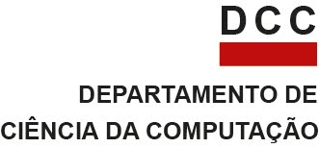


Algoritmo genético para planejamento de caminhos baseados em curvas de Bezier
Thiago Meireles Grabe
Trabalho Final de Robótica Móvel - 2018/2
Departamento de Ciência da Computação
Universidade Federal de Minas Gerais
Belo Horizonte – MG – Brasil

Slide 2
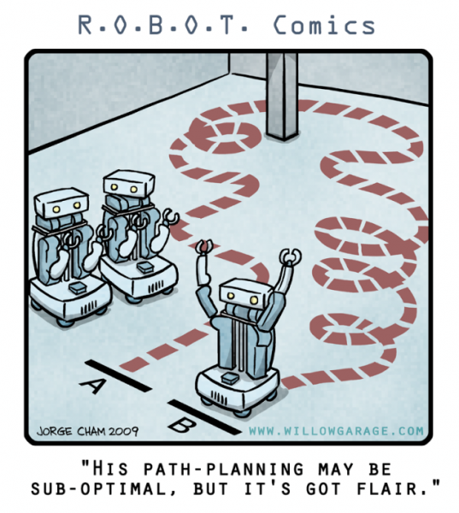
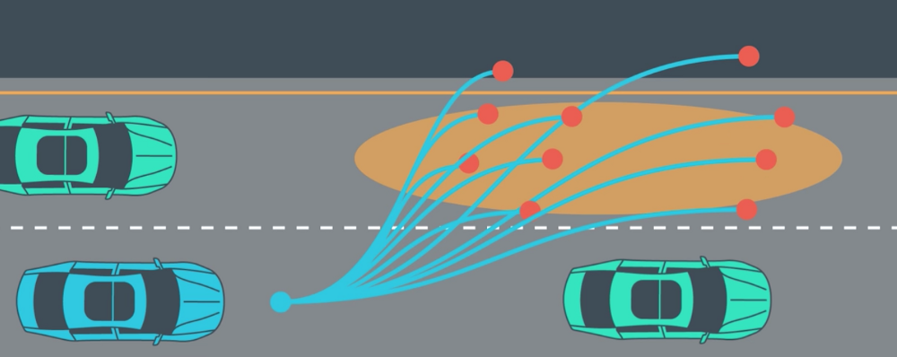
Introdução
Motivação
Planejamento de Trajetórias
Encontrar um conjunto de configurações VÁLIDAS para que o robô navegue de um ponto inicial a um ponto final.
Notes:
Path planning and trajectory tracking are two of the fundamental tasks when it comes to mobile robots
Can be studied as a two-step approach. First, plan a path from a start position to a goal position (path planning). Second, then track the created path (trajectory Tracking).
On image: robot represented as a ball. Red ball is robot’s initial position, green ball is the desired destination. Triangles are the planned path, green line (full and dashed) the tracked trajectory based on the triangle path.

Slide 3
Introdução
Motivação
Planejamento de Trajetórias
Encontrar um conjunto de configurações VÁLIDAS para que o robô navegue de um ponto inicial a um ponto final de forma eficiente!!!
Tempo de deliberação;
Contorno eficiente de obstáculos;
Caminho “suave”.
Notes:
Path planning and trajectory tracking are two of the fundamental tasks when it comes to mobile robots
Can be studied as a two-step approach. First, plan a path from a start position to a goal position (path planning). Second, then track the created path (trajectory Tracking).
On image: robot represented as a ball. Red ball is robot’s initial position, green ball is the desired destination. Triangles are the planned path, green line (full and dashed) the tracked trajectory based on the triangle path.

Slide 4
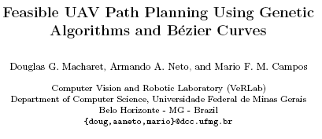
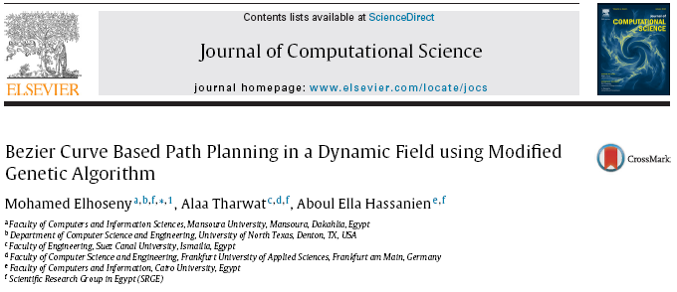
Introdução
Trabalhos Relacionados
Notes:
Path planning and trajectory tracking are two of the fundamental tasks when it comes to mobile robots
Can be studied as a two-step approach. First, plan a path from a start position to a goal position (path planning). Second, then track the created path (trajectory Tracking).
On image: robot represented as a ball. Red ball is robot’s initial position, green ball is the desired destination. Triangles are the planned path, green line (full and dashed) the tracked trajectory based on the triangle path.

Slide 5
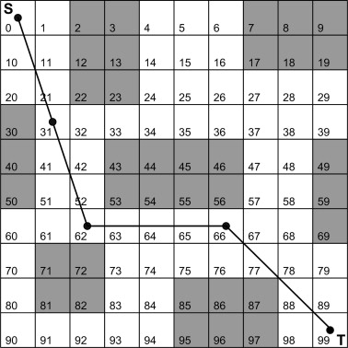
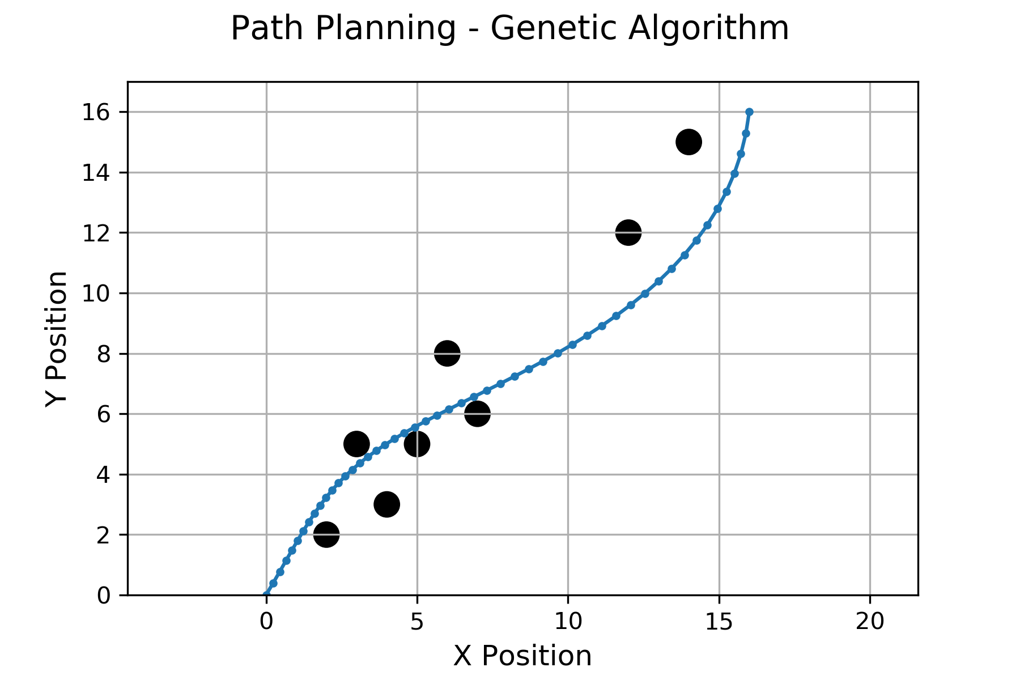
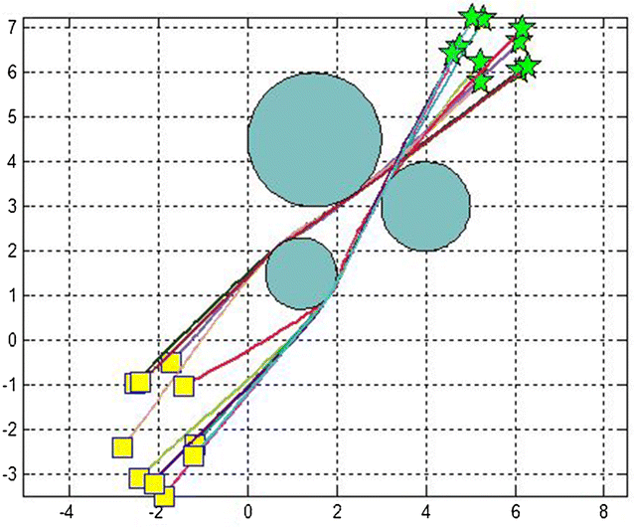
Introdução
Formulação do Problema
Dado um mapa e suas características (obstáculos), uma configuração inicial e final, qual caminho o robô deve seguir para ir de um ponto a outro de forma eficiente, sem mudanças bruscas de direção e sem colisão com obstáculos? É possível utilizar um algoritmo genético para planejar um caminho?
Notes:
Path planning and trajectory tracking are two of the fundamental tasks when it comes to mobile robots
Can be studied as a two-step approach. First, plan a path from a start position to a goal position (path planning). Second, then track the created path (trajectory Tracking).
On image: robot represented as a ball. Red ball is robot’s initial position, green ball is the desired destination. Triangles are the planned path, green line (full and dashed) the tracked trajectory based on the triangle path.

Slide 6
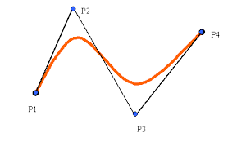
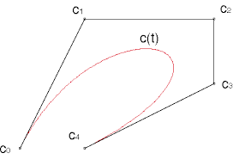
Metodologia
Curvas de Bezier
Curvas de Bezier são curvas paramétricas polinomiais no plano ou no espaço.
Utilizadas em modelagem tridimensional, animações, engenharia e arquitetura.
Notes:
Path planning and trajectory tracking are two of the fundamental tasks when it comes to mobile robots
Can be studied as a two-step approach. First, plan a path from a start position to a goal position (path planning). Second, then track the created path (trajectory Tracking).
On image: robot represented as a ball. Red ball is robot’s initial position, green ball is the desired destination. Triangles are the planned path, green line (full and dashed) the tracked trajectory based on the triangle path.

Slide 7
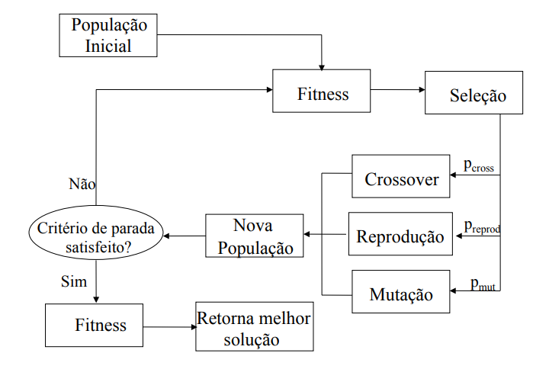
Metodologia
Algoritmo Genético
Algoritmo evolucionário de otimização e busca para diversos problemas.
São eficientes para busca de soluções ótimas ou quase ótimas.
Figura da disciplina Computação Natural – Gisele L. Pappa
Notes:
Path planning and trajectory tracking are two of the fundamental tasks when it comes to mobile robots
Can be studied as a two-step approach. First, plan a path from a start position to a goal position (path planning). Second, then track the created path (trajectory Tracking).
On image: robot represented as a ball. Red ball is robot’s initial position, green ball is the desired destination. Triangles are the planned path, green line (full and dashed) the tracked trajectory based on the triangle path.

Slide 8
Metodologia
Planejamento de trajetória
Como premissa principal, o mapa é conhecido bem como a posição do agente.
Os pontos inicial e final são, o primeiro e último ponto de controle, da curva de Bezier.
Os demais z pontos de controle são escolhidos aleatoriamente.
Curva de Bezier é definida e os n pontos que definem a curva são armazenados em um vetor (solução candidata).
Notes:
Path planning and trajectory tracking are two of the fundamental tasks when it comes to mobile robots
Can be studied as a two-step approach. First, plan a path from a start position to a goal position (path planning). Second, then track the created path (trajectory Tracking).
On image: robot represented as a ball. Red ball is robot’s initial position, green ball is the desired destination. Triangles are the planned path, green line (full and dashed) the tracked trajectory based on the triangle path.

Slide 9

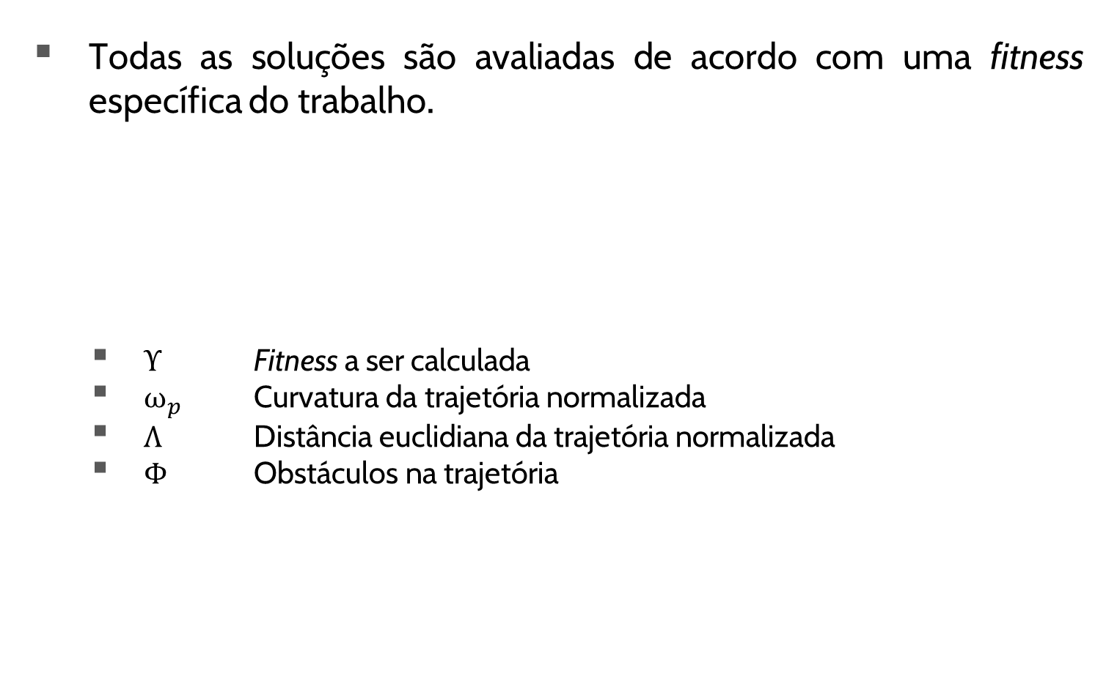
Metodologia
Planejamento de trajetória
Todas as soluções são avaliadas de acordo com uma fitness específica do trabalho.
ϒ Fitness a ser calculada
${\text{ω}}_{p}$ Curvatura da trajetória normalizada
$Λ$ Distância euclidiana da trajetória normalizada
Φ Obstáculos na trajetória
Notes:
Path planning and trajectory tracking are two of the fundamental tasks when it comes to mobile robots
Can be studied as a two-step approach. First, plan a path from a start position to a goal position (path planning). Second, then track the created path (trajectory Tracking).
On image: robot represented as a ball. Red ball is robot’s initial position, green ball is the desired destination. Triangles are the planned path, green line (full and dashed) the tracked trajectory based on the triangle path.

Slide 10
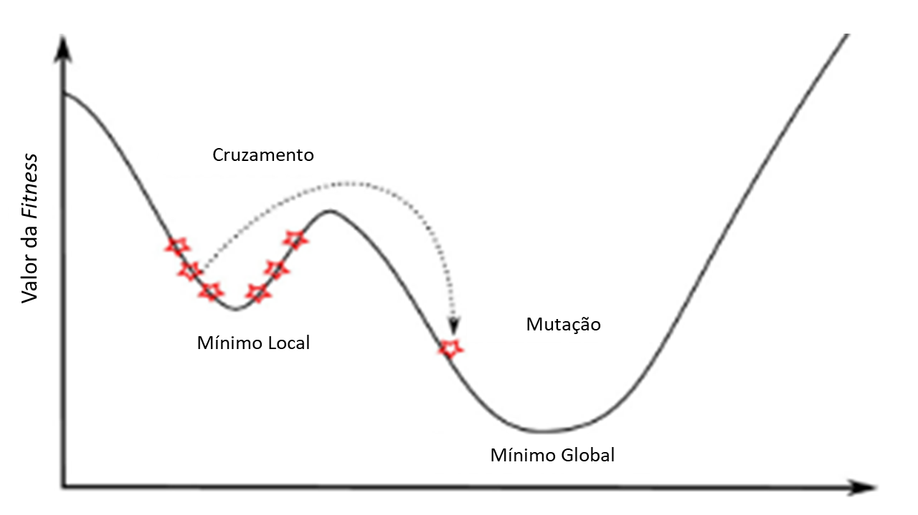
Metodologia
Planejamento de trajetória
Operadores genéticos elitistas são chamados dada uma devida probabilidade de ocorrência:
Mutação = 10%
Cruzamento = 90%
Mutação permite busca por todo o espaço de busca.
Cruzamento permite a convergência para um mínimo (local ou global).
Notes:
Path planning and trajectory tracking are two of the fundamental tasks when it comes to mobile robots
Can be studied as a two-step approach. First, plan a path from a start position to a goal position (path planning). Second, then track the created path (trajectory Tracking).
On image: robot represented as a ball. Red ball is robot’s initial position, green ball is the desired destination. Triangles are the planned path, green line (full and dashed) the tracked trajectory based on the triangle path.

Slide 11
Experimentos
Planejamento de Trajetórias
Parâmetros:
Número de Indivíduos
Número de Gerações
Quantidade de pontos de controle da curva de Bezier
Quantidade de configurações por trajetória
Probabilidade de mutação e cruzamento
Fitness mínima (elitismo)
Obstáculos
Número de Gerações
150
300
350
Notes:
Path planning and trajectory tracking are two of the fundamental tasks when it comes to mobile robots
Can be studied as a two-step approach. First, plan a path from a start position to a goal position (path planning). Second, then track the created path (trajectory Tracking).
On image: robot represented as a ball. Red ball is robot’s initial position, green ball is the desired destination. Triangles are the planned path, green line (full and dashed) the tracked trajectory based on the triangle path.

Slide 12
Resultados
Planejamento de Trajetórias
Notes:
Path planning and trajectory tracking are two of the fundamental tasks when it comes to mobile robots
Can be studied as a two-step approach. First, plan a path from a start position to a goal position (path planning). Second, then track the created path (trajectory Tracking).
On image: robot represented as a ball. Red ball is robot’s initial position, green ball is the desired destination. Triangles are the planned path, green line (full and dashed) the tracked trajectory based on the triangle path.

Slide 13
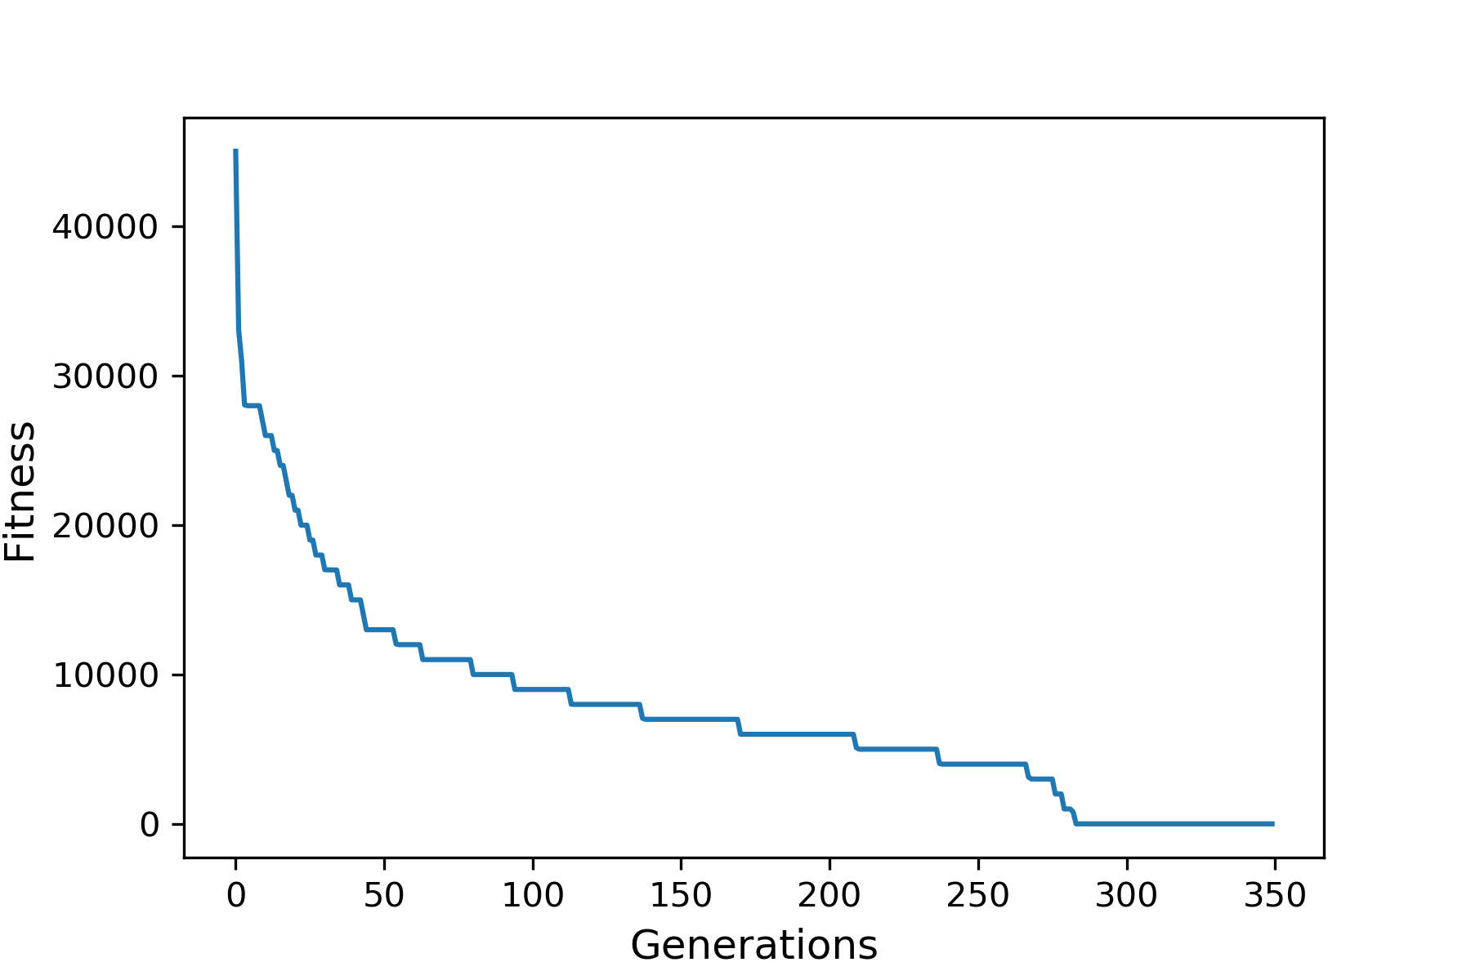
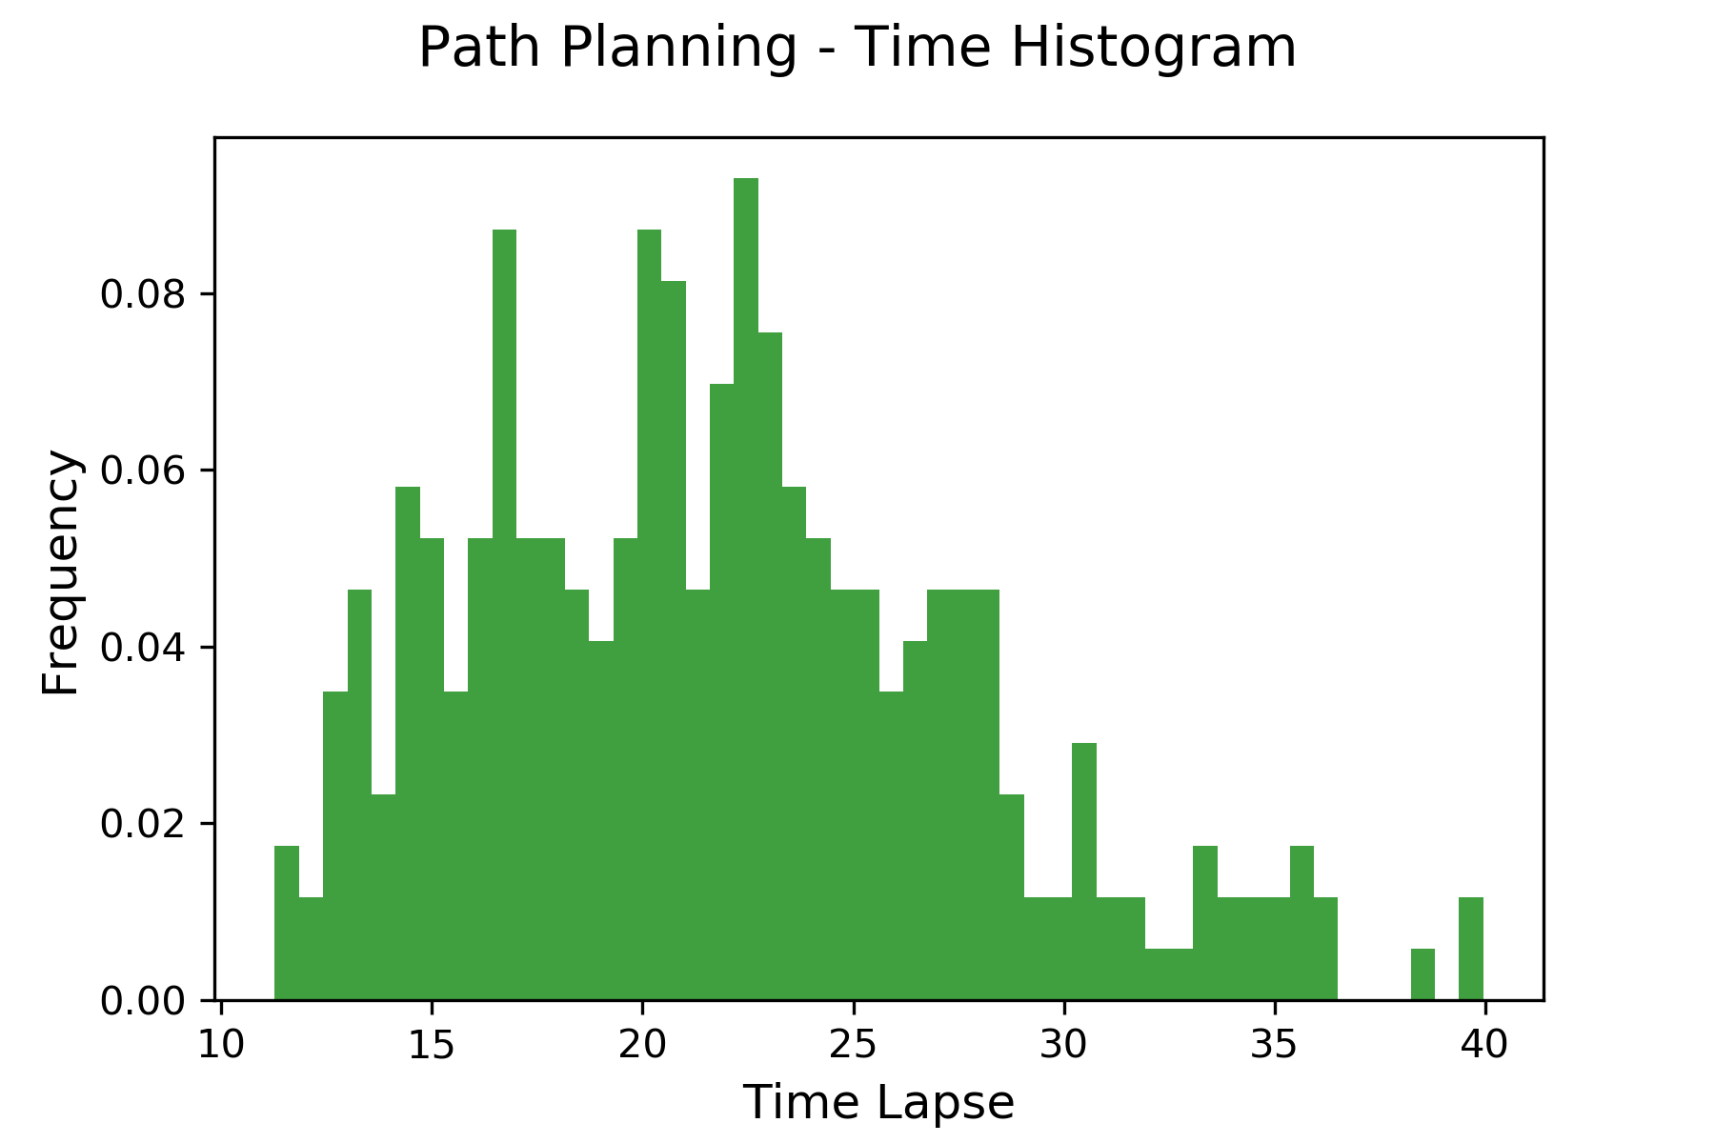
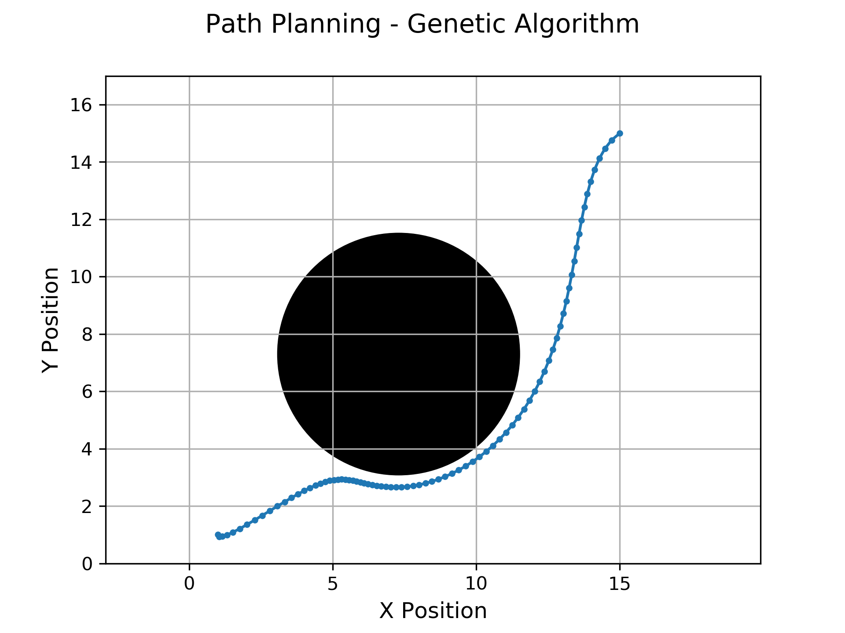
Resultados
Planejamento de Trajetórias
Notes:
Path planning and trajectory tracking are two of the fundamental tasks when it comes to mobile robots
Can be studied as a two-step approach. First, plan a path from a start position to a goal position (path planning). Second, then track the created path (trajectory Tracking).
On image: robot represented as a ball. Red ball is robot’s initial position, green ball is the desired destination. Triangles are the planned path, green line (full and dashed) the tracked trajectory based on the triangle path.

Slide 14
Conclusões
Trabalho Final – Robótica Móvel
Paradigma robótico hierárquico
Algoritmo genético utilizando cruzamento e mutação como operadores genéticos apresentou soluções válidas
Planejamento de caminho é feito pelo método proposto
Elitismo causa problemas de mínimos locais
Ajuste de parâmetros de forma empírica (esperado)
Notes:
Path planning and trajectory tracking are two of the fundamental tasks when it comes to mobile robots
Can be studied as a two-step approach. First, plan a path from a start position to a goal position (path planning). Second, then track the created path (trajectory Tracking).
On image: robot represented as a ball. Red ball is robot’s initial position, green ball is the desired destination. Triangles are the planned path, green line (full and dashed) the tracked trajectory based on the triangle path.

Slide 15
Conclusões
Trabalhos Futuros
Controlar elitismo para explorar melhor espaço de busca
Aprimorar a função de fitness
Ajuste de parâmetros para diversos mapas ou conjunto de mapas
Melhorar tempo de deliberação
Implementação para robôs diferenciais
Notes:
Path planning and trajectory tracking are two of the fundamental tasks when it comes to mobile robots
Can be studied as a two-step approach. First, plan a path from a start position to a goal position (path planning). Second, then track the created path (trajectory Tracking).
On image: robot represented as a ball. Red ball is robot’s initial position, green ball is the desired destination. Triangles are the planned path, green line (full and dashed) the tracked trajectory based on the triangle path.

Slide 16


Obrigado!
Thiago Meireles Grabe
thiago.grabe@dcc.ufmg.br

