Slide 1
Next-Day Weather Prediction for Macau
t+1
CSAI3121 · GROUP PROJECT
Forecasting tomorrow's temperature and weather condition with machine learning
Thiago Honorato Ferreira · Marcelo Oliveira Volpato · João Vitor Konrad
Macao Polytechnic University · November 2026
Notes:
Presenter: Thiago. Introduce the team and the goal: predict tomorrow's maximum and minimum temperature and tomorrow's weather condition in Macau, using only information available today. Suggested split: Thiago slides 1-4, Marcelo 5-8, João 9-11.

Slide 2
Two tasks, one day ahead
PROBLEM AND DATA
01
Regression
Data source
15
4,383
Tomorrow's maximum and minimum temperature (°C), one model each
→
Metric: MAE
days in the suggested Visual Crossing file: a forecast, not history
days of ERA5 history from Open-Meteo, 2014–2025
02
Classification
Tomorrow's condition: Clear, Partly Cloudy, Cloudy or Rain
Same 18 columns as the Visual Crossing file
Quality audit with physical rules: 0 issues
Windiest days match real typhoons
Metric: Macro F1
Notes:
The specification recommends Visual Crossing, but the downloaded file had only 15 rows with future dates: it was the default 15-day forecast. We downloaded 12 years of daily ERA5 reanalysis from Open-Meteo instead and mapped it to the same column names, so the code works with either source. The quality audit found no duplicates, gaps or impossible values, so no cleaning step was needed. Extreme gusts were kept because they are real typhoons such as Mangkhut and Hato.

Slide 3
How the code is organised
METHOD
01
02
03
04
05
06
07
Data
Quality
EDA
Features
Split
Models
Test
weather_prediction_macau.ipynb
weather_utils.py
The analysis step by step, with an interpretation after each result
About 470 lines; runs end to end with Restart & Run All
Fixed seed: every run reproduces the same tables
Data: download, format conversion, coverage check
Quality and 76 features
9 regressors, 8 classifiers, grids, ensemble
Metrics and block bootstrap
Notes:
The notebook only shows the analysis steps; all reusable functions live in weather_utils.py, grouped into data, quality, features, models and evaluation. The pipeline goes from data collection to a single final test. Every refactoring was checked by comparing the result tables before and after, which had to stay identical.

Slide 4
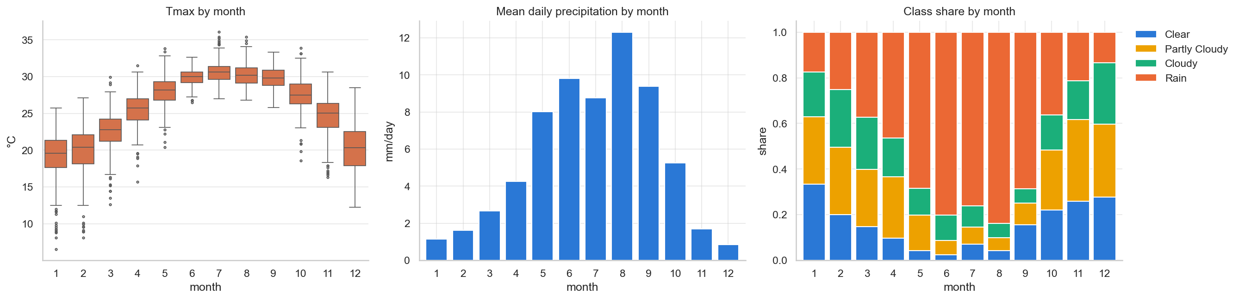
Strong memory and strong seasons
EXPLORATORY ANALYSIS
0.93
>69%
48%
lag-1 autocorrelation of Tmax: persistence is a hard baseline
of days are rainy from May to September
of all days are Rain, so we use macro F1 instead of accuracy
Notes:
Three findings shaped the modelling. Temperature changes slowly: today's maximum correlates 0.93 with tomorrow's, so simply repeating today is already a strong forecast. There is a strong annual cycle, with rain dominating the summer monsoon, which motivates seasonal features. And the classes are imbalanced, with Rain on 48% of days, so we use macro F1 rather than accuracy.

Slide 5
76 features, all built from day t or earlier
FEATURE ENGINEERING
14
20
5
24
Today's values
Lags
Differences
Rolling statistics
current state of the atmosphere
t−1 and t−2: warming or cooling?
1-day and 3-day changes
3, 7 and 14-day windows
3
4
2
4
Physical
Seasonality
Wind direction
Today's class
diurnal range, dew-point depression
sine and cosine of day and month
sine and cosine, so 359° ≈ 1°
one-hot persistence
Leakage checks pass: target(t) equals Tmax(t+1) in 100% of rows, and no feature copies the target (max |r| = 0.939).
Notes:
Presenter: Marcelo. To predict tomorrow we may only use what is known at the end of today. Lags and differences capture the trend, rolling means the recent regime, sine and cosine encodings the season, and today's class gives the classifier persistence. Automatic checks confirm there is no leakage. The day of the week was tested and dropped because it varies Tmax by less than 0.2 °C.

Slide 6
Evaluation respects time
EVALUATION
Train
Validation
Test
2014–2021 · 2,892 days
2022–23 · 730 days
2024–25 · 731 days
Grid search over five time-ordered folds
Split by the date being predicted: no future label reaches training
A shuffled k-fold would train on the future and inflate scores
Final model chosen on validation, then tested once
7-day block bootstrap tests significance
fit on the past score the next period
Notes:
Training uses 2014 to 2021, validation 2022 to 2023 and test 2024 to 2025, split by the date being predicted. Hyperparameters are tuned with a grid search over five time-ordered folds: each fold fits on the past and scores the period after it, with a one-day gap. The test set is used exactly once, and a block bootstrap tells us whether differences against persistence are real.

Slide 7
Nine regressors: the top three are within 0.002 °C
RESULTS · REGRESSION
Validation MAE for tomorrow's Tmax (°C) · axis starts at 0.9
Linear ≈ boosting
Gradient boosting
1.032
Ridge trains in milliseconds, gradient boosting in about 6 s.
Ridge
1.033
Linear regression
1.034
Extra trees
1.048
Tuning: no gain
Lasso
1.049
Grid search moved MAE from 1.032 to 1.035 °C.
Hist. gradient boosting
1.054
Random forest
1.058
Top-3 average wins
SVR
1.139
Boosting + Ridge + linear regression: 1.011 °C.
KNN
1.217
Persistence
1.244
Notes:
We compared nine regressors; the axis starts at 0.9 °C to make the differences visible. Gradient boosting, Ridge and plain linear regression are practically tied, which tells us the relation is close to linear once the features are good. Grid search did not improve the best model, but averaging the three best models, which mix boosted trees with linear models, lowered validation MAE to 1.011 °C. The same procedure for Tmin selected an ensemble of three tree models.

Slide 8
19% and 11% less error than persistence
RESULTS · TEST SET 2024–2025
1.22 °C
0.99 °C
Tmax test MAE by season (°C)
1.91
Tmax MAE, vs 1.51 °C for persistence
Tmin MAE, vs 1.11 °C for persistence
1.43
1.10
0.97
Both gains are statistically significant
95% CI of the MAE reduction: [0.21, 0.36] °C for Tmax and [0.07, 0.17] °C for Tmin. The model still smooths extremes, so the largest misses fall on the sharpest changes.
Winter (Nov–Mar)
Summer (May–Sep)
Persistence
Final model
Notes:
On the 2024-2025 test set the ensemble cuts the error by 19% for the maximum and 11% for the minimum, and the bootstrap intervals exclude zero, so the gains are real. Most of the improvement is in winter, when cold fronts cause sudden drops: the error for Tmax goes from 1.91 to 1.43 °C. In summer the weather is stable and persistence is already good.

Slide 9
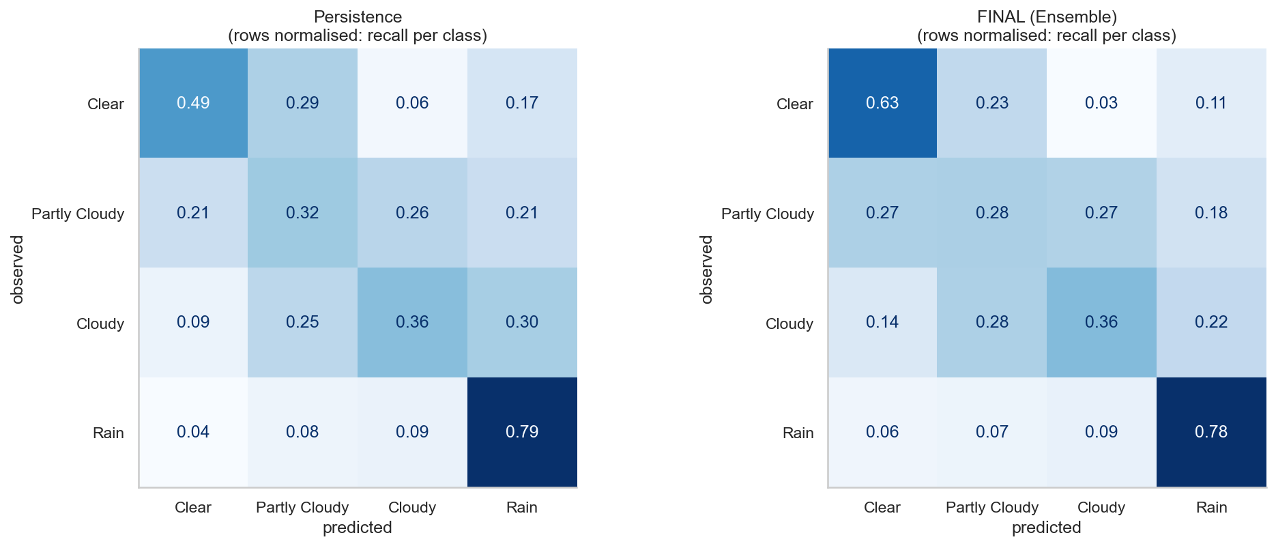
Close to persistence, but useful rain odds
RESULTS · CLASSIFICATION
0.501
0.88
macro F1 on test, vs 0.489 for persistence (not significant)
ROC AUC of the rain probability
Rain is predicted well (F1 0.81)
The three dry classes are split by cloud thresholds and get confused
Recall of Clear rises from 0.49 to 0.63
Brier score 37% better than climatology
Row-normalised test confusion matrices: persistence (left), final ensemble (right)
Notes:
Presenter: João. For the four-class problem the soft-voting ensemble of extra trees, random forest and logistic regression reaches a macro F1 of 0.501 against 0.489 for persistence, but the bootstrap interval includes zero, so we do not claim an improvement. Rain is easy; the three dry classes are separated by arbitrary cloud thresholds and get mixed up. Where the model does help is the probability of rain: AUC 0.88 and a Brier score 37% better than climatology.

Slide 10
What made the difference
DISCUSSION
01
Model diversity
Limitations and responsible use
Gradient boosting and extra trees were not in our first three models, yet won. Tmax test MAE: 1.27 → 1.22 °C.
One grid point: approaching typhoons and fronts are invisible
Classes depend on our thresholds (1 mm, 30%, 70%)
Only two test years
Always report uncertainty (about ±1 °C, rain as a probability)
Never a substitute for SMG warnings
02
Ensembles over tuning
Averaging different families helped; grid search barely moved the scores.
03
Features carry the signal
Today's values, rolling means and seasonality dominate the importance.
Notes:
Three lessons: comparing many model families mattered more than tuning, averaging different families helped, and the features did the heavy lifting. The main limitation is that we look at a single grid point, so systems approaching from elsewhere are invisible. The model should always be presented with its uncertainty and never replace official SMG warnings.

Slide 11
Good features and diverse models beat complexity
CONCLUSION
A simple baseline is hard to beat in daily weather. We beat it clearly for temperature and report honestly where we did not.
−19%
−11%
0.88
Questions?
Tmax error
Tmin error
rain AUC
Notes:
To conclude: with careful features and a wide model comparison we reduced temperature errors by 11 to 19 percent with statistical significance, while the four-class condition stayed close to persistence. Next steps would be adding neighbouring stations and hourly data, and producing probabilistic forecasts. Thank you; we are happy to take questions.

