Slide 1
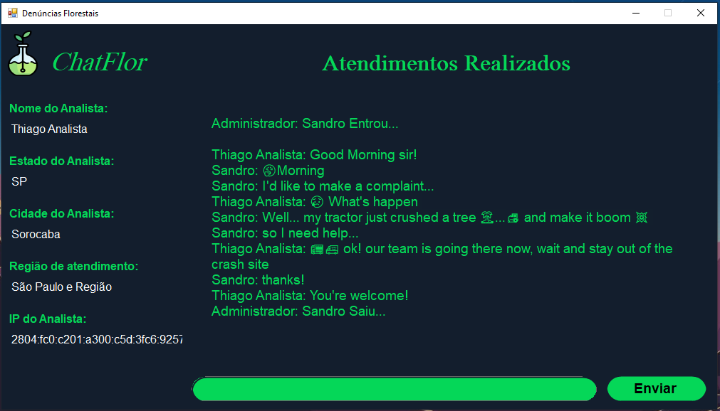
Good Morning!

Slide 2
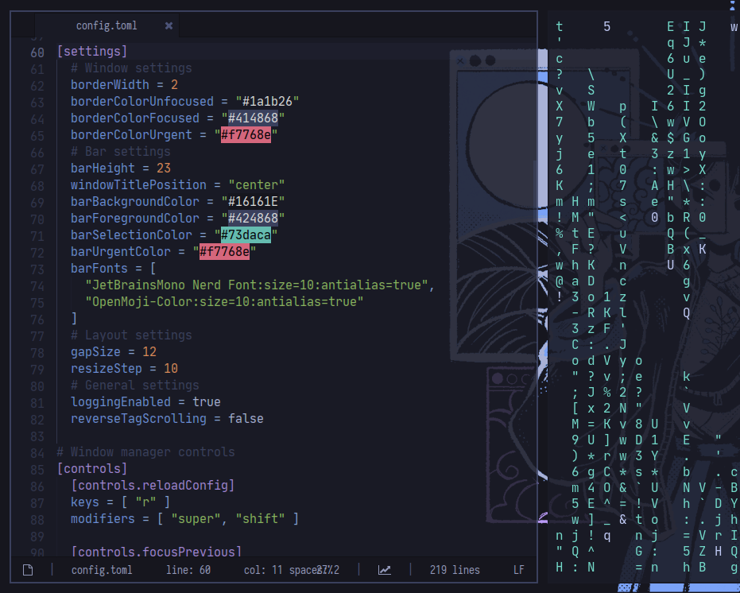
Programmers or developers are people who make software.
Software is a set of instructions, data or programs used to operate computers and execute specific tasks
Software development covers several areas, for example: Web development, Game development, Desktop development
What is Programming

Slide 3

Environmental sustainability is the responsibility to conserve natural resources and protect global ecosystems to support health and wellbeing, now and in the future.
Environmental Sustainability

Slide 4

The Project name is ChatFlor
The design of this project is about scenarios where the employee cannot use any means of communication like a smartphone in the factory or any place where the smartphone is restricted.
if each sector of the factory has a token (computer for sector use) then this software will be installed on it and there will be another token in the admin sector where the analyst can talk and solve the whistleblower's problem
About the Project

Slide 5
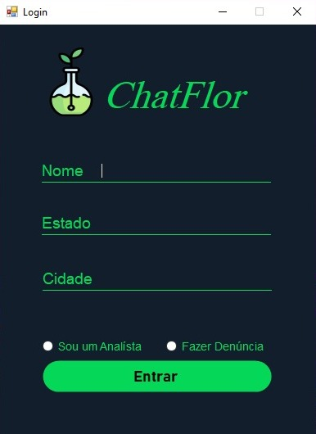
The Login chat was design to be friendly and responsable as possible for the user experience
The logo of the Project is on this screen
Login Chat is for the user to put his name, state and city, then check if he is an analyst or a whistleblower
Login Chat

Slide 6
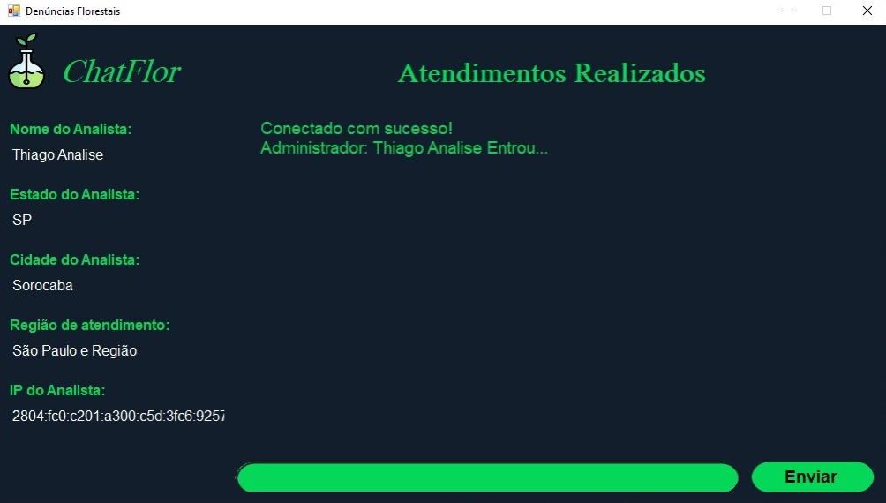
The Analyst chat was design to be friendly and responsable as possible for the user experience
The logo of the Project is on this screen
The Analyst Chat is for the Analyst to view the whistleblower's message log and respond by resolving their issue or just chat.
Analyst Chat

Slide 7
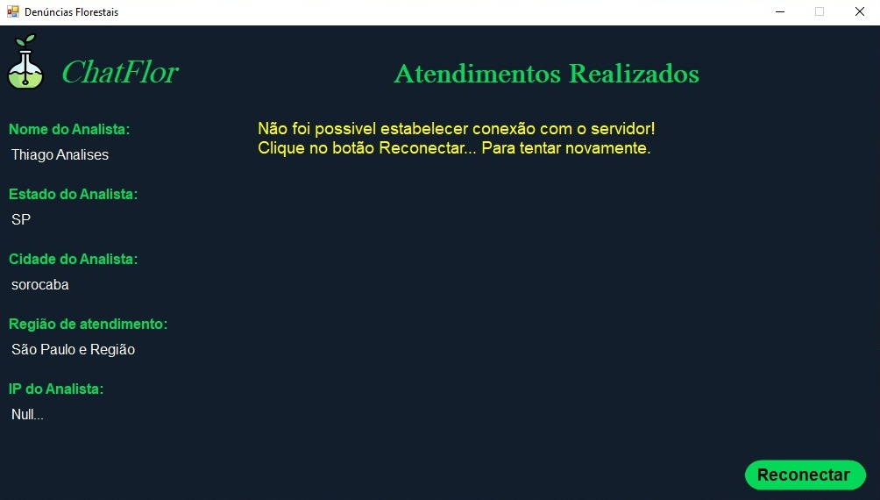
The Analyst chat was design to be friendly and responsable as possible for the user experience
The logo of the Project is on this screen
If the Server is disconnected the Analyst chat will show a message and the entire chat log will be yellow
Analyst Chat

Slide 8
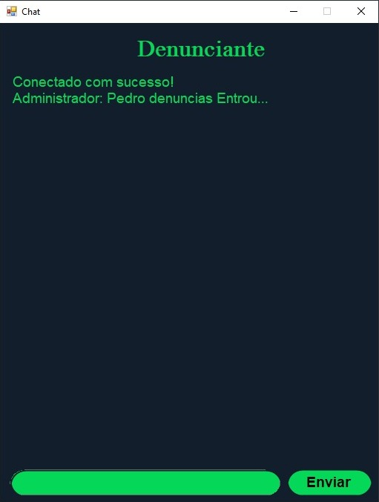
The Whistleblower chat was design to be friendly and responsable as possible for the user experience
There is a Label to show us that this chat is the whistleblower chat
Whistleblower Chat is for viewing the Analyst message log and writing about your problem or just chatting.
Whistleblower Chat

Slide 9
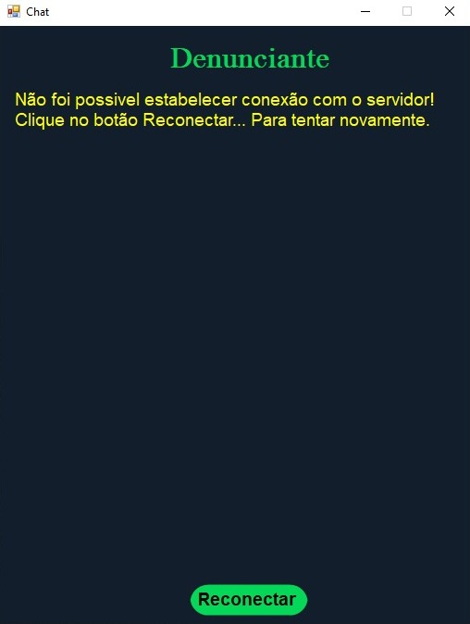
The Whistleblower chat was design to be friendly and responsable as possible for the user experience
There is a Label to show us that this chat is the whistleblower chat
If the Server is disconnected the Whistleblower chat will show a message and the entire chat log will be yellow
Whistleblower Chat

Slide 10
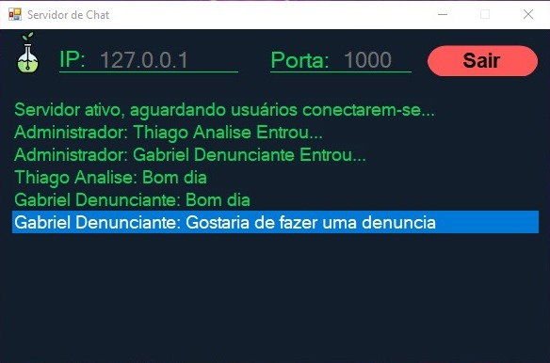
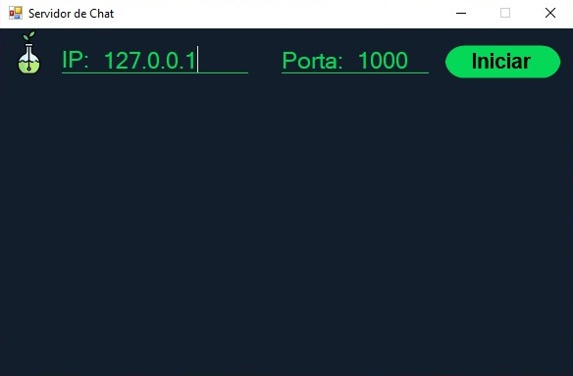
Server Chat

Slide 11
This Project is about a solution of a real problem where the employee cannot use any means of communication like a smartphone in the factory or any place where the smartphone is restricted.
It is important to mention that this project has not been tested in production, it is completely academic.
NET SUPORT. REDE DE COMPUTADORES: DEFINIÇÃO E TIPOS. CRT-RJ. Rio de Janeiro, 2021. Disponível em: https://www.crtrj.gov.br/rede-de-computadoresdefinicao-e-tipos/. Acesso em: 17 abr. 2022.
LIMA, Eugenio . C# E .Net: Guia Do Desenvolvedor. 1 ed. Rio de Janeiro: Campus, 2002. 358 p.
DEVMEDIA. Linguagem C#: Introdução ao C#. DevMedia. Disponível em: https://www.devmedia.com.br/guia/linguagem-csharp/38152. Acesso em: 8 abr. 2022.
NET SUPORT. REDE DE COMPUTADORES: DEFINIÇÃO E TIPOS. CRT-RJ. Rio de Janeiro, 2021. Disponível em: https://www.crtrj.gov.br/rede-de-computadoresdefinicao-e-tipos/. Acesso em: 17 abr. 2022.
Conclusion and References

Slide 12
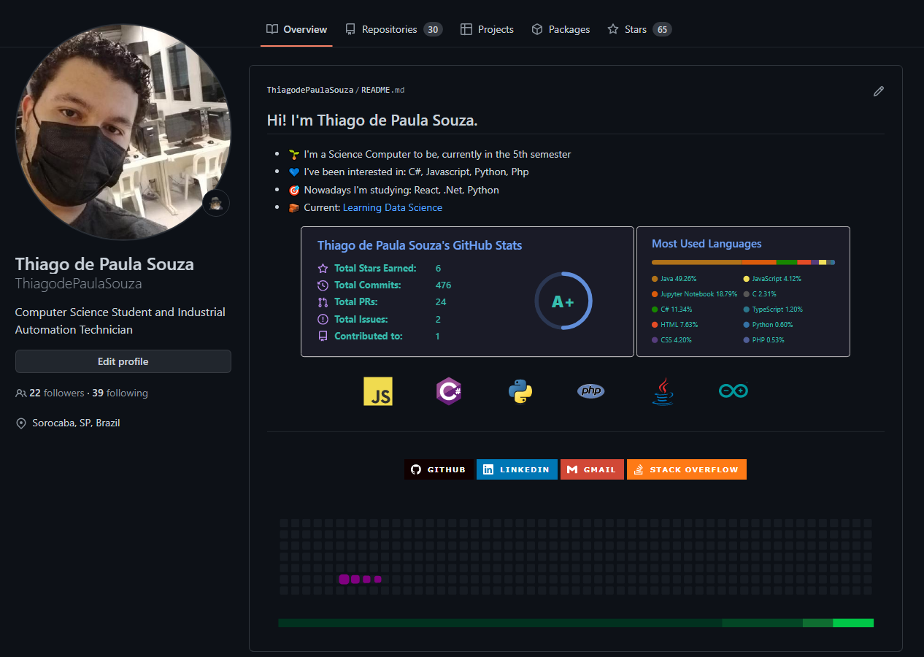
Thank you!!!

