Slide 1
Data
Test Sample Size
Train
Test
Time

Slide 2
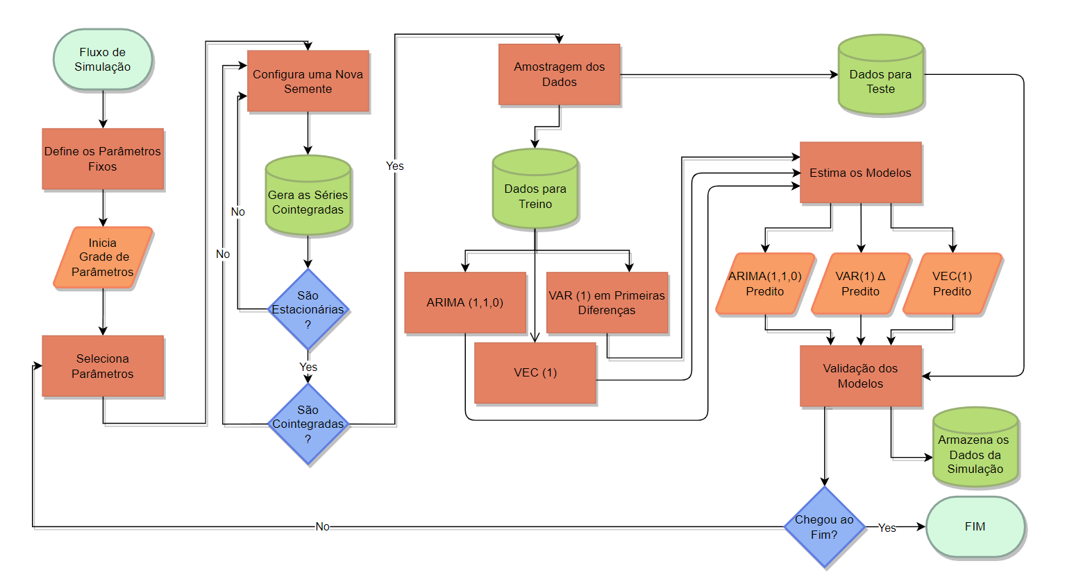
ARIMA(p,d,q)
predito
Δ VAR(p)
predito
VEC(p)
predito
ARIMA(p,d,q)
Δ VAR(p)
VEC (p)

Slide 3
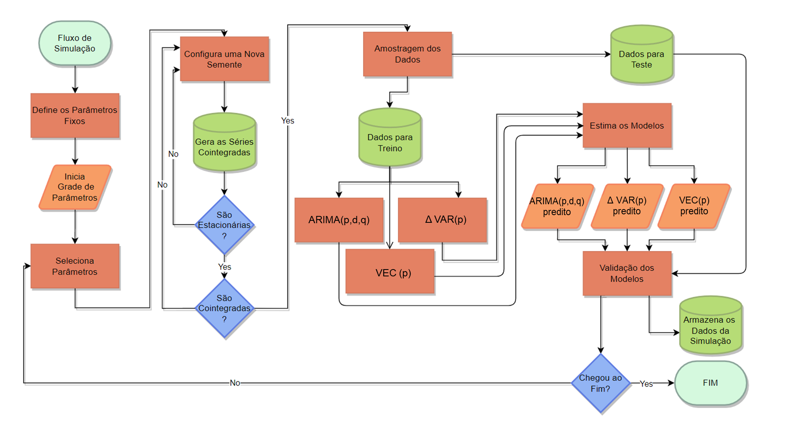

Slide 4
https://online.visual-paradigm.com/w/qkjbwiqj/diagrams/#diagram:workspace=qkjbwiqj&proj=0&id=1

