Slide 1
Method of Finite Elements I Shear locking and Hourglassing
Konstantinos Vlachas
Institute of Structural Engineering (IBK)
Department of Civil, Environmental, and Geomatic Engineering (DBAUG)
ETH Zürich

Slide 2
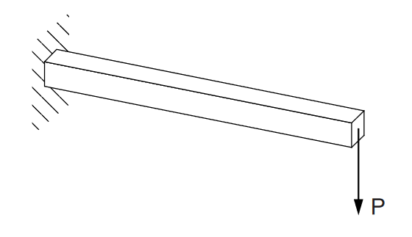
Problem Setting
Cantilever beam under a point load at its free end.
Classic test to assess the influence of : - the order of the element - the element formulation - the level of integration
Source: Abaqus Documentation

Slide 3
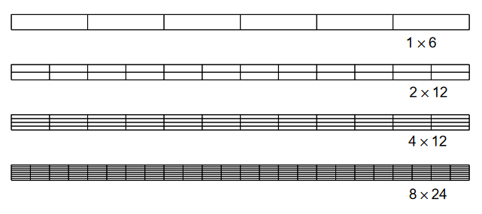
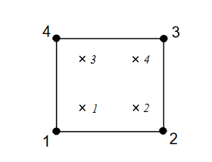
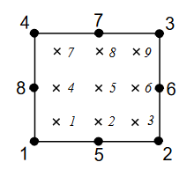
Discretization & Element Formulation
Four different mesh densities
Linear & Quadratic elements

Slide 4
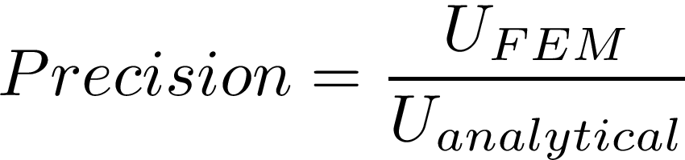
Normalized Results
Linear elements underestimate deflection and are unusable
Finer meshes do not improve accuracy
It makes no difference how many elements are through the thickness of the beam
Element | Mesh Density (Depth × Length)
 | 1 × 6 | 2 × 12 | 4 × 12 | 8 × 24
Linear shell | 0.074 | 0.242 | 0.242 | 0.561
Quadratic shell | 0.994 | 1.000 | 1.000 | 1.000
Linear solid | 0.077 | 0.248 | 0.243 | 0.563
Quadratic solid | 0.994 | 1.000 | 1.000 | 1.000

Slide 5
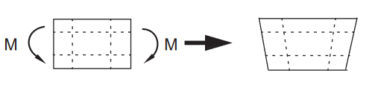
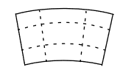
Shear Locking in linear elements
instead of
At the Gauss integration points, the angle has changed, which indicates shear stress
This is incorrect: In pure bending, shear stresses should be zero
This spurious shear stress arises because the edges of the element cannot curve.
The strain energy creates shear deformations rather than the intended bending ones
So, the total deflections are underestimated => the element is too stiff

Slide 6
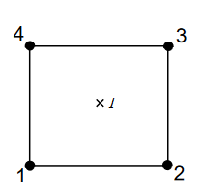
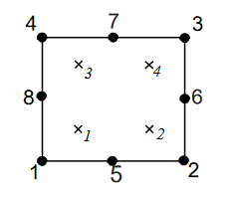
What to do
Shear locking only affects the fully integrated, linear elements subjected to bending
Shear locking is not a problem for quadratic elements since their edges are able to curve
Use fully integrated, linear elements when the loads produce minimal bending
Use a different element type if you have doubts
Fully integrated, quadratic elements can also lock under complex stress states. However, they are very useful for modeling areas where there are local stress concentrations.
Consider using Reduced Integration elements

Slide 7
Normalized Results (Reduced Integration)
Cases *: no stiffness to resist the applied load
Case **: Two elements through width are needed
Linear reduced-integration elements tend to be too flexible due to hourglassing.
Element (with reduced int.) | Mesh Density (Depth × Length)
 | 1 × 6 | 2 × 12 | 4 × 12 | 8 × 24
Linear shell | 20.3* | 1.308 | 1.051 | 1.012
Quadratic shell | 1.000 | 1.000 | 1.000 | 1.000
Linear solid | 70.1* | 1.323 | 1.063 | 1.015
Quadratic solid | 0.994** | 1.000 | 1.000 | 1.000

Slide 8
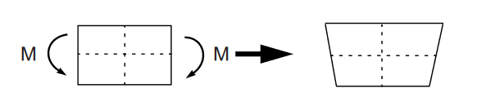
Hourglassing
The dotted visualization lines through the Gauss point, do not change in length
This means that all stress components are zero!
This bending mode is thus a zero-energy mode because no strain energy is generated
The element is unable to resist this type of deformation since it has no stiffness
In a coarse mesh, this zero-energy mode can propagate, producing meaningless results.
Here, at least four elements should be used through the thickness
Quadratic reduced-integration elements are not susceptible to locking and are generally the best choice (except in large-displacement, high-distortion simulations)
Notes:
Compare hourglassing energy to total or internal energy, should be around 5% not more + manual inspection
Eg abaqus -> ALLAE is the total energy dissipated as artificial strain energy

Slide 9
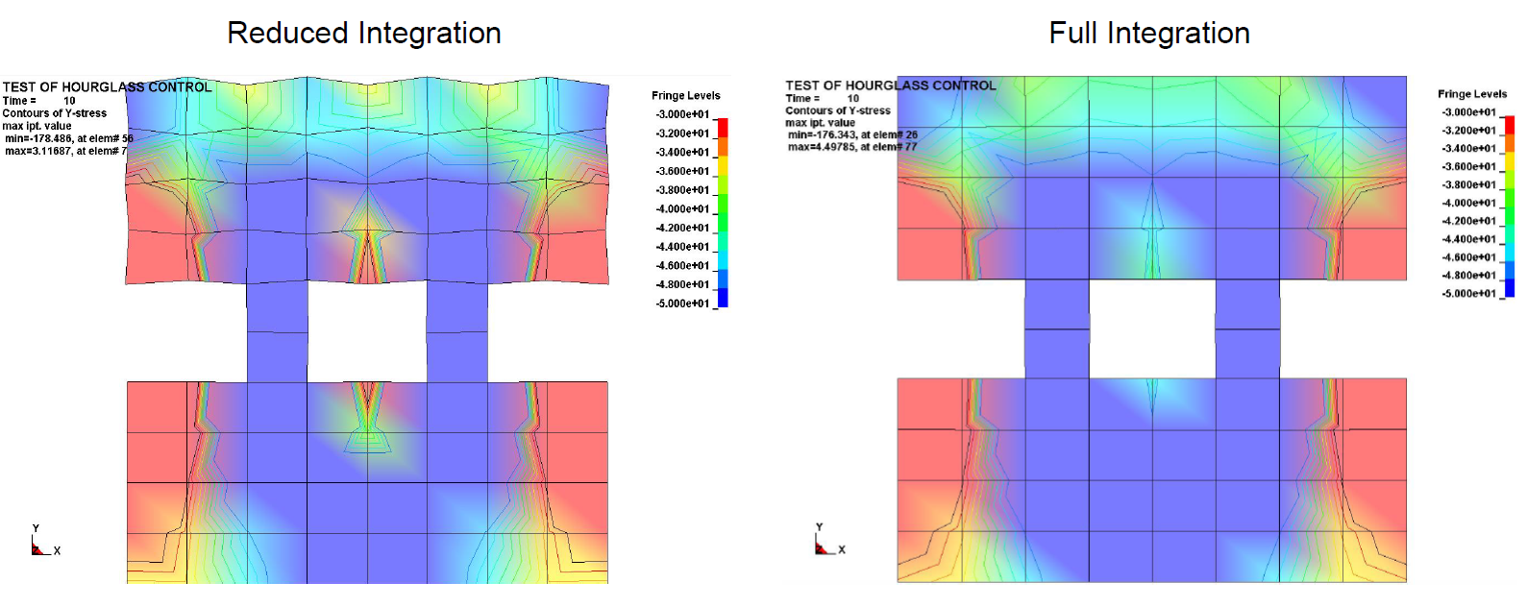
Hourglassing - Examples
Source: Applied Finite Element Analysis, ETHZ

Slide 10
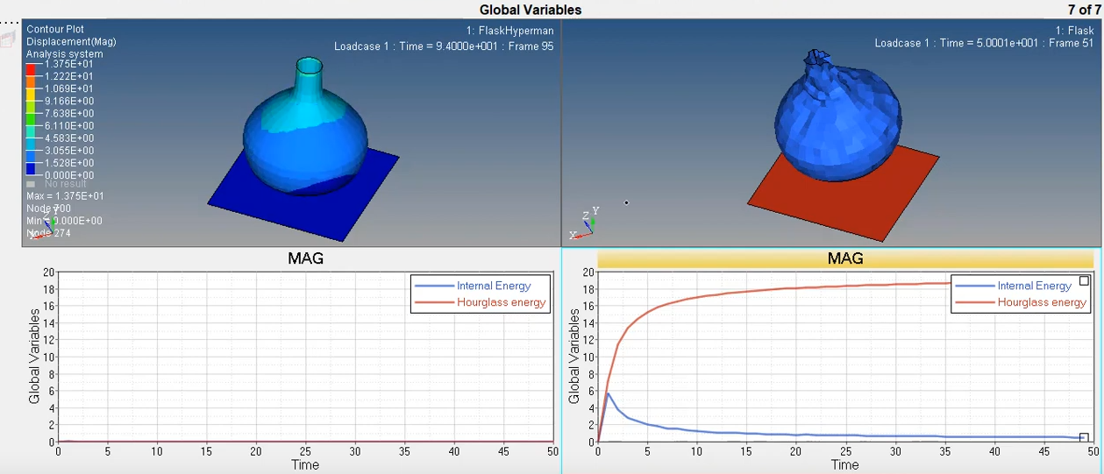
Hourglassing - Examples
Source: Youtube

Slide 11
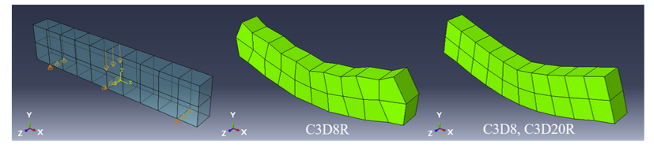
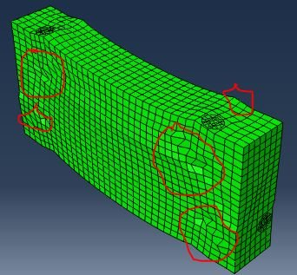
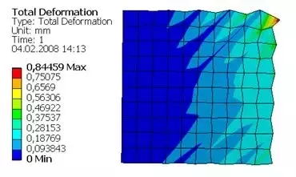
Hourglassing - Examples

