Slide 1
Method of Finite Elements I TRI vs QUAD case study
Konstantinos Vlachas
Institute of Structural Engineering (IBK)
Department of Civil, Environmental, and Geomatic Engineering (DBAUG)
ETH Zürich

Slide 2
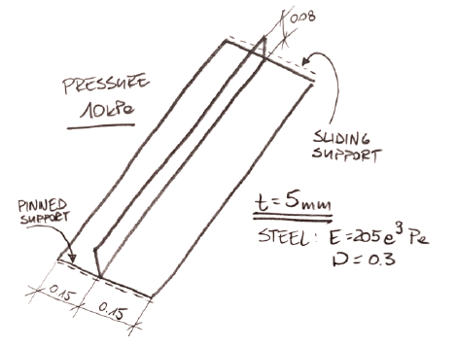
Problem Setting
Plate in bending with a single stiffener on top.
Model that may be susceptible to shear locking (thanks to a stiffener).
Mesh with four different element types, with element size kept consistent for comparison
Compute deformations and stress
Evaluate buckling capacity
Source: Enterfea

Slide 3
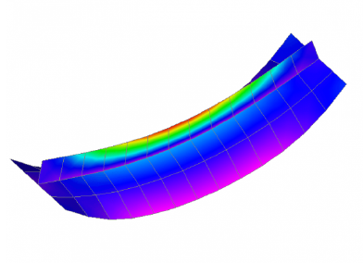

Maximal von Mises stress in the middle of the stiffener
Mesh of four-noded QUADs
Mesh of three-noded TRIs

Slide 4
Maximal von Mises stress in the middle of the stiffener

Slide 5
Vertical Displacement in the stiffener middle span [mm]

Slide 6
Eigenvalue analysis

Slide 7
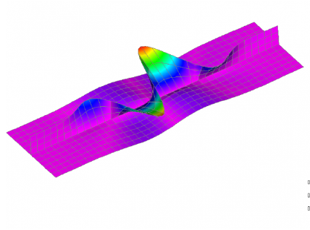
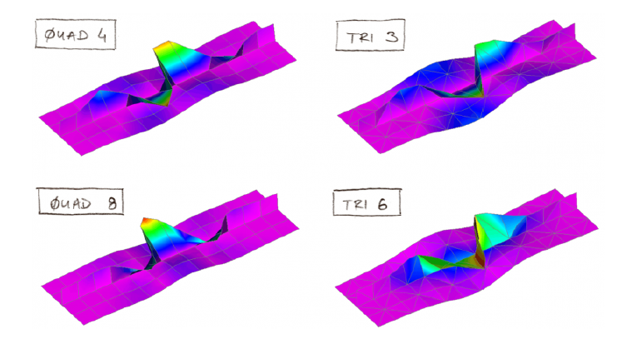
Eigenvalue analysis
First eigenvalue (QUAD8, 3 elements on stiff. height)
First eigenvalue (1 element on stiff. height)

Slide 8
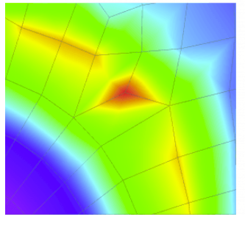
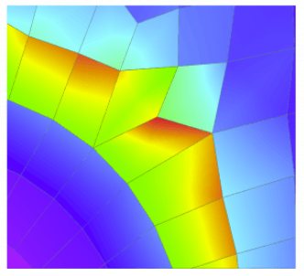
Node Averaging
The stresses computed in element-by-element fashion will generally exhibit jumps between elements.
It is usually convenient to “smooth out” those jumps by computing averaged nodal stresses. This averaging may be done in two ways:
Unweighted averaging: assign same weight to all elements that meet at a node;
Weighted averaging: the weight assigned to element contributions depends on the stress component and the element geometry and possibly the element type.
Stresses visualization (with post-processing)
Stress visualization (without node averaging)

Slide 9
Learning Outcomes
Main differences between elements & how we study these differences.
Constant or Linear Strain Triangles are infamous for good reason.
QUAD elements are usually a good choice
Strongly encouraged to use similar case studies for your problems
Take mesh complexity, computational time & convergence speed into account!

