Slide 1




Stability of recombination hotspots and mutation load
Thibault Joseph
Julien Latrille
Team meeting 11/02/2022
Le Cross-over

Slide 2
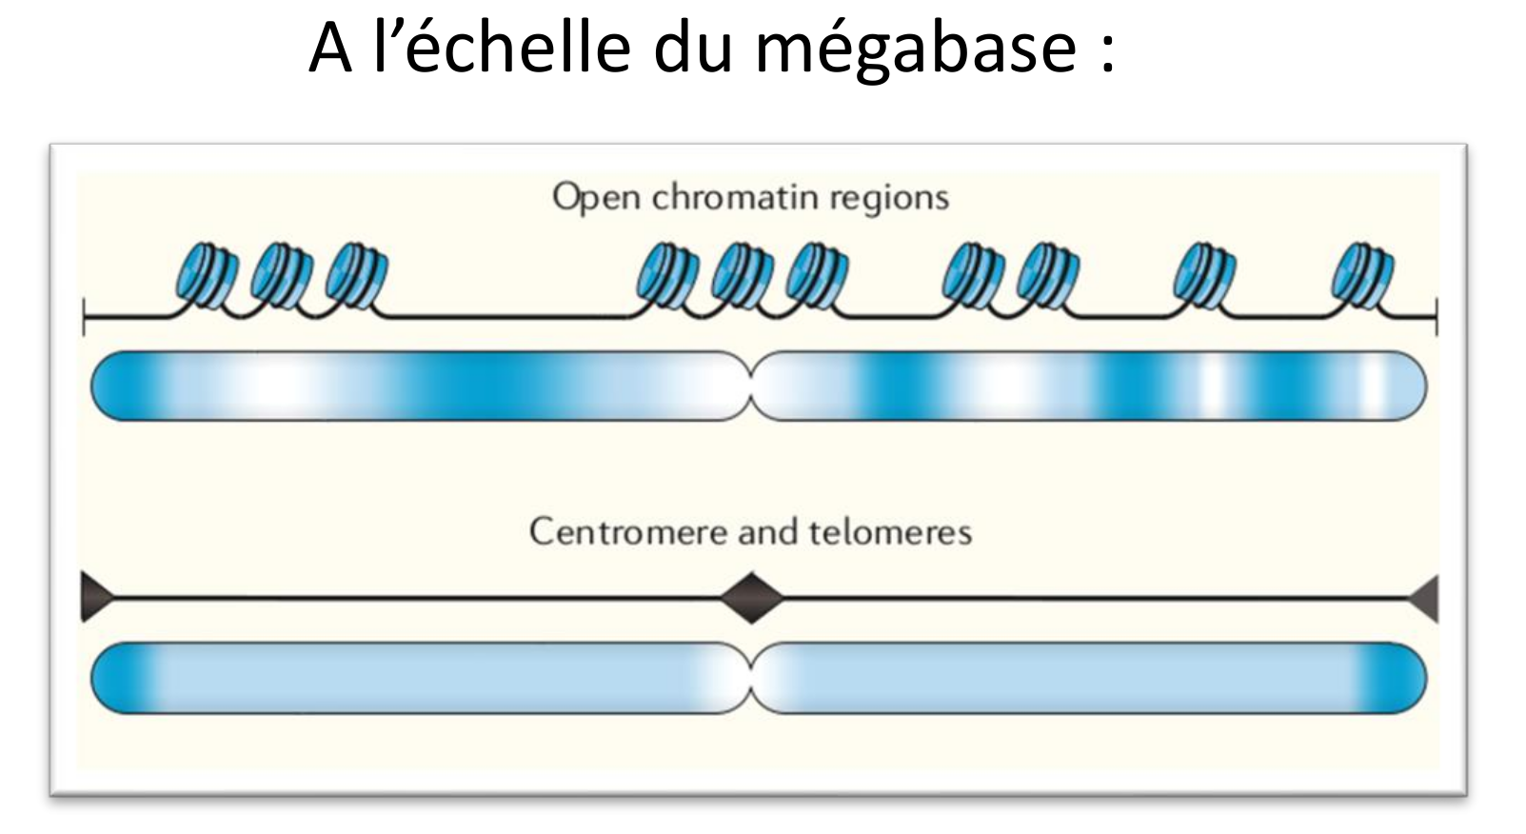
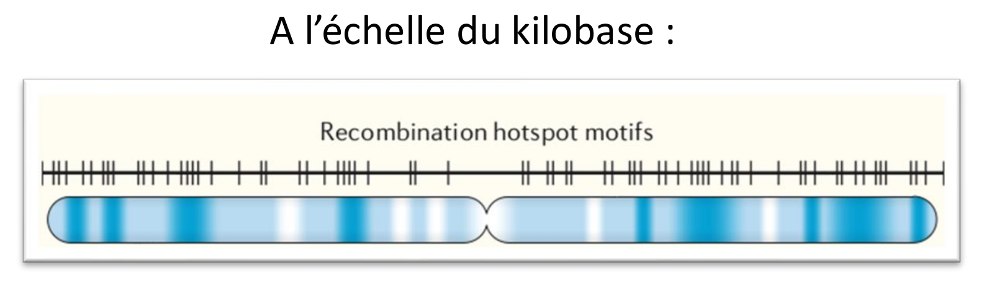
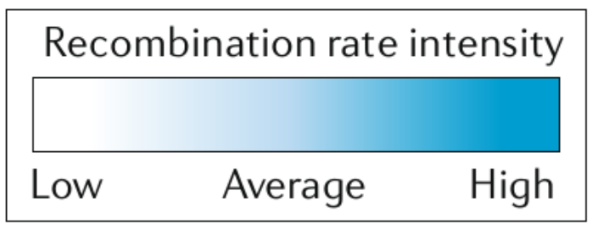
Recombination rate varies along the genome at different scales
Expérience pilote
Analyses
At the Mb scale
At the kb scale
Some species have recombination hotspots, others not.
What are the advantages and disadvantages of having recombination hotspots ?

Slide 3
Why are hotspots a good thing ?
Increase fertility

Slide 4
Why are hotspots a good thing ?
Increase fertility
Facilitate homolgy search by limiting the number of sites in a large genome.
Decrease the time of gametogenesis and enhance fertility.
1st order selection on modifyer of recombination heterogeneity

Slide 5
Why are hotspots a good thing ?
Increase fertility
Facilitate homolgy search by limiting the number of sites in a large genome.
Decrease the time of gametogenesis and enhance fertility.
1st order selection on modifyer of recombination heterogeneity
Only evidence in rodents (mice and rats with PRDM9 which have different roles)

Slide 6
Why are hotspots a good thing ?
Increase fertility
Enhance selection efficiency
Facilitate homolgy search by limiting the number of sites in a large genome.
Decrease the time of gametogenesis and enhance fertility.
1st order selection on modifyer of recombination heterogeneity
Only evidence in rodents (mice and rats with PRDM9 which have different roles)

Slide 7
Why are hotspots a good thing ?
Increase fertility
Enhance selection efficiency
Facilitate homolgy search by limiting the number of sites in a large genome.
Decrease the time of gametogenesis and enhance fertility.
1st order selection on modifyer of recombination heterogeneity
Concentrate recombination near gene promoter could increase the efficacy of selection in region where mutations display the most extremes fitness effects.
Only evidence in rodents (mice and rats with PRDM9 which have different roles)

Slide 8
Why are hotspots a good thing ?
Increase fertility
Enhance selection efficiency
Facilitate homolgy search by limiting the number of sites in a large genome.
Decrease the time of gametogenesis and enhance fertility.
1st order selection on modifyer of recombination heterogeneity
Concentrate recombination near gene promoter could increase the efficacy of selection in region where mutations display the most extremes fitness effects.
Recombination in hotspots is far more elevated than what would be needed to break genetic linkage
Only evidence in rodents (mice and rats with PRDM9 which have different roles)

Slide 9
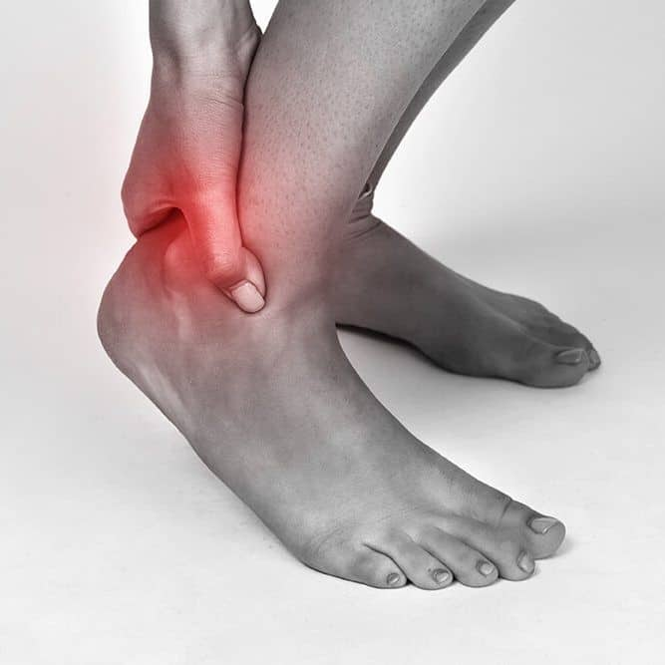
Why are hotspots a bad thing ?
They call it the achilles heels of genomes…

Slide 10

Why are hotspots a bad thing ?
They call it the achilles heels of genomes…
The dark side of recombination…

Slide 11

Why are hotspots a bad thing ?
They call it the achilles heels of genomes…
The dark side of recombination…

Slide 12
Advantage and disadvantage of gBGC
Deleterious AT sites
Deleterious GC sites
Beneficial GC sites
Beneficial AT sites

Slide 13
Advantage and disadvantage of gBGC
Deleterious AT sites
Deleterious GC sites
If there is a mutation bias towards AT
Beneficial GC sites
Without gBGC
Beneficial AT sites

Slide 14
Advantage and disadvantage of gBGC
Deleterious AT sites
Deleterious GC sites
If there is a mutation bias towards AT
Beneficial GC sites
Without gBGC
Beneficial AT sites
Weak gBGC

Slide 15
Advantage and disadvantage of gBGC
Deleterious AT sites
Deleterious GC sites
If there is a mutation bias towards AT
Beneficial GC sites
Without gBGC
Beneficial AT sites
Weak gBGC
Strong gBGC

Slide 16
Advantage and disadvantage of gBGC
Deleterious AT sites
Deleterious GC sites
If there is a mutation bias towards AT
Beneficial GC sites
Without gBGC
Beneficial AT sites
Weak gBGC
Strong gBGC
The impact of gBGC on the mutation load has been broadly studied theoretically in Nagylaki 1983, Glemin et al. 2003, Glemin 2010.

Slide 17
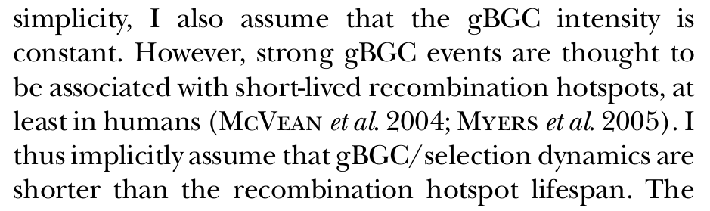
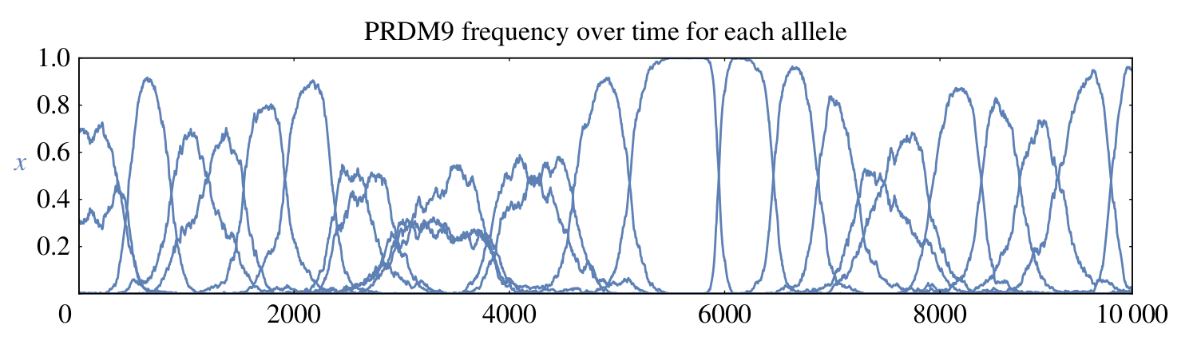
Problematic
All previous models assume a constant intensity of gBGC across time.
«
S. Glémin 2010
. »
Latrille et al. 2017

Slide 18
Problematic
All previous models assume a constant intensity of gBGC across time.
«
S. Glémin 2010
. »
For which value of b, s and hotspot lifespan does this assumption hold ?

Slide 19
Problematic
All previous models assume a constant intensity of gBGC across time.
«
S. Glémin 2010
. »
For which value of b, s and hotspot lifespan does this assumption hold ?
Can short-lived hotspot reduce the mutation load ?

Slide 20
Biological relevance : PRDM9-dependent hotspots
Our model mimics a succession regime when we have more or less one PRDM9 allele at a time.

Slide 21
Biological relevance : PRDM9-dependent hotspots
Our model mimics a succession regime when we have more or less one PRDM9 allele at a time.
When PRDM9 is highly polymorphic, the conversion rate from W to S becomes b times the PRDM9 allele frequency, which reduces the load at that site and can bring significant advantage.

Slide 22
Biological relevance : PRDM9-dependent hotspots
Our model mimics a succession regime when we have more or less one PRDM9 allele at a time.
When PRDM9 is highly polymorphic, the conversion rate from W to S becomes b times the PRDM9 allele frequency, which reduces the load at that site and can bring significant advantage.
It is difficult to estimate the turnover time of PRDM9 alleles.

Slide 23
Biological relevance : PRDM9-dependent hotspots
Our model mimics a succession regime when we have more or less one PRDM9 allele at a time.
When PRDM9 is highly polymorphic, the conversion rate from W to S becomes b times the PRDM9 allele frequency, which reduces the load at that site and can bring significant advantage.
It is difficult to estimate the turnover time of PRDM9 alleles.
For mice, Latrille et al. 2017 predicted it between 0.6xNe and 1.6xNe (in a polymorphic regime under several assumptions)

Slide 24
Biological relevance : PRDM9-dependent hotspots
Our model mimics a succession regime when we have more or less one PRDM9 allele at a time.
When PRDM9 is highly polymorphic, the conversion rate from W to S becomes b times the PRDM9 allele frequency, which reduces the load at that site and can bring significant advantage.
It is difficult to estimate the turnover time of PRDM9 alleles.
For mice, Latrille et al. 2017 predicted it between 0.6xNe and 1.6xNe (in a polymorphic regime under several assumptions)
If those values are the same in humans, the gBGC/selection dynamic should not be affected that much by the hotspots lifespan.

Slide 25
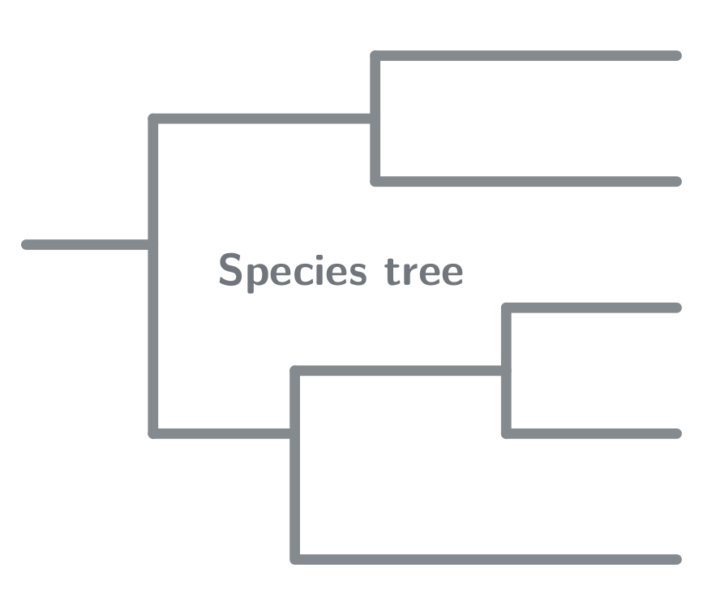
Consequences on estimations of B=4Neb
WS substitution
Time spent as a hotspot
Time spent as a coldspot

Slide 26
Consequences on estimations of B=4Neb
If the probability of fixation is not affected by the lifespan of the hotspot, the number of substitutions will only depend on the time spent as a hotspot and its strength.
WS substitution
Time spent as a hotspot
Time spent as a coldspot

Slide 27
Consequences on estimations of B=4Neb
If the probability of fixation is not affected by the lifespan of the hotspot, the number of substitutions will only depend on the time spent as a hotspot and its strength.
Our results suggest that the mean B integrated over time estimated from neutral substitutions is valid even for PRDM9-induced hotspots.
WS substitution
Time spent as a hotspot
Time spent as a coldspot

Slide 28
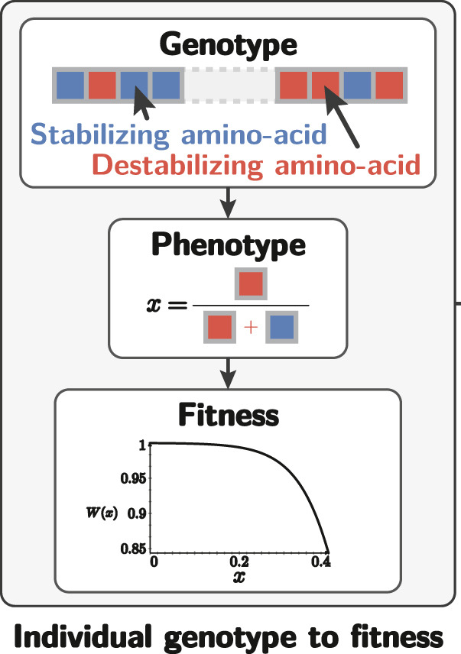
Accounting for fitness landscape and epistasis
Latrille and Lartillot 2021

Slide 29
Accounting for fitness landscape and epistasis
Latrille and Lartillot 2021
If epistasis is more likely to occur between proximal sites, for the same amount of deleterious mutations fixed in the genome, clustered deleterious substitutions can have more impact on fitness.

Slide 30
Accounting for fitness landscape and epistasis
Latrille and Lartillot 2021
If epistasis is more likely to occur between proximal sites, for the same amount of deleterious mutations fixed in the genome, clustered deleterious substitutions can have more impact on fitness.
Under this condition, having unstable hotspots can limit the deleterious effects of gBGC on fitness.

Slide 31
Thank you for your attention !
Questions ? Suggestions ?

