Slide 1
Design input review
Presentation

Slide 2
SUMMARY
Product Presentation
Product Functionment
Project Presentation
Team Organizational Chart
Planing Presentation
Provisioning events
Principal Milestones
Deliverable
Budget

Slide 3
Project Presentation
Language JAVA
CMMI level 3
Agile Project Management
Chat IRC
Windows 10 software
Works with JVM

Slide 4
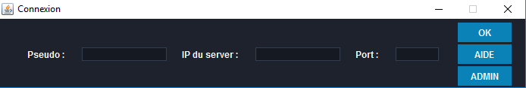
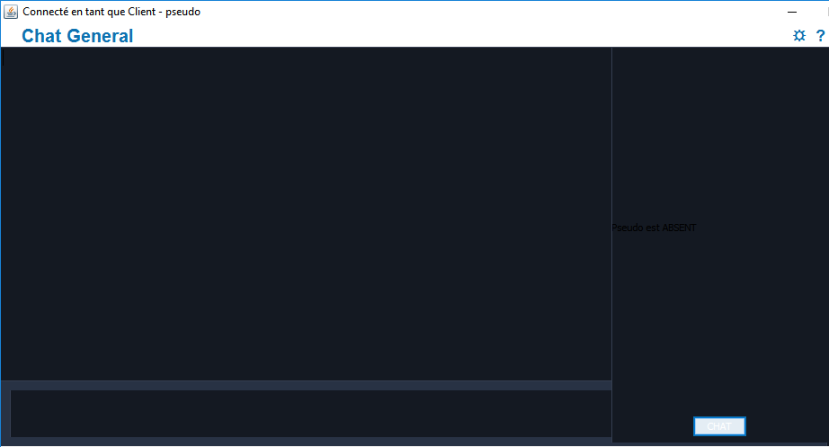

Product presentation

Slide 5
Product operation
High Availability and datas persistance
Client
Client
Client
In case of crash
SERVER 1
SERVER 2
JMS

Slide 6
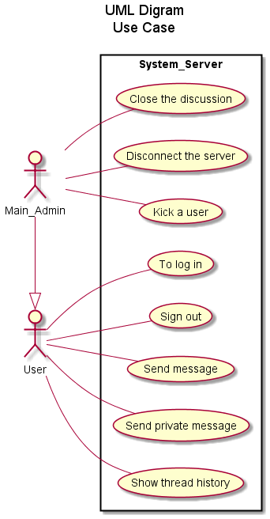
Product presentation
Use Case Diagram

Slide 7
TEAM presentation
 | Role in the team
SARROBERT Thibault | Project Manager
ROMAN Olivier | Architect
MOREAU Maxime | Tester Validator
ORTEGA Pablo | Developer

Slide 8
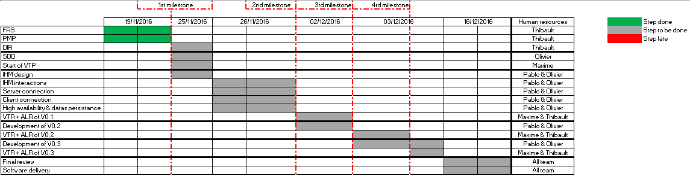
Planning Presentation

Slide 9
Planning Presentation
Provisionning Events → 5%
PC crash
OS
Naturel Contingencies
Risks analysis
Validation
Automaticaly = 20%
Manual = complete

Slide 10
Budget previsition
Human resources
Developer → 100€/hour
Tester validator → 100€/hour
Architect → 150€/hour
Project manager → 180€/hour
40 hours/man
Matrials
2 Servers
Developement Materials
Estimation → €

