Slide 1
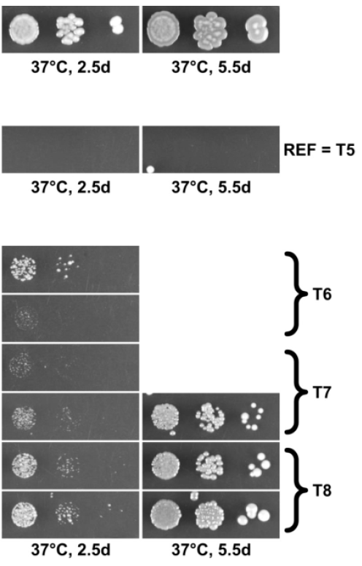
Identification of ΔTOM1 suppressors in S. Cerevisiae
Wild type – TOM1 ubiquitinates unassembled ribosomal proteins
ΔTOM1 – Accumulation of ribosomal proteins - No growth at 37°C
Frameshift
PMT1
Involved in quality control of ribosomal subunits
Interacts with HAS1, involved in the biogenesis of 40S and 60S subunits
Stop gained
KRE6
Known weak ΔTOM1 suppressor – membrane protein
Missense
KRE9
Close to KRE6 – Both KRE6 and KRE9 interacts with ribosomal genes
Missense
VTC4
Direct physical interactor of TOM1 – interaction not described
Missense
KRE6
Known weak ΔTOM1 suppressor – membrane protein
Missense
ROT1
Chaperone involved in protein folding – interacts with ribosomal genes
Notes:
TOM1 ubiquitine ligase -> ubiquinates unassembled ribosomal proteins
Gene Trigger Of Mitosis 1 is deleted -> accumulation of ribosomal proteins -> no growth at 37°C
Mutations in other genes -> grow again at 37°C

Slide 2
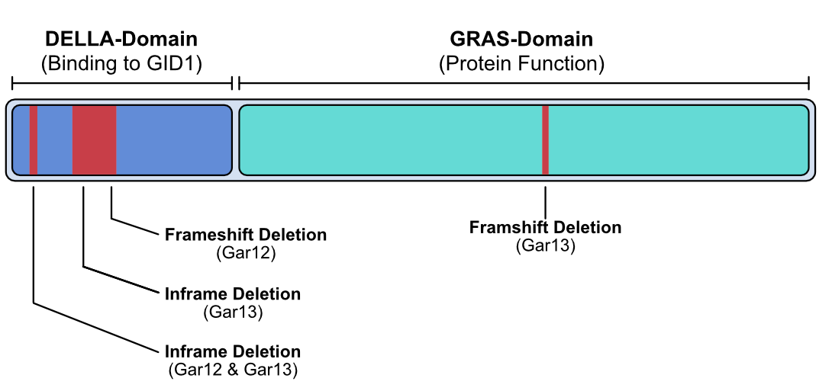
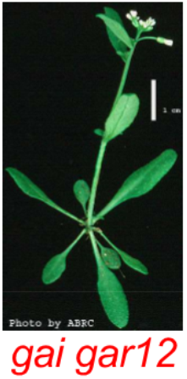
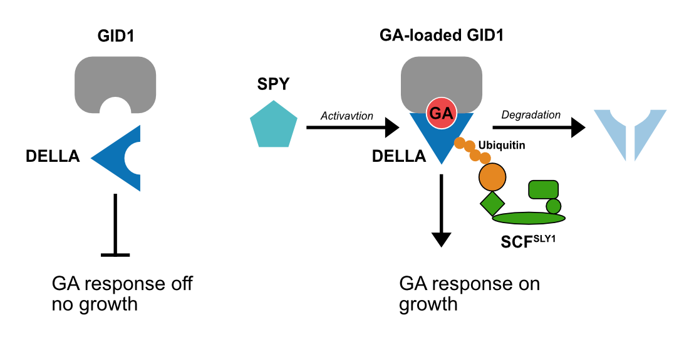
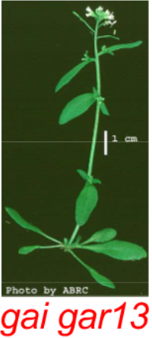

Identication of gai phenotype revertant mutations in Arabidopsis thaliana
gai phenotype : 51bp deletion in DELLA domain -> no growth
gar (gai revertant): have the 51bp deletion but grow
Gar12:
Original deletion +1 bp -> Frameshift deletion that affects the entire protein – DELLA cannot repress -> growth
Gar13:
Original 51bp deletion
Frameshift deletion in GRAS-domain
Gar12 & Gar13:
One missense mutation in SPY
Inframe 3bp deletion in DELLA
Notes:
GAI – Giberellic Acid Insensitive – Plants deficients in biosynthesis of Giberellic Acid
Modulation of plant growth by decreasing the responsiveness to GA

Slide 3
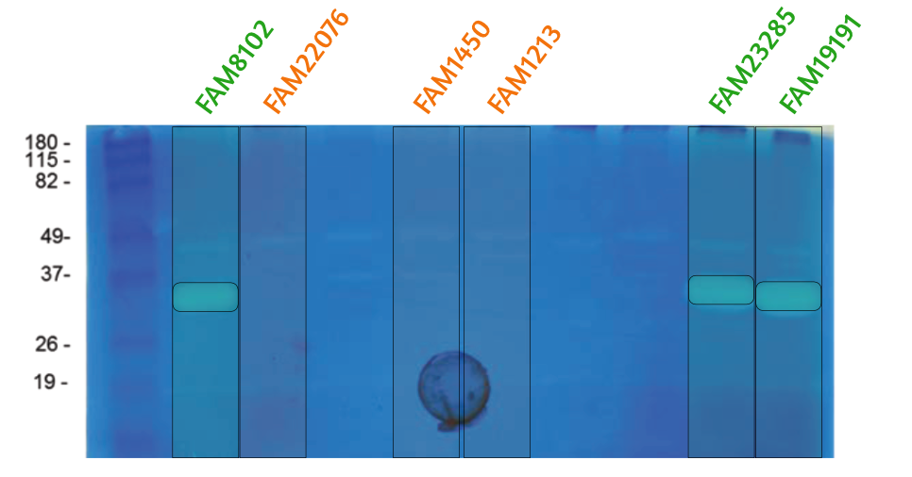



Lactobacillus heleveticus Genome De Novo Assembly
Peptidoglycan hydrolases (PGHs): enzymes used in cheese ripening
3 strains show a specific PGH activity, 3 do not.
~30 kDa
810 bp
New gene in a group or loss of gene product in the other ?
One gene matching group and size:
Lhv_2053, Lysin, pseudogene in L. helveticus.
893 bp / 33 kDa
Provenance: Bacteriophage Cp-1
Assemble
Annotate
Compare

