Slide 1
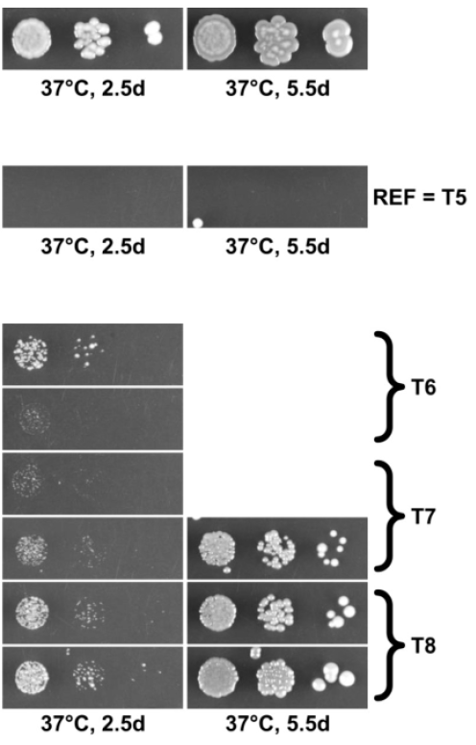
Identification of ΔTOM1 suppressors in S. Cerevisiae
Wild type – TOM1 ubiquitinates unassembled ribosomal proteins
ΔTOM1 – Accumulation of ribosomal proteins - No growth at 37°C
Frameshift
PMT1
Involved in quality control of ribosomal subunits
Interacts with HAS1, involved in the biogenesis of 40S and 60S subunits
Stop gained
KRE6
Known weak ΔTOM1 suppressor – membrane protein
Missense
KRE9
Close to KRE6 – Both KRE6 and KRE9 interacts with ribosomal genes
Missense
VTC4
Direct physical interactor of TOM1 – interaction not described
Missense
KRE6
Known weak ΔTOM1 suppressor – membrane protein
Missense
ROT1
Chaperone involved in protein folding – interacts with ribosomal genes
Thibault Schowing, BC.7107, HS2019
Notes:
TOM1 ubiquitine ligase -> ubiquinates unassembled ribosomal proteins
Gene Trigger Of Mitosis 1 is deleted -> accumulation of ribosomal proteins -> no growth at 37°C
Mutations in other genes -> grow again at 37°C

Slide 2
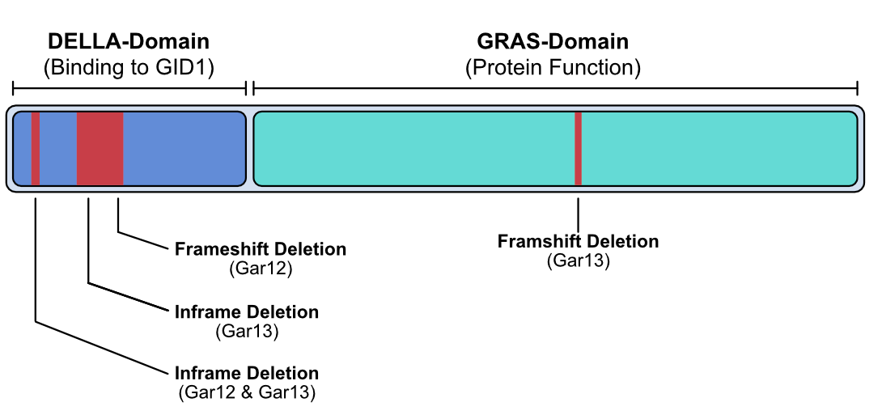
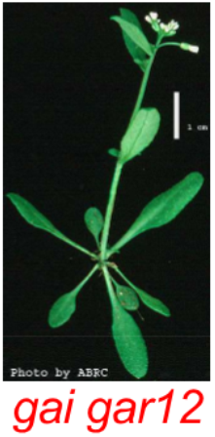
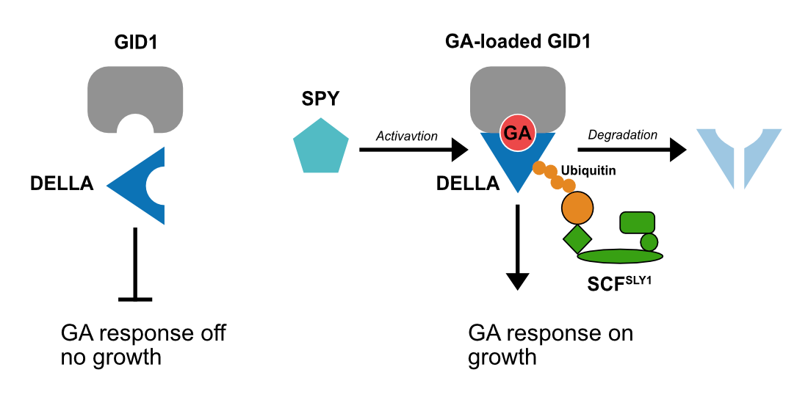
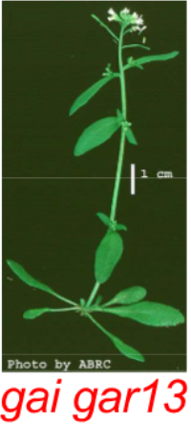

Identification of gai phenotype revertant mutations in Arabidopsis thaliana
gai phenotype : 51bp deletion in DELLA domain -> no growth
gar (gai revertant): have the 51bp deletion but grow
Gar12
• Original deletion +1 bp: Frameshift deletion that affects the entire protein – DELLA cannot repress growth
Gar13
• Original 51bp deletion
• Frameshift deletion in GRAS-domain growth
Gar12 & Gar13
One missense mutation in SPY
Inframe 3bp deletion in DELLA
Thibault Schowing, BC.7107, HS2019
Notes:
Modulation of plant growth by decreasing the responsiveness to GA (GA promotes growth)
Mutation in DELLA-domain prevents DELLA from binding to GA-loaded GID1 and renders it resistant to degradation -> gain-of-function,
Mutation in GRAS-domain may lead to an inactive protein, cannot repress TF -> loss of function
Inactive or resistent to degradation

Slide 3
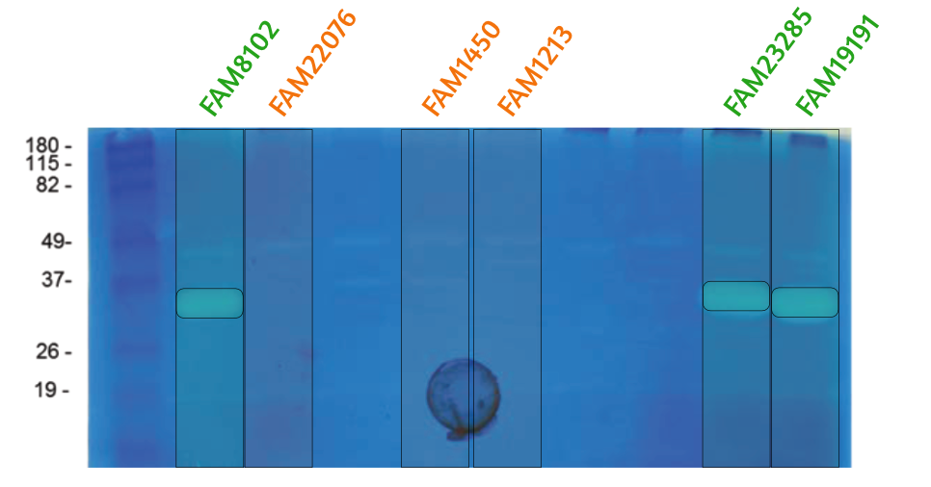




Lactobacillus heleveticus Genome De Novo Assembly
Peptidoglycan hydrolases (PGHs): enzymes used in cheese ripening
3 strains show a specific PGH activity, 3 do not.
~30 kDa
810 bp
One gene matching group and size:
• Lhv_2053, Lysin, pseudogene in L. helveticus.
• 893 bp / 33 kDa
Provenance: Bacteriophage Cp-1
Assemble
Sequence
Compare
Annotate
Thibault Schowing, BC.7107, HS2019
Notes:
Here we try to find what causes the activity shown in the zymography.
After having sequenced, assembled and annotated their genome, we compared them and found that the strains showing the activity possess a Lysin pseudogene that might produce a protein with a matching molecular weight.

