Slide 1
RESEARCH INITIATION PROJECT — FINAL PRESENTATION
Finding Failing Transformers Without Labels
Label-free health monitoring from dissolved-gas analysis — and a hidden trap in how such models are validated.
Thibaut Faucheux — CESI Engineering School, France
Supervised by Dr. Rattanakorn Phadungthin — KMUTNB, Bangkok, Thailand
July 2026 · 5-week research project

Slide 2
PLAN
What the next 20 minutes look like
01
Context — transformers, gas analysis, and a fleet with no labels
02
Contribution 1 — a fault-type map learned without labels
03
Contribution 2 — the validation trap: surveillance bias
04
Contribution 3 — a fleet risk index + live dashboard demo
05
Take-aways — for the field, and for me
CESI × KMUTNB — Research Initiation 2026
2

Slide 3
1 · CONTEXT
A blood test for transformers
Power transformers are critical, million-euro assets. When something goes wrong inside — overheating, sparking, arcing — the insulating oil breaks down and releases dissolved gases. Measuring them is called DGA: Dissolved Gas Analysis.
Each gas is a clue:
H2 — sparking
C2H2 — arcing (worst)
C2H4/CH4 — overheating
CO/CO2 — paper ageing
Transformer
fault heats the oil
Gases dissolve in oil
Lab: 7 gases (ppm)
CESI × KMUTNB — Research Initiation 2026
3

Slide 4
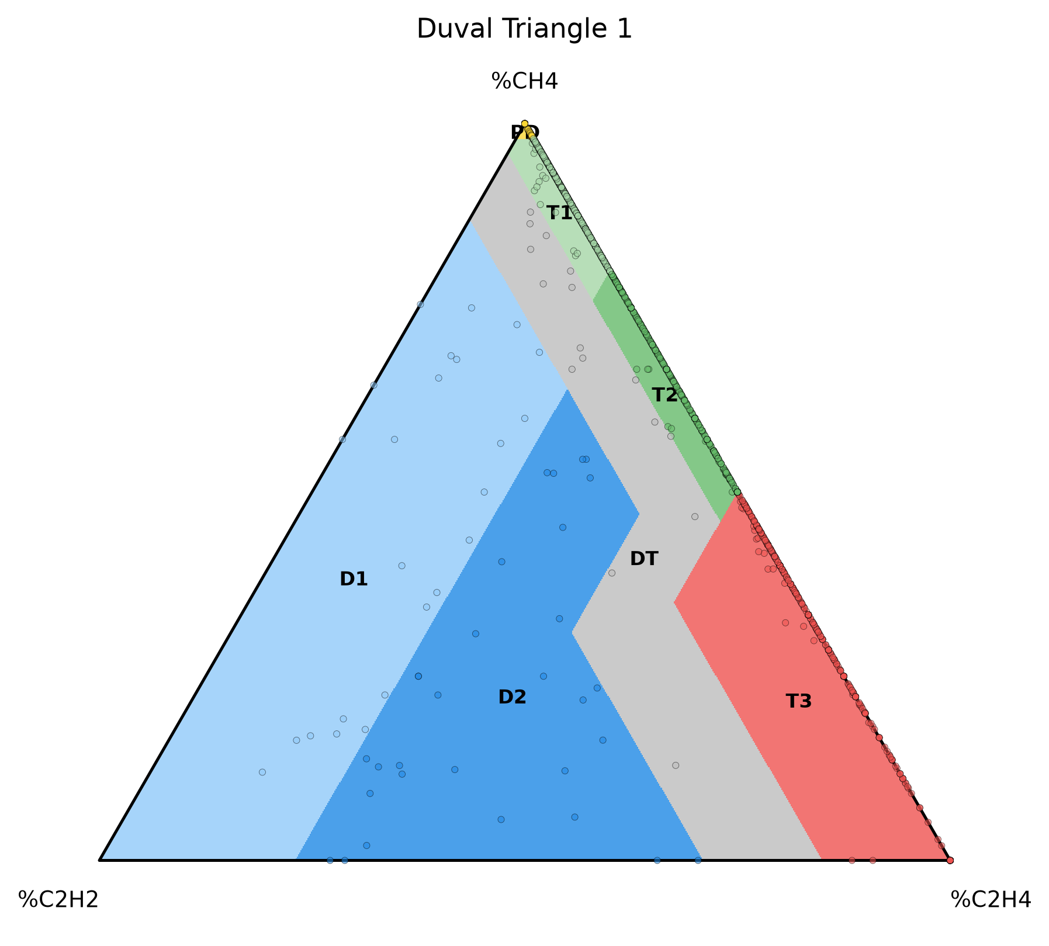
1 · CONTEXT
The problem: experts are scarce, labels don't exist
Expert rules (Duval, IEC ratios) work — but need an expert, and often answer “undetermined”.
Machine learning reaches 99% accuracy in papers — but needs labelled faults, which utilities almost never have.
Our fleet: zero confirmed fault labels. Just gas numbers and messy operator notes.
Goal: rank 628 transformers by risk and read fault types — using no labels at all.
The Duval Triangle — an expert rule from the 1970s, still the industry standard.
CESI × KMUTNB — Research Initiation 2026
4

Slide 5
1 · CONTEXT
Real fleet data — not a curated benchmark
628
4,563
5 yrs
42
transformers in service
oil samples analysed
of history (2019–2024)
manufacturers
What “real” means here
Why that is interesting
Gas values stored as text, with dashes for missing
Most published methods are tested on small, clean, balanced datasets (often under 200 samples). Whether they survive contact with a real fleet is exactly the open question — and the messiness itself hides a scientific finding.
Operator notes mix English and Thai — 69% contain Thai
Notes log everything: faults, but mostly maintenance and admin
No ground truth; assembled from multiple sources, anonymised
CESI × KMUTNB — Research Initiation 2026
5

Slide 6
1 · CONTEXT
Five weeks that did not go as planned — on purpose
Week 1
Week 2 — discovery
Week 3
Week 4
Week 5
Clean the data,
Risk index built — then we find
Attack our own results: simpler
Consolidate: 6-page paper,
Final report, coherence audit,
rebuild expert rules
our validation label is biased
wins; Thai notes translated
dashboard, defense decks
this defense
Research is not a straight line. Our two strongest findings came from questioning our own results — not from the original plan.
CESI × KMUTNB — Research Initiation 2026
6

Slide 7
2 · CONTRIBUTION 1 — FAULT TYPES WITHOUT LABELS
The severity trap
Feed raw gas concentrations to any model, and it learns “how much gas” — not “which fault”. The same fault at low and high gassing looks like two different things.
Concentrations (ppm)
Proportions (the gas “recipe”)
arcing, severe
arcing, early
same fault — far apart
same fault — same place
FOR THE EXPERTS
A plain autoencoder on log-concentrations encodes magnitude: total gas is linearly readable from its 2-D latent (R² = 0.63), and agreement with Duval classes is near-noise (ARI 0.14–0.16).
CESI × KMUTNB — Research Initiation 2026
7

Slide 8
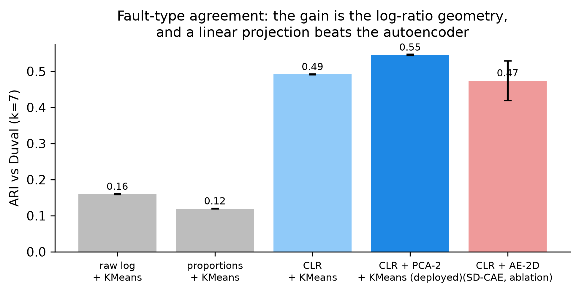
2 · CONTRIBUTION 1 — FAULT TYPES WITHOUT LABELS
Use the right geometry, and fault types appear
0.16 → 0.55
agreement with expert diagnosis (ARI) — 3.4× better, with zero labels
The trick is not a bigger model. It is treating gas proportions with the mathematics made for proportions (log-ratios), then the simplest possible projection.
FOR THE EXPERTS
Centred log-ratio (Aitchison) on the 5 combustible gases → standardise → PCA-2 → KMeans (k=7). ARI 0.545 ± 0.002 vs Duval. Deterministic. Holds on a temporal split: fit pre-2022, score 2022+ → ARI 0.45.
Agreement with the expert (Duval) classes, from raw inputs to our representation.
CESI × KMUTNB — Research Initiation 2026
8

Slide 9
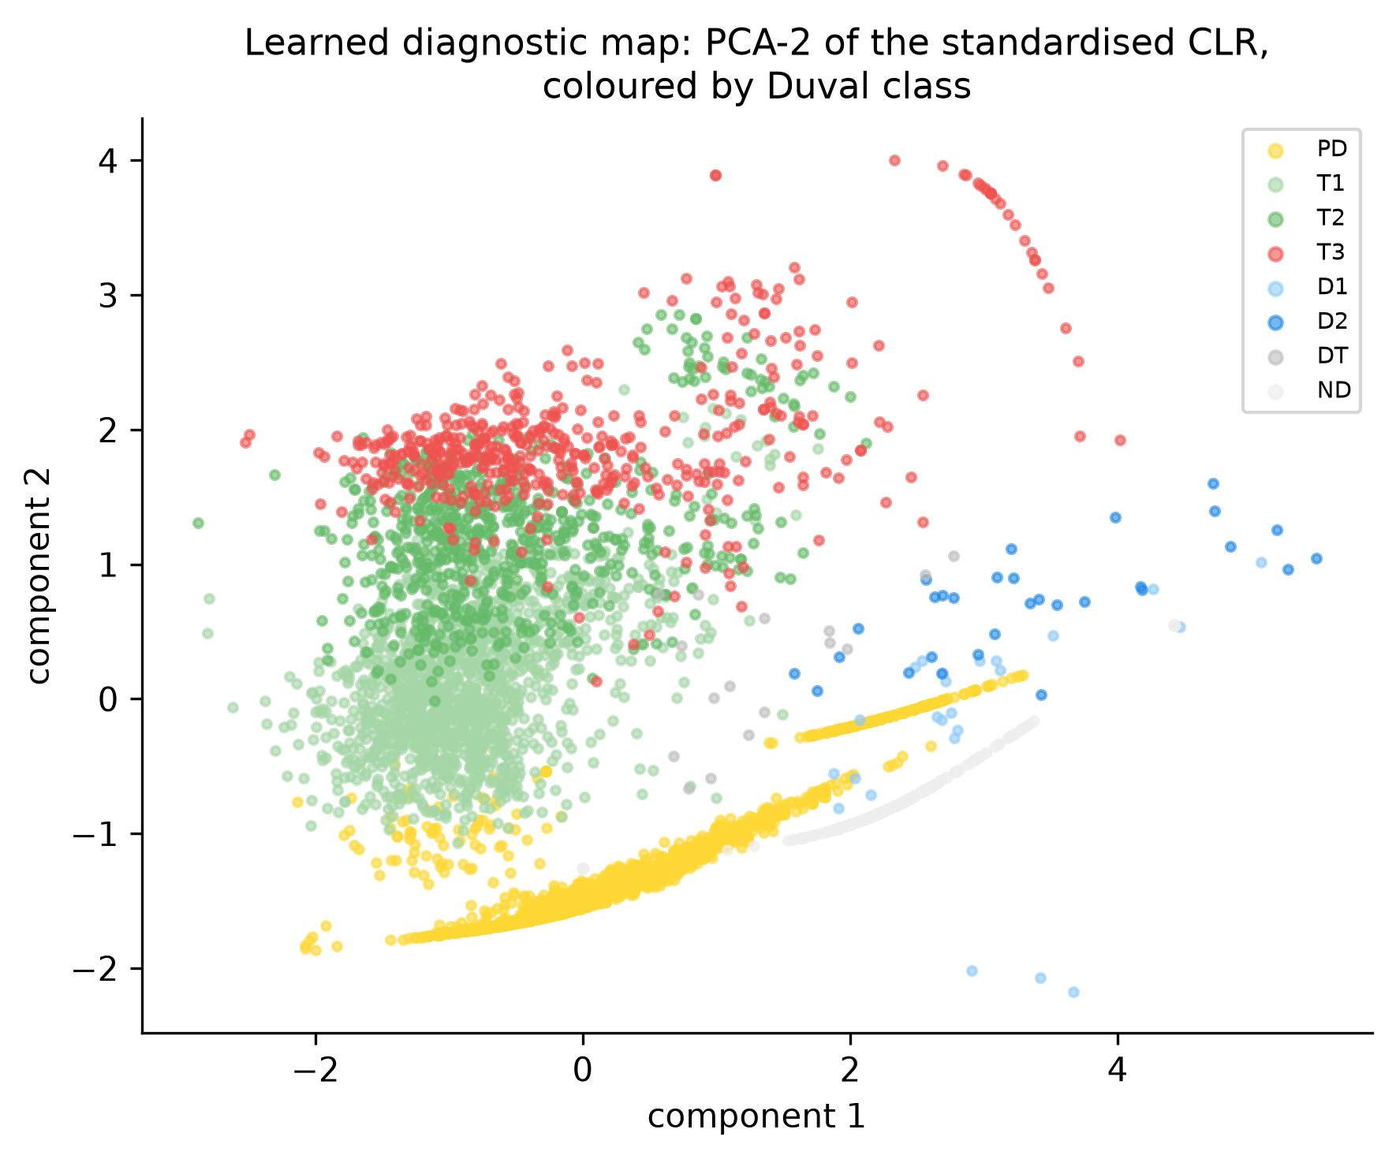
2 · CONTRIBUTION 1 — FAULT TYPES WITHOUT LABELS
A data-driven diagnostic map — and an honest negative
Discharge, partial-discharge and thermal regions emerge on their own
Readable axes — an engineer can interpret the directions
Deterministic: same data in, same map out
NEGATIVE RESULT
We also built a deep autoencoder (SD-CAE) and an adversarial variant. Neither beat the simple linear map. We report both as negatives — knowing what does not work is a result too.
Every dot is an oil sample. Colours = expert diagnosis, added afterwards — the map itself never saw them.
CESI × KMUTNB — Research Initiation 2026
9

Slide 10
3 · CONTRIBUTION 2 — THE VALIDATION TRAP
“The more you look, the more you find”
To check our risk score, we used the only “truth” available: operator-logged field events. Then we noticed something wrong.
Operator worries
Samples it more
Logs more notes
“Risky” in the data
about a transformer
extra oil tests
events get recorded
the loop feeds itself
the loop feeds itself — attention, not chemistry
FOR THE EXPERTS
This is surveillance / informed-presence bias, well known in medicine and health records (Sackett 1979; Haut & Pronovost 2011; Goldstein 2016). To our knowledge, never reported for DGA — models in this field are routinely validated against such labels.
CESI × KMUTNB — Research Initiation 2026
10

Slide 11
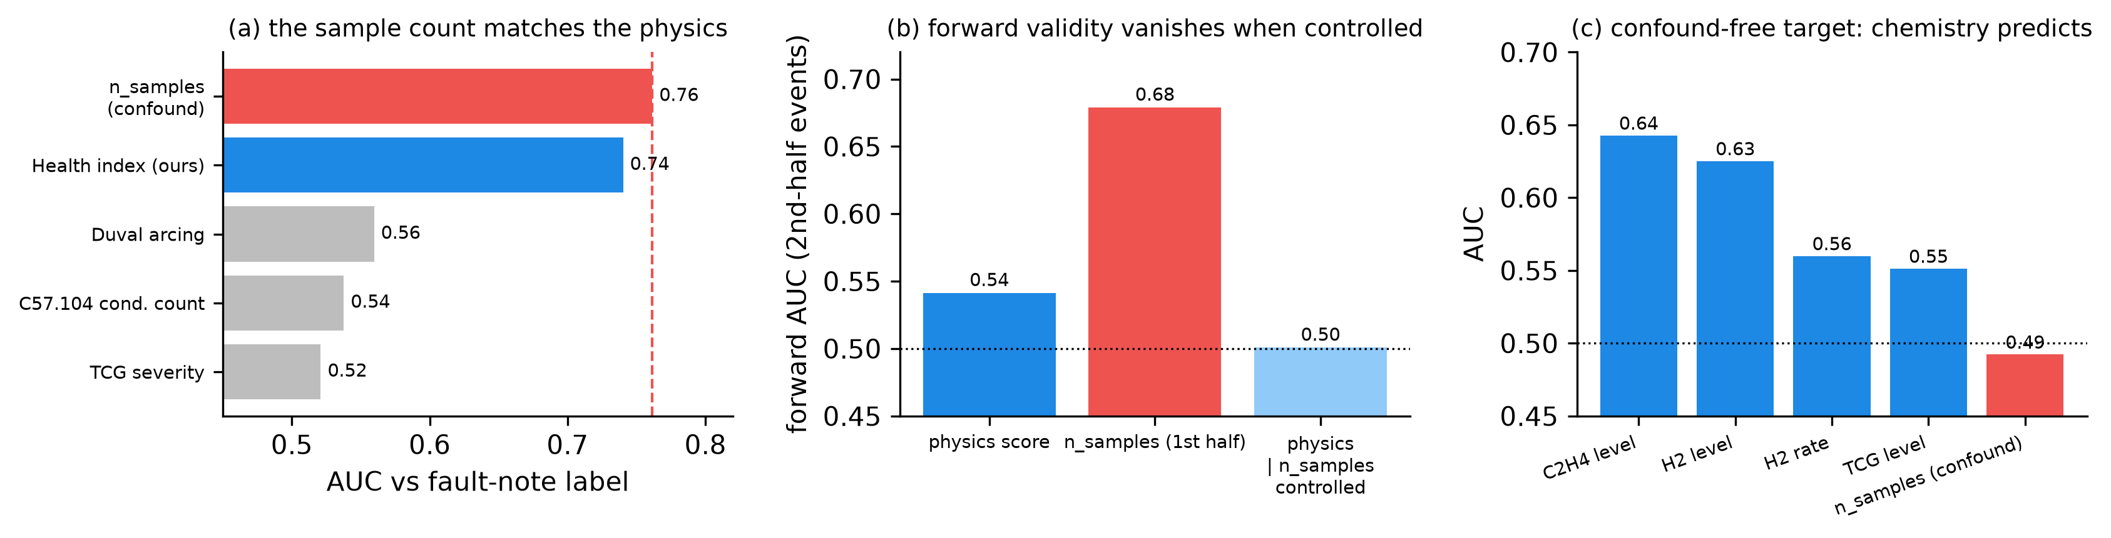
3 · CONTRIBUTION 2 — THE VALIDATION TRAP
Three tests, one verdict
(a) The tie. Counting how often a unit was sampled predicts logged events as well as all our chemistry combined (0.76 vs 0.74 — statistically indistinguishable).
(b) No foresight. Control for the sample count, and the score's ability to predict future events drops to a coin flip (0.50).
(c) The fix. Define the target by chemistry (arcing onset) instead of attention — now gases predict (0.64) and the count does not (0.49).
CESI × KMUTNB — Research Initiation 2026
11

Slide 12
3 · CONTRIBUTION 2 — THE VALIDATION TRAP
Repairing the label: 211 Thai notes, read one by one
69%
211
+6
of operator notes contain Thai — invisible to the English keyword filter
distinct Thai notes translated and classified (released for expert validation)
genuine electrical events recovered (noise, breaker explosions, insulation symptoms)
Example finds
The punchline
“หม้อแปลงมีเสียงดัง” — transformer making abnormal noise
“ตามผลเนื่องจาก Bkr. ระเบิด” — follow-up after breaker explosion
“ค่า p.f สูง” — high insulation power factor
On the repaired label, the sample-count's advantage disappears entirely (0.734 vs 0.735). Part of the “trap” was simply that the label was incomplete — in a language the pipeline didn't read.
CESI × KMUTNB — Research Initiation 2026
12

Slide 13
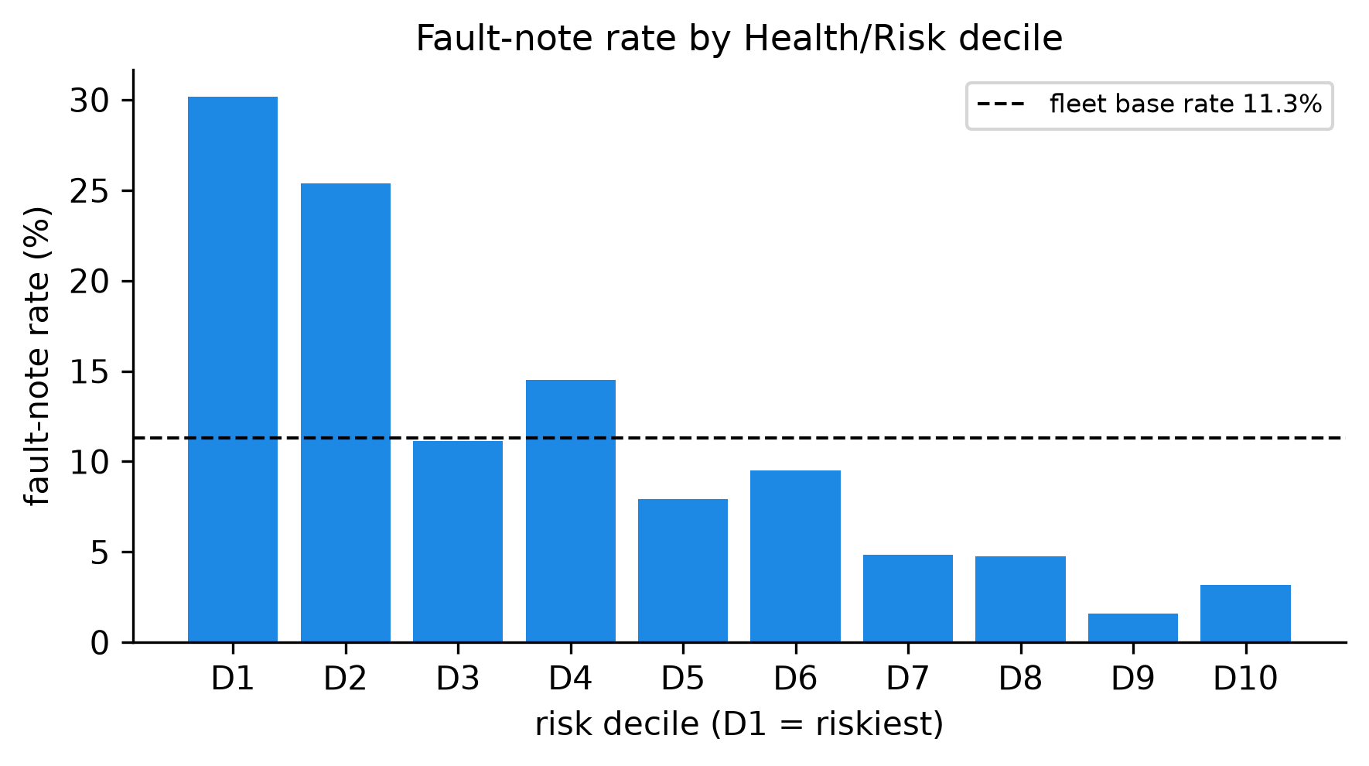
4 · CONTRIBUTION 3 — FROM RESEARCH TO PRACTICE
A triage list for the maintenance team
27%
event rate in the riskiest 10% of the fleet…
2%
…versus the safest 10%
Four transparent ingredients: gas severity, acetylene (arcing), the speed of hydrogen rise, and statistical novelty. No black box — and always reported together with the surveillance-bias floor from the previous slides.
Fleet sorted into 10 risk groups by our label-free index. Real logged events concentrate exactly where the index says they should.
CESI × KMUTNB — Research Initiation 2026
13

Slide 14
4 · CONTRIBUTION 3 — FROM RESEARCH TO PRACTICE
DEMO
The whole project, live
1. Fleet ranking — 628 units re-ranked live as we switch scoring profile
2. Transformer inspector — gas history, expert diagnoses, “why this score”
3. The fault-type map and the surveillance-bias evidence — the paper, interactive
localhost:8501 — runs on the anonymised dataset · if the demo gods object, every view also exists as a paper figure
CESI × KMUTNB — Research Initiation 2026
14

Slide 15
5 · TAKE-AWAYS
What this project says to the field
1
2
3
The right geometry beats a bigger model.
Validation labels can lie.
Honest negatives are results.
A linear method in the correct mathematical space outperformed deep networks — simpler, interpretable, deployable.
Any DGA risk model validated on operator-logged events should report the sample-count “confound floor” — otherwise surveillance can be mistaken for diagnostic skill.
Deep SVDD, VAE, adversarial disentanglement, RUL modelling: tested, rejected, documented. Future work starts further ahead.
Deliverables: a 6-page IEEE paper draft (3 contributions) · a reproducible pipeline (one command regenerates every number, 10 automated tests) · an anonymised public dataset extract · the interactive dashboard.
CESI × KMUTNB — Research Initiation 2026
15

Slide 16
5 · TAKE-AWAYS
What five weeks of research taught me
The scientific method, for real — hypothesis, test, and the discipline to pivot when the evidence disagrees with the plan
A full research stack — Python/PyTorch, statistics, LaTeX/IEEE writing, git, automated testing, Streamlit
Statistical honesty — confidence intervals, paired tests, blocked bootstraps; “0.76 vs 0.74” means nothing until you test it
Working across languages and cultures — a French student, a Thai fleet, English science; 211 Thai field notes read and classified
Attack your own results first — the finding that a simple method beat our own headline model came from auditing ourselves before reviewers would
Scoping — five weeks forces choices: what to cut, what to consolidate, what to hand to future work
CESI × KMUTNB — Research Initiation 2026
16

Slide 17
THANK YOU
Questions?
Thibaut Faucheux · CESI × KMUTNB
With thanks to Dr. Rattanakorn Phadungthin for the supervision and domain guidance.
628 transformers · 4,563 samples · ARI 0.16 → 0.55 without labels · one validation trap exposed · 6-page IEEE paper · live dashboard

