Slide 1

WEBZINE
TEAM N°2

Slide 2
THE TEAM
Thomas BERNARD ( Project manager and developer )
Quentin RHGHI ( OPS )
Thibaut MONIN ( Lead Developer )
Aurélien BISSEY ( Developer )
Quentin BOURDELOT ( Developer )

Slide 3
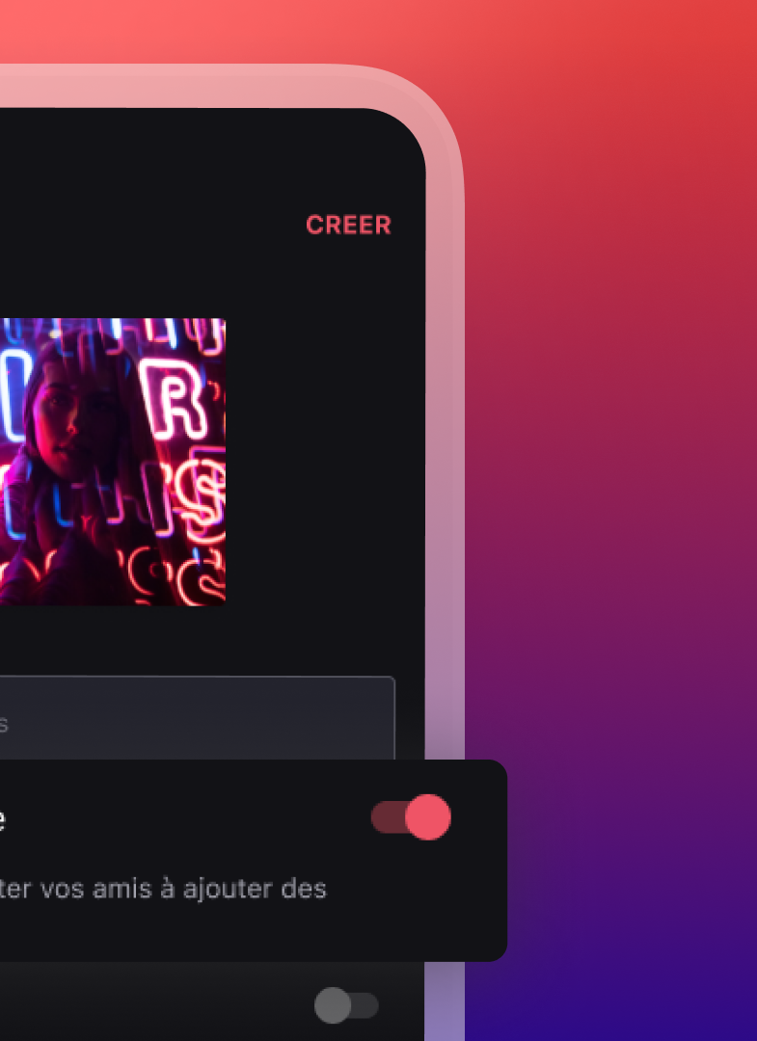
BONUSES
Playlist choice
Dashboard
CI / CD
Pagination option

Slide 4
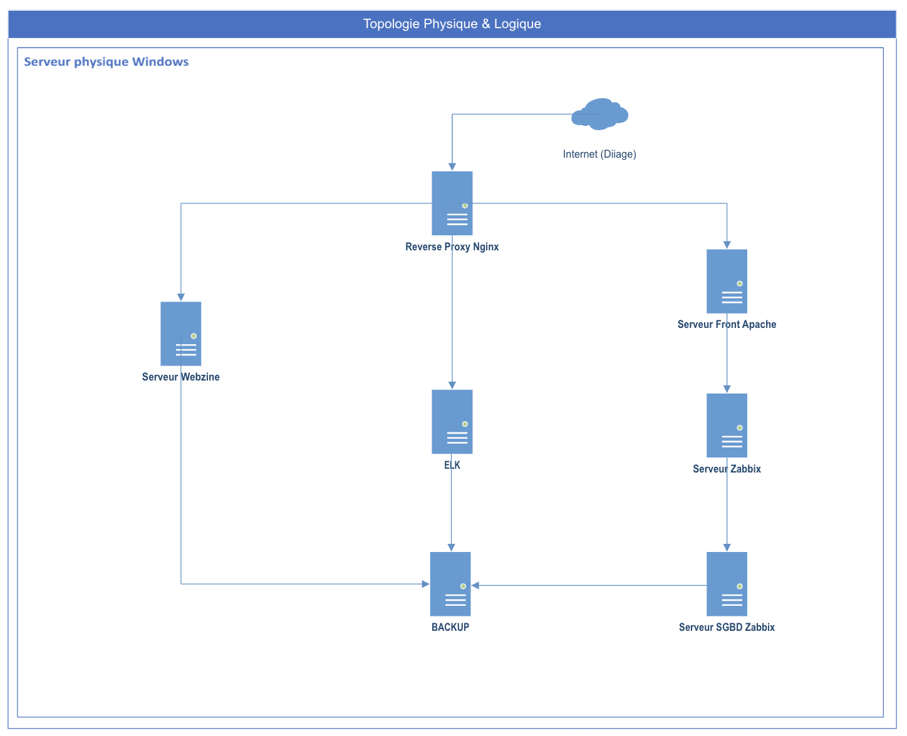
Infrastructure diagram

Slide 5
Demonstration
Met tes trucs la quentin

Slide 6
TASKS
THIBAUT MONIN | AURELIEN BISSEY | QUENTIN BOURDELOT | THOMAS BERNARD | QUENTIN RHIGHI
EF CORE JSON SERVICE CI / CD CALL HTTP POSTGRES SQL CONFIG FILE SEEDING DATA LOGS UNIT TESTS CREATING ENTITIES REPOSITORY CONTRACTS DEEZER API | MODEL STATE DOCUMENTATION DESIGN BOOTSTRAP | MODEL STATE DESIGN BOOTSTRAP AREAS VIEW COMPONENTS EXCEPTION FILTER | PICTURE SERVICE AZURE DEVOPS ROOTING DESIGN BOOTSTRAP DTO SEEDING DATA DEPENDENCY INJECTION COUCHE REPOSITORY DEEZER API CONFIG FILE | VM CREATION VM SECURITY REVERSE PROXY MONITORING LOGS DEPLOYEMENT DOCUMENTATION

Slide 7
DEMONSTRATION

Slide 8
QUESTIONS ?

