Slide 1

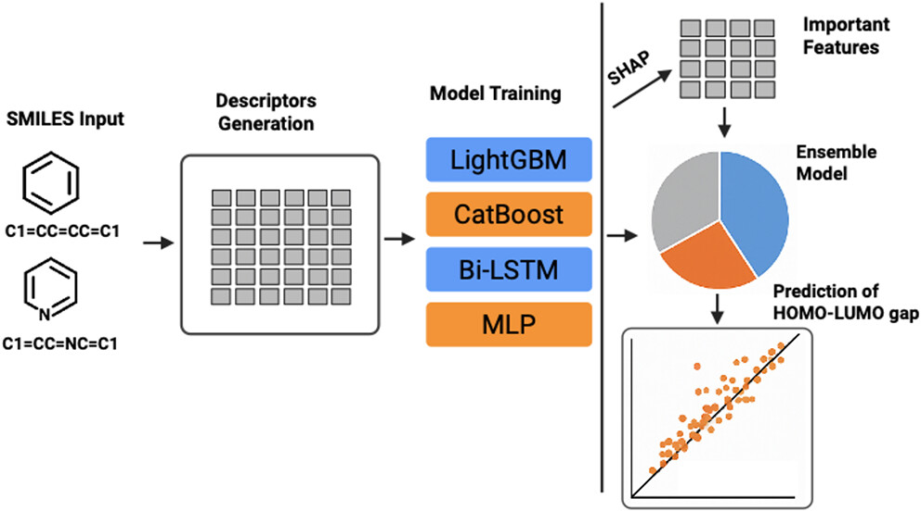

SMILES input
Feature generation
Model training
RDKit
Nested CV LightGBM
C1=CC=CC=C1
Predicting
HOMO-LUMO gap
C1=CC=NC=C1
QM9
HOMO-LUMO gap
MAE/R²

Slide 2
LightGBM Regression with Nested Cross-Validation & Hyperparameter Tuning

