Slide 1
NII-FJP meeting
March 14th, 2015

Slide 2

Xuan-Thien Phan
-2002-2005: Hue Uni. of Science (Math.)
-2005-2010: B.E, HCMUT
-2010-2012: M.Sc, HCMUT
-2013: intern NII, Yamada lab
-2014-201x: lecturer UIT &
PhD candidate, NII, Fukuda lab (MEXT)
Research topics:
wireless/ad-hoc network
software-defined network
Anomaly/intrusion detection
Contact: thienpx@uit.edu.vn / xuanthiencs@gmail.com
*** “Together we move forward” ***

Slide 3
Early-stage anomaly detection and mitigation in large-scale networks
Xuan-Thien Phan, Prof. Kensuke Fukuda
(NII-NECOMA project members)

Slide 4
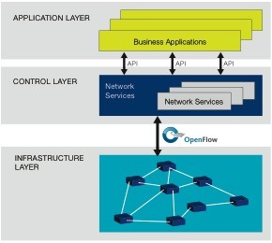
Software-Defined Network (SDN)
Control plane
Data plane
OpenFlow
FIGURE 1: SDN architecture

Slide 5
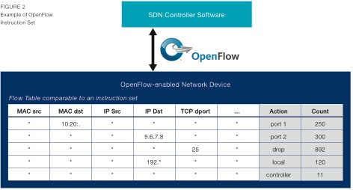
Software-Defined Network (SDN)
Network programmability
Centralized control
Flexibility
Real-time control
Notes:
Global view of network
Can observe changes in network
Manage in real-time
Programmabitity (fist proposed by SDN)
Thong nhat cac protocol

Slide 6

SDN members
Universities Lab: Stanford,…
SDN consortium
NTT
IBM
Juniper
Google
Hp
Intel
…

Slide 7
Our research
Motivation:
Increasing number of anomalies such as misconfiguration and remote attacks.
Problem for the users and Internet service operators:
Affect directly the availability of network services
Prevent legitimate users from accessing the networks resources.
Existing anomaly detection approaches:
Conventional network architecture
Heavy processing to extract information for traffic analysis
Delay time in detection, inflexiblity in reaction

Slide 8
Our research
Network traffic analysis
Query network traffic statistics
Analyze the collected information
Anomaly/intrusion detection
Detection model/algorithm
Attack mitigation
Control flow traffic behavior
React against attack traffic
Recover network service

Slide 9
Thank you!

