Slide 1
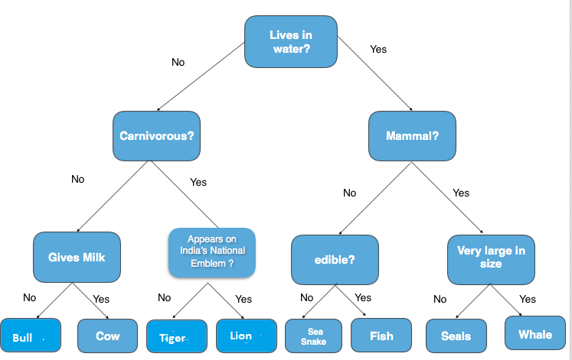
Decision Trees

Slide 2
What is a DT?
A Decision Tree is a supervised learning predictive model that uses a set of binary rules to calculate a target value
It is used for either classification (categorical target variable) or regression (continuous target variable)
Hence, it is also known as CART (Classification & Regression Trees)

Slide 3
Examples of use
Credit scoring models in which the criteria that causes an applicant to be rejected need to be clearly documented and free from bias
Diagnosis of medical conditions based on laboratory measurements, symptoms, or the rate of disease progression
Marketing studies of customer behaviour such as satisfaction or churn, which will be shared with management or advertising agencies

Slide 4
Advantages
Simple to understand and interpret. White box.
Requires little data preparation. (No need for normalization or dummy vars, works with NAs)
Works with both numerical and categorical data.
Handles nonlinearity (in contrast to logistic regression)
Possible to validate a model using statistical tests. Gives you confidence it will work on new data sets.
Robust. Performs well even if you deviate from assumptions
Scales to big data

Slide 5
Disadvantages
Easy to overfit
Complex “if-then” relationships between features inflate tree size

Slide 6
Structure of DT
Root Node: The node that performs the first split. In the above “Guess the Animal” example, root node would be the question lives in water.
Terminal Nodes/Leaves: Nodes that predict the outcome.
Branches: arrows connecting nodes, showing the flow from question to answer.

Slide 7
Algorithm behind DT
repeatedly partitioning the data into multiple sub-spaces, so that the outcomes in each final sub-space is as homogeneous as possible
recursive partitioning
1. Given a subset of training data, find the best feature for predicting the labels on that subset.
2. Find a split on that feature that best separates the labels, and split into two new subsets
3. Repeat steps one and two recursively until you meet a stopping criterion

Slide 8
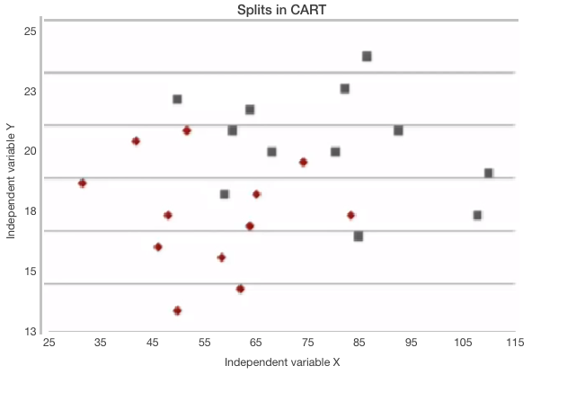
Example
The plot below shows a sample data for two independent variables, x and y, and each data point is colored by the outcome variable, red or grey.

Slide 9
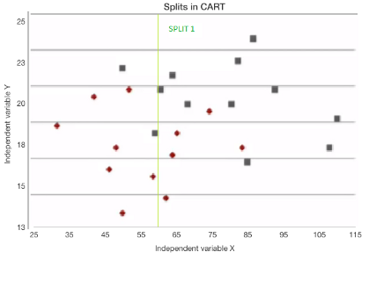
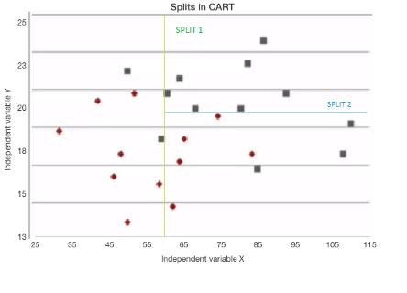
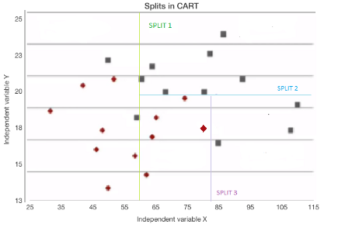
RT tries to split this data into subsets so that each subset is as pure or homogeneous as possible. The first three splits that RT would create are shown below

Slide 10
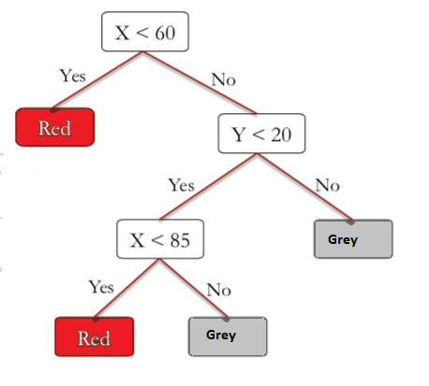
If a new observation fell into any of the subsets, it would now be decided by the majority of the observations in that particular subset
The tree for the splits looks like this:

Slide 11
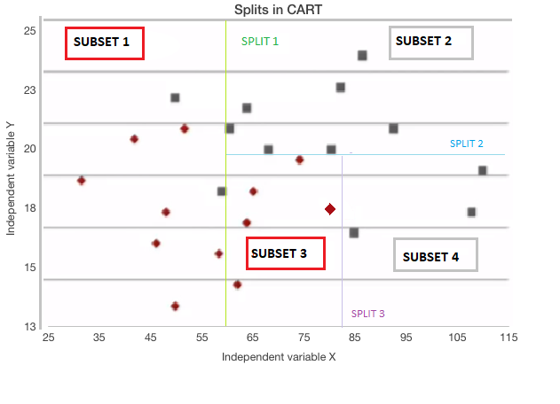
Classification Tree
Predictions for Subset 1:
Red data = 7, Grey data = 2
% of Red data = 7/(7+2) ~ 78% and % of Grey data ~22%. This means 78% of the data is Red.
Now just like in Logistic Regression, we can use a threshold value to obtain our prediction.
A Threshold of 0.5/50%, corresponds to picking most frequent outcome which would be Red.

Slide 12
Regression Trees
To predict outcome in such cases, since we have continuous output variables, we simply report the average of the values at that leaf
For example, if we had the values 3, 4, and 5 at one of the leaves, we will just take the average i.e 4.

Slide 13
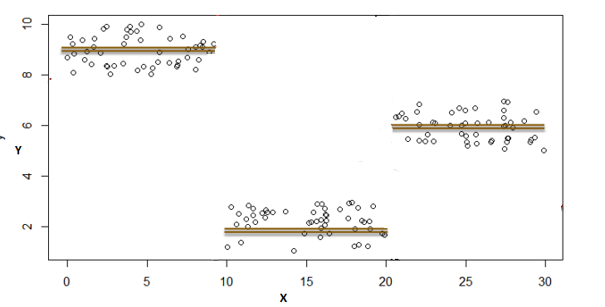
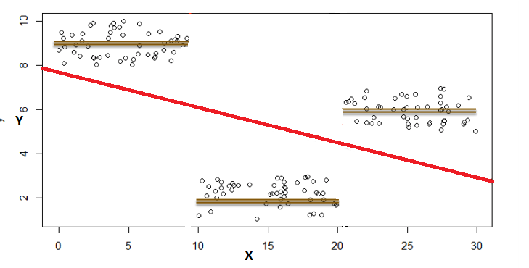
Example

Slide 14
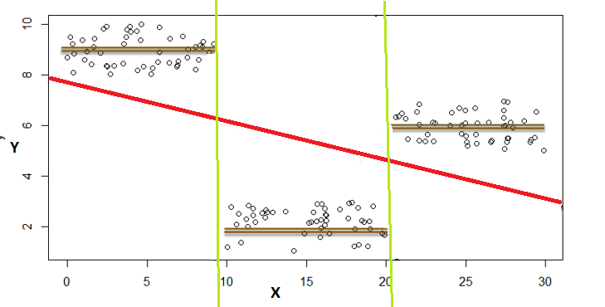
As is quite evident, linear regression does not do very well on this data set
The data lies in three different groups. If we draw lines here, we see x is either less than 10, between 10 and 20, or greater then 20

Slide 15
Decision Trees can fit in this this kind of of problem easily. So if splits are at:
x ≤10 |output would be the average of those values.
10 < x ≤ 20 |output would be the average of those values.
20< x≤ 30 |output would be the average of those values.

Slide 16
Measures used for split
Gini Index: It is the measure of inequality of distribution
It says if we select two items from a population at random then they must be of same class and probability for this is 1 if population is pure (It works with categorical target variable “Success” or “Failure”)
Lower value of Gini, higher homogeneity

Slide 17
Entropy: Way to measure impurity
Less impure node require less information to describe them and more impure node require more information. If the sample is completely homogeneous, then the entropy is zero and if the sample is an equally divided one, it has entropy of one.

Slide 18
Information gain: Information Gain is simply a mathematical way to capture the amount of information one gains(or reduction in randomness) by picking a particular attribute
In a decision algorithm, we start at the tree root and split the data on the feature that results in the largest information gain (IG)
IG tells us how important a given attribute is

Slide 19
Rpart library
You can use rpart library and use it (like lm(), glm() etc)
Or use caret which has rpart and feed it as a parameter for method in the train() function
You can specify whether to use information gain or gini index as splitting criterions in the train function
parms = list(split = "information"),

Slide 20
Avoiding overfitting: Bagging, Pruning, Boosting
Bagging: create bootstrapped samples from your set (default validation method if no traincontrol is set for train() function)
Boosting: Boosting works in a similar way, except that the trees are grown sequentially: each tree is grown using information from previously grown trees. Boosting does not involve bootstrap sampling; instead, each tree is fitted on a modified version of the original dataset
Pruning: technique that reduces the size of decision trees by removing sections of the tree that provide little power to classify instances (train() does that automatically by selecting tree with lowest CP (complexity parameter))
https://www.datacamp.com/community/tutorials/decision-trees-R

Slide 21
Moral of the story
The train function from caret library already takes care of a lot of things
Just experiment a bit by tuning the parameters and try out gbm, xgbTree (boosting) and treebag (bagging) methods in train()
Set tunellength parameter to different sizes and compare trees (pruning)
Check out extra resources folder for examples and articles
I updated my titanic workbook but it’s quite messy (sorry!)
A lot of them also cover random forests (which officially will be covered tomorrow)

Slide 22
For today
Continue working on report
Implement a tree based classifier and use it on your data
Play around with parameters

Slide 23
Question
Would you be interested in going through (easy) case studies
Something that could be used in an interview question
e.g. 1. how would you build a recommender system?
2. how would you evaluate whether your algorithm is successful
This is obviously not for the exam (neither for the report). Just for interest/future interview prep
We could divide group and those that find is interesting meet in another room while rest works on report
Up to you

