Slide 1
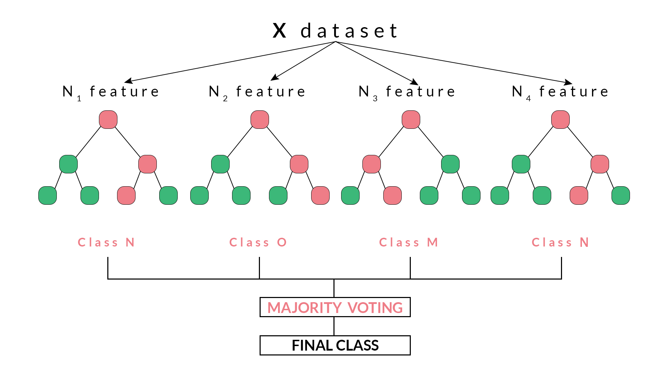
Random Forest Algorithm

Slide 2
Random Forest
Random forest is a collection of many decision trees. Instead of relying on a single decision tree, you build many decision trees say 100 of them. And you know what a collection of trees is called — a forest
So you now understand why is it called a forest

Slide 3
RF continued
Definition: Many decision trees. That’s it
Need to understand Decision Tree
Example: After having all the rounds of interviews, the final call whether to select or reject the candidate is based on the majority of the decision from each panel. If out of 5 panel of interviewers, 3 recommends a hire and two against a hire, we tend to go ahead with selecting the candidate. I hope you get the gist

Slide 4
Why random?
Say our dataset has 1,000 rows and 30 columns
2 levels of randomness in this algorithm:
- At row level: Each of these decision trees gets a random sample of the training data (say 10%) i.e. each of these trees will be trained independently on 100 randomly chosen rows
- At column level: The second level of randomness is introduced at the column level. Not all the columns are passed into training each of the decision trees. Say we want only 10% of columns to be sent to each tree. This means a randomly selected 3 column will be sent to each tree
The results from each of the tree are taken and the final result is declared accordingly
Voting and averaging is used to predict in the case of classification and regression respectively

Slide 5
Advantages of RF
Reduces chance of overfitting compared to single DT
You don’t have to worry much about the assumptions of the model or linearity in the dataset (when all you are about is prediction and want a quick and dirty way out)

Slide 6
Disadvantages of RF
Need a lot of data (don’t train well on smaller datasets)
Predictive, not descriptive (hard/impossible to understand results). You get variable importance but this may not suffice when the objective might be to see the relationship between the response and the features
Takes time to train (on real big data)

Slide 7
Task for today
Have at least one classifier coded up (preferably two) and compared against each other using your dataset
Linear/logistic regression vs one tree based method (regression/prediction)
At 12pm I will go through sample interview questions (it’s optional)

Slide 8
R
Method = “rf”
Check titanic notebook for plots of error rate and feature importance using RandomForest library
Tutorials in extra resources folder

