Slide 1
Revision
Exam tomorrow: 10am – 12:30pm

Slide 2
Rda files
Most of the resources will be provided in Rda files
So you need to be able to read them using
Load()
And get()
If Rda contains several dataframes get(x[index])

Slide 3
Interpret models
Predicting science score
 | Model 1 | Model 2
math | +1.59
read |  | -0.4

Slide 4
What does that mean?
With 1 grade increase of math, science increases by 1.59
With 1 grade increase of read, science decreases by 0.4
 | Model 1 | Model 2
math | +1.59
read |  | -0.4

Slide 5
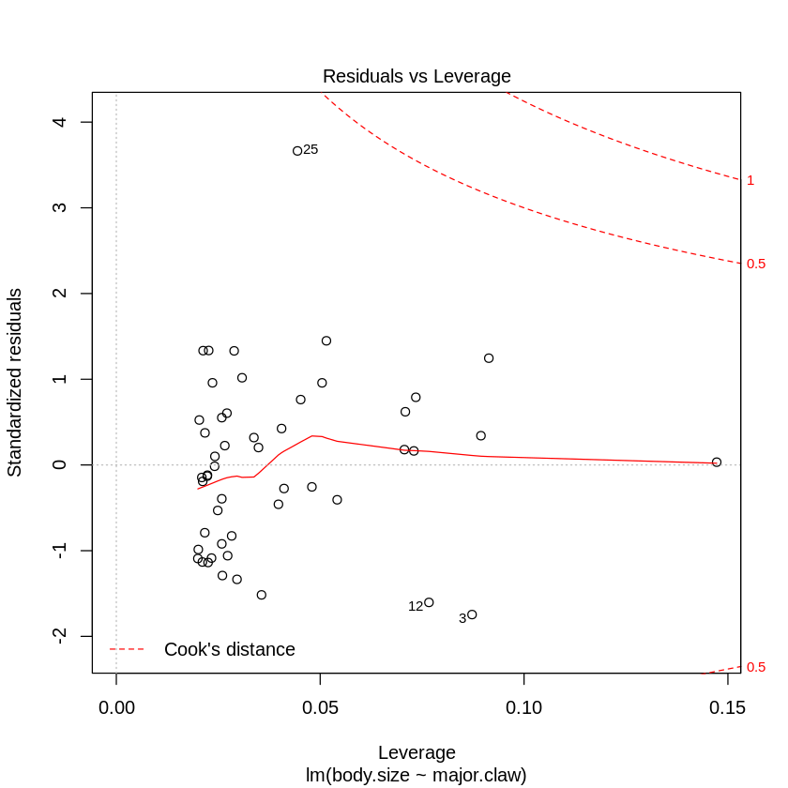
Diagnostic plots
plot(model)

Slide 6
An observation with a standardized residual that is larger than 3 (in absolute value) is deemed by some to be an outlier (e.g. by the guy who wrote the R book)
But it depends on the overall leverage of the data. If all the datapoints are quite spread out and there are a lot of datapoints around 2 SR, then 3 might be not that bad

Slide 7
Use lm() and glm()
Use lm() and glm() if no cross validation is needed
ANOVA for example doesnt work on objects created by caret::train()

Slide 8
There will be “new” stuff
Google is your friend
Use your brain
Look up what parameters functions can take
SAVE your work every couple of minutes (or more often)
Don’t waste more than 1.5minutes per mark
JUST MOVE ON

Slide 9
Useful libraries
Caret
MASS
Dplyr
Tidyr
Texreg
Readr (if you use read_csv instead of read.csv)
Please install them on your Computers TODAY

Slide 10
Resources
My sample exam questions and provided sample answers
Last year’s exam paper (ignore KNN question – it’s weird)
Tutorials on the basics in R, t-test, linear and logistic regression
Visualisation tutorial (ggplot)
Titanic examples and your reports for splitting data into train and test, cross-validation, confusion matrixes, accuracy calculation for LinR, LogR, KNN and NB

Slide 11
Exam
10 am (please arrive by 9:45am)
Know your candidate number
Don’t bring your own laptop
Log into moodle
There will be an exam section which contains
Submission link
Resources you will need to download
Exam brief (same as the one you’ll be handed out)

Slide 12
Resources
Rda, csv files
Maybe a picture of a plot in colour
Dataset info (don’t waste your time reading it - the column names will be pretty intuitive)

Slide 13


Slide 14
Big thanks to Joe!

Slide 15
For Today
Revision (however you want)
I’d suggest to create some sort of “summary” or sample project so you can look up stuff quickly instead of having everything spread out in a bunch of files/folders

Slide 16
Tomorrow after exam: drinks 12:45pm onwards at the Marlborough Arms (towards Tottenham Court Road, before Planet Organic)

