Slide 1
A different kind of test
we will again have a little test - bit different in nature than you are used to
test how good you are at phrasing questions to find the answers online you need
Why?
Because we won’t always be around to help you with trivial things (You need to be able to help yourself)
It’s much more efficient (e.g. at the end of session 1 a girl asked me how to change the font size in a plot – I sat next to her and googled it for her)
Will make you feel for confident during the exam

Slide 2
Day 3
if you cannot remember what p-values, normal distribution, standard deviation and standard error are – spend the first 30min to do a quick statistics refresher (online tutorial). I put some suggestions into the extra resources folder

Slide 3
Day 3
Work through the t-test and linear regression activities. Have a look into the extra resources folder where I compiled a list of websites that offer additional material/good examples/explanations
By the end of the day you should be able to:
Understand the t-test and how to use it in R and interpret results
Understand the concept of correlation and fitting by least squares method
Understand how to perform a simple linear regression in R and how to interpret the results.

Slide 4
Linear Regression
Simplest approach for statistical learning
Good starting point for more advanced approaches
Actually many fancy SL techniques can be seen as extension of linear regression
Understanding LR will build a good base for moving on to more complex approaches

Slide 5
LR is good to answer:
Is there a relationship between 2 variables?
How strong is this relationship?
Which variable contributes the most? (covered tomorrow)
How accurately can we estimate the effect of each variable
How accurately can we predict the target?
Is the relationship linear? (duuuh)
Is there an interaction effect (covered tomorrow)

Slide 6
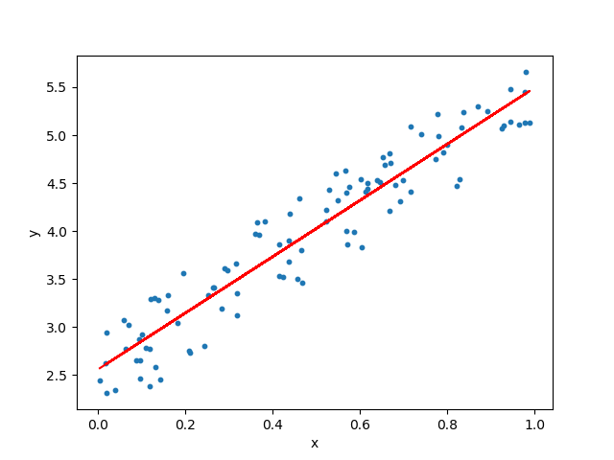
Graphical representation

Slide 7
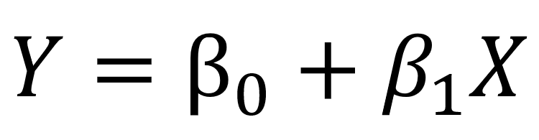
Equation
Equation for a linear model with 1 variable and one target
In the equation above, the betas are the coefficients. These coefficients are what we need in order to make predictions with our model.
It’s high school maths: Y = intersect + slope*X

Slide 8
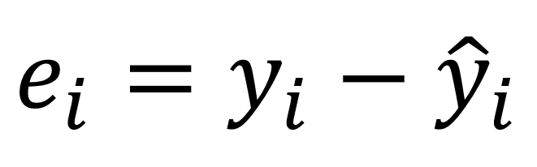
How do we find the parameters?
need to minimize the least squares or the sum of squared errors
linear model is not perfect and it will not predict all the data accurately, meaning that there is a difference between the actual value and the prediction
Error:

Slide 9
Why square errors?
because the prediction can be either above or below the true value, resulting in a negative or positive difference respectively
if we did not square the errors, the sum of errors could decrease because of negative differences and not because the model is a good fit (positive and negative canceling each other out)

Slide 10
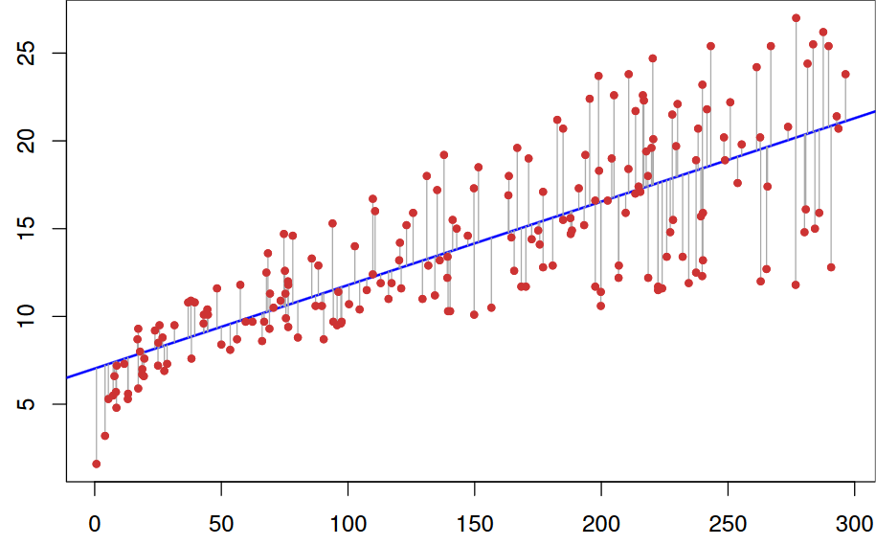
Red dots: true data
Blue line: linear model
Grey lines: errors between predicted and the true values
→ blue line minimises the sum of the squared length of the grey lines

Slide 11
Then some heavy math happens that is not covered in this course, you can finally estimate the coefficients
The R lm() function will do that for you :)

Slide 12
Assess accuracy of your model
Will be covered in more detail next week
R² metric measures the proportion of variability in the target that can be explained using a feature X
assuming a linear relationship, if feature X can explain (predict) the target, then the proportion is high and the R² value will be close to 1.
If the opposite is true, the R² value is then closer to 0

Slide 13
But never forget...
Correlation doesn't prove causation
Ice cream sales and shark attacks have a linear relationship (the more ice cream is sold, the more people are attacked by sharks)
Why? Do you taste better after eating ice cream?

Slide 14
Therefore
THINK about your data
Explore it
Dont just randomly plug different variables into your model until you get a high R²

