Slide 1
Day 4
Work through the Multivariate LR and MV LR + interactions tutorials and do the exercises using the High School Dataset
By the end of the day you should be able to:
Explore the principles of multivariate linear regression
Understand how to interpret p-values on coefficients, R² value, and F-test p-value.
Understand how we can include factor variables in a regression model.
Understand how to include interactions in a model.
Understand how to fit using polynomials.

Slide 2
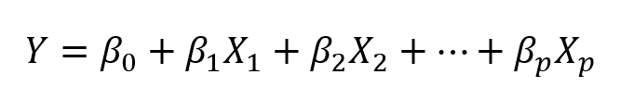
Multiple Linear Regression
In real life situations, there will never be a single feature to predict a target
The equation is very similar to simple linear regression; simply add the number of predictors and their corresponding coefficients:

Slide 3
Assessing relevancy of a predictor
Whenever you add variables to your model, you will explain more of the variance in the dependent variable.
We would like to know whether the difference (the added explanatory power) is statistically significant.
compare the residual sum of squares (RSS)*** of the two models.
The RSS is the sum over the squared deviations from the regression line and that is the unexplained error.
The restricted model (fewer variables) is always expected to have a larger RSS than the unrestricted model (the restricted model (fewer variables) has less explanatory power)
*** same as sum of squared errors talked about yesterday!

Slide 4
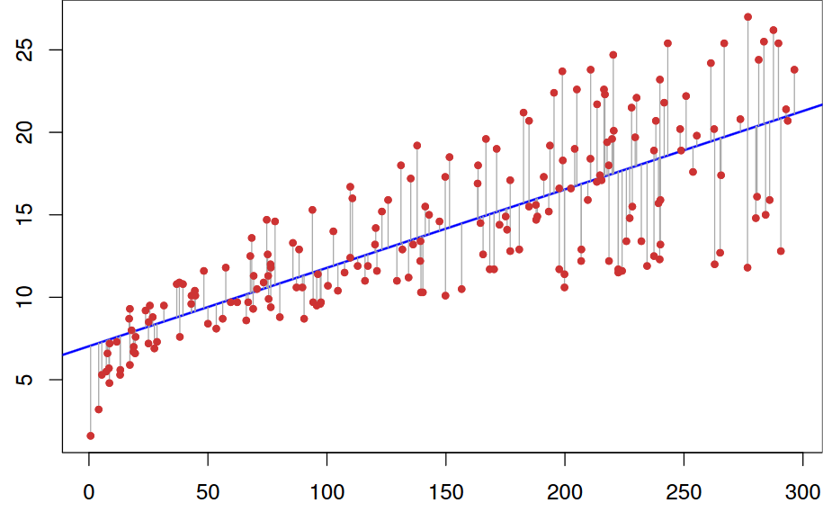
Remember this from yesterday? We want to check whether the gray lines got significantly shorter when adding new variables

Slide 5
F-Test
We test whether the reduction in the RSS is statistically significant using a distribution called F-distribution
You do not need to know how to calculate p-values from the F- distribution, as we can use the anova() function in R to do this for us
If p-value is small we can reject the null hypothesis that the unrestricted model has no more explanatory power than the restricted model

Slide 6
Assess accuracy of model
Comparing R² between two models not good because R² always increases when variables are added (more about that next week)
Compare Adjusted R²
R-squared that has been adjusted for the number of predictors in the model. The adjusted R-squared increases only if the new term improves the model more than would be expected by chance (genius!)

Slide 7
Interactions
Having multiple predictors in a linear model means that some predictors may have an influence on other predictors
Go through the tutorial – there is a nice example (probably homework)

Slide 8
Homework
1. Work your way through the two multivariable regression activities.
2. Read through Chapters 2 and 3 of the course textbook and try to understand the concepts involved
3. Example exam questions

Slide 9
Because apparently I dont have other hobbies...
I took a question from last year’s exam and created model answers for it (linear regression)
I invented a new question for t-test and created model answers
Have a go at them. You should be able to do them without any problems since we covered all the material necessary (including googling the correct stuff)
I will upload the model answers Sunday evening

