Slide 1
Automated variable Selection
Imagine you have 100 different variables
Imagine selecting the best set manually like we did last week
Ugh…
Several automated ways available in R:
stepAIC() [MASS package], which choose the best model by AIC
regsubsets() [leaps package], which has the tuning parameter nvmax specifying the maximal number of predictors to incorporate in the model. returns multiple models with different size up to nvmax. You need to compare the performance of the different models for choosing the best one.
The train() function [caret package] provides an easy workflow to perform stepwise selections using the leaps and the MASS packages. It has an option named method
Check extra resources for examples

Slide 2
How to choose best model?
Different ways to evaluate performance of a model
Questions to ask:
Is the error going down?
How much variance is explained? (maybe error went down but model overall is bad)
Do you want to penalise larger error? (e.g. cancer detection)
How well does the model perform on new data

Slide 3
Let’s start from the beginning...

Slide 4
Machine Learning
Building a model of a dataset so that we can relate the behaviour of variable Y to predictor variable X (also called independent variable)
Regression if Y is numerical (e.g. X: number of rooms, Y: house price)
Classification if Y is a category: (e.g. Y survived/died, X: tumour size, age, gender)

Slide 5
Y ~ f(x)
f(X): regression function describing the true relationship between Y and X
Why ~?
X cannot be fully explained by behaviour of Y. There are unknown variables not included as predictors and random factors
Notation: Y = f(X) + ε (random error)

Slide 6
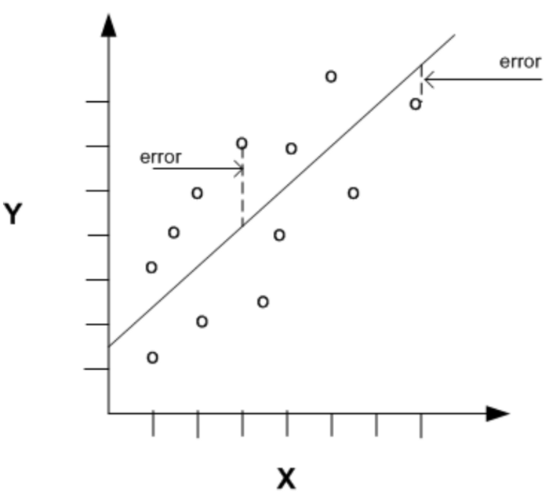
Error Metrics
There are three main errors (metrics) used to evaluate models, Mean absolute error, (Root) Mean Squared error and R2 score

Slide 7
MAE
Mean Absolute Error
What does Error mean? Prediction Error → Actual Value - Predicted Value
This prediction error is taking for each record after which we convert all error to positive. This is achieved by taking Absolute value for each error as below
Absolute Error → |Prediction Error|
MAE = Average of All Absolute Errors

Slide 8

Problem with MAE
When you average these out, you might get a very low error if you are underestimating and overestimating equally as they will cancel each other out. To get rid of the effect of the negative value while taking the mean, we square them.

Slide 9
Example
Case 1: Actual Values = [2,4,6,8] , Predicted Values = [4,6,8,10]
Case 2: Actual Values = [2,4,6,8] , Predicted Values = [4,6,8,12]
MAE for case 1 = 2.0, RMSE for case 1 = 2.0
MAE for case 2 = 2.5, RMSE for case 2 = 2.6
RMSE penalizes the last value prediction more heavily than MAE

Slide 10
So which do you use?
As always: it depends…
RMSE will obviously penalise outliers. So it depends what you define as an outlier
Get rid of outliers
If data very scattered – probably RMSE is a better metric
If data close to regression line – RMSE and MAE will be almost the same

Slide 11
R² and Adjusted R²
R Squared & Adjusted R Squared are often used for explanatory purposes and explains how well your selected independent variable(s) explain the variability in your dependent variable(s).
MAE and RMSE used to compare two models – it doesn’t tell you how well a model actually performs
R² = 1− Total Variation /Explained Variation

Slide 12
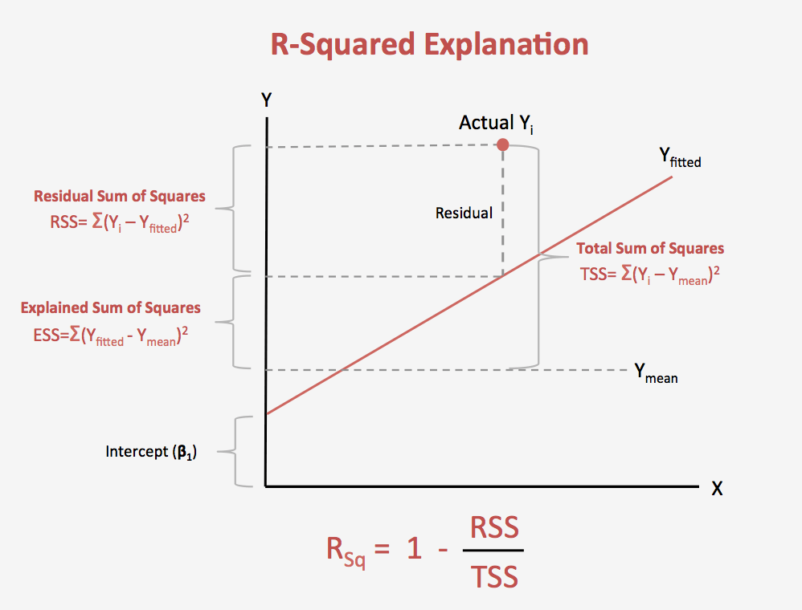
R²
R-squared explains to what extent the variance of one variable explains the variance of the second variable. So, if the R² of a model is 0.50, then approximately half of the observed variation can be explained by the model's inputs.

Slide 13
Adjusted R²
R² always increases if new predictors are added
The adjusted R-squared is a modified version of R-squared that has been adjusted for the number of predictors in the model. The adjusted R-squared increases only if the new term improves the model more than would be expected by chance.

Slide 14
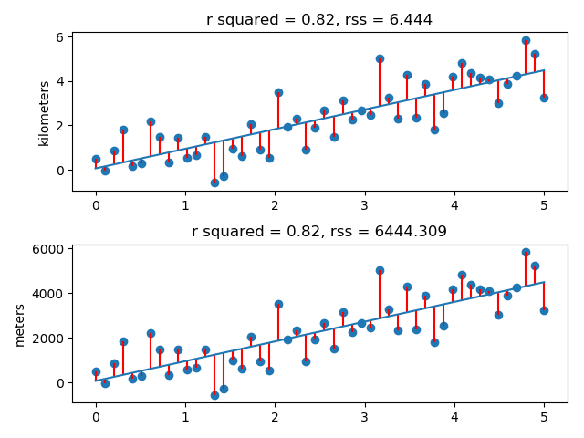
Extra resources
There are other metrics. Please look into the extra resources folder for some useful links
Be aware which metrics are general (like R²) and which are given in the units of the data:
AIC, BIC

Slide 15
What we have done so far
Used whole data we had to build model and measure performance of the model
What is the problem with that?

Slide 16
Solution: Training and Test Data
Divide our data into training and test data
Why?

Slide 17
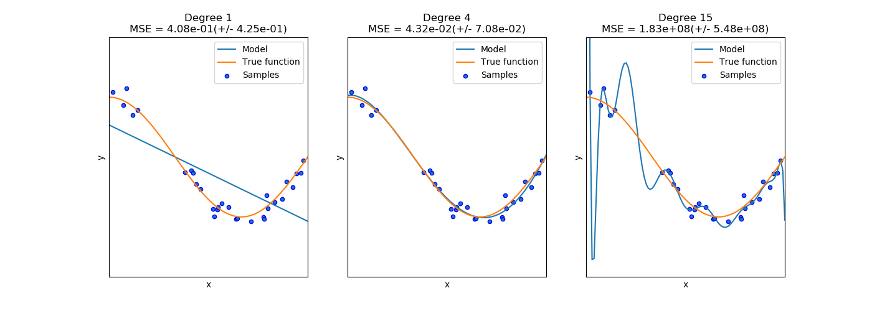
Overfitting
force our model to fit to the training set rather than the actual domain
Linear regression:
if we add too many features
polynomials

Slide 18
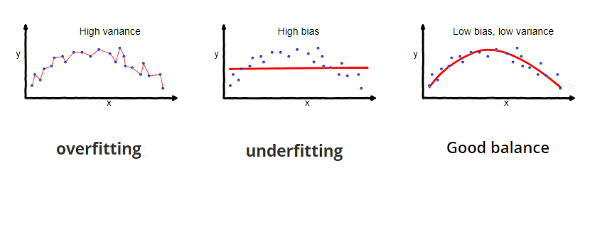
Bias-Variance tradeoff
Bias is the difference between the average prediction of our model and the correct value which we are trying to predict
→ Model with high bias pays very little attention to the training data and oversimplifies the model. It always leads to high error on training and test data.
Variance is the variability of model prediction for a given data point or a value which tells us spread of our data.
→ Model with high variance pays a lot of attention to training data and does not generalize on the data which it hasn’t seen before. As a result, such models perform very well on training data but has high error rates on test data.

Slide 19
Note
This stuff is not per se tested in the exam
But those are chore concepts of machine learning
Popular ML/DS interview questions:
What are the differences between overfitting and underfitting (and how to avoid either)?
What is bias, variance trade off?

Slide 20
Cross Validation
Will be covered tomorrow – but you might come across it in the tutorials/articles in the extra resources
Task for today: check .docx file

Slide 21
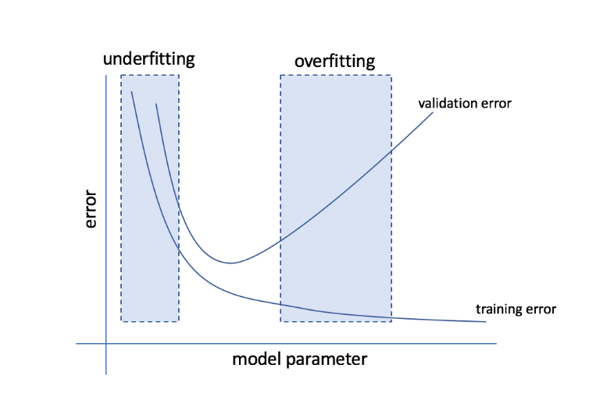
Cross Validation
a model validation technique for assessing how the results of a statistical analysis (model) will generalise to an independent data set.
to estimate how accurately a predictive model will perform in practice (real life)
An optimal model will perform well on training and test data

Slide 22
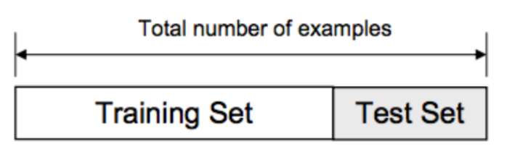
Cross Validation
What are the problems by just dividing data into training and test like we did yesterday?

Slide 23
Problem
What if the split we make isn’t random?
What if one subset of our data has only people from a certain state, employees with a certain income level but not other income levels, only women or only people at a certain age?
will result in overfitting, even though we’re trying to avoid it as it is not certain which data points will end up in the validation set and the result might be entirely different for different sets
→ Thus, it is a good choice only if we have enough data.

Slide 24
Solution: k-fold CV
As there is never enough data to train a model, removing a part of it for validation poses a problem of underfitting
By reducing the training data, we risk losing important patterns/ trends in data set, which in turn increases error induced by bias
So, what we require is a method that provides ample data for training the model and also leaves ample data for validation
→ K Fold cross validation does exactly that.

Slide 25
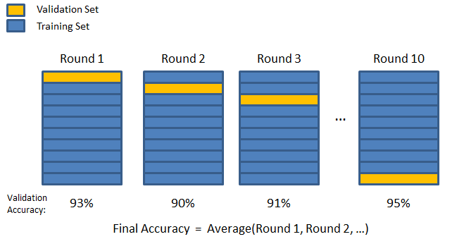
It can be viewed as repeated holdout and we simply average scores after K different holdouts. Every data point gets to be in a validation set exactly once, and gets to be in a training set k-1times.

Slide 26
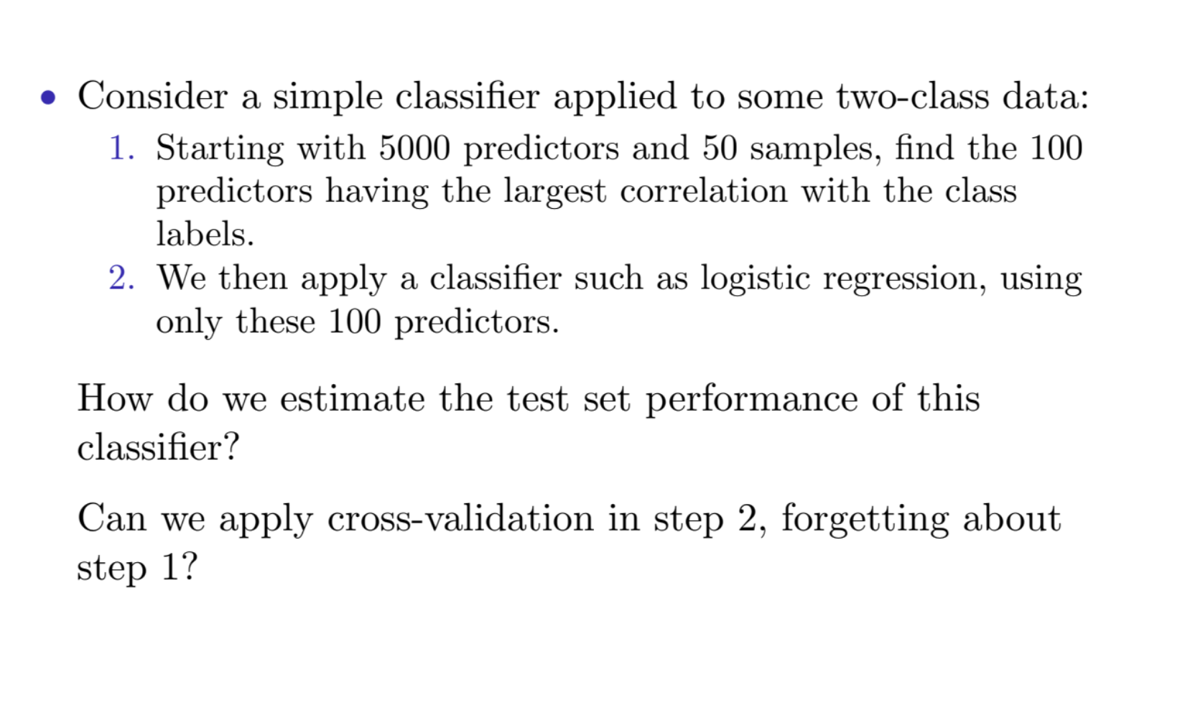
Question for you

Slide 27
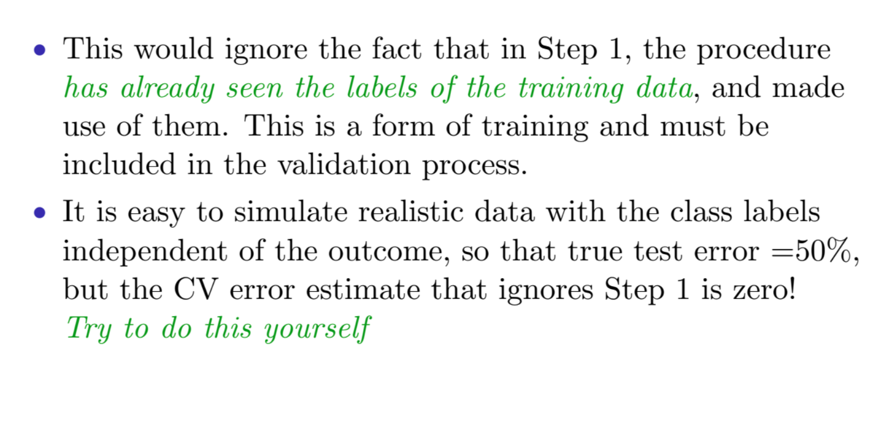
No

Slide 28
Example: My Master Thesis
16 online debates (from forums)
Assessing convincingness of argument pairs
Training on 15 debates, testing on 16th
Repeat 16 times
Average accuracy

Slide 29
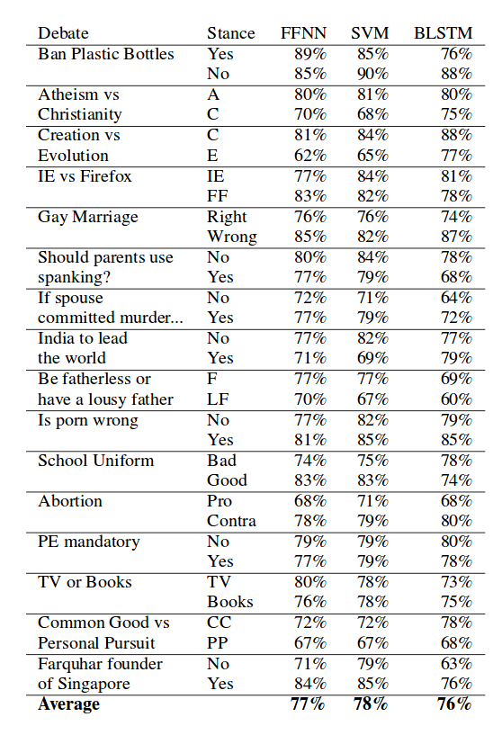

Slide 30
Different types
Validation set (what we did until yesterday)
LOOCV (leave one out)
K-fold
K-fold with repetition
http://www.sthda.com/english/articles/38-regression-model-validation/157-cross-validation-essentials-in-r/
(also in the extra resources folder)

Slide 31
Task for today
Kaggle Challenge: https://www.kaggle.com/c/house-prices-advanced-regression-techniques/overview
Use everything we learned so far
Use CV!!
Work in groups if you want
Develop a regression model to predict log(house price)*** based on other columns in the Ames house price dataset.
Use optimal set predictors (use stepwise selection)
***(we take the log()of the housing data, so that% errors in pricing small cheap/ large expensive houses are equally important)

Slide 32
Suggestion
first only use numerical columns and try to find optimal set of predictors by selecting them (it takes a while to clean the data otherwise – e.g. converting all columns to factors etc)
Manually: using corrplot and comparing p-values of different models
Using stepwise selection methods
Submit your optimal model to kaggle and record your score

Slide 33
Day 7
Finishing/revising what you haven’t finished in the past 2 days
Building regression models
Evaluating the models (metrics, Cross validation)
If you want something new (not in exam):
Bootstrapping
Examining Residuals
Nonlinear fits
Regularisation

