Slide 1
Classification
Predicting category
Eye colour {brown, green, blue}
Spam-email {yes, no}
Given a feature vector X and a qualitative response Y taking values in the set C (possible categories), the classification task is to build a function C(X) that takes the input feature vector X and predicts its value for Y

Slide 2
Example: My Master Thesis
Given an argument I counted the - number of words - number of nouns - number of verbs - number of errors
Resulting feature vector for Argument A: {28, 6, 4, 1}
Argument B: {18, 4, 3, 0}
Which one is more convincing given these feature vectors? (Outcome (0,1) or (1,0)

Slide 3
Other example
Predicting flower based on colour, petal length and height
Flowers: Rose, Lilly (1,2)
Colours: Red, blue, Yellow (1, 2, 3)
Flower A: {1, 3, 20} → prediction: 1 (Rose)
Flower B: {2, 3, 40} → prediction: 2 (Lilly)

Slide 4
Estimating probabilities
Often we are more interested in estimating the probabilities that X belongs to category C
For example, probability that an insurance claim is fraudulent
Fraudulent: Yes/No (not very informative)
Fraudulent: 40%/60% (more likely No, but probably worth looking into this)

Slide 5
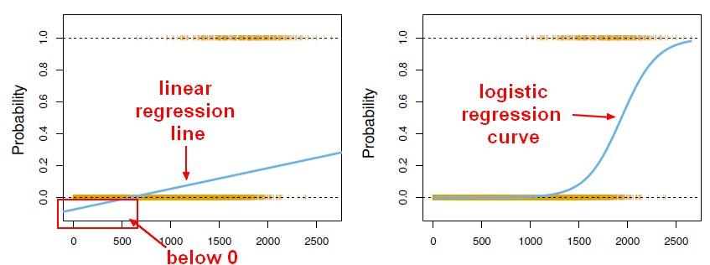
If outcome Binary (yes, no)
Could use linear regression. No if <50% and Yes if >50%
Linear regression might produce probabilities less than zero or bigger than 1
Logistic regression is appropriate

Slide 6
If your outcome is not binary
Logistic regression not appropriate
If you have more than two classes then Linear Discriminant Analysis (LDA) is the preferred linear classification technique (given that all groups are identically distributed – otherwise Quadratic Discriminant Analysis (QDA))
In order to understand LDA you need to understand PCA (principal component analysis)
I will not cover LDA and QDA – please check extra resources file for excellent videos and tutorials
I personally prefer Support Vector Machines (SVMs) but these are not covered in this course, but again: feel free to look into them!

Slide 7
Most common classification algorithms
Logistic regression (covered today)
Naive Bayes Classifier (covered today)
Support Vector Machine
K-nearest Neighbour (covered tomorrow)
Decision Trees (covered next week)
Random Forest (covered next week)
I honestly have no idea why Discriminant Analysis is in the Syllabus...

Slide 8
Again...
The type of algorithm you use depends ON YOUR DATA
You cannot really say one is better than the other

Slide 9
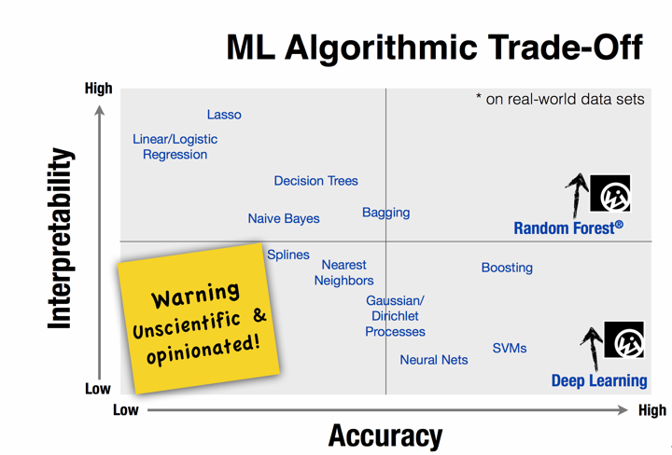

Slide 10
PCA
Not in exam but a useful technique for exploratory data analysis, allowing you to better visualize the variation present in a dataset with many variables
Need to understand PCA in oder to understand LDA
Please check extra resources for resources and again an excellent video (University of North Carolina)

Slide 11
Naive Bayes Classifier
It is a classification technique based on Bayes’ Theorem with an assumption of independence among predictors
Naive Bayes model is easy to build and particularly useful for very large data sets
It’s super simple and is known to outperform even highly sophisticated classification methods
That’s why we will cover this instead of LDA/QDA (but again, please feel free to follow the actual syllabus. No, they wont be in the exam)

Slide 12
NB classifier
works particularly well with natural language processing (NLP) problems
family of probabilistic algorithms that take advantage of probability theory and Bayes’ Theorem to predict the tag of a text (like a piece of news or a customer review)
probabilistic, which means that they calculate the probability of each tag for a given text, and then output the tag with the highest one

Slide 13
Example 1
Text | Tag
“A great game” | Sports
“The election was over” | Not Sports
“Very clean match” | Sports
“A clean but forgettable game” | Sports
“It was a close election” | Not Sports
Now, which tag does the sentence “A very close game” belong to?

Slide 14
Since Naive Bayes is a probabilistic classifier, we want to calculate the probability that the sentence “A very close game” is Sports and the probability that it’s Not Sports
Written mathematically, what we want is P(Sports | a very close game)— the probability that the tag of a sentence is Sports given that the sentence is “A very close game”.
That’s great, but how do we calculate these probabilities?

Slide 15
Feature Engineering
The first thing we need to do when creating a machine learning model is to decide what to use as features (predictors in LR)
if we were doing classification on health, some features could be a person’s
height, weight, gender, and so on.
We would exclude things that maybe are known but aren’t useful to the model, like a person’s name or favorite color.
But here we dont have numeric features!
Solution: word frequencies

Slide 16
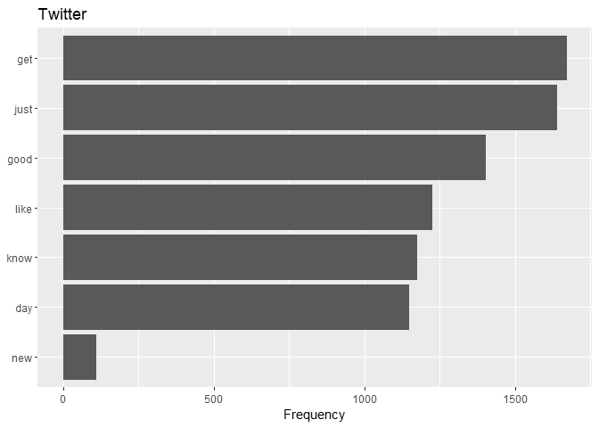

Slide 17
We ignore the word order and sentence construction (hence, NAIVE bayes) treating every document as a set of the words it contains
Features will be the counts of each of these words
May seem too simplistic but it works surprisingly well

Slide 18
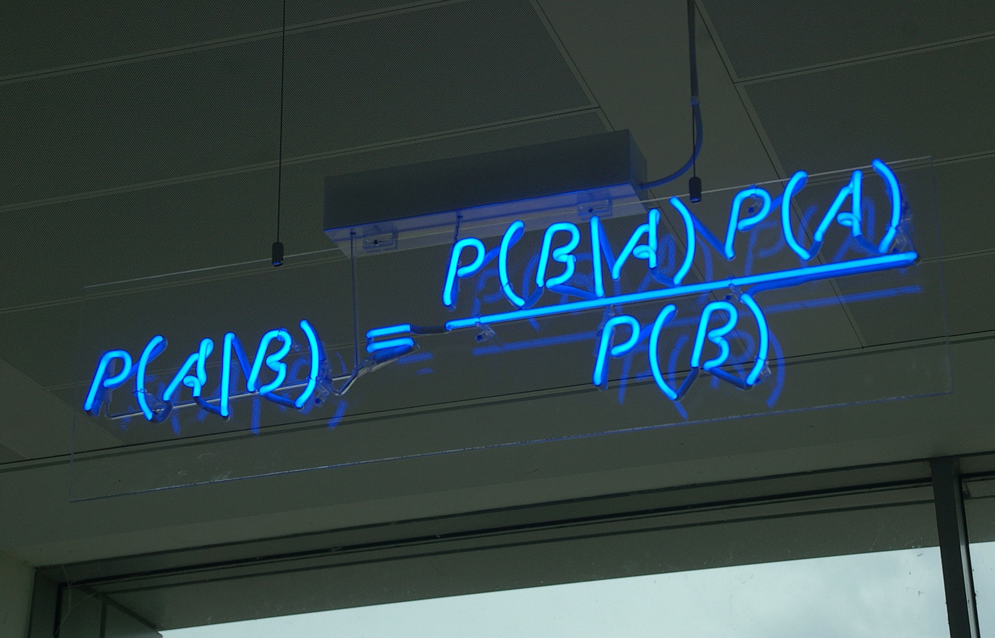
Bayes Theorem

Slide 19
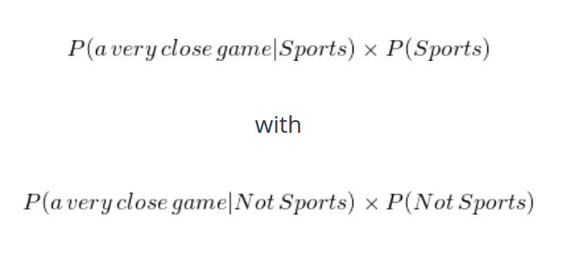
Since for our classifier we’re just trying to find out which tag has a bigger probability, we can discard the divisor —which is the same for both tags— and just compare

Slide 20
count how many times the sentence “A very close game” appears in the Sports tag, divide it by the total, and obtain P(a very close game | Sports)
Problem: that exact sentence doesnt appear in our training data ( P = 0)

Slide 21
Being Naive
So here comes the Naive part: we assume that every word in a sentence is independent of the other ones
This means that we’re no longer looking at entire sentences, but rather at individual words
So for our purposes, “this was a fun party” is the same as “this party was fun” and “party fun was this”
Therefore: P(“a very close game”) =
= P(“a”) X P(“very”) * P(“close”) * P(“game”)

Slide 22
A priori probability of each tag: for a given sentence in our training data, the probability that it is Sports P(Sports) is 3/5 and P(Not Sports) is 2/5
P(a very close game | Sports) = P(a | Sports) * P(very | Sports) * P(close | Sports) * P(game | Sports)
Problem: “close” is not in any Sports texts
P(close|Sports) = 2/11
Since we are multiplying, we will end up with P = 0!
Solution: laplace smoothing: adding 1 to every count, so it’s never 0. To balance this, we add the number of possible words to the divisor (so division will never be greater than 1)
Possible words: 'a', 'great', 'very', 'over', 'it', 'but', 'game', 'election', 'clean', 'close', 'the', 'was', 'forgettable', 'match' (14)
Text | Tag
“A great game” | Sports
“The election was over” | Not Sports
“Very clean match” | Sports
“A clean but forgettable game” | Sports
“It was a close election” | Not Sports

Slide 23
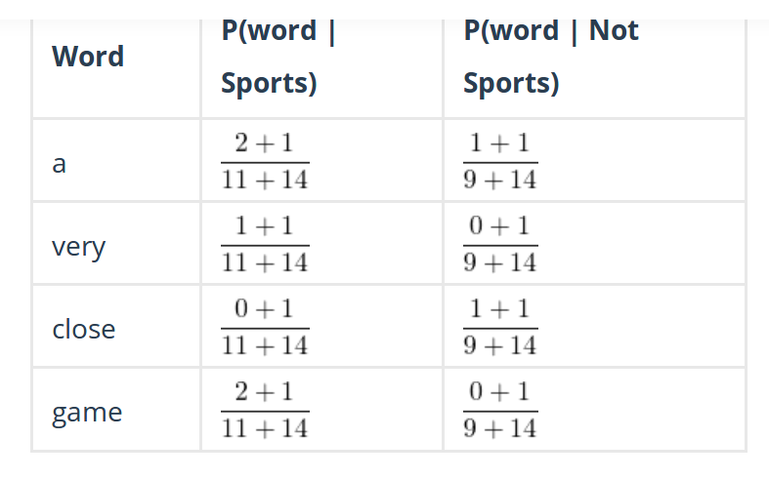

Slide 24
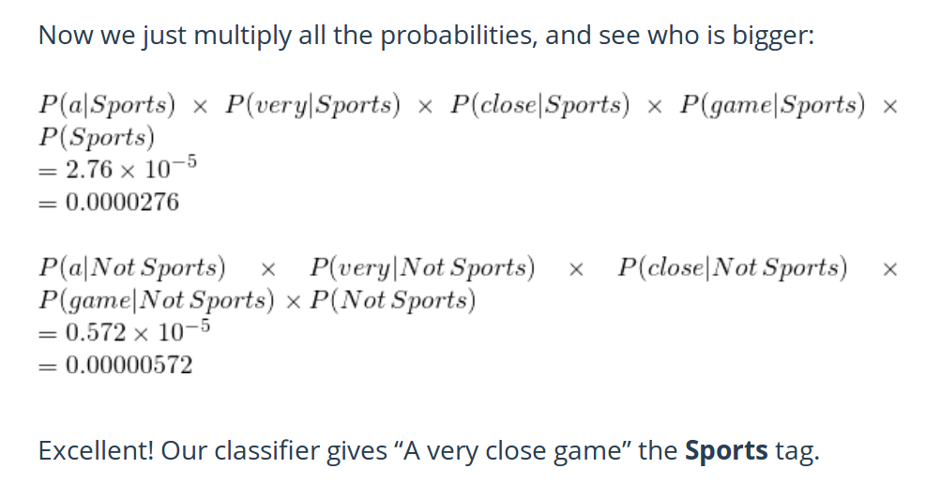
And finally...

Slide 25
Example 2
Famous Titanic dataset
Let’s try to predict whether or not they survived the shipwreck based on ticket fare information
Random sample: 500 passengers, 30% survived
Among those who survived fare ticket mean was 100$
Among those who didnt, fare ticket mean 50$

Slide 26
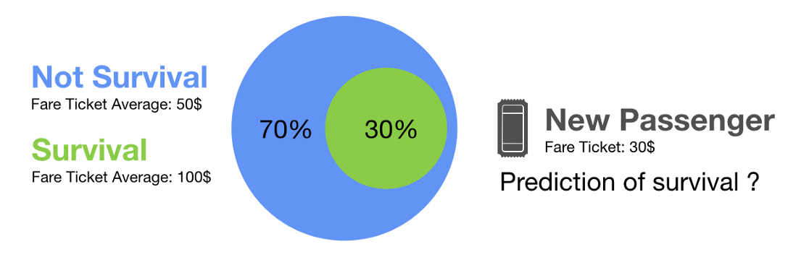
New passenger
You have a new passenger and dont know whether he survived or not but you know he bought a 30$ ticket
What is your prediction of survival for this passenger?

Slide 27
You probably predict that he didnt survive
Why? Because according to the information contained in the random subset of passengers, you assumed that chances of survival were low and that being boor reduces the chances of survival
You put this passenger in the closest group of likelihood (low fare ticket group)
That’s exactly what NB classifier does

Slide 28
NB not just for text classification
Real time prediction: because it’s fast
Multi-class prediction
Recommendation System: predict whether a user would like a given resource or not (Spotify, ASOS, Amazon...)

Slide 29
Assessing model accuracy
Overall Accuracy: out of 100 people your model predicted the tag correctly for 84 = 84% accurate (easy)
This is often not enough – you also want to know false positive and false negatives
Confusion matrix of Precision and Recall

Slide 30
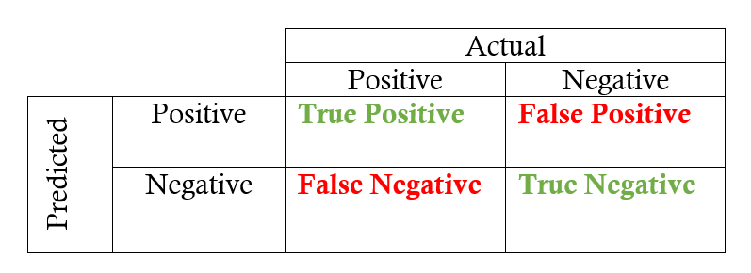

Slide 31
Example
Recognising oranges from apples.
Picture contains 12 oranges and some apples
Your model recognises 8 oranges
5/8 are actual oranges (true positives) and the rest are apples (false positives)
Precision: 5/8
Recall: 5/12

Slide 32
Example 2
Search engine returns 30 pages
20 of them are relevant
Fails to return other 40 relevant pages
Precision: 20/30 = 1/3
Recall 20/60 = 1/3

Slide 33
Recall: ability of a classification model to identify all relevant instances
Precision: ability of a classification model to return only relevant instances
F1 score: single metric that combines recall and precision using the harmonic mean

Slide 34
Precision vs Recall
False Negative in Cancer Detection: Recall is a better measure!!
You want to find ALL the instances of cancer, even if some of them are false positives
YouTube recommendations: False negatives less of a concern: Precision is better here
You want to recommend only relevant stuff, even if you miss some

Slide 35
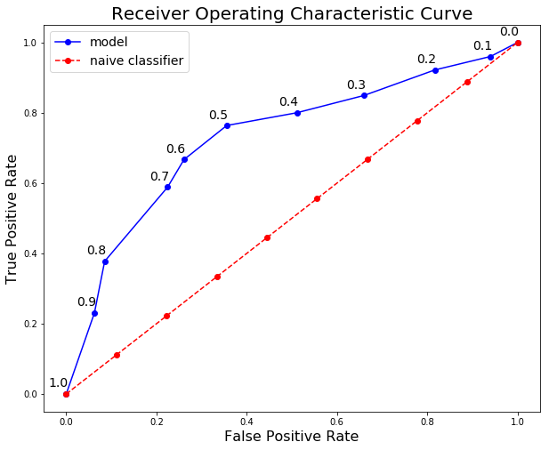
ROC curve
https://towardsdatascience.com/beyond-accuracy-precision-and-recall-3da06bea9f6c

Slide 36
Report
The Report Brief is online now, please have a look at it
Unfortunately I cannot change it so you are limited to linear and logistic regression and decision trees (covered next week)
But please feel free to include more models and compare them and show why your chosen one is better than the others (at the end of the day – it’s still me, who is marking them)
Brief in general confusing – can’t think of a dataset where you can apply regression AND classification… I would choose a classification task for the report
Unless you use trees for regression...but I find this utterly confusing for a beginners course in ML...

Slide 37
Choice of dataset
You are free to choose a dataset you like apart from very famous ones (IRIS, Boston, Titanic etc) since there is just too much material on them on the net
If you don’t have a dataset by tomorrow, talk to me

Slide 38
NLP
Who’s interested in text classification tasks can talk to me and I will give a more detailed intro into - stopword removal - word lemmatisation - use of n-grams - use of tf-idf

Slide 39
Feature Engineering
Not part of this course
But essential part of Machine Learning
Only big companies can afford hiring data engineers and data scientists separately
Usually Data Scientists need to be able to do both
I actually worked as a data engineer last summer
Good Feature Engineering can improve your ML model a lot!
Just so you know. I will give some examples today

Slide 40
Task for today
I will walk you through the EDA of the titanic dataset – this is how your report should look (more or less...)
I will show you how to train logistic regression model and NB model and how to evaluate them
Understand what I did in the Titanic “Report”
Start with your report (find dataset, explore it...)

