Slide 1
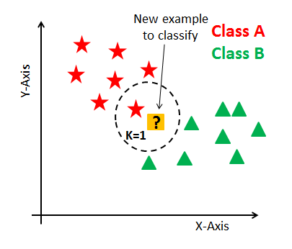
K-Nearest Neighbour Algorithm

Slide 2
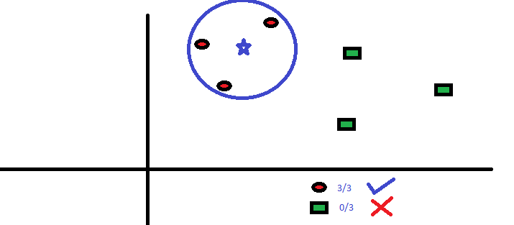
Classification
Can also be used for regression but let’s not get started on this again…
The “K” is KNN algorithm is the nearest neighbors we wish to take vote from. Let’s say K = 3
We want to know what category the blue star belongs to
Take vote of closest 3 neighbours

Slide 3
How do we choose K?
with a given K value we can make boundaries of each class
These boundaries will segregate the classes
let’s see the effect of the value for K on the class boundaries

Slide 4
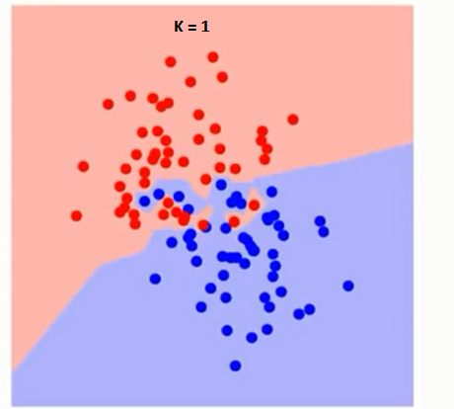
K = 1
What is happening here?

Slide 5
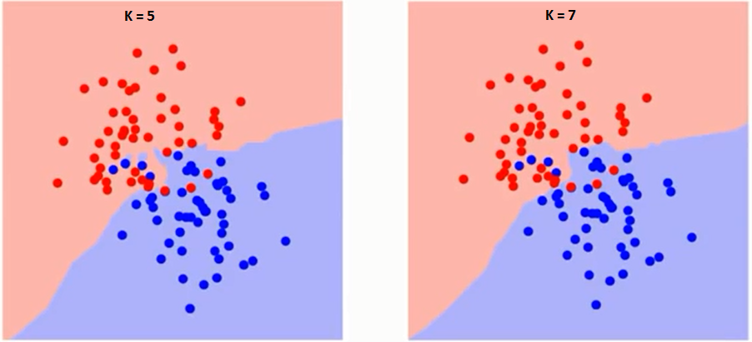
Better K Values to avoid overfitting

Slide 6
What should K not be if
If you have 2 classes?
If you have 7 classes?

Slide 7
Answers
If you have 2 classes, K should be an odd number
If you have 7 classes, K should not be a multiple of 7

Slide 8
Caret::train() is smart
It will return the model with the best K for you
You can specify the range of values it should look for K and plot K vs Accuracy

