Slide 1
EXE Week 9
Pagination

Slide 2
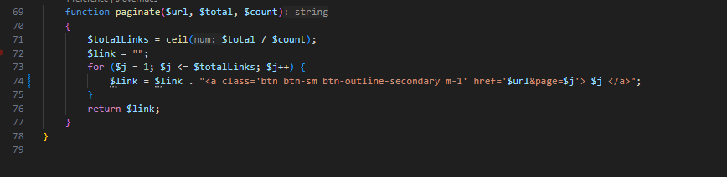
Pagination function
Screenshot pagination function

Slide 3
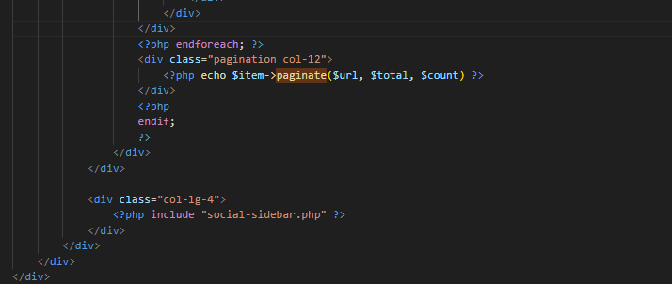
Pagination function
Screenshot pagination function

Slide 4
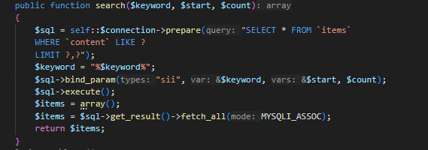
Search
Screenshot of search function

Slide 5
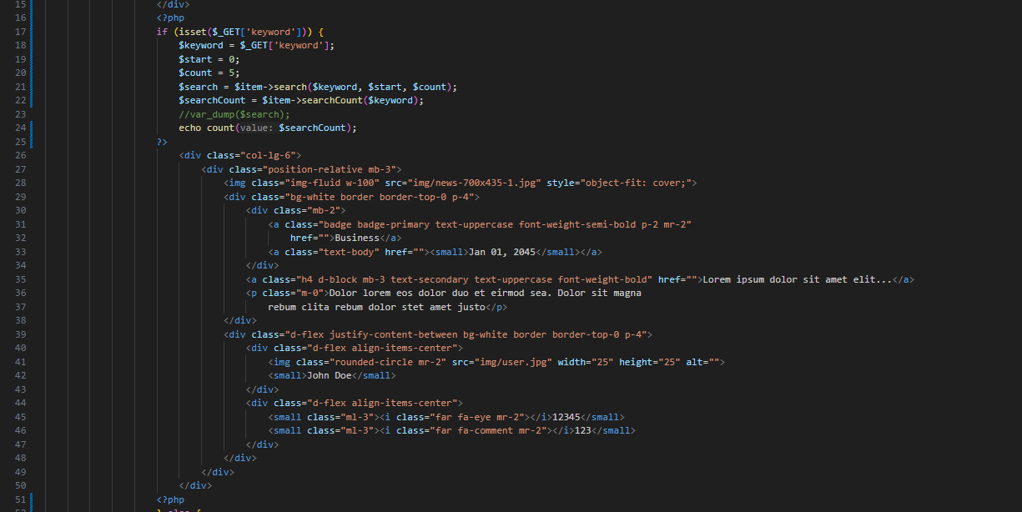
Search
Screenshot of search function

Slide 6
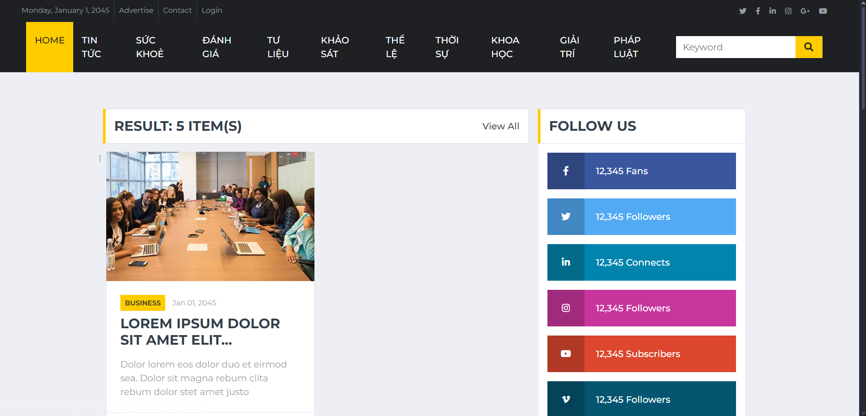
Result
Screenshot of result code to display pagination and search result

Slide 7
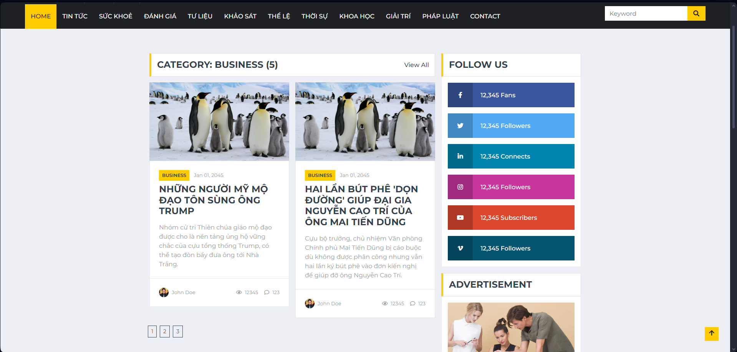
Result
Screenshot of the pagination show in browser

