Slide 1
RHEINOL QUICK SERVICE SUPERVISOR: Nguyễn Thị Cẩm Hương
MEMBER
Lê Đình Thiện Vũ (Leader)
Phan Ánh Phúc
Đặng Hữu Phương Nam

Slide 2
AGENDA
Introduction
1
Implementation
2
3
Outcome
Future Plan
4

Slide 3
INTRODUCTION
1
Brief description, Problem definition, Proposed solution

Slide 4
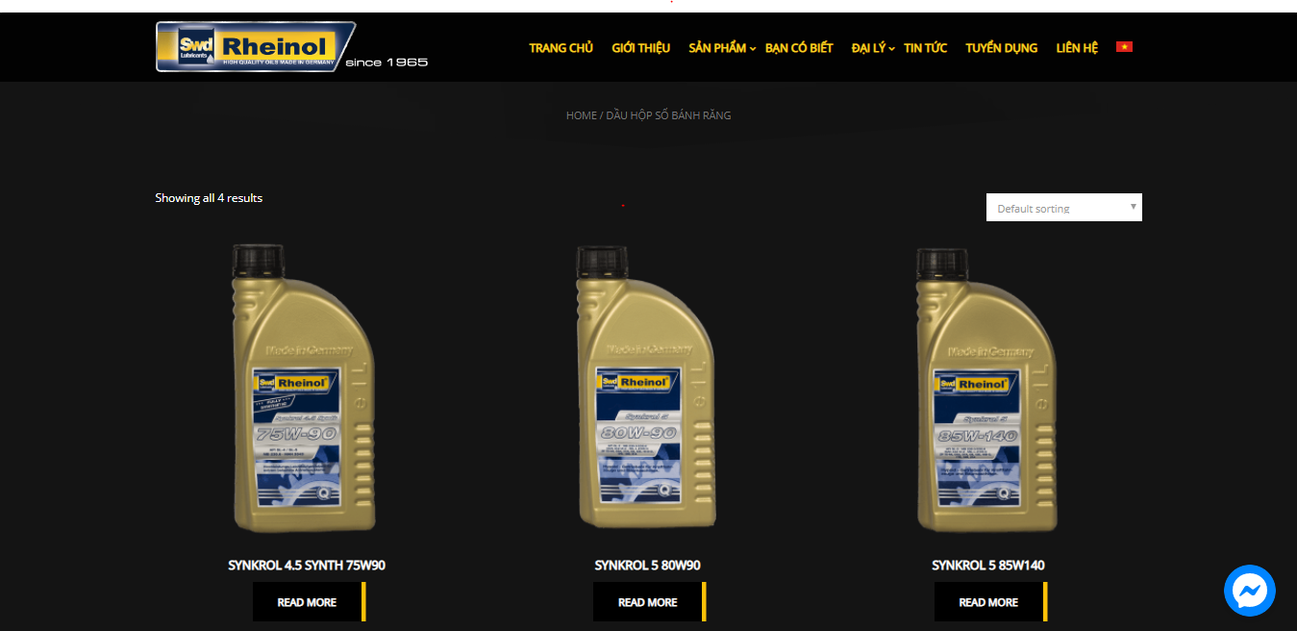
CURRENT SITUATION
The website just displays Rheinol’s information and products.
The website does not support customers in buying products or using services.
The system cannot manage products, services or customers.

Slide 5

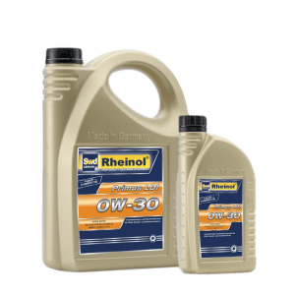
PROBLEM DEFINITION
The customers can only see product’s information or introduction to the company .
The customers cannot buy products or use Rheinol’s service through the website.

Slide 6





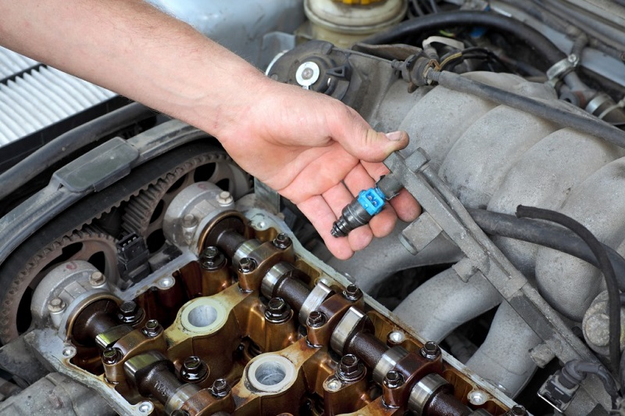

PROBLEM DEFINITION
The system does not manage loyal customers to offer promotions.
The system has no control over the services or products they are trading.

Slide 7

PROBLEM DEFINITION
The customers do not know the available time of the garage to book a service.

Slide 8

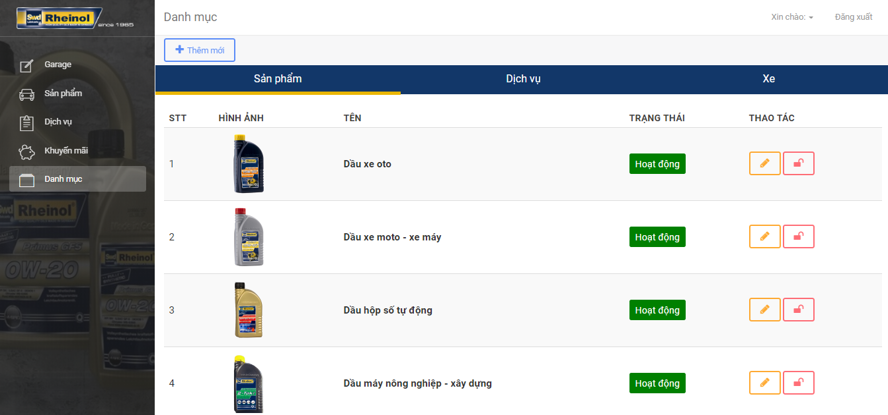
SOLUTION
Web application for administrator
Mobile application for customer

Slide 9
SOLUTION
Managing product, service, and promotion
Creating a direct order
Viewing report chart
Web application for administrator

Slide 10
SOLUTION
Buying products
Booking service with an available slot
Paying by wallet
Receiving notification for the service’s maintainance
Mobile application for customer

Slide 11
IMPLEMENTATION
2
Design and Implement system

Slide 12
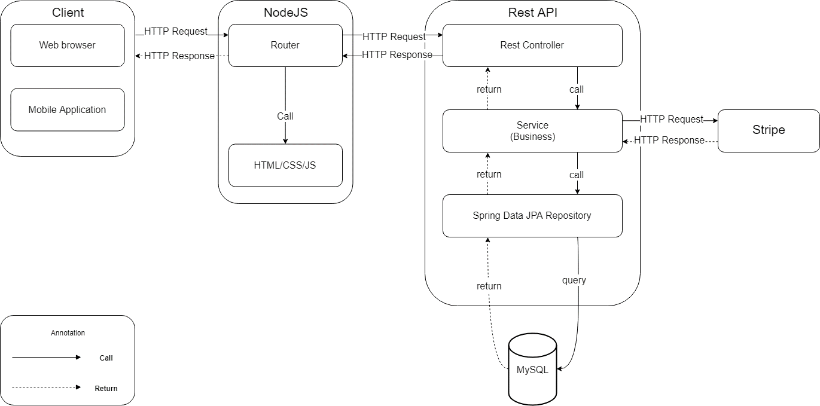
SYSTEM ARCHITECTURE

Slide 13

DEMO

Slide 14



MAIN PROCESS
1. Login with
Authorized user
2. Choose product and service
3. Book available slot
4. Choose promotion
Guest
Home Screen
Cart Screen
Booking Screen
Cart Screen
5. Create the
order

Slide 15



MAIN PROCESS
1. Login with
Authorized user
2. Paying by wallet
3. Rating service
Guest
Rating Pop up
7. Complete task and send notification to user
1. Login with
Technical
2. Verify Service
Technical
List order Screen
Checking Screen
3. Send notification to sales clerk
6. Sending confirmation to technical
4. Login with
Sales clerk
5. Select order
Sales clerk
Manage order page
Confirm Pop up

Slide 16
REGISTER BANK CARD
2. Login as Authorized user role
3. Choose register bank card
1. Access to app
Login screen
User screen
Register screen
Guest
5. Save information
4. Register bank card
Bank card screen

Slide 17
TRANSFER CAR
2. Login as Authorized user role
3. Choose manage car
1. Access to app
Login screen
User screen
List car screen
Guest
4. Select car
5. Input information
List car screen
Transfer car screen

Slide 18
SUGGEST PROMOTION
2. Login as Authorized user role
3. Choose product or service
1. Access to app
Login screen
Home screen
Cart screen
Guest
5. Save information
4. Choose promotion
Cart screen

Slide 19

GARAGE’S INFORMATION
1. Login as Admin role
2. Input the information
3. Click “Save”
Admin
Information Page
Information Page

Slide 20
ADD NEW PROMOTION
1. Login as Admin role
3. Input the information
2. Click “Add new”
List promotion Page
Add new promotion Page
Add new promotion Page
Admin
4. Click “Add”
5. Save new promotion
List promotion Page

Slide 21
ADD NEW ORDER
1. Login as sales clerk role
3. Input the information
2. Click “Add new”
List order Page
Add new order Page
Add new order Page
Sales clerk
4. Click “Add”
5. Save new order
List order Page

Slide 22

VIEW REPORT CHART
1. Login as director role
3. Show report chart
2. Select timeline
Report Page
Report Page
Director

Slide 23
BOOK SERVICE
Time
 | 8:30 | 9:00 | 9:30 | 10:00 | 10:30 | 11:00 | 11:30 | ... | 15:00 | 15:30 | 16:00 | 16:30 | 17:00
1
2
3
4
5
Slot

Slide 24


BOOK SERVICE
Employee 1
Employee 2
Employee 3
Employee 4
Assign
Assign
Assign
Assign

Slide 25
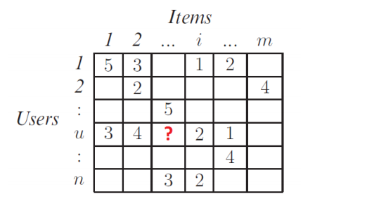
SUGGEST PRODUCT

Slide 26
OUTCOME
3
Value and challenge

Slide 27

ASSESSMENT: VALUE
Customers easily buy products and book the service
Administration can manage product, service and promotion
Viewing report chart about revenue or rating
Simpler order’s status control

Slide 28

ASSESSMENT: DISADVANTAGES
Only support Vietnamese

Slide 29
FUTURE PLAN
4

Slide 30

FUTURE PLAN
Apply franchise system
Stock management
Human management
Device management
Statistics of best-selling products
Develop more types of promotions

Slide 31
Q&A

Slide 32
ADD NEW PRODUCT
1. Login as Admin role
3. Input the information
2. Click “Add new”
List product Page
Add new product Page
Add new product Page
Admin
4. Click “Add”
5. Save new product
List product Page

Slide 33
ADD NEW SERVICE
1. Login as Admin role
3. Input the information
2. Click “Add new”
List service Page
Add new service Page
Add new service Page
Admin
4. Click “Add”
5. Save new service
List service Page

