Slide 1
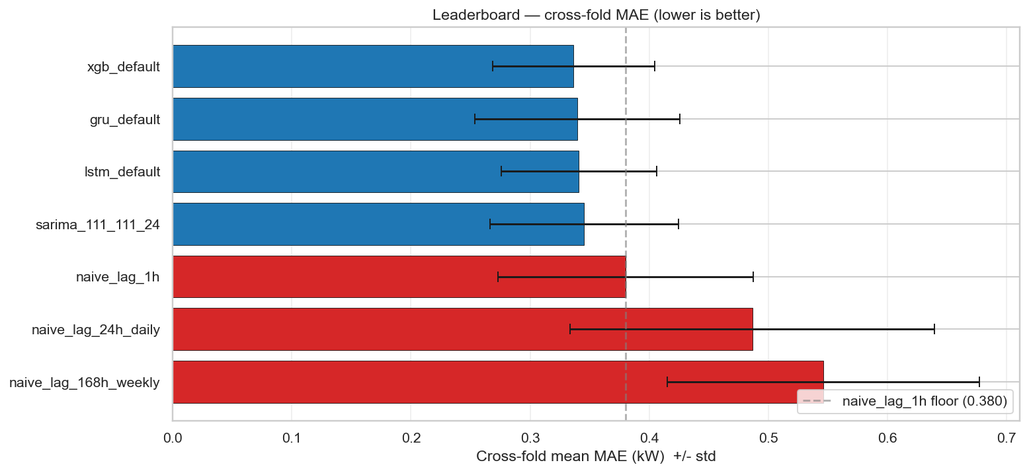
Forecasting Hourly Household Energy Consumption
LUISS Artificial Intelligence Techniques • Industry partner: Enel Global ICT • Thierry Ishimwe, Linda Carla Zorzoli, Mariavittoria Giurato, Cesar Dushimimana
MAE = 0.336 kW
Cross-fold mean, XGBoost (leakage-safe pipeline)
Four model families (SARIMA, XGBoost, LSTM, GRU) compared on a uniform rolling-origin protocol with five metrics. Same-timestamp UCI columns (Voltage, Global_intensity, sub-metering) are mechanically excluded from the feature matrix; short-gap imputation is past-only. The pipeline ships with two regression tests guarding both guarantees.
• Top three are a statistical tie. XGBoost 0.336, GRU 0.339, LSTM 0.341, SARIMA 0.345. Diebold–Mariano: XGBoost vs SARIMA (p=0.022) is the only significant pair at α=0.05.
• GRU is competitive with LSTM at lower complexity. Same MAE within noise; the simpler GRU cell captures sequential structure as well or better at this resolution.
• Weather augmentation validates the future-work priority. Adding 4 Paris-Montsouris weather columns to XGBoost: −0.77% MAE, concentrated on heating-season folds.
• Leakage-safe by construction. Registry blocks same-timestamp components of the target; past-only imputation; two regression tests guard the policy.
github.com/ThierryIshimwe/Energy-Forecasting • Brief: reports/Project_Work_Luiss_AI_Techniques_200326.pdf • Full analysis: notebooks/00_main_deliverable.ipynb

Slide 2
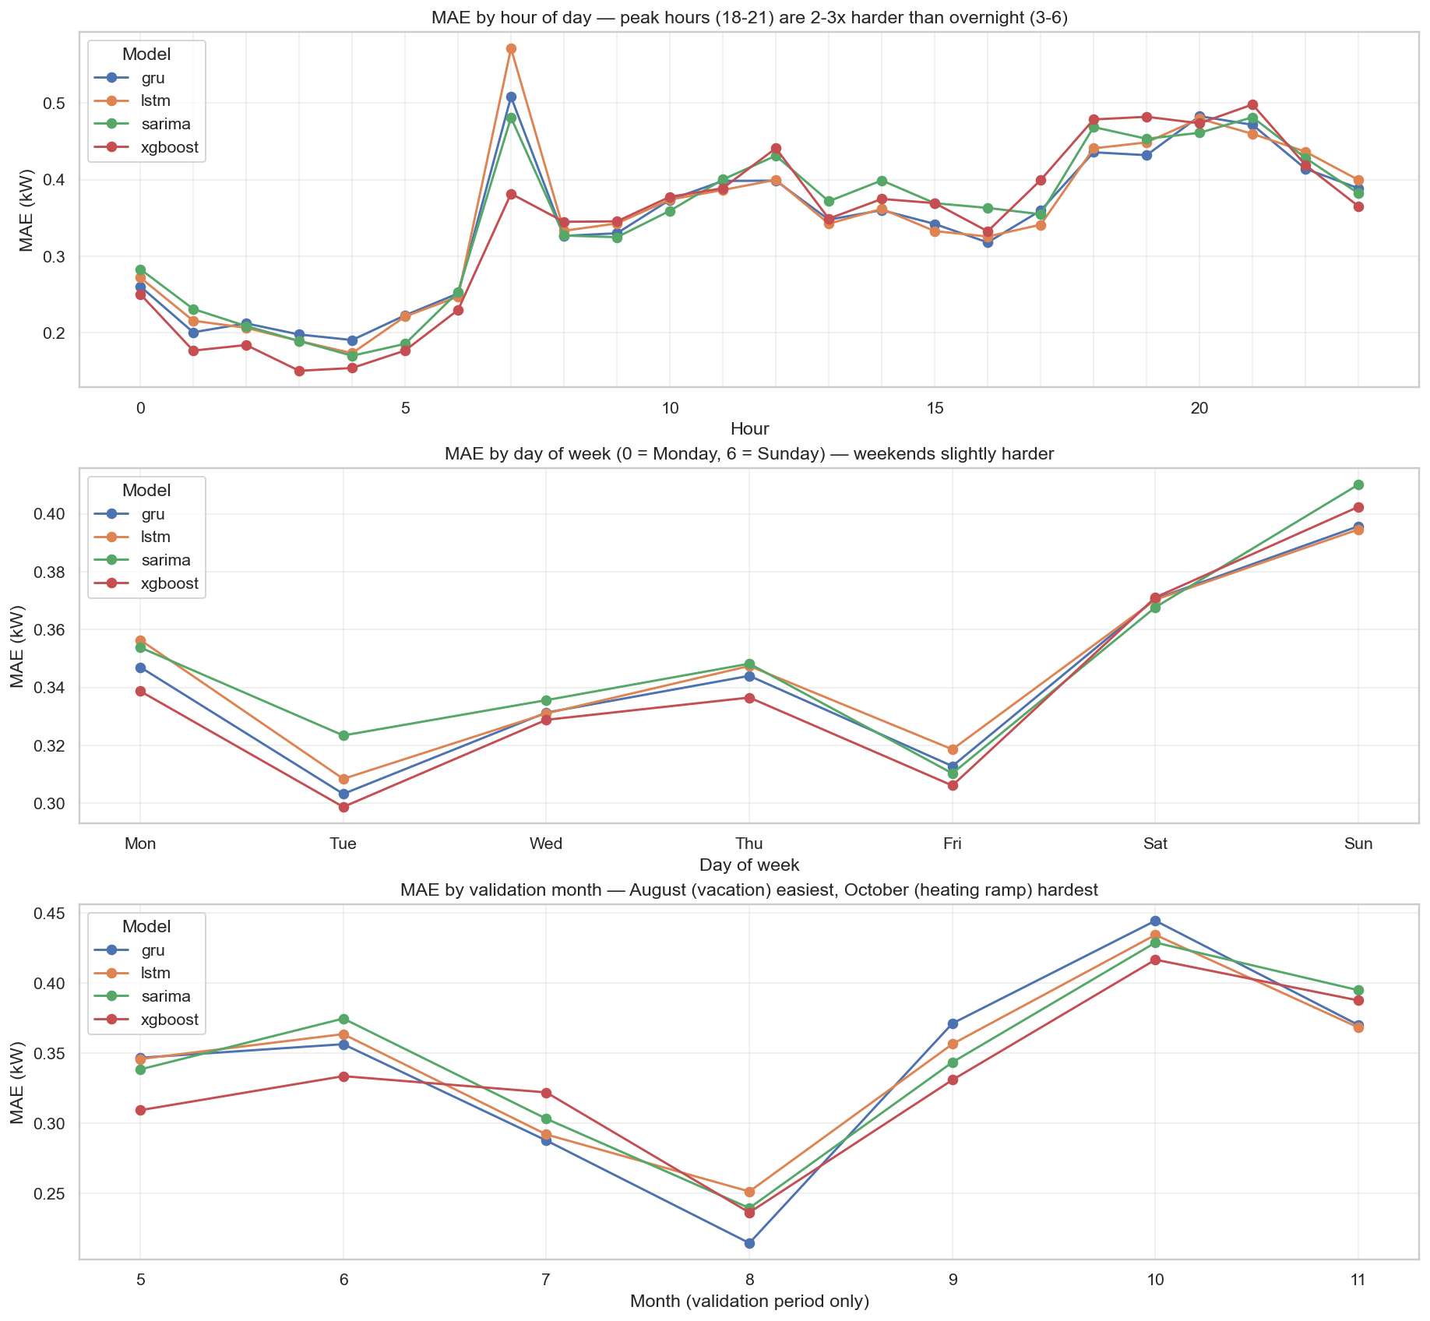
Where Models Win, Where They Lose, and What's Next
Operational implications
• Peak-hour MAE is ~2.5× trough-hour MAE. XGBoost wins quiet hours; GRU wins peaks. For peak-cost-weighted operations, GRU may be the better deployment choice.
• August easiest, October hardest. August = grandes vacances (empty household, flat load). October = regulated période de chauffe (heating ramp, MAE ~2× higher).
• Stacking does NOT break the 3% cluster. Base-model errors are too correlated. The bottleneck is input information, not model variety.
Future work
• Extend weather to SARIMA / LSTM / GRU. The −0.77% gain on XGBoost is a lower bound. ~70 min DL retrain on the already-built augmented matrix.
• 24-step-ahead day-ahead forecasting. Current results are 1-step-ahead at hourly resolution. Production at Enel uses 24-step horizons made once per day from a fixed cutoff.
MAE by hour-of-day, day-of-week, and validation month. Peak hours and October heating-ramp dominate the error budget.
github.com/ThierryIshimwe/Energy-Forecasting • Brief: reports/Project_Work_Luiss_AI_Techniques_200326.pdf • Full analysis: notebooks/00_main_deliverable.ipynb

