Slide 1
Systèmes intelligents avancés classic CNN models
Maxime Ambard
LEAD CNRS UMR 5022
Institut Marey – I3M
64 rue Sully - 210000 DIJON CEDEX - France
Contact : maxime.ambard@u-bourgogne.fr

Slide 2
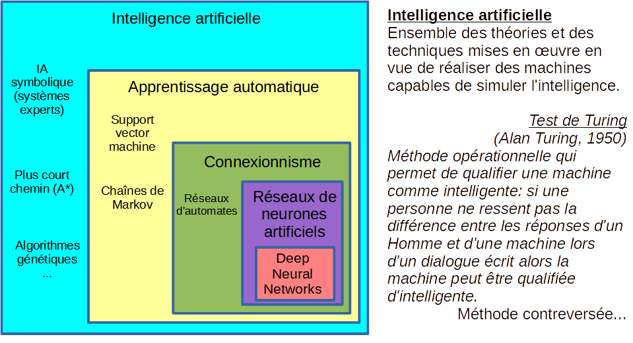
Terminology

Slide 3
SUMMARY (4A)
I- Introduction and Terminology
II- Machine Learning
II-1 Unsupervised learning
Clustering
Dimension Reduction
II-2 Supervised learning
Classification
Regression
III- Focus on Artificial Neural Networks

Slide 4
II-1 Unsurpervised learning
Algorithms that analyze data without labels or a target variable in order to automatically discover its structure, organization, or hidden relationships (such as clusters, latent components, or distribution).
Customer segmentation: Which groups of customers exhibit similar purchasing behaviors in order to personalize marketing offers?
Anomaly detection: Which files or financial transactions appear unusual and could indicate fraud or technical issues?
Dimensionality reduction for visualization: How can complex data, such as images or genetic sequences, be represented in two or three dimensions to explore their structure?
Topic analysis in text: What topics or themes automatically emerge from a large corpus of articles or customer reviews?
Discovery of relationships between variables: Are there hidden patterns or groups of highly correlated variables in scientific or industrial measurements?

Slide 5
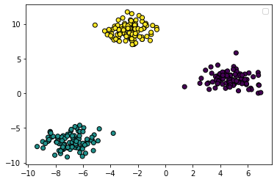
II-1-1 Clustering
Clustering is a type of unsupervised learning where the goal is to group a set of objects in such a way that objects in the same group (or cluster) are more similar to each other than to those in other groups. The idea is to find inherent structures within data based solely on the features of the data without any labeled outcomes.
Warning ! Different clustering algorithms with different parameters would detect different cluster configurations.
Question : what are the categories inside this dataset ?
Reply :
Aplying this algorithm with these parameters give this result.
On this base, this would mean that the dataset can be segmented as follows…
Cluster #1
Cluster #3
Cluster #2

Slide 6
II-1-1 Clustering
Four algorithms to know :
a. K-means
Algorithme de partitionnement qui regroupe les données en K clusters en minimisant la variance intra-cluster, chaque groupe étant représenté par son centroïde (moyenne).
b. Gaussian mixture model (GMM)
Modèle de clustering probabiliste qui représente les données comme un mélange pondéré de plusieurs distributions gaussiennes, chaque observation étant décrite par une probabilité d’appartenance à chaque cluster plutôt qu’une affectation stricte.
c. Hierarchical clustering (CAH)
Méthode hiérarchique qui construit récursivement une arborescence de clusters (dendrogramme) en fusionnant progressivement les groupes les plus proches selon une mesure de distance.
d. DBSCAN
Algorithme basé sur la densité locale qui forme des clusters comme des régions denses de points connectés et identifie automatiquement les points isolés comme du bruit (outliers).

Slide 7
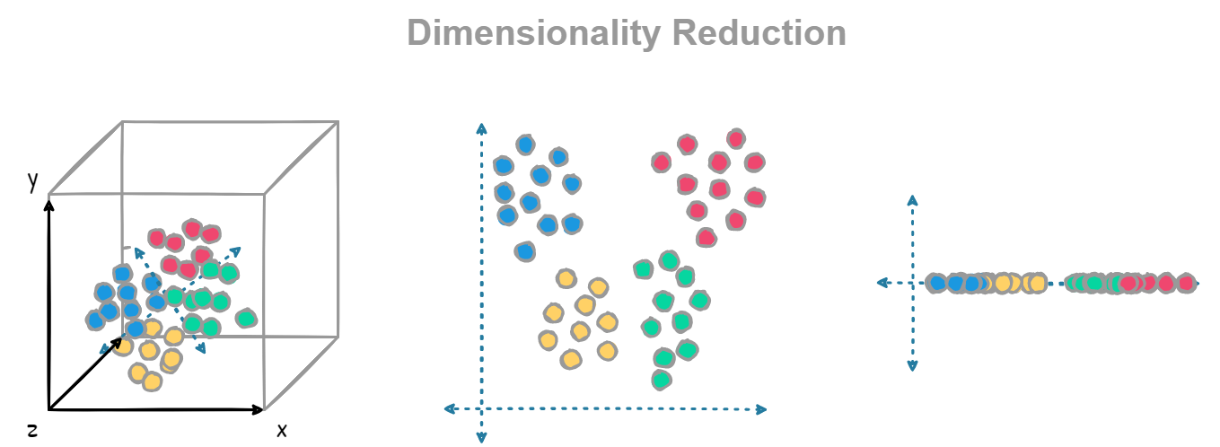
II-1-2 Dimension reduction
Dimensionality reduction is a technique used to simplify datasets by projecting them into a lower-dimensional space while keeping the most important information. The goal is to make the data easier to visualize, analyze, or feed into other algorithms, without losing key patterns or relationships.
Warning! Different reduction methods and parameter choices can highlight different structures in the data
Question: which directions or components capture the main variability of this dataset?
Reply: Applying this method with these settings gives this result. Based on this, it seems that the dataset can be represented along these key dimensions for further analysis or visualization.

Slide 8
II-1-2 Dimension reduction
The three dimensionality reduction algorithms to know:
PCA (Principal Component Analysis) – Principal Component Analysis
  A linear method that projects data into a lower-dimensional space while preserving maximum variance.
t-SNE (t-Distributed Stochastic Neighbor Embedding) – t-SNE
  A non-linear technique, particularly suited for visualizing data in 2D or 3D, preserving the local structure of the data.
UMAP (Uniform Manifold Approximation and Projection) – UMAP
  A fast non-linear method that preserves both local and global structure of data, often used for visualization and machine learning.

Slide 9
II-2 Supervised learning: A dataset
In supervised machine learning, a dataset is a collection of labeled examples, where each example pairs input features with a known output (can be multidimensional). It is used to train a model to learn the relationship between inputs and outputs for making predictions on new data.
Classifier
Performance
Dataset
Training:
80% Data
Training set – The portion of the dataset used to teach the model by adjusting its parameters.
Validation set – A subset used to tune hyperparameters and prevent overfitting during training.
Test set – A separate dataset used to evaluate the model’s performance on unseen data.
Validation:
10% Data
Test:
10% Data

Slide 10
Surpervised learning
Algorithms that learn from labeled data, where each example is paired with a known target variable, in order to build a model capable of predicting that target on new, unseen data.
Classification: Is this email spam or not spam, based on its content and metadata?
Regression: What will be the price of a house given its surface area, location, and number of rooms?
Medical diagnosis: Does this patient have a given disease, based on their symptoms and test results?
Credit risk scoring: How likely is a loan applicant to default, based on their financial history?
Image recognition: What object or animal is present in this photograph, based on a set of labeled training images?

Slide 11
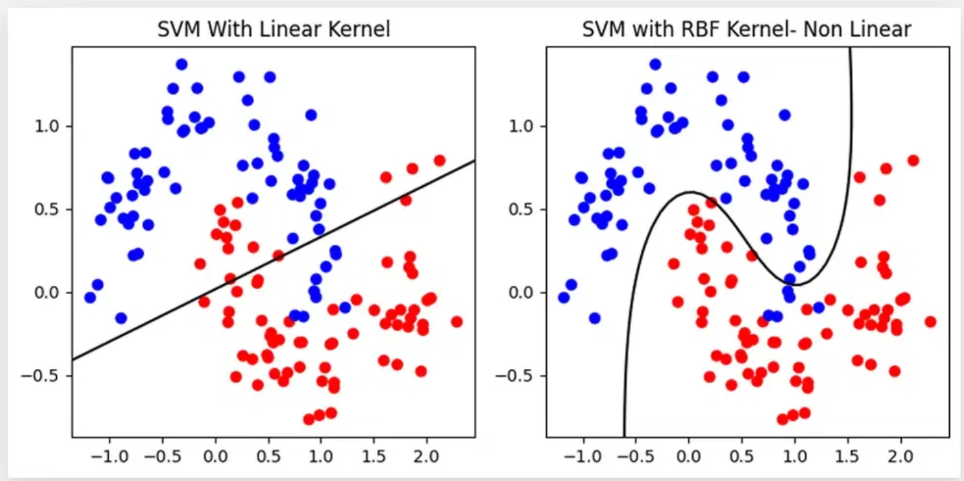
Linear VS non-linear classification

Slide 12
II-2-1 Classification - Algorithms
Appart neural network, three algorithms to know :
a. K Nearest Neigbours (KNN)
KNN is a supervised machine learning algorithm that classifies a data point based on the majority class of its k closest neighbors in the dataset.
b. Decision tree
A Decision Tree is a machine learning model that makes predictions by splitting data into branches based on feature values, forming a tree-like structure of decisions.
c. Support Vector Machine (SVM)
SVM is a supervised learning algorithm that finds the optimal boundary (hyperplane) to separate data points from different classes with the maximum margin.

Slide 13
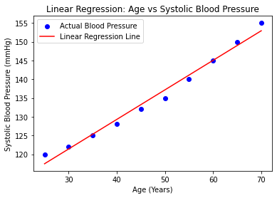
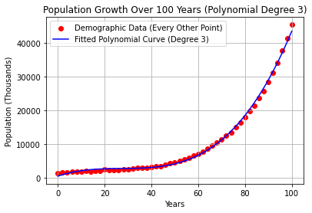
Linear VS non-linear regression
Linear regression
Non-Linear regression (Polynomial 3)

Slide 14
II-6 Regression Algorithms
Non-parametric algorithms
  a. KNN regression
  b. Kernel regression
Parametric algorithms
  Error minimisation
    Linear
    Non-linear
  Likelihood maximisation
    Probabilist model

Slide 15
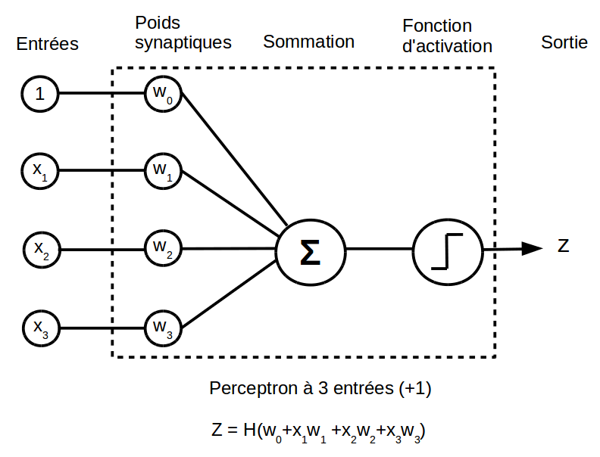
2-3 PERCEPTRON
Linear perceptron with Heaviside activation function (Non linearity):
  n inputs x1, ..., xn + bias
  n+1 synaptic coefficients w₀, w₁ ..., w_{n}
  an output o
  → Activation function

Slide 16
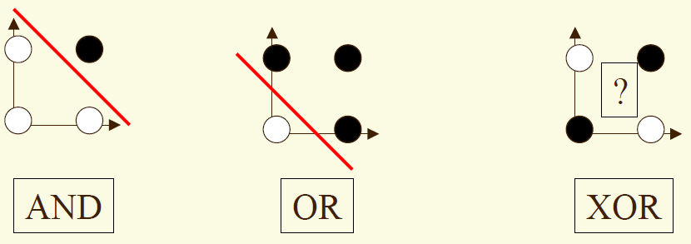
Perceptron Limitation
  Perceptron = linear classifier (linearly separable set).
  To learn the Exclusive OR (XOR), we use a Multi-Layer Perceptron.

Slide 17
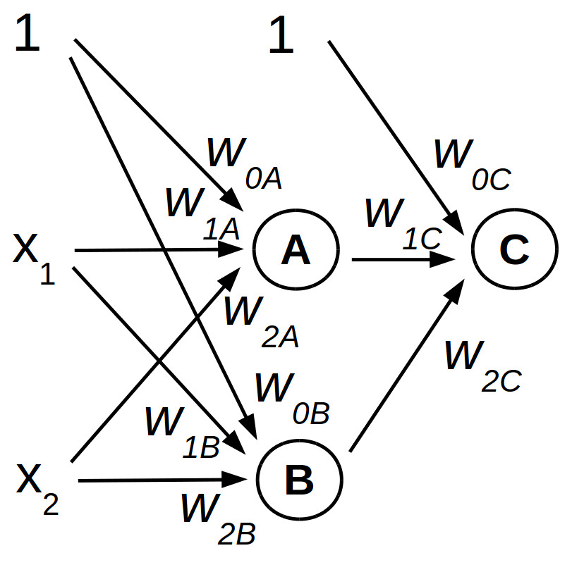
2-4 Multi Layer Perceptron (MLP)
In 1980, revolution of the Multi-Layer Perceptron (MLP)
Neurone A
Réponse de C fonction de l’espace d’entrée A, B
1
Neurone C
0
W0A=1
W1A=-2
W2A=-2
1
x2
1
W0A=-1
W1A=2
W2A=2
B
1
0
1
0
x1
0
1
A
Neurone B
1
1
Réponse de C en fonction de l’espace d’entrée x1, x2
W0B=-1.5
W1B=1
W2B=1
Neurone C
x2
1
0
1
W0A=-1
W1A=2
W2A=2
x2
0
0
1
x1
1
0
1
x1

Slide 18
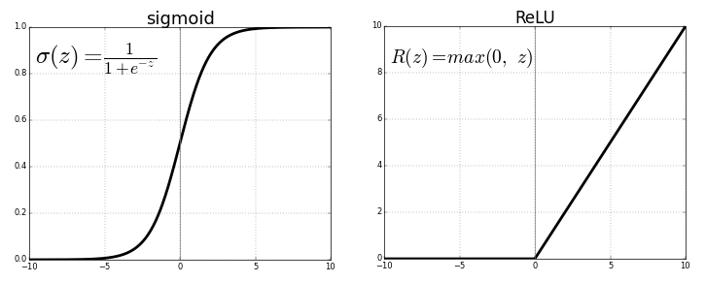
Activation Function for a Multi-Layer Perceptron (1/2)
→ Learning method to automatically set the synaptic weights
→ Requires a derivable activation function for the gradient backpropagation
→ Using Sigmoid for hidden layers:

Slide 19
Activation Function for a Multi-Layer Perceptron (1/2)
Learning Back-Propagation algorithm summary:
1- Initialize weights and biases randomly.
2- Perform forward pass to calculate the predicted output.
3- Calculate the error using MSE.
4- Perform backpropagation to compute gradients and update weights and biases.
Repeat until the model converges (loss is minimized).

Slide 20
Descente de gradient
Déterminer les poids synaptiques afin de minimiser l'erreur
Eq
W

Slide 21


Descente de gradient
Minimisation de l'erreur
Descente de la « pente » d'erreur.
La pente d'erreur est donnée par
Eq
$$\frac{∂Eq}{∂W}$$
$$\frac{∂E}{∂W}$$
W

Slide 22
Descente de gradient
Minimisation de l'erreur
Descente de la « pente » d'erreur.
La pente d'erreur est donnée par
Eq
$$\frac{∂Eq}{∂W}$$
$$\frac{∂E}{∂W}$$
W

Slide 23

Minimisation de l'erreur
Descente de la « pente » d'erreur.
La pente d'erreur est donnée par
Eq
$$\frac{∂Eq}{∂W}$$
$$\frac{∂E}{∂W}$$
W

Slide 24
Descente de gradient
Minimisation de l'erreur
Descente de la « pente » d'erreur.
La pente d'erreur est donnée par
Eq
$$\frac{∂Eq}{∂W}$$
$$\frac{∂E}{∂W}$$
W

Slide 25

Descente de gradient
Minimisation de l'erreur
Descente de la « pente » d'erreur.
La pente d'erreur est donnée par
Eq
$$\frac{∂Eq}{∂W}$$
$$\frac{∂E}{∂W}$$
W

Slide 26
Descente de gradient
Minimisation de l'erreur
Descente de la « pente » d'erreur.
La pente d'erreur est donnée par
Eq
$$\frac{∂Eq}{∂W}$$
$$\frac{∂E}{∂W}$$
W

Slide 27

Descente de gradient
Minimisation de l'erreur
Descente de la « pente » d'erreur.
La pente d'erreur est donnée par
Eq
$$\frac{∂Eq}{∂W}$$
$$\frac{∂E}{∂W}$$
W

Slide 28
Descente de gradient
Minimisation de l'erreur
Descente de la « pente » d'erreur.
La pente d'erreur est donnée par
Eq
$$\frac{∂Eq}{∂W}$$
$$\frac{∂E}{∂W}$$
W

Slide 29
Descente de gradient
Minimisation de l'erreur
Descente de la « pente » d'erreur.
La pente d'erreur est donnée par
Eq
$$\frac{∂E}{∂W}$$
W

Slide 30
Descente de gradient
Minimisation de l'erreur
Descente de la « pente » d'erreur.
La pente d'erreur est donnée par
Eq
$$\frac{∂E}{∂W}$$
W

Slide 31
Descente de gradient
Minimisation de l'erreur
Descente de la « pente » d'erreur.
La pente d'erreur est donnée par
$$\frac{∂E}{∂W}$$

Slide 32
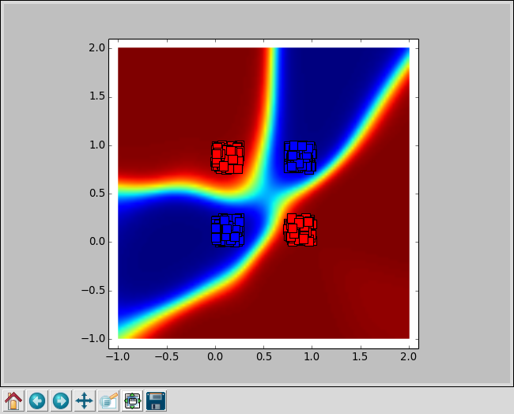

Slide 33
What is a ANN in a mathematical view
A graph of tensor operations in which parameters are tuned to minimize the errors between the computed outputs (Y) and the target outputs (Y*) given the inputs (X). The parameters are modified using the gradient of the error (E) relatively to them.
W6
Y*
OP2
OP4
OP6
Y
E
X
OP1
OP7
OP9
OP10
loss
OP3
OP5
OP8
W1
W9
W3

Slide 34
What is a ANN in a mathematical view
A graph of tensor operations in which parameters are tuned to minimize the errors between the computed outputs (Y) and the target outputs (Y*) given the inputs (X). The parameters are modified using the gradient of the error (E) relatively to them.
W6
Y2
Y4
Y*
OP2
OP4
OP6
Y6
Y1
Y8
Y9
Y
E
X
OP1
OP8
OP9
OP10
loss
Y3
Y5
OP3
OP5
OP7
Y7
W1
W9
W3

Slide 35















What is a ANN in a mathematical view
A graph of tensor operations in which parameters are tuned to minimize the errors between the computed outputs (Y) and the target outputs (Y*) given the inputs (X). The parameters are modified using the gradient of the error (E) relatively to them.
$$\frac{∂Y6}{∂W6}$$
W6
$$\frac{∂Y4}{∂Y2}$$
$$\frac{∂Y6}{∂Y4}$$
Y2
Y4
Y*
$$\frac{∂Y2}{∂Y1}$$
OP2
OP4
OP6
$$\frac{∂Y8}{∂Y6}$$
Y6
$$\frac{∂Y9}{∂Y8}$$
Y1
Y8
Y9
Y
E
X
OP1
OP8
OP9
OP10
loss
Y3
Y5
$$\frac{∂Y3}{∂Y1}$$
OP3
OP5
OP7
Y7
$$\frac{∂Y8}{∂Y7}$$
$$\frac{∂Y}{∂Y9}$$
$$\frac{∂E}{∂Y}$$
W1
W9
$$\frac{∂Y5}{∂Y3}$$
$$\frac{∂Y7}{∂Y5}$$
$$\frac{∂Y1}{∂W1}$$
W3
$$\frac{∂Y9}{∂W9}$$
$$\frac{∂Y3}{∂W3}$$

Slide 36
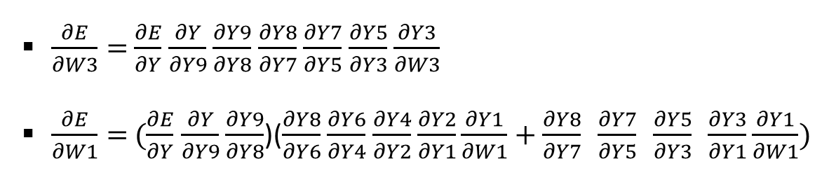
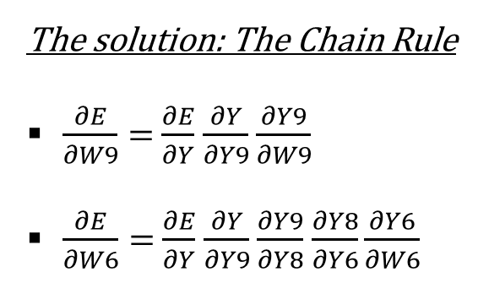
What is a ANN in a mathematical view
The solution: The Chain Rule
$\frac{∂E}{∂W9}=$ $\frac{∂E}{∂Y}$ $\frac{∂Y}{∂Y9}$ $\frac{∂Y9}{∂W9}$
$\frac{∂E}{∂W6}=$ $\frac{∂E}{∂Y}$ $\frac{∂Y}{∂Y9}$ $\frac{∂Y9}{∂Y8}$ $\frac{∂Y8}{∂Y6}\frac{∂Y6}{∂W6}$
$\frac{∂E}{∂W3}=$ $\frac{∂E}{∂Y}$ $\frac{∂Y}{∂Y9}$ $\frac{∂Y9}{∂Y8}$ $\frac{∂Y8}{∂Y7}$ $\frac{∂Y7}{∂Y5}$ $\frac{∂Y5}{∂Y3}$ $\frac{∂Y3}{∂W3}$
$\frac{∂E}{∂W1}=$ $(\frac{∂E}{∂Y}$ $\frac{∂Y}{∂Y9}$ $\frac{∂Y9}{∂Y8}$)($\frac{∂Y8}{∂Y6}$ $\frac{∂Y6}{∂Y4}$ $\frac{∂Y4}{∂Y2}$ $\frac{∂Y2}{∂Y1}\frac{∂Y1}{∂W1}+\frac{∂Y8}{∂Y7} \frac{∂Y7}{∂Y5} \frac{∂Y5}{∂Y3} \frac{∂Y3}{∂Y1}\frac{∂Y1}{∂W1})$
$$\frac{∂Y6}{∂W6}$$
W6
$$\frac{∂Y4}{∂Y2}$$
$$\frac{∂Y6}{∂Y4}$$
Y2
Y4
Y*
$$\frac{∂Y2}{∂Y1}$$
OP2
OP4
OP6
$$\frac{∂Y8}{∂Y6}$$
Y6
$$\frac{∂Y9}{∂Y8}$$
Y1
Y8
Y9
Y
E
X
OP1
OP8
OP9
OP10
loss
Y3
Y5
$$\frac{∂Y3}{∂Y1}$$
OP3
OP5
OP7
Y7
$$\frac{∂Y8}{∂Y7}$$
$$\frac{∂Y}{∂Y9}$$
$$\frac{∂E}{∂Y}$$
W1
W9
$$\frac{∂Y5}{∂Y3}$$
$$\frac{∂Y7}{∂Y5}$$
$$\frac{∂Y1}{∂W1}$$
W3
$$\frac{∂Y9}{∂W9}$$
$$\frac{∂Y3}{∂W3}$$

Slide 37



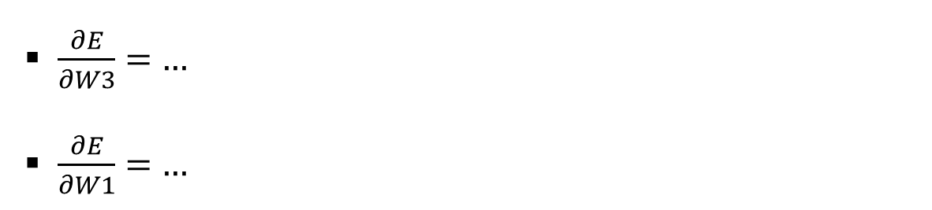



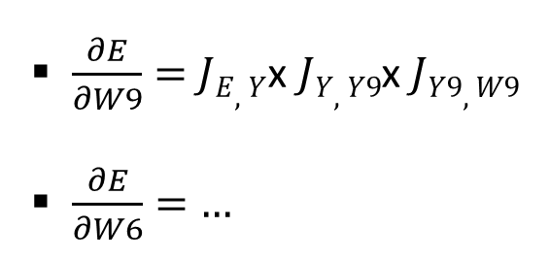









What is a ANN in a mathematical view
$\frac{∂E}{∂W9}=$ $JE,Y$x $JY,Y9$x $JY9,W9$
$\frac{∂E}{∂W6}=$ $…$
$\frac{∂E}{∂W3}=$ $…$
$\frac{∂E}{∂W1}=$ $…$
J: la matrice Jacobienne
W6
$JY6,$_{W6}
$JY2,Y$₁
Y2
$JY4,Y$₂
Y4
Y*
OP2
OP4
OP6
Y6
$JY8,$_{Y6}
$JY9,$_{Y8}
Y1
$JY6,Y$₄
Y8
Y9
Y
E
X
OP1
$JY3,$_{Y1}
OP8
OP9
OP10
loss
Y3
Y5
OP3
OP5
OP7
Y7
$JY8,$_{Y7}
$$JY,Y9$$
$$JY,E$$
W1
W9
$JY1,$_{W1}
$JY5,Y$₃
$JY7,Y$₅
W3
$$JY9,W9$$
$JY3,W$₃

Slide 38
New concepts
Composition of dataset
  Train set, validation set, test set
Hyper-parameters – configuration that does not change during training
  Graph architecture, learning rate, epochs, batch size, optimizer, loss function

Slide 39
Dataset
The whole dataset should be representative of the task on which the network will work
Train set (usually 60% of the dataset)
  The portion of the dataset used to train the model (learning=training). The network updates its weights based on this data by trying to minimize the error (loss function).
Validation set (~20%)
  The model does not learn from this data directly. It’s mainly used to check performance during training and detect overfitting. Helps decide when to stop training (early stopping).
Test set (~20%)
  A completely unseen portion of the dataset used to evaluate the final model’s performance. It measures how well the model generalizes to new, real-world data. It should only be used once training and tuning are finished

Slide 40
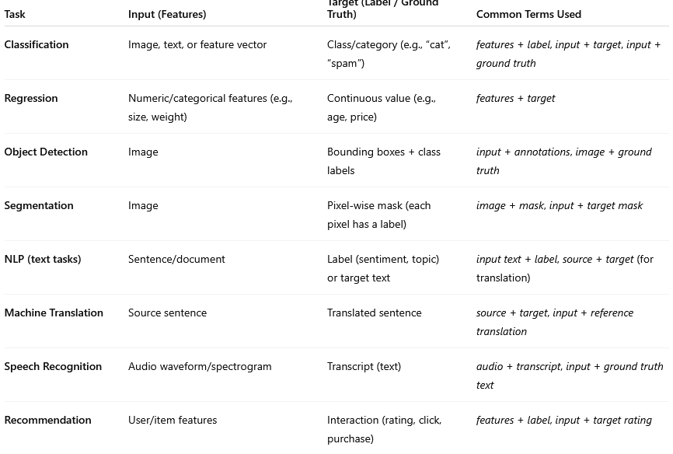
Dataset
A sample
  One element of the dataset with the input and the target. Denominations depend on the Task.

Slide 41
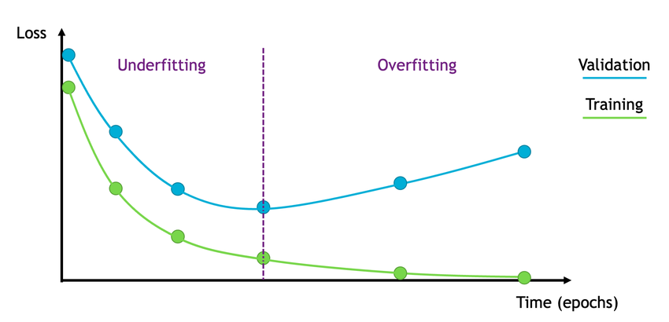
Dataset
The whole dataset should be representative of the task on which the network will work
Early stopping
Validation set
Train set
Expected loss on the test set

Slide 42
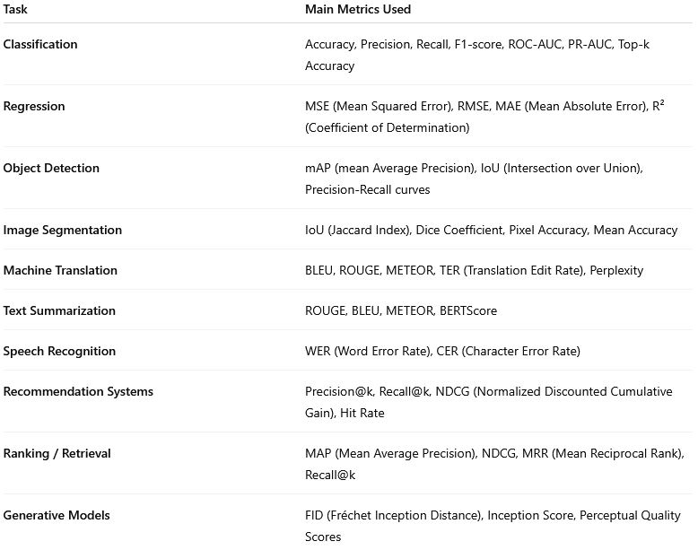
Training
The minimization of the loss function (error) is what « drives » the modification of the network to adapt its synaptic weights. It is the mathematical « energy ».
The final performance is often given in another metrics that explain how good the network actually is at the task. Sometime (rarely) the performance metric and the loss are the same (e.g.: mean square error for regression).

Slide 43
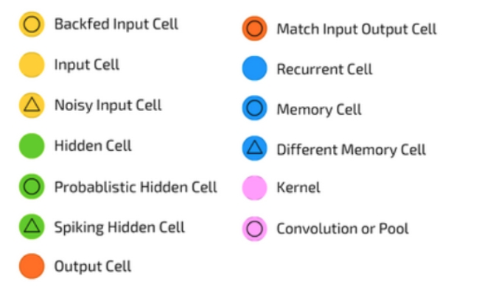
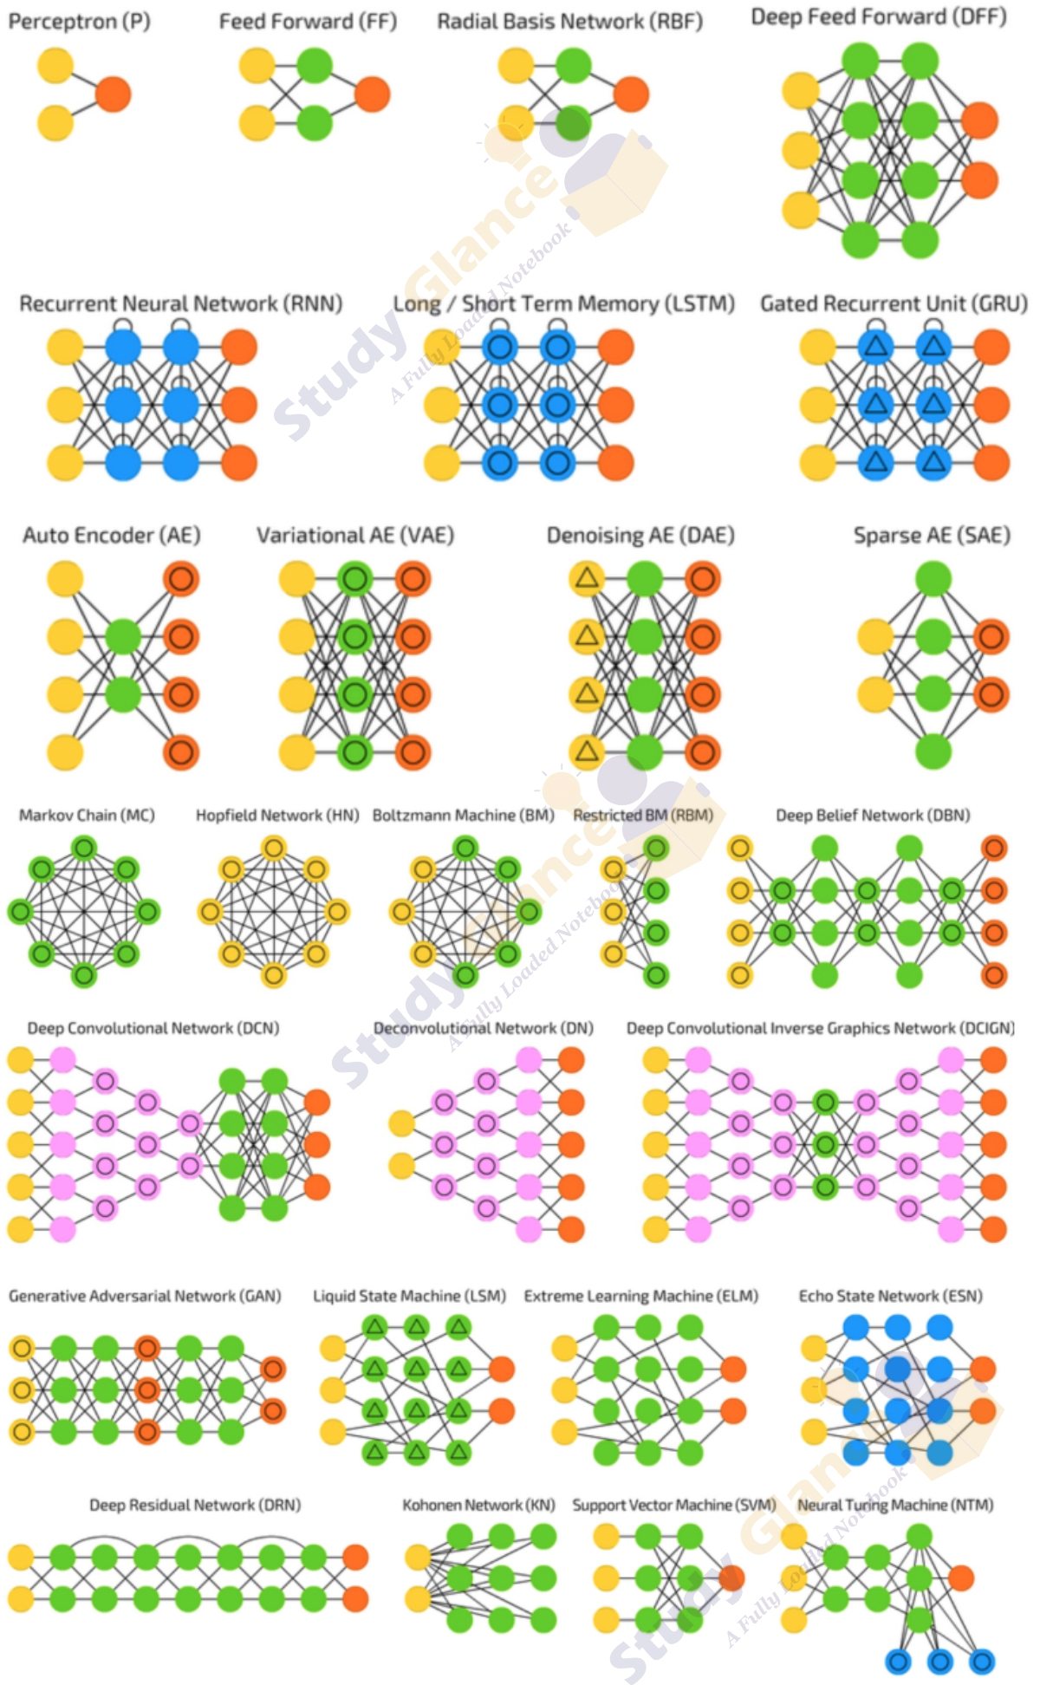
Hyper-parameters
Graph architecture
The structure of the neural network: how layers and nodes are organized and connected. It defines how information flows from inputs to outputs (e.g., fully connected layers, convolutional layers, recurrent layers).

Slide 44
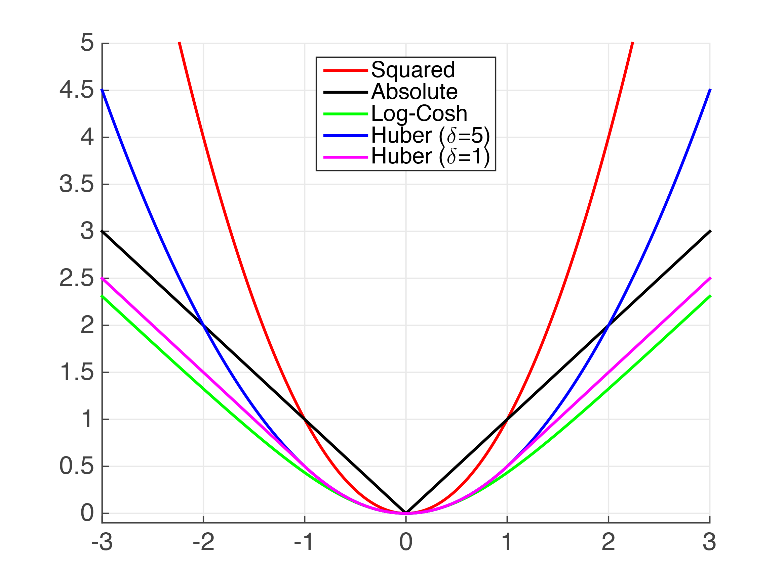
Hyper-parameters
Loss function
A mathematical function that measures how far the network’s predictions are from the target values (error). Guides the optimizer by providing feedback. Examples: Mean Squared Error (MSE) for regression, Cross-Entropy Loss for classification.
L(output – target)
output - target
Examples of loss functions used for regression

Slide 45
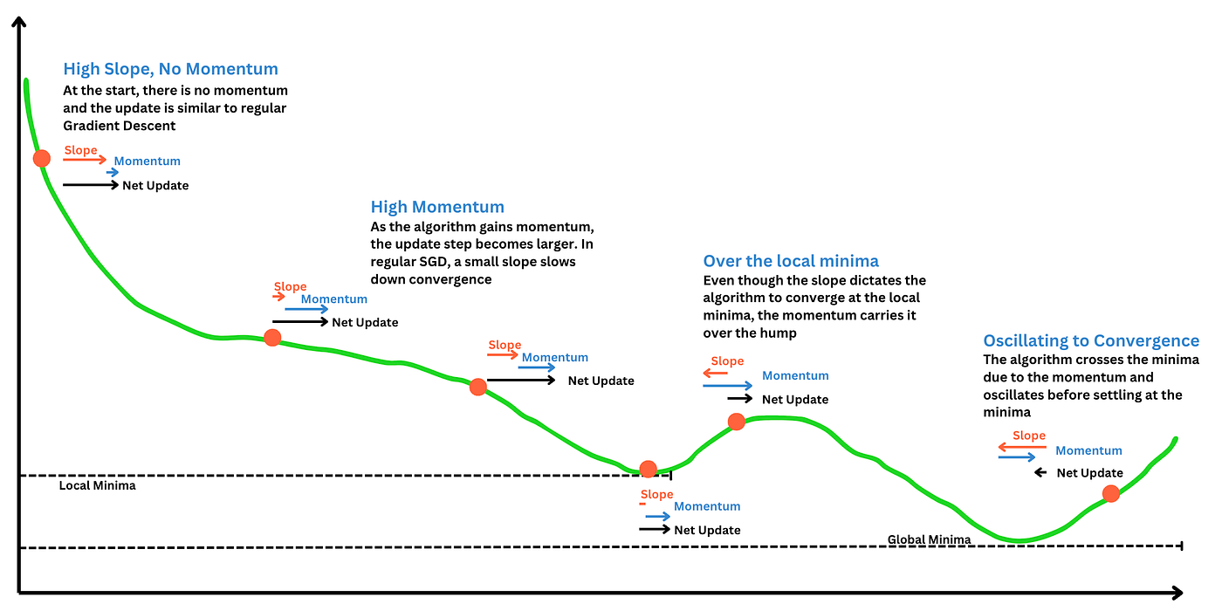
Hyper-parameters
Optimizer
The algorithm used to adjust the neural network’s weights based on the gradients of the loss function. Common examples: SGD (Stochastic Gradient Descent), Adam, RMSprop.
Momentum = inertia

Slide 46
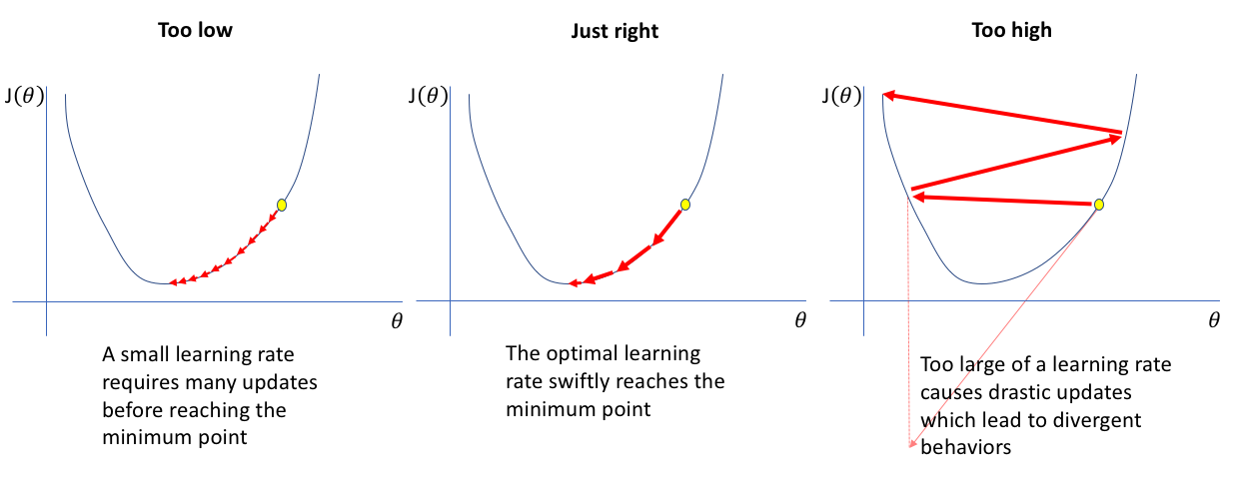
Hyper-parameters
Learning rate
A hyperparameter that controls how much the model’s weights are updated during training. A high learning rate → faster learning but risk of instability. A low learning rate → more stable but slower convergence

Slide 47
Hyper-parameters
Epochs
The number of times the entire training dataset is passed through the network during training. 1 epoch = the model has seen each training example once. More epochs can improve learning, but too many may lead to overfitting.
Early stopping
Validation set
Train set
47

Slide 48
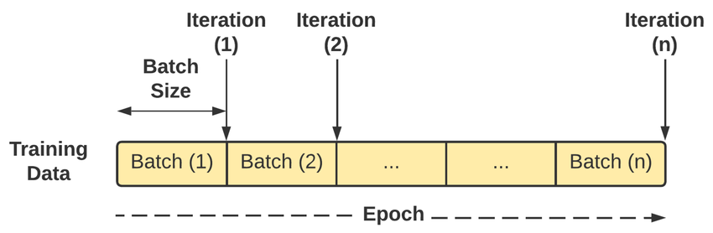
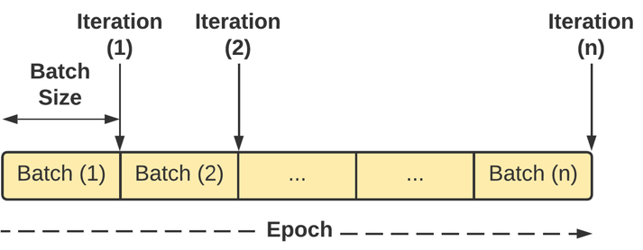
Hyper-parameters
Batch size
The number of training samples processed before updating the model’s weights.
Small batch → more updates, noisier gradients, less memory required.
Large batch → smoother gradients, more memory required.
Epoch = whole dataset has been used for training
Iteration = a batch has been used for training and the weights have been changed

