Slide 1
Systèmes intelligents avancés classic CNN models
Maxime Ambard
LEAD CNRS UMR 5022
Institut Marey – I3M
64 rue Sully - 210000 DIJON CEDEX - France
Contact : maxime.ambard@u-bourgogne.fr

Slide 2
Reminder
Dataset
Hyper-parameters
  Graph architecture, learning rate, number of epochs, batch size, optimizer, loss function

Slide 3
Today
CNN
  Architecture, convolution, pooling, activation, fully connected, padding, stride
Classical CNN
  LeNet-5 – Convolution
  AlexNet – Same RGB
  VGG-16 – Same bigger
  ResNet – jump
  Inception - Multiple simultaneous operations
  MobileNet - Deptwise separable convolution

Slide 4






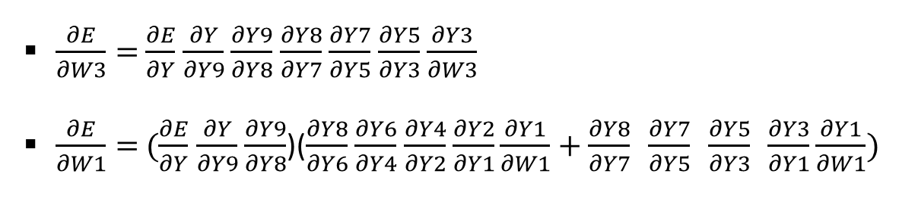
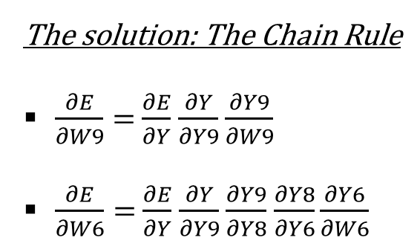









What is a ANN in a mathematical view
The solution: The Chain Rule
$\frac{∂E}{∂W9}=$ $\frac{∂E}{∂Y}$ $\frac{∂Y}{∂Y9}$ $\frac{∂Y9}{∂W9}$
$\frac{∂E}{∂W6}=$ $\frac{∂E}{∂Y}$ $\frac{∂Y}{∂Y9}$ $\frac{∂Y9}{∂Y8}$ $\frac{∂Y8}{∂Y6}\frac{∂Y6}{∂W6}$
$\frac{∂E}{∂W3}=$ $\frac{∂E}{∂Y}$ $\frac{∂Y}{∂Y9}$ $\frac{∂Y9}{∂Y8}$ $\frac{∂Y8}{∂Y7}$ $\frac{∂Y7}{∂Y5}$ $\frac{∂Y5}{∂Y3}$ $\frac{∂Y3}{∂W3}$
$\frac{∂E}{∂W1}=$ $(\frac{∂E}{∂Y}$ $\frac{∂Y}{∂Y9}$ $\frac{∂Y9}{∂Y8}$)($\frac{∂Y8}{∂Y6}$ $\frac{∂Y6}{∂Y4}$ $\frac{∂Y4}{∂Y2}$ $\frac{∂Y2}{∂Y1}\frac{∂Y1}{∂W1}+\frac{∂Y8}{∂Y7} \frac{∂Y7}{∂Y5} \frac{∂Y5}{∂Y3} \frac{∂Y3}{∂Y1}\frac{∂Y1}{∂W1})$
$$\frac{∂Y6}{∂W6}$$
W6
$$\frac{∂Y4}{∂Y2}$$
$$\frac{∂Y6}{∂Y4}$$
Y2
Y4
Y*
$$\frac{∂Y2}{∂Y1}$$
OP2
OP4
OP6
$$\frac{∂Y8}{∂Y6}$$
Y6
$$\frac{∂Y9}{∂Y8}$$
Y1
Y8
Y9
Y
E
X
OP1
OP8
OP9
OP10
loss
Y3
Y5
$$\frac{∂Y3}{∂Y1}$$
OP3
OP5
OP7
Y7
$$\frac{∂Y8}{∂Y7}$$
$$\frac{∂Y}{∂Y9}$$
$$\frac{∂E}{∂Y}$$
W1
W9
$$\frac{∂Y5}{∂Y3}$$
$$\frac{∂Y7}{∂Y5}$$
$$\frac{∂Y1}{∂W1}$$
W3
$$\frac{∂Y9}{∂W9}$$
$$\frac{∂Y3}{∂W3}$$

Slide 5
What is a CNN in a mathematical view
A graph of tensor operations in which parameters are tuned to minimize the errors between the computed outputs (Y) and the target outputs (Y*) given the inputs (X). The parameters are modified using the gradient of the error (E) relatively to them.
A convolutional neural network is a graph in which some of the operation consist in convolutions of tensors (cross-correlation) often used together with pooling and activation function. But many other operators can be also used.

Slide 6
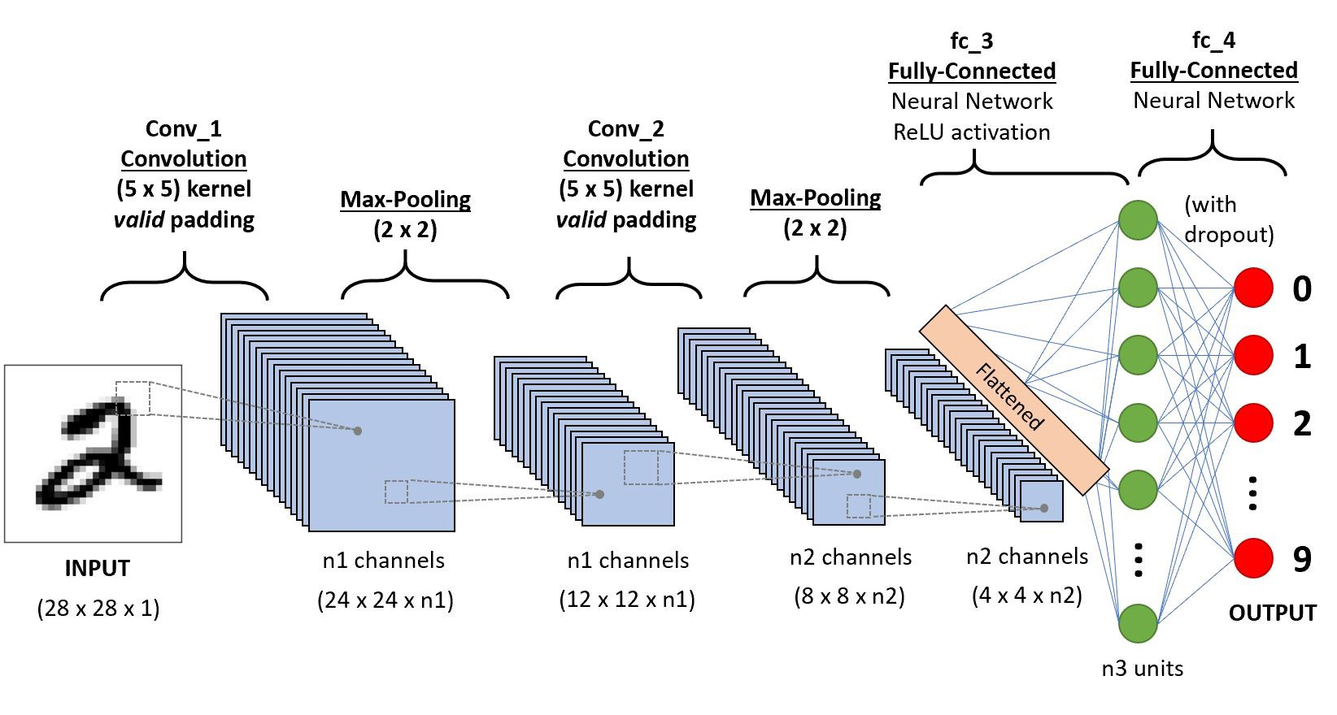
CNN for image analysis
A
B
C
.
Z
26

Slide 7
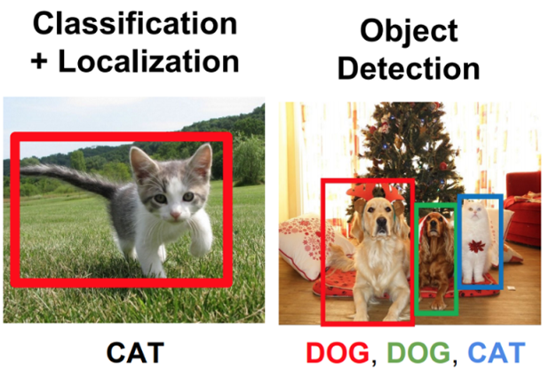
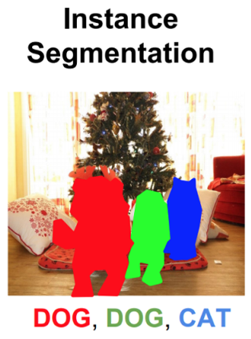

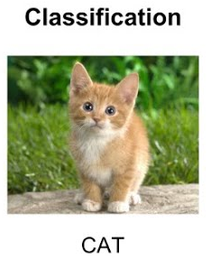
Image analysis…what else ?

Slide 8
Image analysis: convolution bloc ?
image
Conv.
bloc
Conv.
bloc
fully.
Conn.
convolution
pooling
activation
Convolution bloc

Slide 9
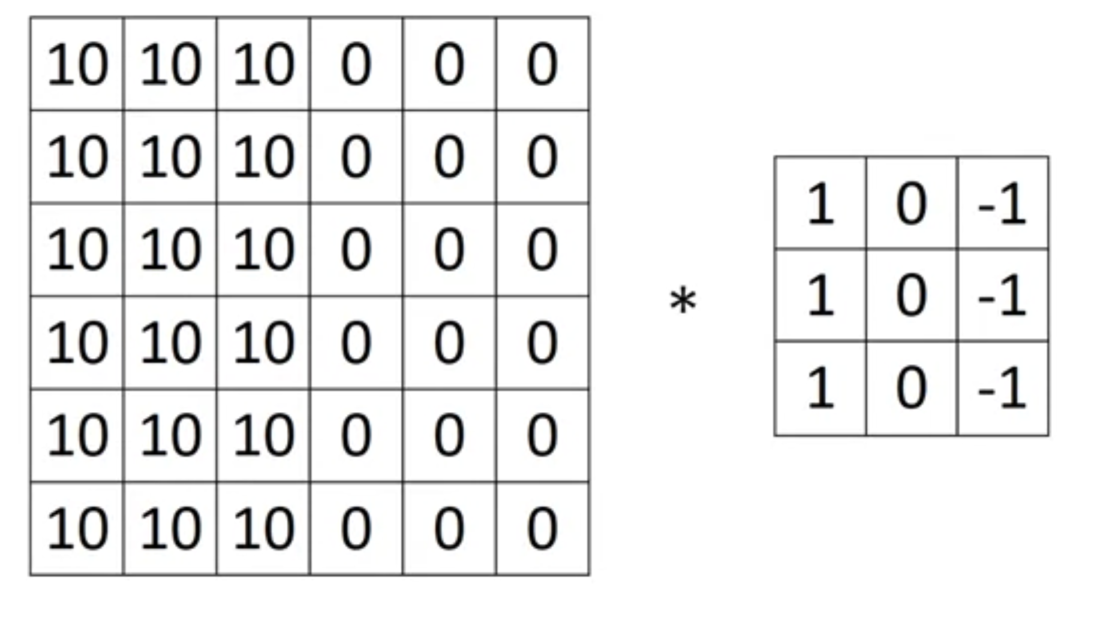
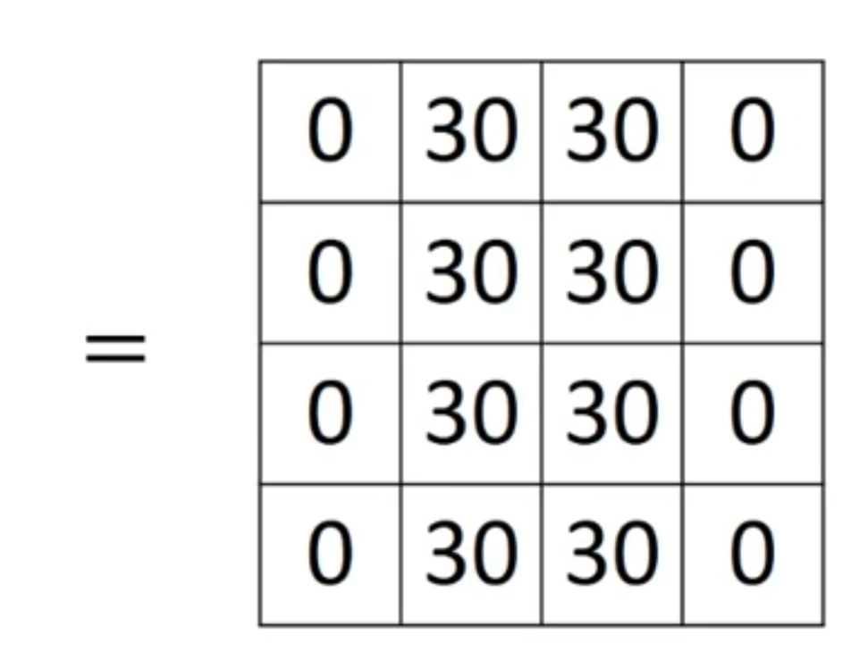
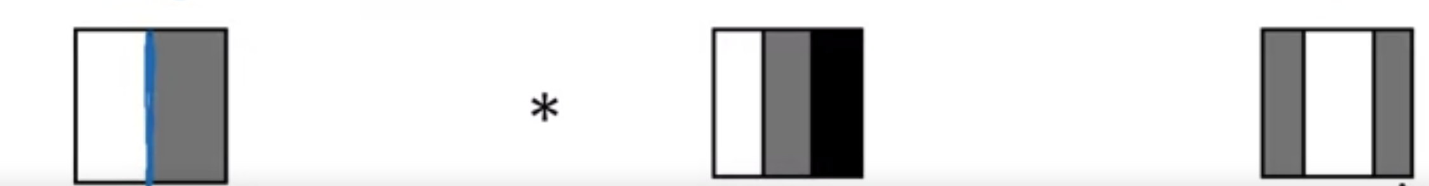
Convoution: Vertical edge detection

Slide 10
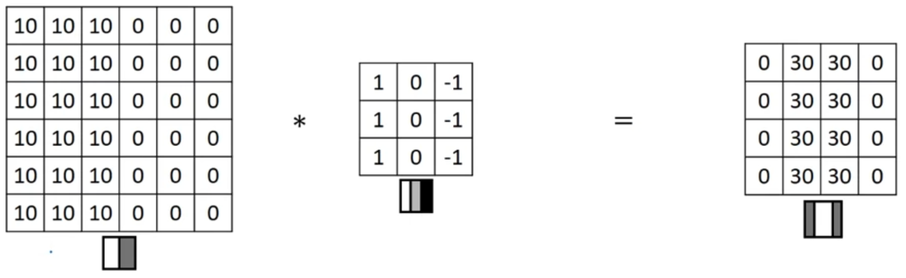
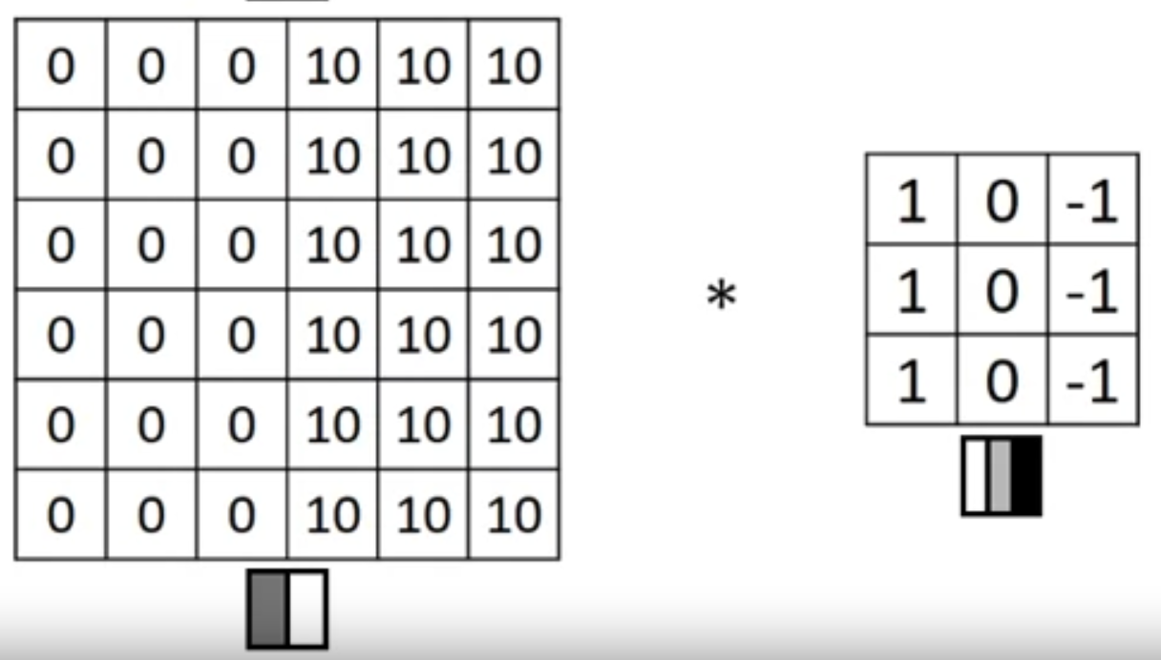
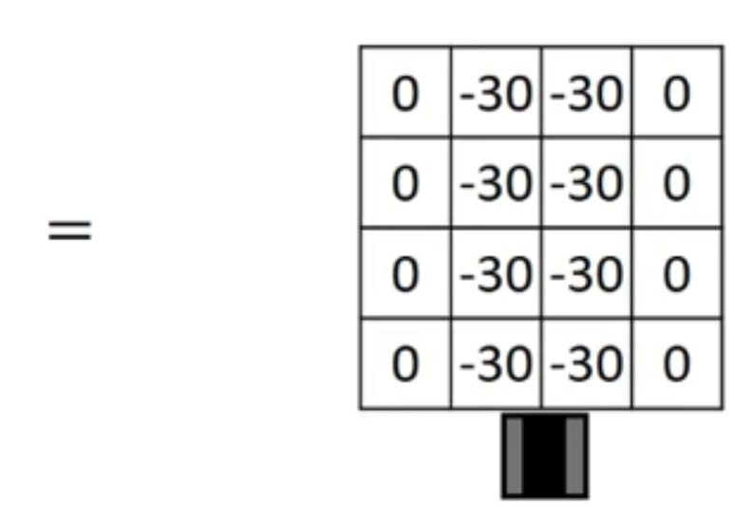
Convolution: Vertical edge detection

Slide 11
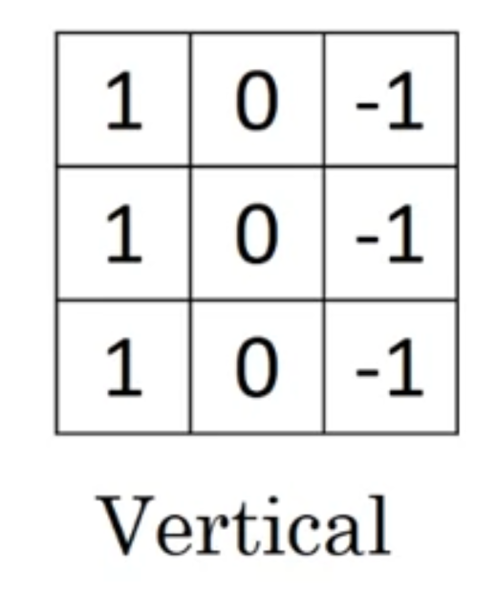
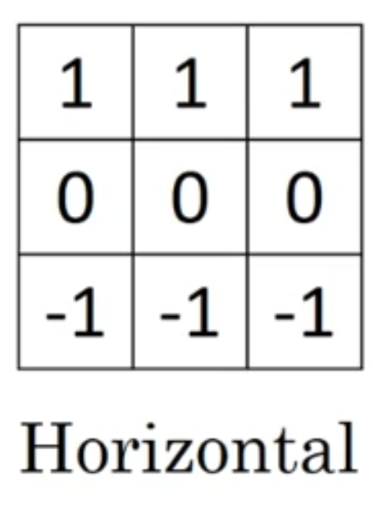
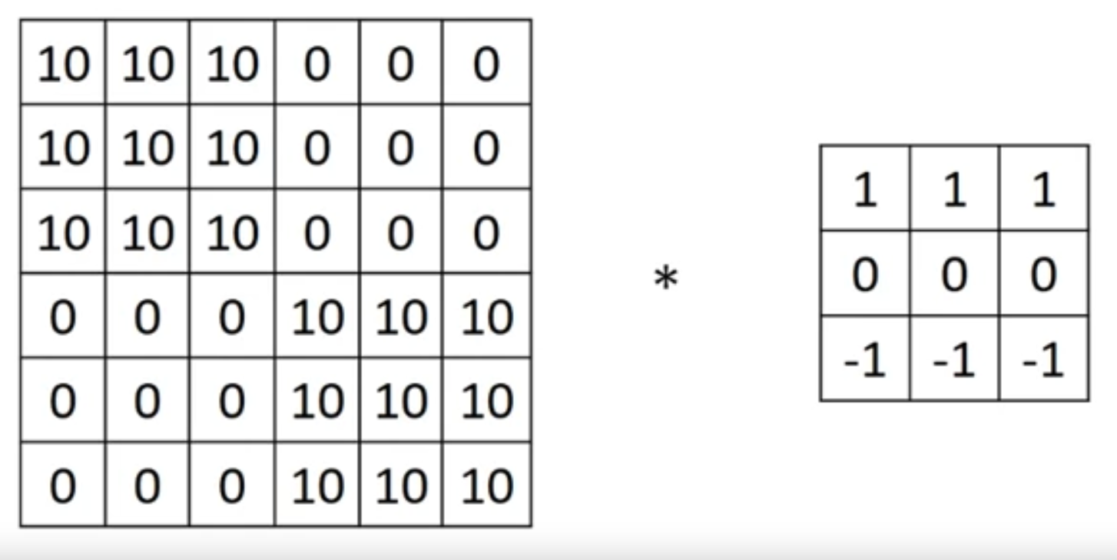
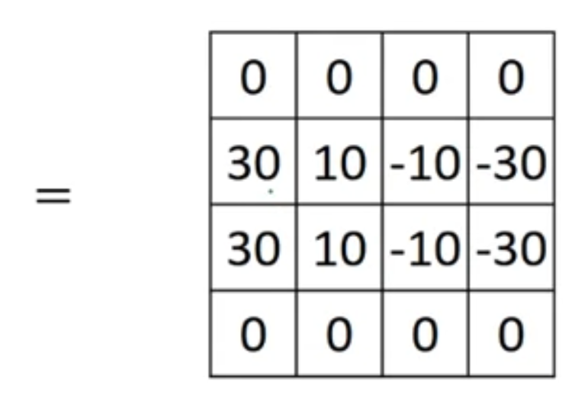
Vertical and horizontal edges

Slide 12
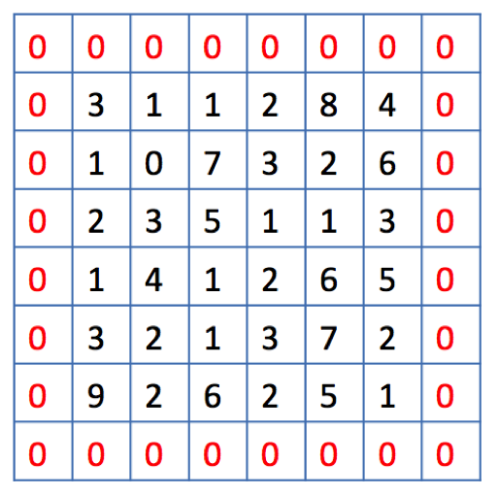
Stride and Image padding
Padding is used to avoid the output shrinking at every convolution
  Usefull on small images
Stride
  Convolution kernel shift
  To reduce data dimension by subsampling

Slide 13
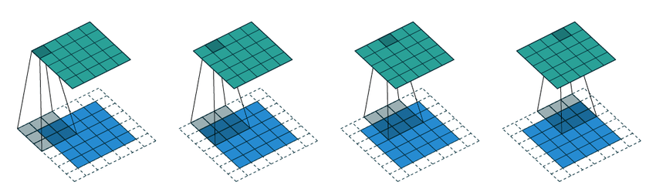
Convolution
Image 5x5, kernel 3x3, padding 1, stride 1

Slide 14
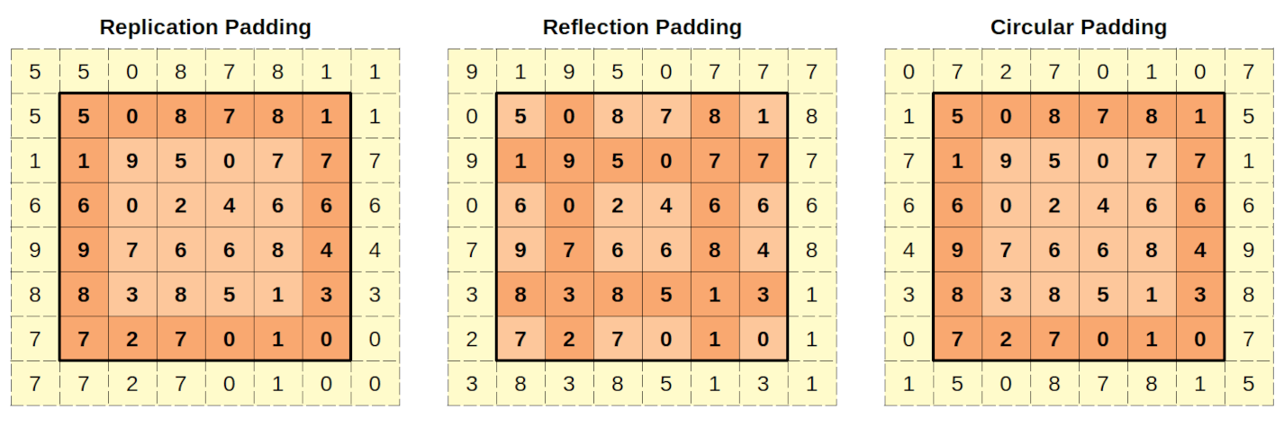
Stride and Image padding

Slide 15
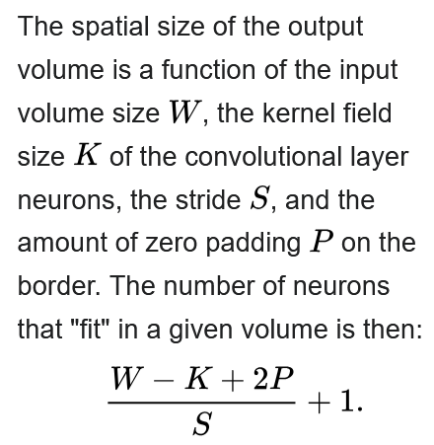



Convolution
To know the size of the output on each dimension
*
=
W=6
K=3
S=1
P=0
W=4
But the complete shape of the output also depends on the number of channels and the number of filters !

Slide 16
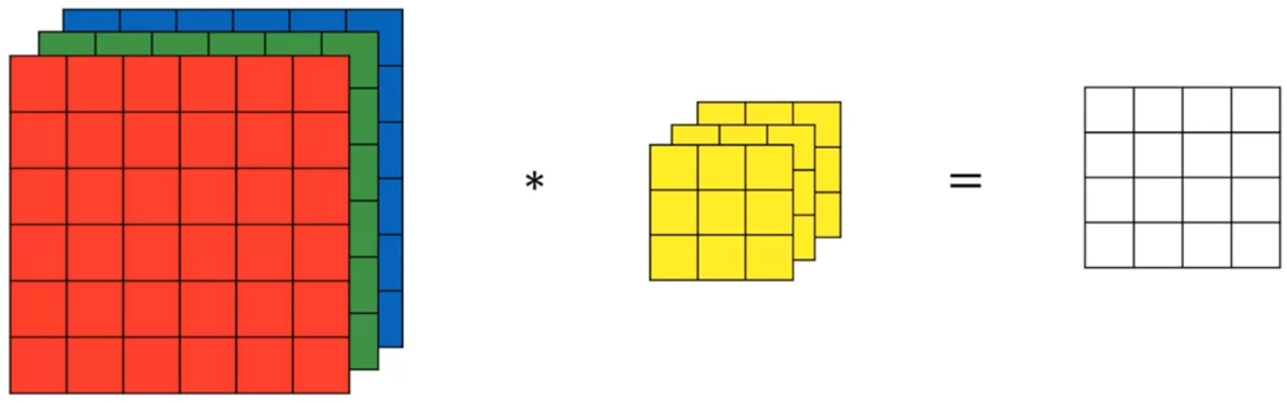
Convolution on RGB images
3x3x3x1
4x4x1
6x6x3

Slide 17
Convolution on RGB images
3x3x3x1
4x4x1
6x6x3

Slide 18
Convolution on RGB images
3x3x3x1
4x4x1
6x6x3

Slide 19
Convolution on RGB images
3x3x3x1
4x4x1
6x6x3

Slide 20
Convolution on RGB images
3x3x3x1
4x4x1
6x6x3

Slide 21
Convolution on RGB images
3x3x3x1
4x4x1x1
=4x4
6x6x3

Slide 22
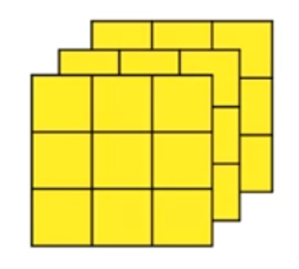
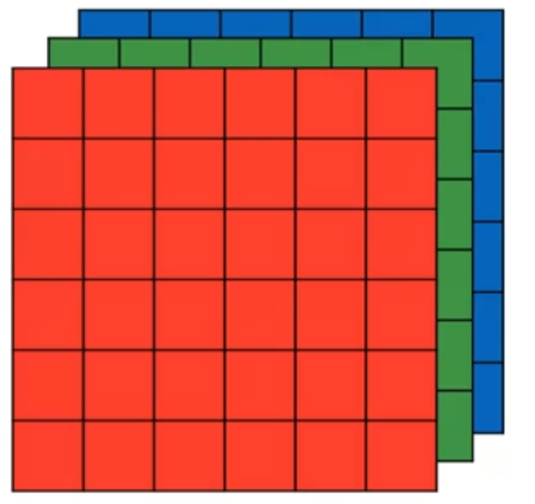
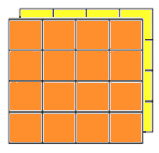


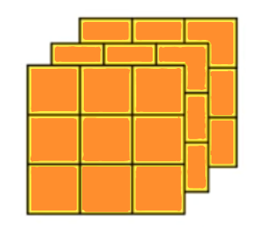
Convolution on RGB images
3x3x3x1
4x4x1x2
-> 4x4x2
6x6x3
3x3x3x1
= 3x3x3x2

Slide 23
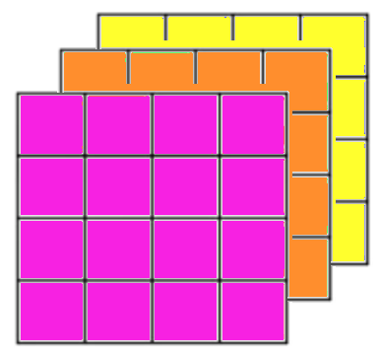
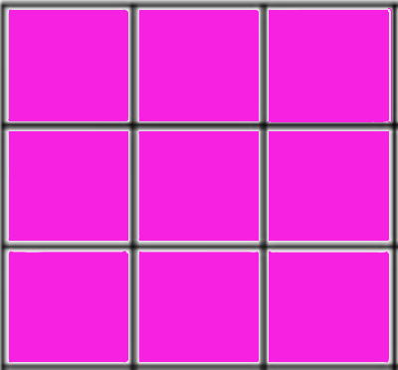
Convolution on RGB images
3x3x3x1
3x3x3x1
4x4x1x3
-> 4x4x3
6x6x3
3x3x3x1

Slide 24
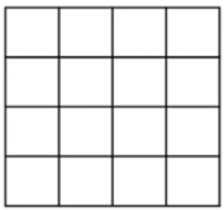
Convolution: Dimensions writing Rules
For input and output tensors, dimensions equal to 1 are discarded
4x4x1x3
-> 4x4x3
4x4x1x1
-> 4x4

Slide 25
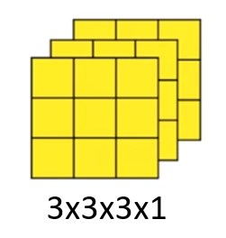
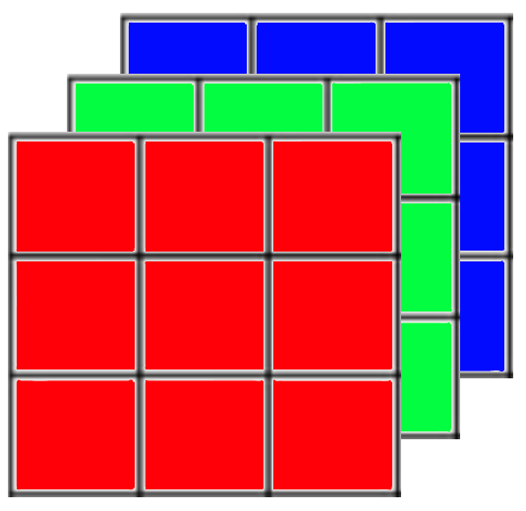
Convolution: Dimensions writing Rules
For convolution tensor (kernel), dimensions equal to 1 are kept
3x3x1x3

Slide 26
Convolution on RGB images
3x3x3x2
6x6x3
S=1, P=0

Slide 27
Convolution on RGB images
4x
3x3x3x2
6x6x3
S=1, P=0
Ws=(W-K+2P)/S+1
Ws = (6-3+0)/1+1 = 4

Slide 28
Convolution on RGB images
4x4x
3x3x3x2
6x6x3
S=1, P=0
Ws=(W-K+2P)/S+1
Ws = (6-3+0)/1+1 = 4

Slide 29
Convolution on RGB images
4x4x1x
3x3x3x2
6x6x3
S=1, P=0
Ws=(W-K+2P)/S+1
Ws = (3-3+0)/1+1 = 1

Slide 30
Convolution on RGB images
4x4x1x2
3x3x3x2
6x6x3
number of filters

Slide 31
Convolution on RGB images
4x4x1x2
=4x4x2
3x3x3x2
6x6x3
number of filters

Slide 32
Convolution on RGB images
4x4x2
3x3x3x2
32 valeurs
54 valeurs
6x6x3
108 valeurs

Slide 33
Convolution on RGB images
4x4x2
3x3x3x2
32 valeurs
54 valeurs
6x6x3
108 valeurs
Nombres de multiplications
= taille de sortie x taille d’un filtre
= (4x4x2) x (3x3x3) = 864

Slide 34
Convolution on RGB images
4x4x2
3x3x3x2
6x6x3
Same number of dimensions

Slide 35
Convolution on RGB images
4x4x2
3x3x3x2
6x6x3
Depth or channels

Slide 36
Convolution on RGB images
4x4x2
3x3x3x2
6x6x3
The number of filters becomes the depth of the output

Slide 37
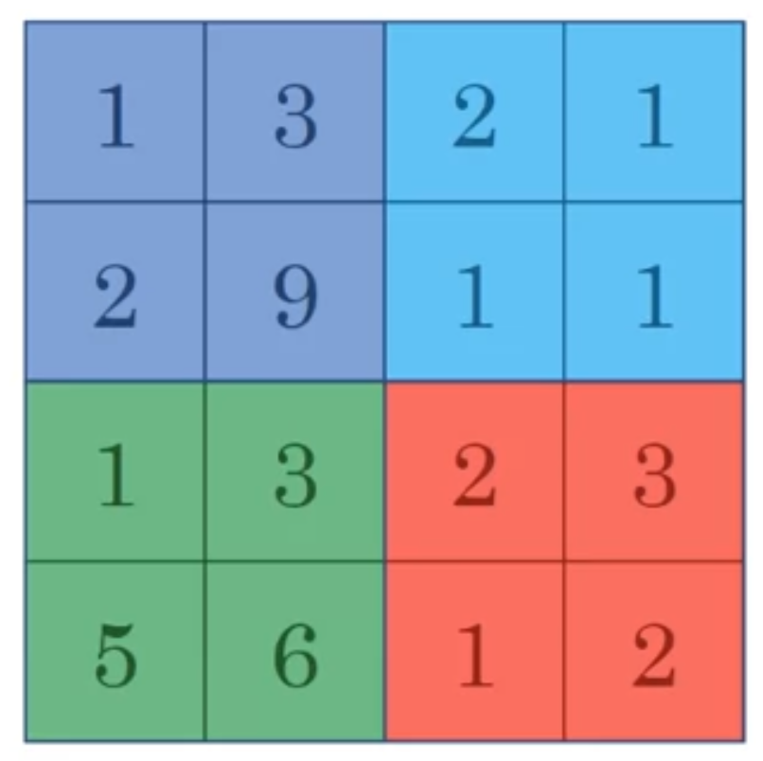
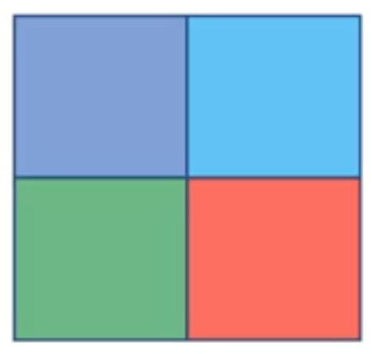
Max pooling
s=2
k=2
9
2
6
3
2x2
Hyperparameters:
k=2
s=2
4x4

Slide 38
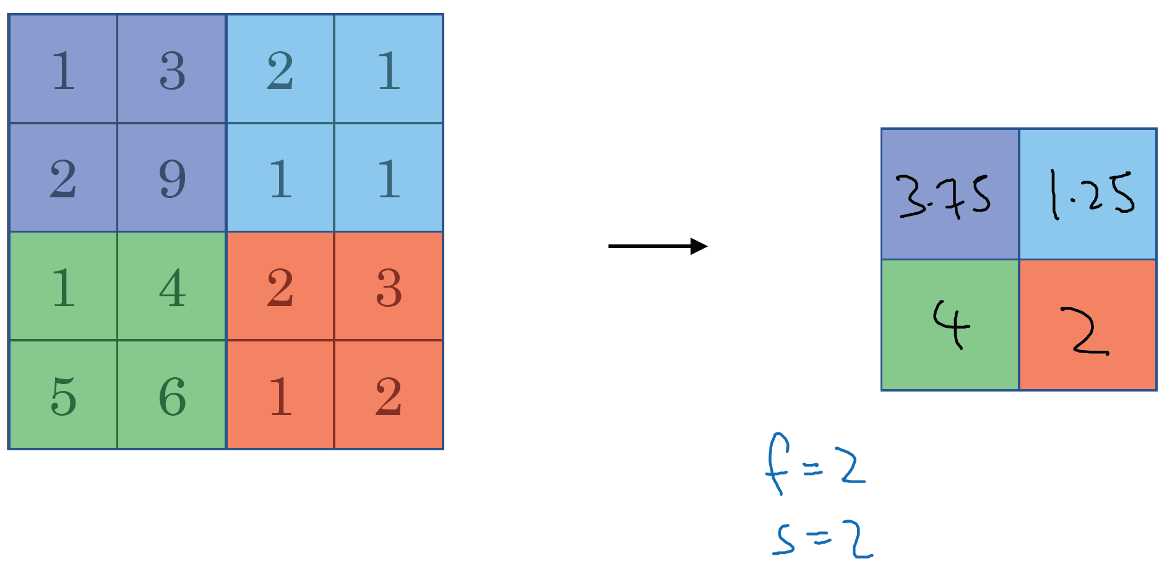
Average pooling

Slide 39
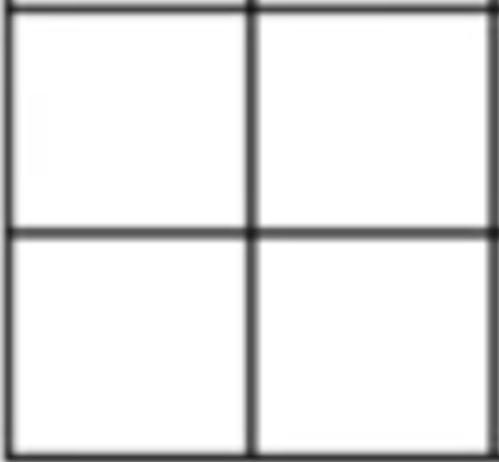
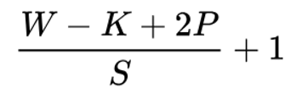
Pooling
POOL
K=2x2
Stride=2
Padding=0
3x3x3
6x6x3
!! Toujours depthwise
= ne change pas le nombre de canaux

Slide 40
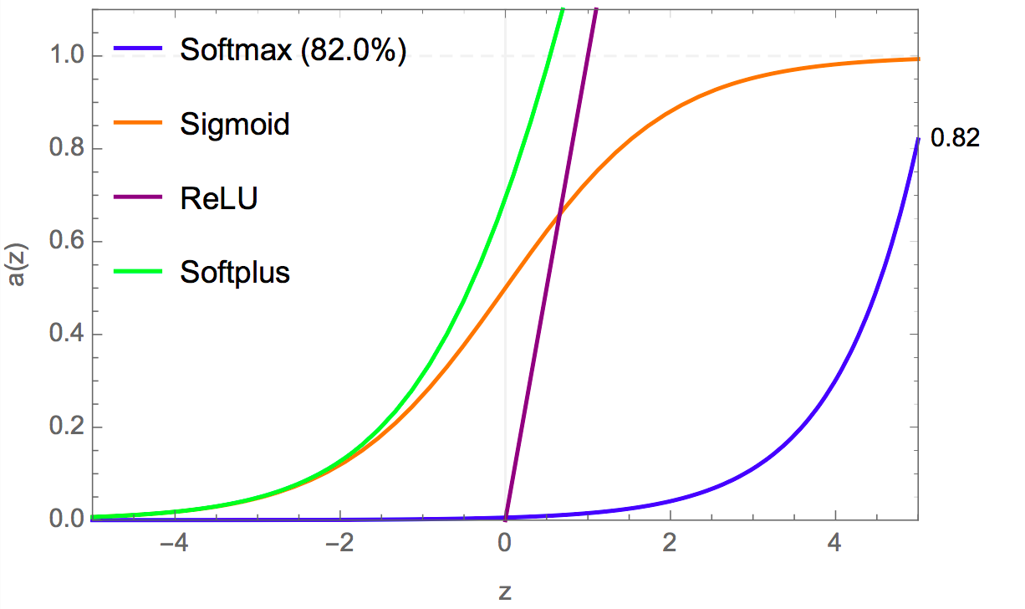
Types de fonctions d’activation (1/2):

Slide 41
Fully connected (head)
A
B
C
.
Z
26

Slide 42
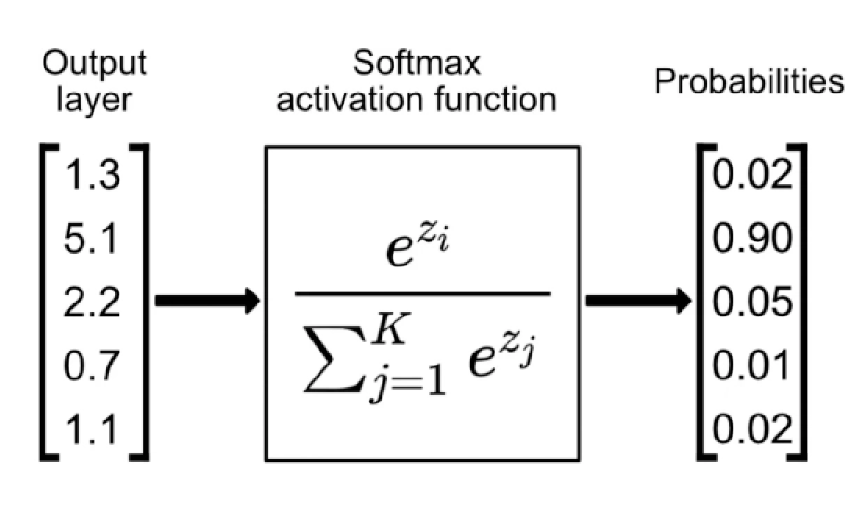
Fully connected (head)

Slide 43
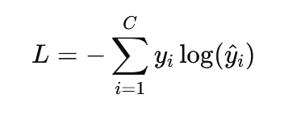
Fully connected (head)
Cross-entropy (Log loss)
C est le nombre de classes.
yi​ est 1 pour la classe correcte et 0 pour les autres (one-hot encoding).
y^i​ est la probabilité prédite pour la classe i

Slide 44
Why look at classic models
Get a better idea of how to assemble the building blocks
Common models in computer vision
Can be applied to other use case
  LeNet5
  AlexNet
  VGG
  ResNet
  Inception

Slide 45
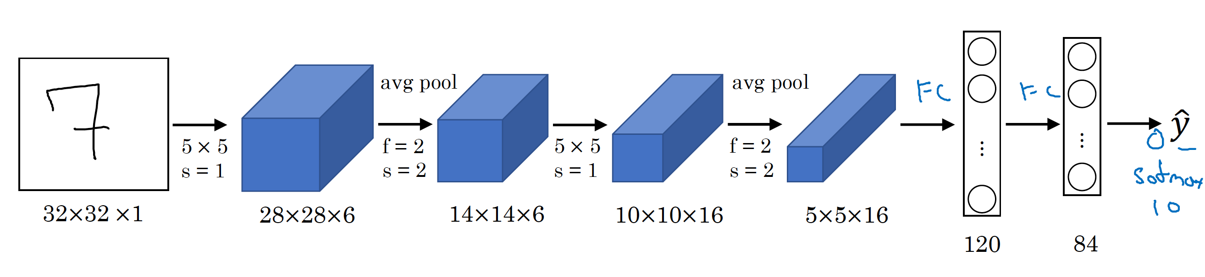
Le Net - 5
5x5x16x120
s=1
5x5x1x6
s=1
5x5x6x16
s=1
LeCun et al., 1998. Gradient-based learning applied to document recognition]

Slide 46
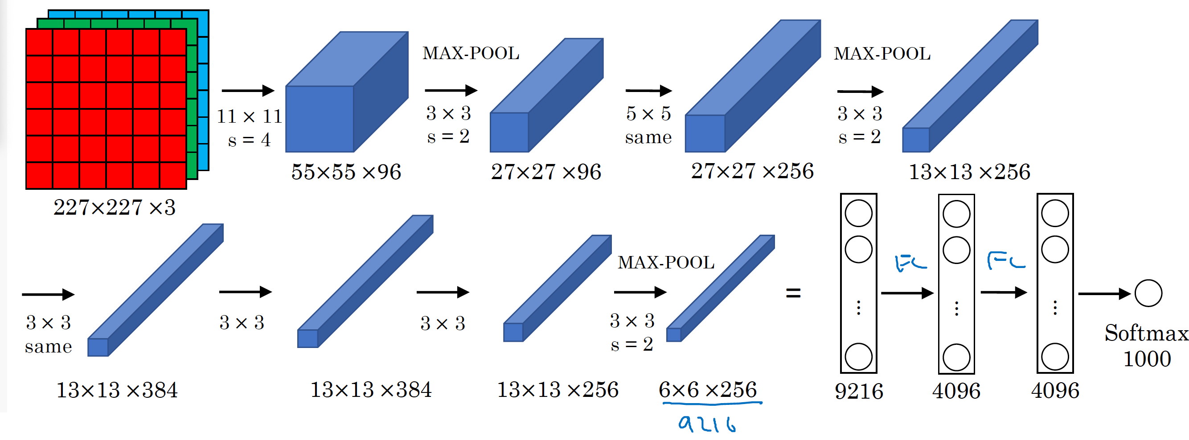
AlexNet
Similar to LeNet but much bigger (160 M parameters)
ReLU activation
Krizhevsky et al., 2012. ImageNet classification with deep convolutional neural networks

Slide 47
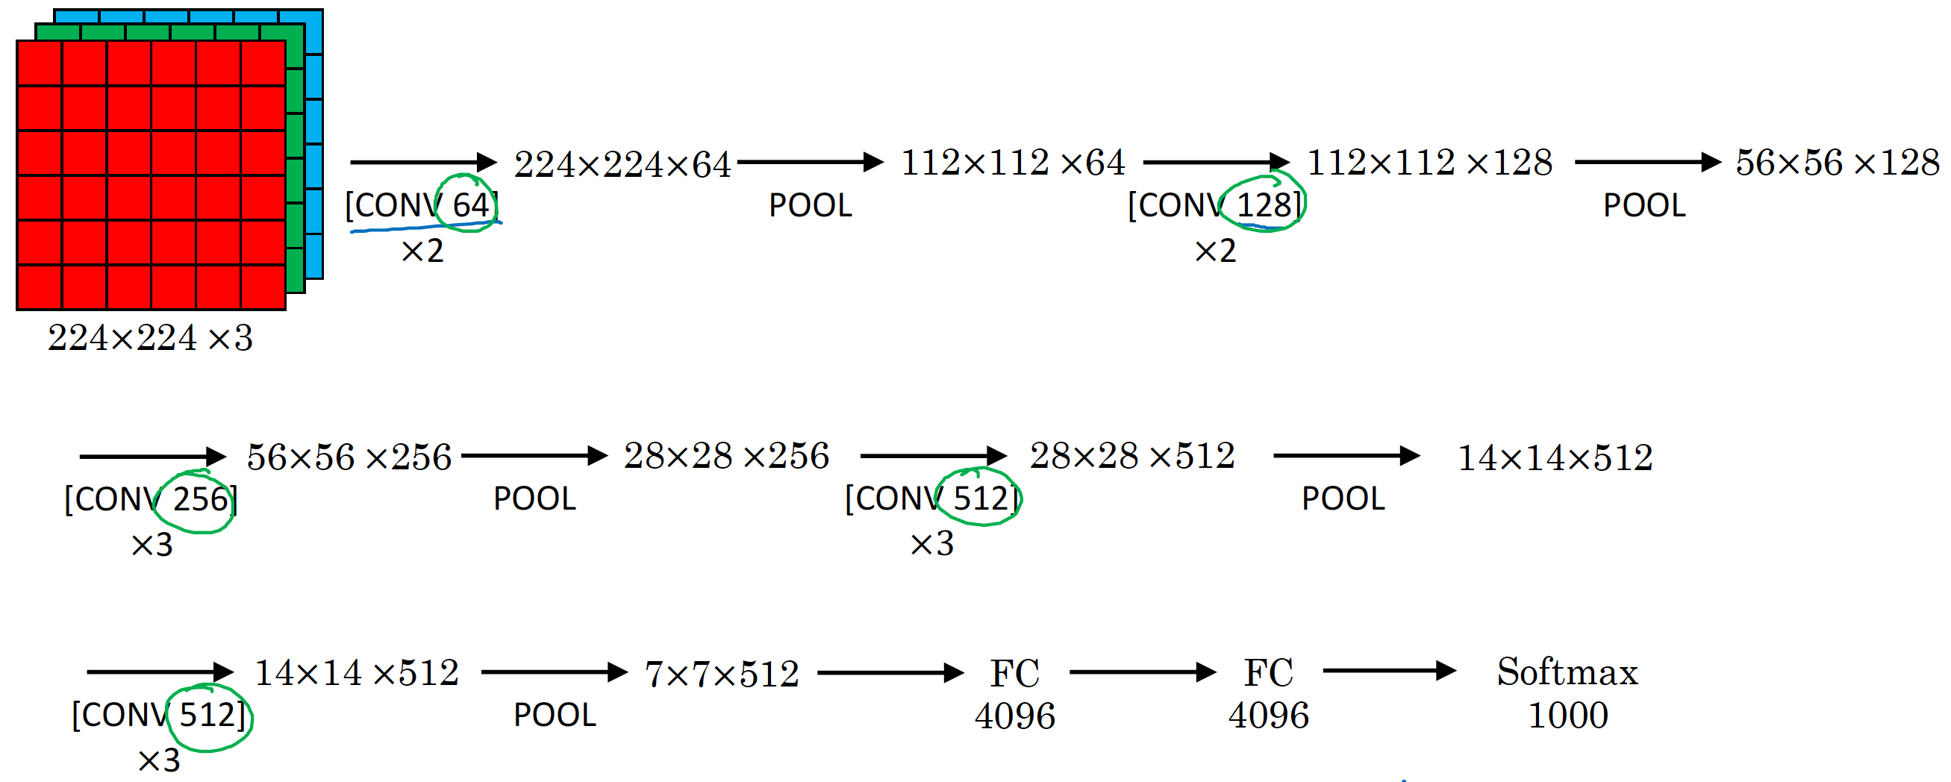
VGG – 16 (Visual Geometry Group 16 layers)
CONV = 3x3 filter, s = 1, p=same, activation=RELU, MAX-POOL = 2x2 , s = 2
138 M parameters
13 CONV + 2FC + SoftMax = 16
[Simonyan & Zisserman 2015. Very deep convolutional networks for large-scale image recognition]

Slide 48
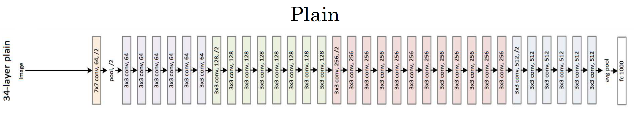
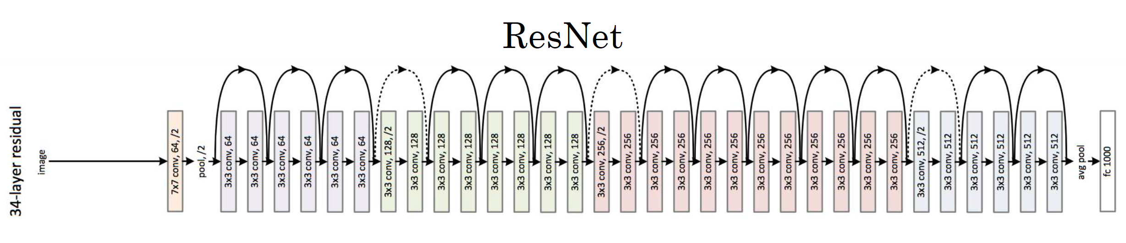
ResNet for images
[He et al., 2015. Deep residual networks for image recognition]

Slide 49
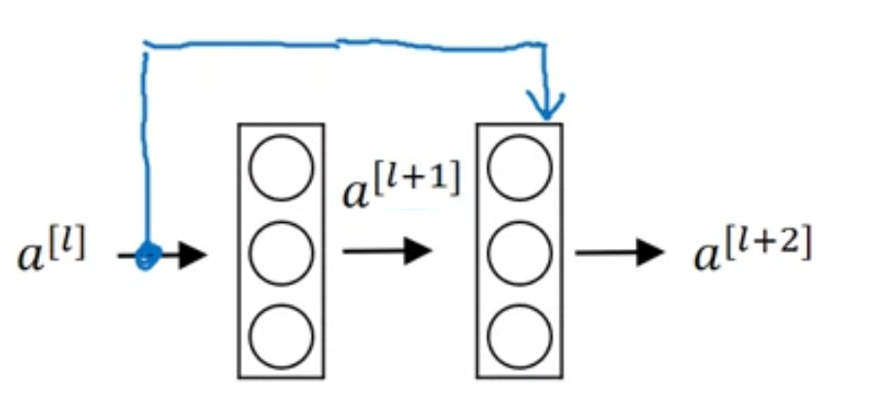
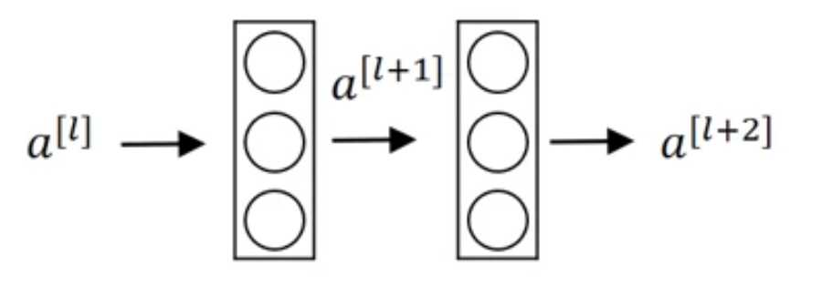
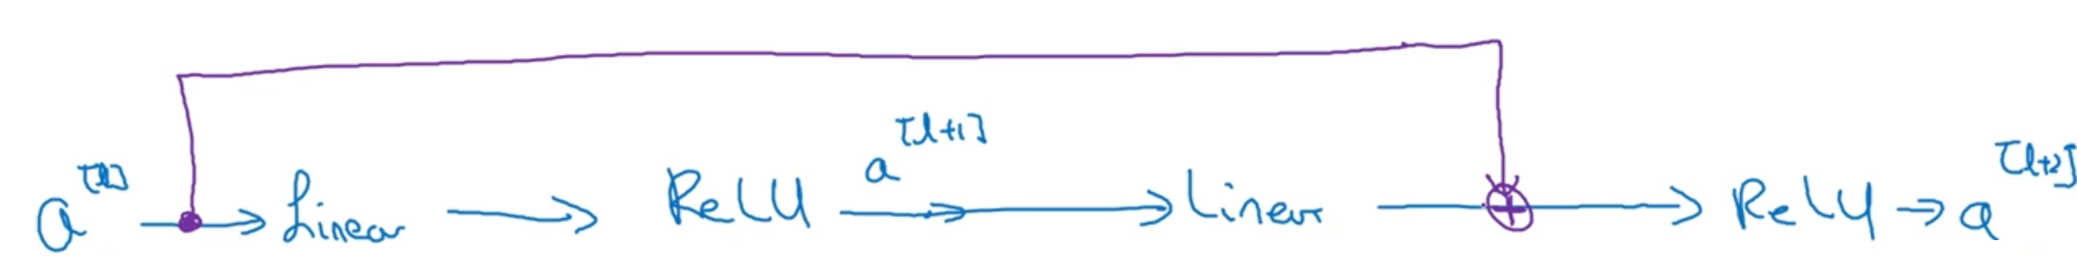
Residual block
Skip connection
[He et al., 2015. Deep residual networks for image recognition]

Slide 50
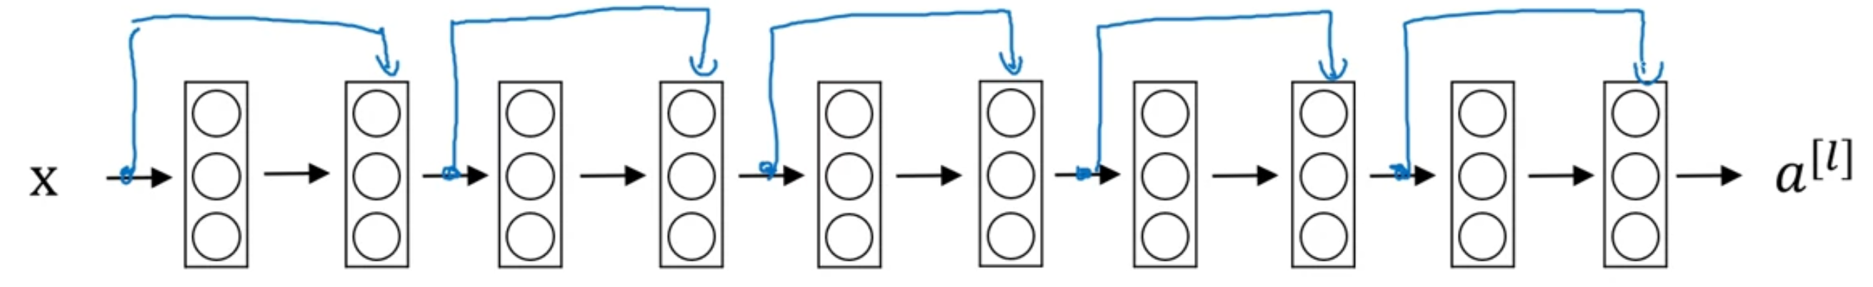
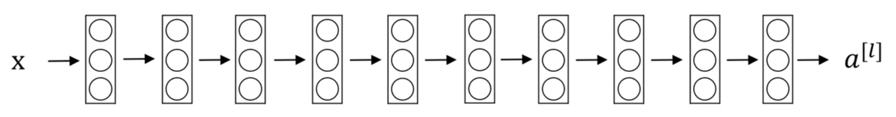
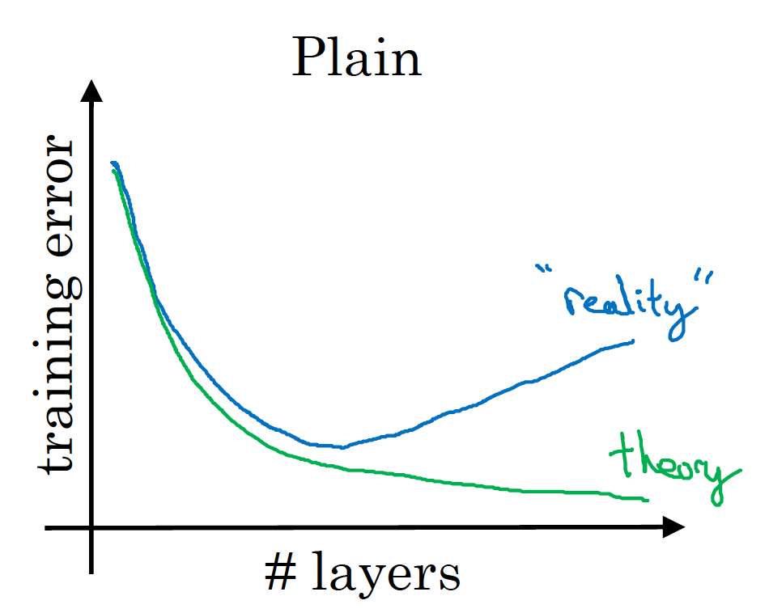
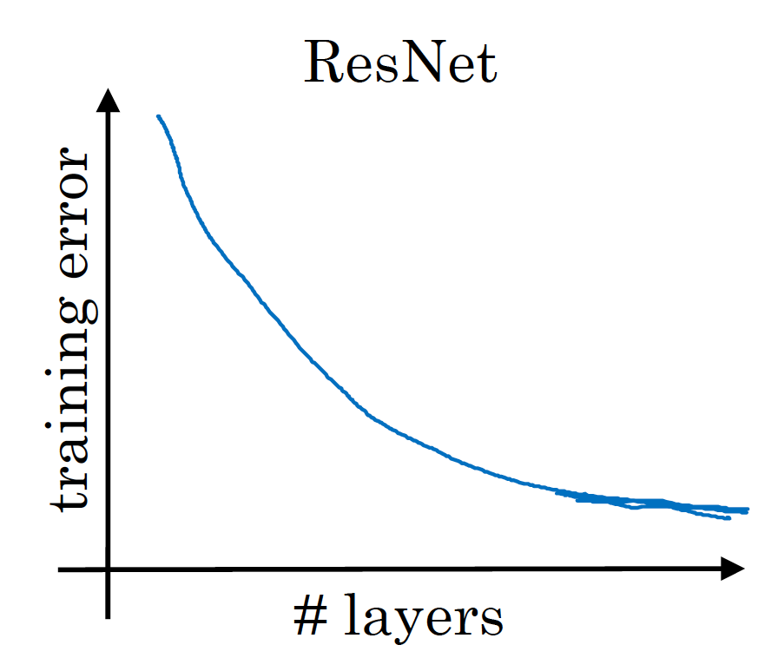
Residual Network

Slide 51
Motivation for Inception Network
For my next layer, should I use :
  3x3 convolution
  5x5 convolution
  Pooling layer
  …. ?
Let’s do it all!

Slide 52




Inception module
Szegedy et al. 2014. Going deeper with convolutions]

Slide 53


1x1 convolution
3 x 3 x 32
1 x 1 x 32 x #filters
#filters=1
3 x 3 x #filters
[Lin et al., 2013. Network in network]

Slide 54

Using 1x1 convolution
To shrink height an width, we have pooling
Using 1x1 convolution can be used to reduce the number of channels

Slide 55










Inception module

Slide 56

Inception network
[Szegedy et al., 2014, Going Deeper with Convolutions]

Slide 57
Mobile Net
Low computational cost at deployment
Useful for mobile and embedded vision applications
Key idea: Normal vs. Depthwise separable convolutions
[Howard et al. 2017, MobileNets: Efficient Convolutional Neural Networks for Mobile Vision Applications]

Slide 58



Depthwise separable convolution
N=5=le nombre de filtres
4x4x5
3x3x3x5
6x6x3
Nombre de multiplications: (4x4x5)x(3x3x3)= 2160, 432N
4x4x3
6x6x3
1x1(x3)x5
3x3x1x3 DW
3x3 DW
Nombre de multiplication:((4*4*3)*(3*3)+((4*4*5)*3) = 672, 432+48N

Slide 59


MobileNet
13 times
17 times
[Sandler et al. 2019, MobileNetV2: Inverted Residuals and Linear Bottlenecks]
Notes:
Expansion = Several 1x1 convolutions to increase number of channel. allows for more computation in depthwise convolution before shrinking down wit projection for memory

Slide 60
Merci pour votre attention

Slide 61
How to use these neural networks ?
Transfer learning (fine-tuning)
  Need less data
  Faster training
Build dataset
Data augmentation
Freeze more layers when fewer data

Slide 62



Common data agumentation

Slide 63

Color shifting

Slide 64
In practice
For each image in a particular batch, one random set of transformation is applied
For large datasets, one CPU thread takes care of data augmentation

Slide 65
Today
CNN

Slide 66

Gradient vanishing
A layer…
Y
Y = X x W
Z = f(Y)
X
W
f
Z
V(X)
V(W)
V(Y)
=
E(X)
E(W)
E(Y)
X
x
W
Y
E(Y) = E(X) . E(W)
Var(Y) = E[X]².Var(Y) + E[Y]².Var(X) + Var(X).Var(Y)

Slide 67





Residual block
Skip connection
[He et al., 2015. Deep residual networks for image recognition]

