Slide 1
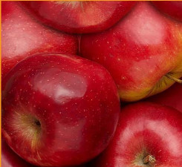
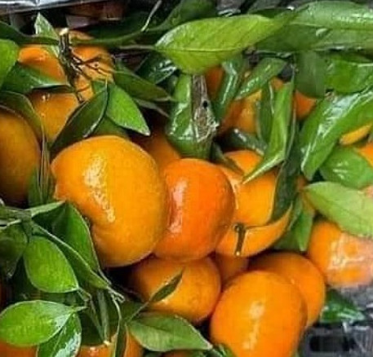
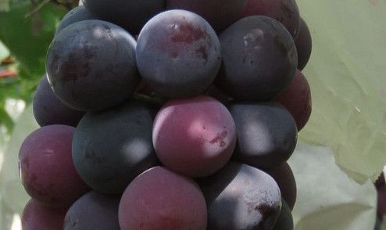
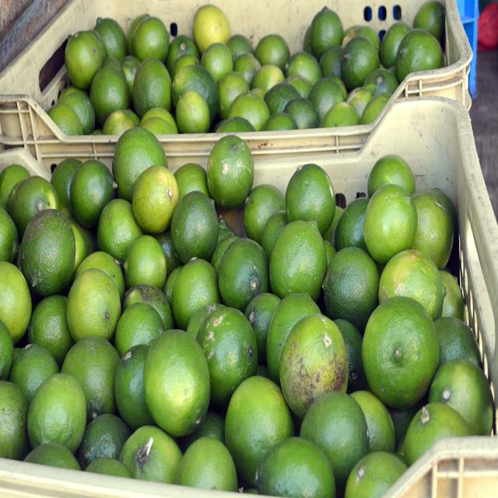
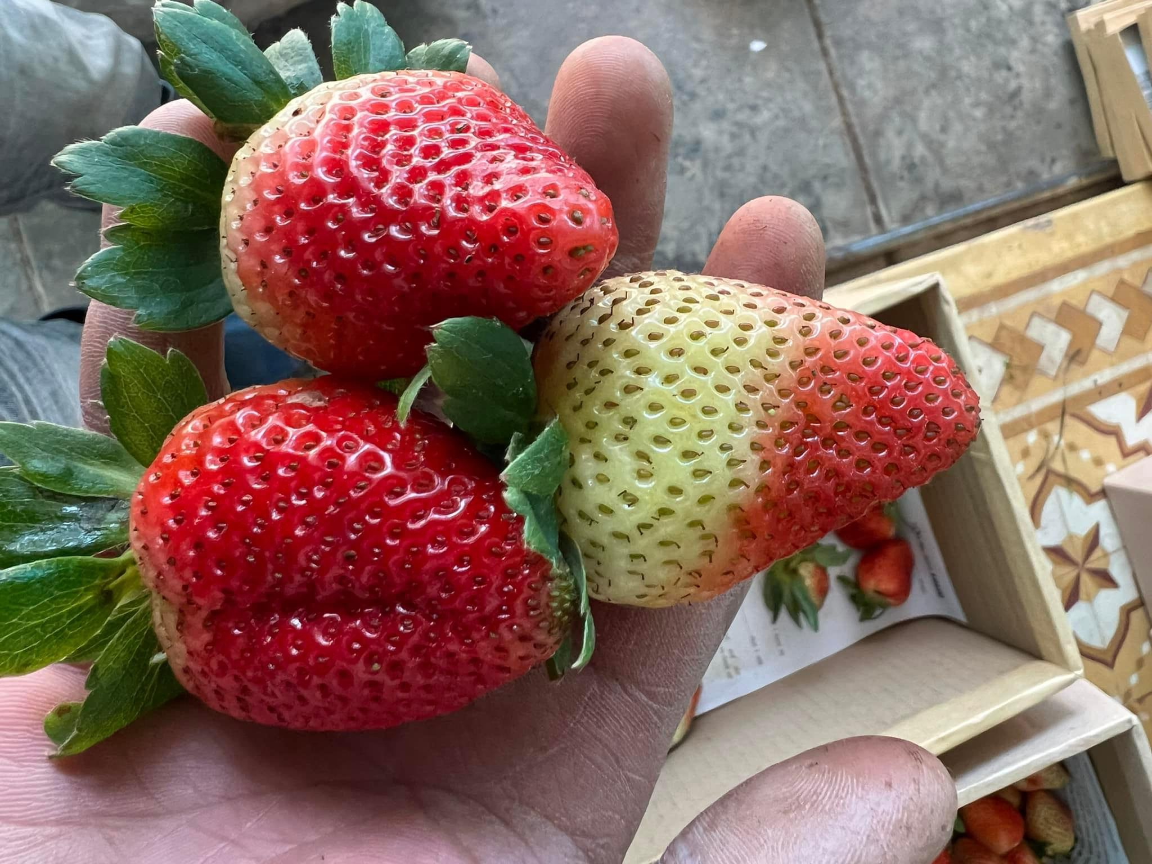
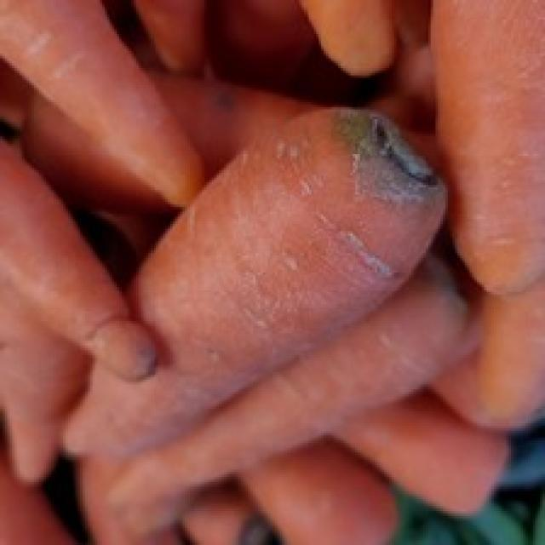
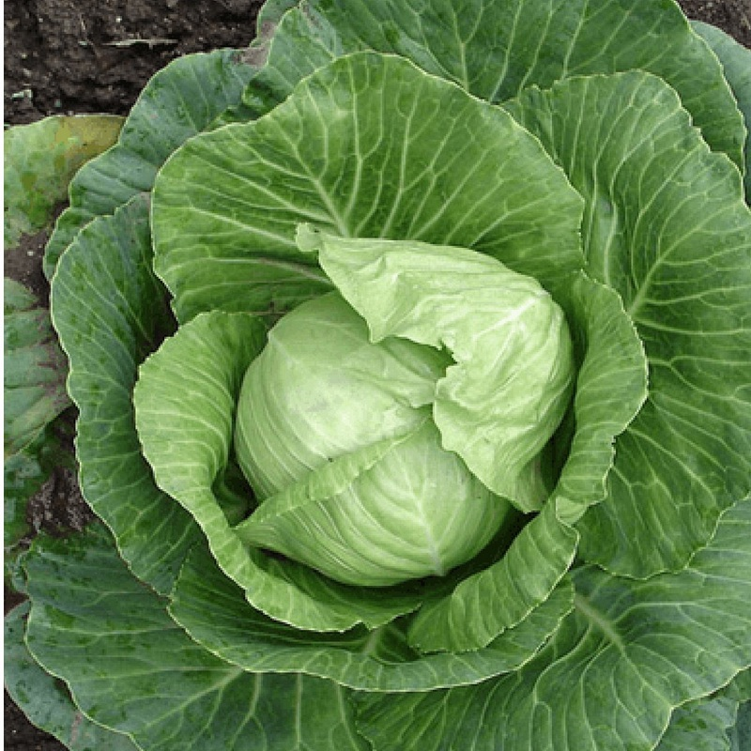
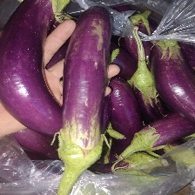
Text Enrichment Module
Adaptive Alignment Fusion
Frozen Text Extractor
Mean()
LLM
…
…
…
texture, gloss, color patterns,…
Visual Refinement Module
Few-shot data
Initial Prototypes
Frozen Image Extractor
Mean()
Anchor
…
…
…

