Slide 1

B.M.S. COLLEGE OF ENGINEERING
(Autonomous Institute, Affiliated to VTU, Belagavi)
DEPARTMENT OF MACHINE LEARNING
(UG Program: B.E. in Artificial Intelligence and Machine Learning)
Course : Natural Language Processing for LLM
Course Code: 24AM7PCLLM
Resume NER: Pretrained vs Fine-Tuned BERT
Alternative Assessment Tool (AAT)
Presented By,
Thijesh Praveen – 1BM23AI200
Uday Kumar M – 1BM23AI203
Semester & Section: 7C
Date:
Faculty In-Charge:
Upeksha Prasad G
Assistant Professor
Department of Machine Learning
BMS College of Engineering
Notes:
Title: Named Entity Recognition for Resume Parsing: Pretrained vs Fine-Tuned BERT. Presented by Thijesh Praveen (1BM23AI200) and Uday Kumar M (1BM23AI203), 7th semester, section C. Course: Natural Language Processing for LLM (24AM7PCLLM).

Slide 2
Agenda
Introduction
Selected NLP Topic Overview
Real-Time Application / API Identified
NLP Model / Architecture Study
Dataset and Preprocessing
Implementation Methodology
Results and Evaluation
Discussion
Conclusion
References
Notes:
The talk follows the structure of the report: introduction, the NER task, our application, the BERT model, data and preprocessing, implementation, results, discussion, conclusion and references.

Slide 3
Introduction: Why Resume Parsing Needs NER
Problem: resumes arrive as unstructured PDF / DOCX text with no fixed layout
ATS need: structured fields — name, contact, education, employers, titles, skills
NER turns raw text into typed entities with character spans
Question: how good is a pretrained NER model on resumes, and how much does fine-tuning add?
Deliverables: measured before-vs-after comparison + REST API + live web demo
219
annotated resumes (DataTurks, Kaggle)
10
resume entity types, BIO tagging
10.3 → 44.8
test micro-F1 (%), before → after fine-tuning
Notes:
Recruiters and applicant tracking systems receive resumes as unstructured PDFs and Word files. To search or match candidates, the text must become structured fields. NER does that extraction. Our question: how well does an off-the-shelf NER model do on resumes, and how much does fine-tuning help?

Slide 4
Selected NLP Topic: Named Entity Recognition
Ashok
Kunam
Team
Lead
-
Microsoft
Real header line from a test resume, tagged by the fine-tuned model
B-NAME
I-NAME
B-DESIGNATION
I-DESIGNATION
O
B-COMPANY
Entity type | Spans | Example
NAME | 223 | Ashok Kunam
EMAIL | 250 | indeed.com/r/…
LOCATION | 416 | Bengaluru
COLLEGE_NAME | 327 | Visvesvaraya Technological Univ.
DEGREE | 296 | Bachelor of Engineering
GRADUATION_YEAR | 249 | 2017
COMPANIES_WORKED_AT | 668 | Microsoft
DESIGNATION | 505 | Server Support Engineer
YEARS_OF_EXPERIENCE | 40 | 2.5 years
SKILLS | 455 | Python, SQL, …
Domain shift: news (CoNLL-2003) → resumes
Label mismatch: 7 of 10 types missing in CoNLL
Ambiguity: company vs college vs skill
Layout noise from PDF extraction
Long inputs: mean 688 words (BERT limit 512 sub-tokens)
Notes:
NER is sequence labelling. Every word gets a BIO label: B for the first word of an entity, I for the following words, O for everything else. Ten entity types give 21 labels. The example shows a real header from the test set, tagged by the fine-tuned model.

Slide 5
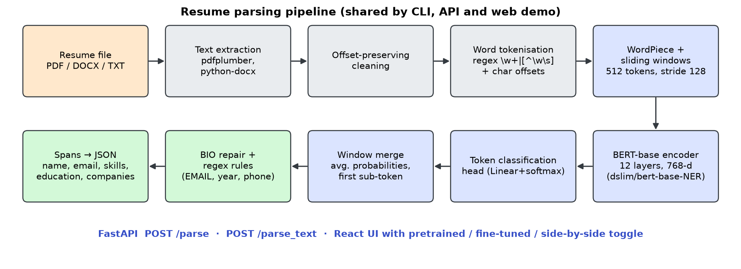
Real-Time Application: Resume NER API and Demo
POST /parse — PDF / DOCX / TXT upload → JSON
model = pretrained | finetuned | both
CPU latency: 1.19 s per resume (mean)
Output: name, email, phone, skills, education, companies, designations + entity spans
Context: commercial resume-parsing APIs (Affinda, Textkernel) return similar JSON
Notes:
Our application: FastAPI backend with POST /parse, React front end. The same pipeline serves the CLI, API and demo. Both models are available so the demo can show them side by side. Commercial parsers such as Affinda and Textkernel offer the same idea as paid REST APIs returning JSON.

Slide 6
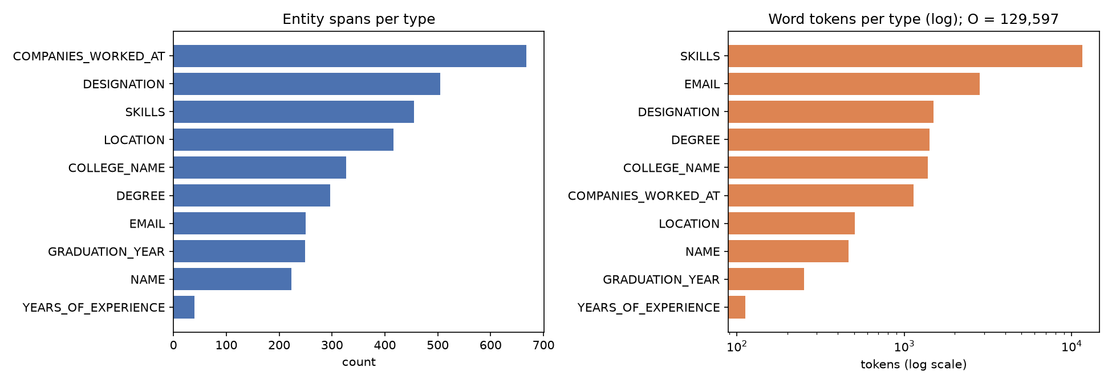
Dataset Overview and Label Distribution
219
resumes (220 raw, 1 duplicate)
150,753
word tokens
Entity spans per type (left) and word tokens per type, log scale (right)
3,429
entity spans
Split: 153 / 33 / 33 resumes (70/15/15, seed 42) + 5-fold CV
Imbalance: 86.0 % of words are O; YEARS_OF_EXPERIENCE only 40 spans
Noise: all 250 EMAIL spans are Indeed URLs; 26 resumes leave the URL unannotated
Notes:
DataTurks Resume Entities for NER from Kaggle: 220 resumes, one duplicate removed. 86 percent of words are outside any entity. Companies are frequent, years of experience very rare, and skills spans are very long because whole sections were annotated.

Slide 7
Preprocessing Pipeline
1
2
3
4
5
6
De-duplicate
Clean text
Fix spans
Tokenise
Span → BIO
WordPiece
1 duplicate removed
noise chars → space, offsets kept
inclusive end, trim, resolve overlaps
regex words + char offsets
21 labels, word-aligned
first sub-token labelled, rest −100
Alignment check (data_prep.py log) | Count
Overlapping spans dropped | 103
Spans expanded to word boundaries | 201
BIO → span round trip recovered | 99.1 %
Train/test identical texts (leakage) | 0
No stopword removal / lemmatisation: entities contain function words ("Bachelor *of* Engineering")
No lower-casing: capitalisation is a key cue; the model is cased
Long resumes: sliding windows of 512 sub-tokens, stride 128
Notes:
Character spans are converted to word-level BIO labels. Cleaning replaces noise characters one for one so offsets stay valid. Stopwords are NOT removed and no lemmatisation is done, because NER must label every word and entities contain function words. A round trip back to spans recovers 99 percent.

Slide 8
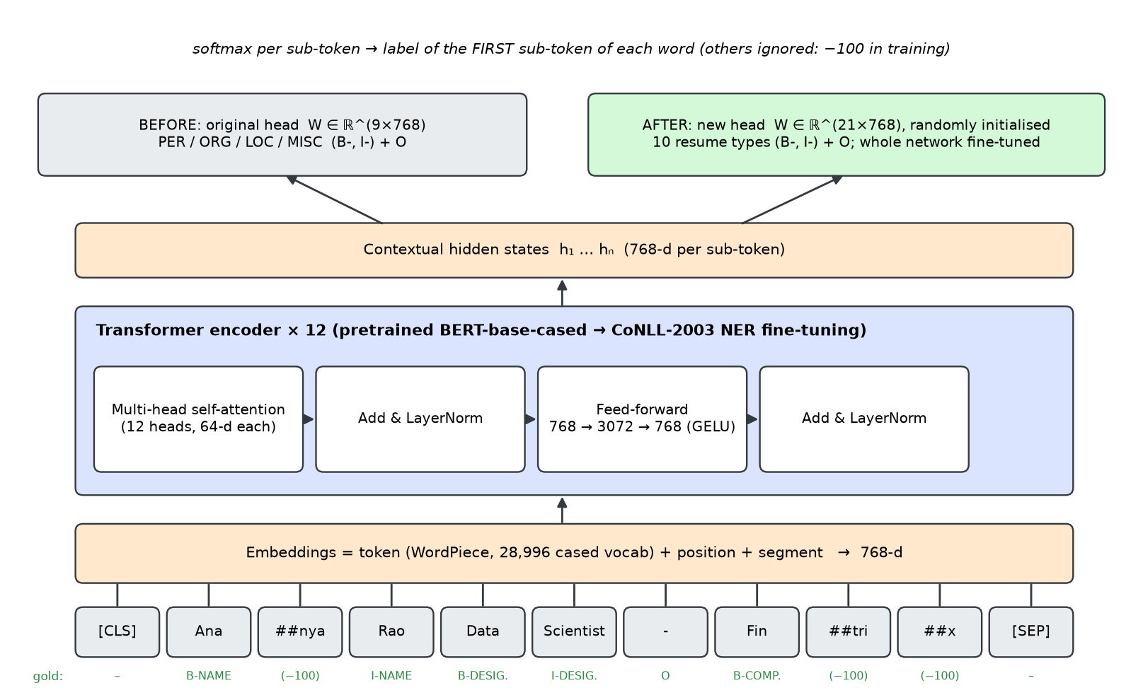
Model: BERT and the Pretrained vs Fine-Tuned Idea
12 layers, 768-d, 12 heads, 108 M params
Before: CoNLL head (9 labels), PER→NAME, ORG→COMPANY, LOC→LOCATION
After: new head (21 labels), whole model fine-tuned, cross-entropy + AdamW
Attention = softmax(QKᵀ/√dₖ)V
Notes:
dslim/bert-base-NER is BERT-base-cased fine-tuned on CoNLL-2003 news NER. Before: we use it as is and map PER, ORG, LOC to our types. After: we keep the encoder, replace the 9-label head by a 21-label head and fine-tune the whole network on resumes. Self-attention lets each token use context from both sides.

Slide 9
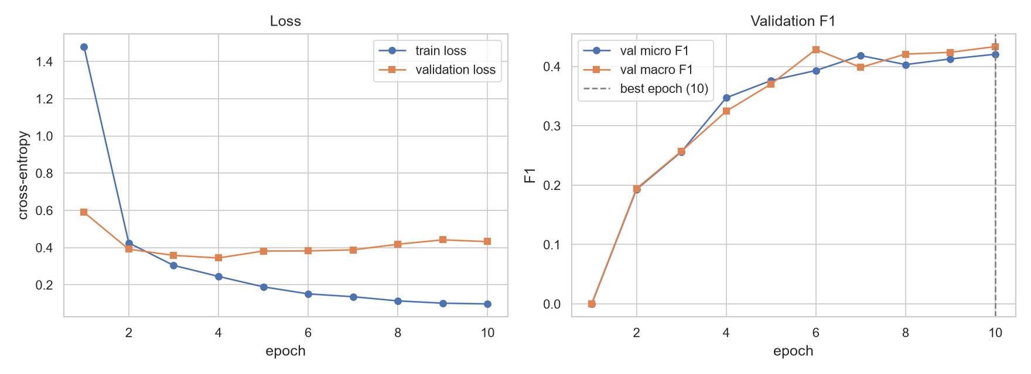
Implementation: Training Setup and Hyperparameters
Hyperparameter | Value
Learning rate | 3e-05
Batch size | 8
Epochs (best kept) | 10 (best 10)
Max length / stride | 512 / 128
Weight decay / warm-up | 0.01 / 10 %
Optimiser | AdamW, bf16
Train time (RTX 4050) | 206 s
Selection | best validation F1
lr | bs | Val F1 | Test F1
2e-05 | 16 | 27.8 | 33.3
2e-05 | 8 | 39.3 | 42.0
3e-05 | 16 | 36.0 | 38.9
3e-05 | 8 | 42.4 | 44.8
5e-05 | 16 | 40.3 | 43.8
5e-05 | 8 | 42.2 | 45.9
Notes:
Learning rate and batch size were chosen by a grid search on the validation set only. The best was learning rate 3e-05, batch size 8, 10 epochs. Training took about 3 minutes on the laptop GPU. Validation F1 kept rising to the last epoch while validation loss rose after epoch 4, so we select checkpoints by F1.

Slide 10
Results: Before vs After Fine-Tuning
Metric (%) | Before | After
Micro F1, all types | 10.3 | 44.8
Macro F1, all types | 5.2 | 44.5
Micro F1, 3 shared types | 12.1 | 56.7
Precision (micro) | 6.9 | 38.7
Recall (micro) | 20.2 | 53.1
+ regex rules (micro F1) | — | 45.6
Test split: 33 resumes, 501 gold entities
Notes:
Same test split, same metric: seqeval strict entity-level F1. The pretrained model only scores on NAME, LOCATION and COMPANY, and is zero on the seven types it cannot express. After fine-tuning every type improves; NAME reaches 82.9 percent. SKILLS and years of experience stay hard.

Slide 11
Results: 5-Fold Cross-Validation and Efficiency
40.7 ± 2.7
fine-tuned CV micro-F1 (%) vs 10.2 ± 1.1 before
1.19 s
CPU per resume (p95 3.0 s)
411 MB
model size · trained in 206 s
Notes:
Cross-validation gives a more reliable estimate: 40.7 plus or minus 2.7 for the fine-tuned model against 10.2 for the pretrained model; fine-tuning wins on every fold. Inference cost is the same for both models because the architecture is the same.

Slide 12
Qualitative Examples: Same Snippet, Both Models
Snippet | Gold | Pretrained (before) | Fine-tuned (after)
Ashok Kunam Team Lead - Microsoft - Email me on Indeed: indeed.com/r/Ashok-Kunam/7aac8767aacf10a0 • Software Engineering professional with over 2.5 years of experience in | Ashok Kunam → NAME Team Lead → DESIGNATION Microsoft → COMPANY indeed.com/r/Ashok-Kunam/7aac8767a → EMAIL | Ashok Kunam → NAME Microsoft → COMPANY Kunam → LOCATION Software Engineering → COMPANY | Ashok Kunam → NAME Team Lead → DESIGNATION Microsoft → COMPANY indeed.com/r/Ashok-Kunam/7aac8767a → EMAIL 2.5 years → YRS EXP.
The divisions were also compared against each other (comparison reports) EDUCATION B.E Visvesvaraya Technological University 2017 Bachelor of Engineering in Engineering | B.E → DEGREE Visvesvaraya Technological Univers → COLLEGE Bachelor of Engineering in Enginee → DEGREE | Technological University → COMPANY Engineering → COMPANY Engineering → COMPANY | B.E → DEGREE Visvesvaraya Technological Univers → COLLEGE 2017 → GRAD. YEAR Bachelor of Engineering in Enginee → DEGREE
Notes:
The pretrained model tags universities as companies and splits header lines. The fine-tuned model reproduces the resume labels: degrees, colleges, graduation years and Indeed profile links.

Slide 13
Ablations and Error Analysis
Error category (test) | Count
Correct | 266
Boundary error | 121
Type error (incl. boundary+type) | 10
Missed | 104
Spurious | 224
Hardest: SKILLS (11.1), YEARS_OF_EXPERIENCE (13.3), COLLEGE_NAME (37.0)
SKILLS: whole sections up to 352 words → boundary errors
Annotation gaps: 26 unlabelled Indeed URLs; URL labelled LOCATION in 4 resumes
Notes:
Each ablation changes one setting. Sliding windows and enough epochs matter most; class weighting hurts; the regex rule layer adds a little through EMAIL. Most remaining errors are boundary errors and spurious predictions, many of which are real but unannotated entities.

Slide 14
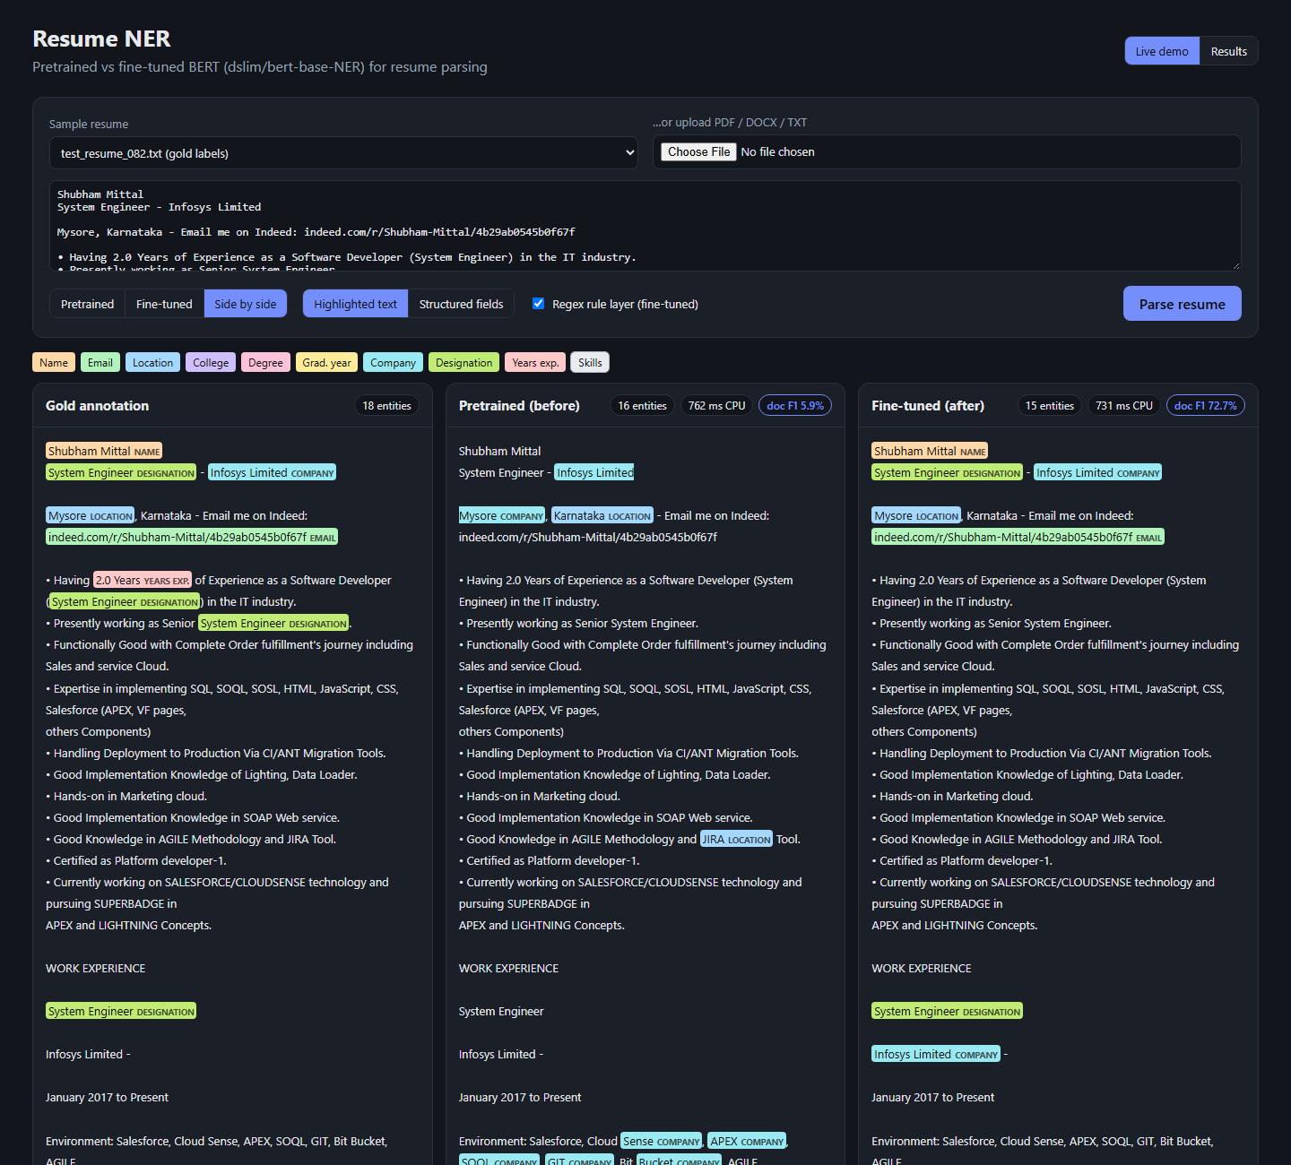
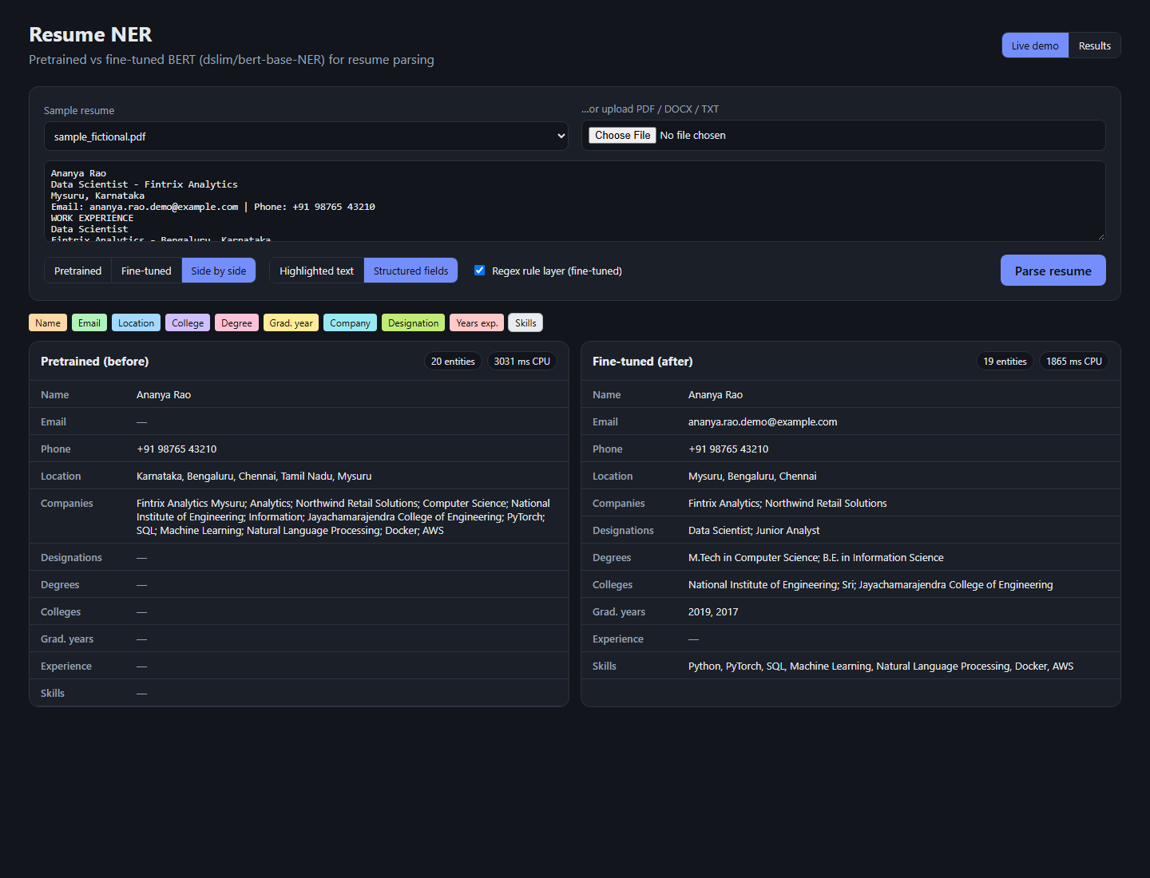
Live Demo: Pretrained vs Fine-Tuned Toggle
Upload PDF / DOCX / TXT or pick a sample
Pretrained · fine-tuned · side-by-side toggle
Gold labels + per-document F1 for test resumes
Results tab: before-vs-after tables and figures
Notes:
Live demo: run uvicorn app.api:app and open localhost:8000. Pick test_resume_082 and the side-by-side view: gold, pretrained and fine-tuned columns with per-document F1. Then upload the fictional PDF and switch to structured fields. Deep link: /?sample=test_resume_082.txt&mode=compare

Slide 15
Discussion and Challenges
Why fine-tuning helps
Challenges
Data quality
New labels: 7 of 10 types do not exist in CoNLL
Guidelines shift: only employers, the candidate's city
Encoder knowledge is reused: big gain from 153 resumes
Shifted, overlapping character spans
Sub-word ↔ word ↔ character alignment
Resumes up to 3,684 words
Small, noisy, imbalanced data
EMAIL = Indeed URLs only (250 spans)
31 resumes with WORK EXPERIENCE but no company labelled
GRADUATION_YEAR labelled in only 104 resumes
Notes:
Fine-tuning helps for two reasons: the label set changes and the annotation guidelines differ from news. The challenges were span alignment, sub-word alignment, long resumes and the tiny, noisy dataset.

Slide 16
Conclusion and Future Work
10.3 → 44.8
test micro-F1 (%)
Learned
Pretrained NER does not transfer when labels and guidelines differ
Fine-tuning is data-efficient
Strict entity F1 + validation-only selection + CV
Data quality is the ceiling
Future work
Layout-aware models (LayoutLM)
Cleaner, larger annotation
LLM-based JSON extraction
CRF / partial-match metrics
Fairness and bias audit
5.2 → 44.5
test macro-F1 (%)
82.9 %
NAME F1 after fine-tuning
Notes:
Summary: same model, same data, same metric. Fine-tuning raised micro F1 from about 10 to about 45 percent and the system runs on a laptop CPU. Next steps: layout-aware models such as LayoutLM, cleaner and larger data, LLM-based extraction for comparison, and a fairness audit before any use in hiring.

Slide 17
References
[1] J. Devlin et al., "BERT: Pre-training of deep bidirectional transformers for language understanding," NAACL-HLT, 2019.
[2] A. Vaswani et al., "Attention is all you need," NeurIPS, 2017.
[3] E. F. Tjong Kim Sang and F. De Meulder, "Introduction to the CoNLL-2003 shared task," CoNLL, 2003.
[4] dslim, "bert-base-NER," Hugging Face model card, huggingface.co/dslim/bert-base-NER.
[5] DataTurks, "Resume Entities for NER," Kaggle, kaggle.com/datasets/dataturks/resume-entities-for-ner.
[6] T. Wolf et al., "Transformers: State-of-the-art natural language processing," EMNLP Demos, 2020.
[7] H. Nakayama, "seqeval: A Python framework for sequence labeling evaluation," 2018.
[8] Y. Xu et al., "LayoutLM: Pre-training of text and layout for document image understanding," KDD, 2020.
[9] M. Raghavan et al., "Mitigating bias in algorithmic hiring: Evaluating claims and practices," FAT*, 2020.
[10] Affinda and Textkernel resume-parser API documentation (docs.affinda.com, developer.textkernel.com).
Notes:
All references are real and verified; the full list in IEEE style is in the report.

Slide 18
Thank you !

