Slide 1

B.M.S. COLLEGE OF ENGINEERING
(Autonomous Institute, Affiliated to VTU, Belagavi)
DEPARTMENT OF MACHINE LEARNING
(UG Program: B.E. in Artificial Intelligence and Machine Learning)
Course : Social Network Analysis
Course Code: 24AM7PESNA
Link Prediction in a Co-authorship Network: Recommending Future Research Collaborations
Alternative Assessment Tool (AAT)
Presented By,
Student Name & USN : Thijesh Praveen V (1BM23AI200)
Student Name & USN : Uday Kumar M (1BM23AI203)
Semester & Section:
Date:
Faculty In-Charge:
Lavanya B Koppal
Department of Machine Learning
BMS College of Engineering
Notes:
Introduce the team and the topic: predicting future co-authorships in the arXiv GR-QC collaboration network and turning the predictions into collaborator recommendations.

Slide 2
Agenda
Problem Definition
Dataset and Network Modeling
Methodology: Link Prediction Heuristics
Experimental Setup
Results and Evaluation
Top-K Comparison
Recommendations
Visualization
Insights, Limitations and Future Work
Conclusion
Notes:
Roadmap of the talk.

Slide 3
Problem Definition
Domain: academic collaboration - who writes papers with whom.
Link prediction: given today's co-authorship network, which unconnected pairs of authors are most likely to collaborate in the future?
Why it matters: collaborator recommendation (Google Scholar, ResearchGate), team formation, reviewer suggestion, forecasting the growth of a field.
Formal task: hide part of the edges, score every non-adjacent pair s(u, v) using only the visible graph, and rank the hidden edges at the top.
Network element | Mapping
Node | Author (researcher)
Edge | Co-authored >= 1 paper
Type | Undirected, unweighted
Self-loops | Removed
Experiments on | Largest connected component
Notes:
A paper with k authors becomes a k-clique, so the network is highly clustered. Link prediction turns the question 'who should collaborate?' into a ranking problem.

Slide 4
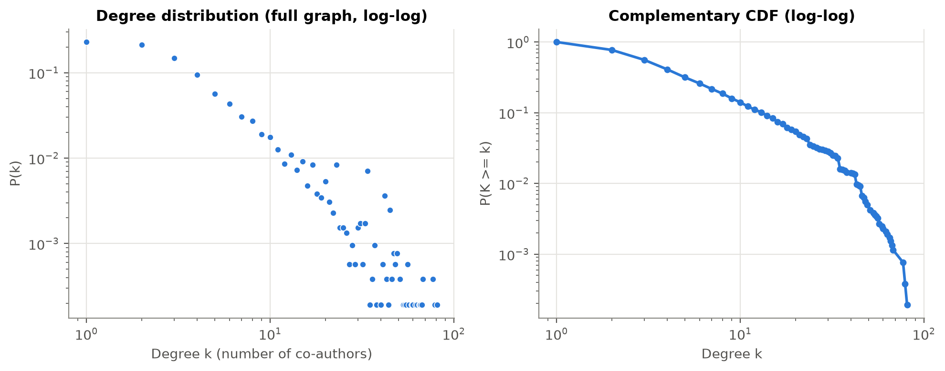
Dataset and Network
Statistic | Full graph | LCC
Nodes (authors) | 5,242 | 4,158
Edges (co-authorships) | 14,484 | 13,422
Density | 0.00105 | 0.00155
Average degree | 5.53 | 6.46
Avg. clustering coefficient | 0.530 | 0.557
Transitivity | 0.630 | 0.629
Connected components | 355 | 1
Diameter / avg. path length | - | 17 / 6.05
SNAP ca-GrQc (arXiv General Relativity, 1993-2003); 12 self-loops and 14,484 duplicate lines removed.
Sparse but highly clustered and small-world; heavy-tailed degrees (median 3, max 81).
Louvain: 42 communities, modularity 0.846.
Notes:
The LCC keeps 79.3% of the authors. High clustering is exactly what neighbourhood-based link predictors exploit.

Slide 5
Methodology
Load & clean
edge list
Largest
connected comp.
80/20 edge split
(spanning tree kept)
Negative sampling
1:1, full-graph
non-edges
Score pairs on
G_train only
(CN, JC, AA, PA)
Evaluate &
recommend
Four heuristics written from scratch with Python neighbour sets (src/scores.py) and cross-checked against NetworkX on 16,106 pairs: max difference 0.
Leakage-free: test edges are removed before any score is computed; train positives are scored with their own edge hidden.
Evaluation: ROC-AUC, Average Precision, Precision@K, P/R/F1 at a train-chosen threshold, 5-seed stability, hard negatives, hit rate.
Recommendation: rank all distance-2 non-adjacent pairs; explain each by its shared co-authors.
Notes:
The spanning tree contains every bridge, so removing only non-tree edges keeps the training graph connected and no author is isolated.

Slide 6
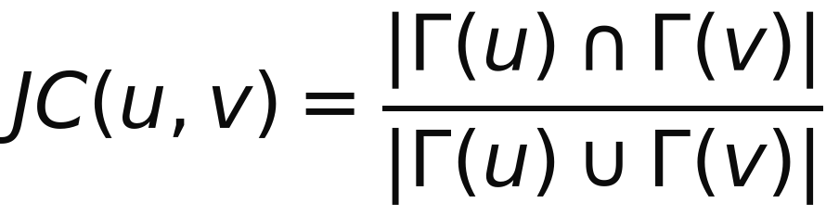
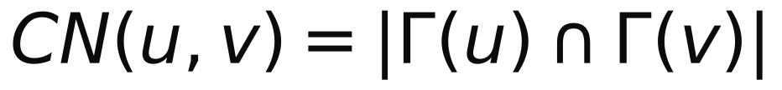
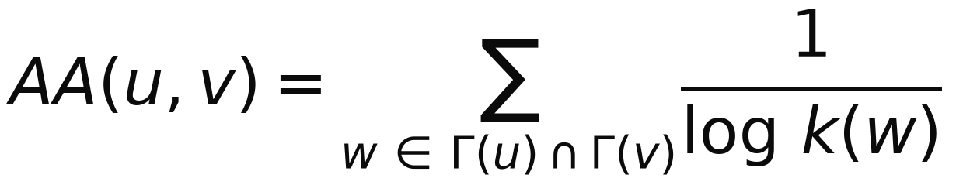
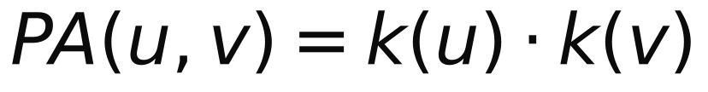
Heuristic Formulas
Common Neighbours
Jaccard Coefficient
Number of shared co-authors (triadic closure).
Shared co-authors as a fraction of all co-authors.
Adamic-Adar
Preferential Attachment
Shared co-authors weighted by 1/log(degree): rare collaborators count more than hubs.
Product of degrees: 'rich get richer', favours hubs.
Notes:
Gamma(x) = set of co-authors of x, k(x) = degree. A shared co-author with 3 collaborators contributes 1/ln 3 to Adamic-Adar, one with 60 collaborators only 1/ln 60.

Slide 7
Experimental Setup
Split (seed 42): 10,738 train edges / 2,684 test edges (20 % of 13,422); a random spanning tree of 4,157 edges always stays in train - the training graph keeps all 4,158 nodes and stays connected.
Negative sampling: pairs that are NOT edges of the full graph, 1:1 - 10,738 train and 2,684 test negatives (disjoint).
Leakage avoided: every score is computed on the training graph only.
Threshold: the value that maximises F1 on the TRAINING pairs, then applied unchanged to the test pairs.
Metrics: ROC-AUC, Average Precision, Precision@K (K = 10, 20, 50, 100), Precision/Recall/F1.
Robustness: 5 random splits (seeds 42, 43, 44, 45, 46); hard negatives = 2,684 non-links at distance 2.
Notes:
Without negative sampling there would be nothing to rank the positives against; sampling from non-edges of the FULL graph guarantees that a hidden test edge is never labelled negative.

Slide 8
Results
Method | ROC-AUC | AP | Threshold | Precision | Recall | F1 | P@100
Common Neighbours | 0.9554 | 0.9550 | 1 | 0.995 | 0.912 | 0.952 | 1.000
Jaccard | 0.9555 | 0.9555 | 0.0119 | 0.995 | 0.912 | 0.952 | 1.000
Adamic-Adar | 0.9557 | 0.9558 | 0.2423 | 0.995 | 0.912 | 0.952 | 1.000
Preferential Attachment | 0.8490 | 0.8662 | 10 | 0.652 | 0.902 | 0.756 | 1.000
Local indices (CN, Jaccard, AA) nearly tied: ROC-AUC 0.9554-0.9557; Preferential Attachment far behind (0.8490).
8.8% of test positives but 99.6% of random negatives share no co-author - 'at least one shared co-author' already separates most pairs.
Best overall: Adamic-Adar - mean ROC-AUC 0.9568 +/- 0.0028 over 5 splits.
Notes:
The thresholds of CN, Jaccard and AA all amount to 'at least one common neighbour', which is why their precision, recall and F1 are identical.

Slide 9
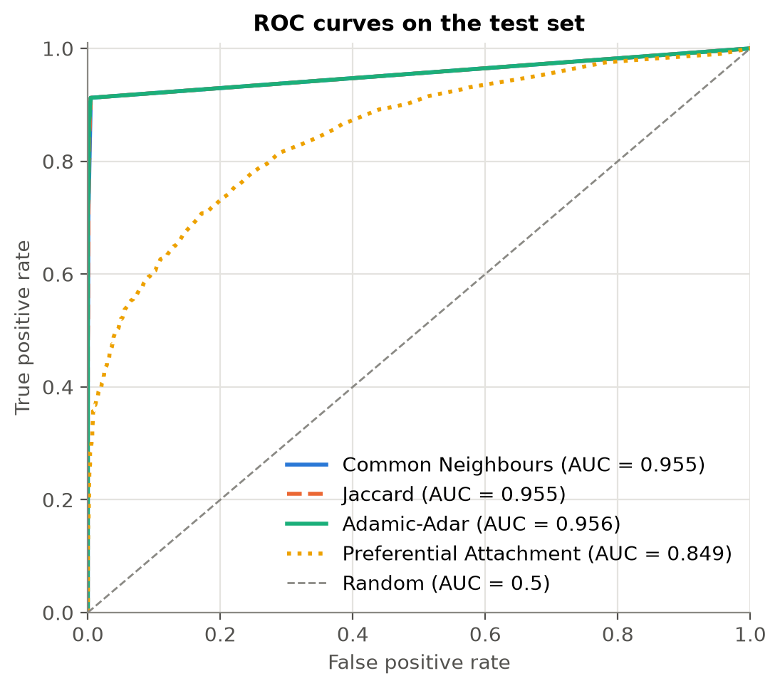
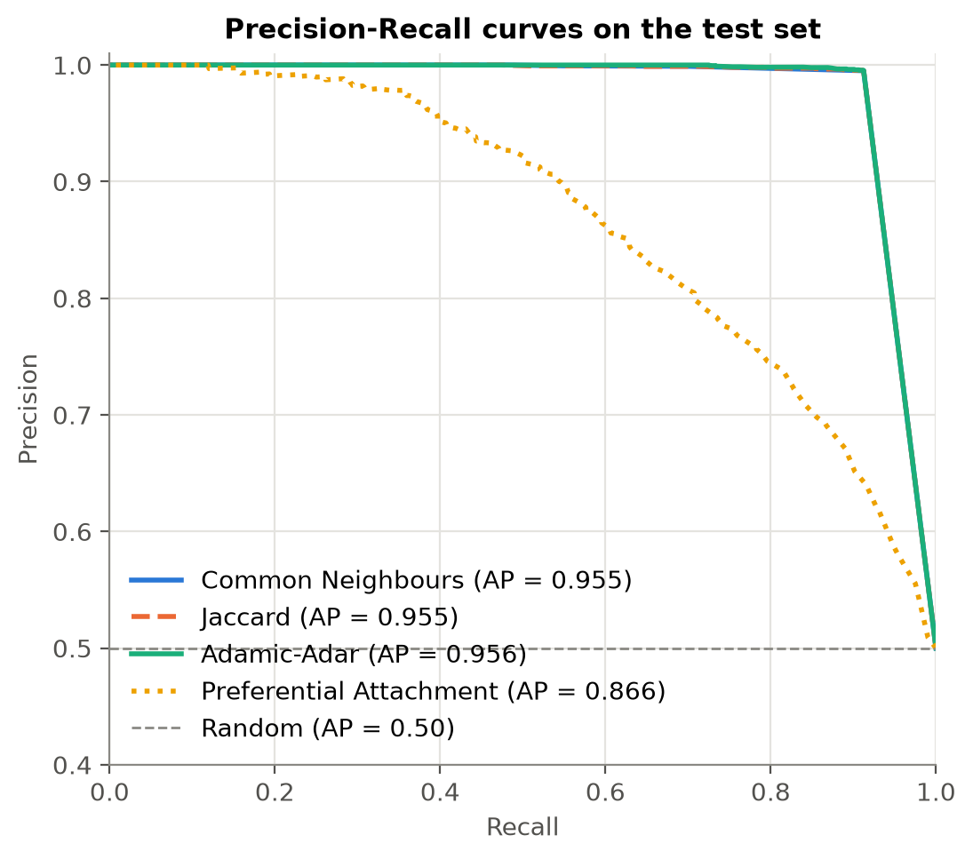
ROC and Precision-Recall Curves
CN, Jaccard and Adamic-Adar overlap; Preferential Attachment ranks pairs far less sharply.
Notes:
ROC-AUC = probability that a random positive is scored above a random negative. AP summarises precision across all recall levels.

Slide 10
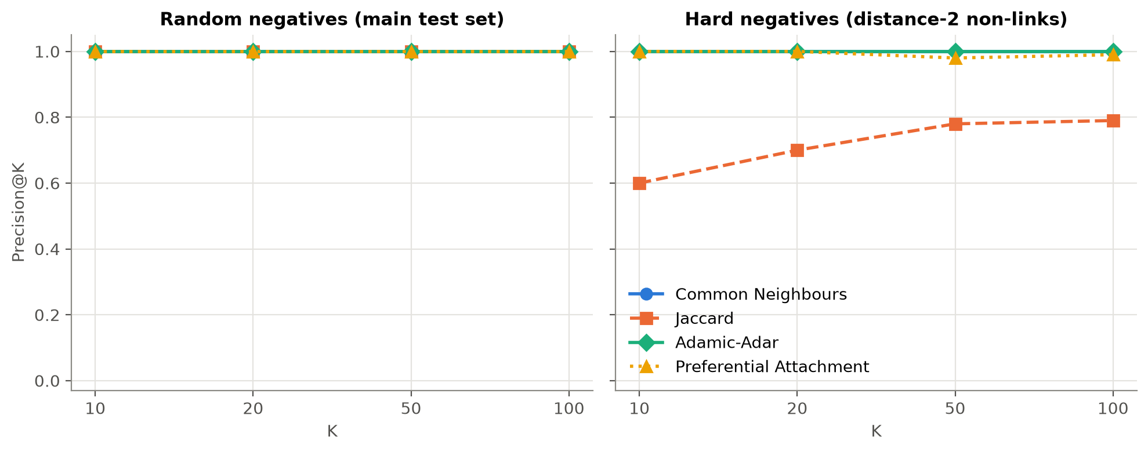
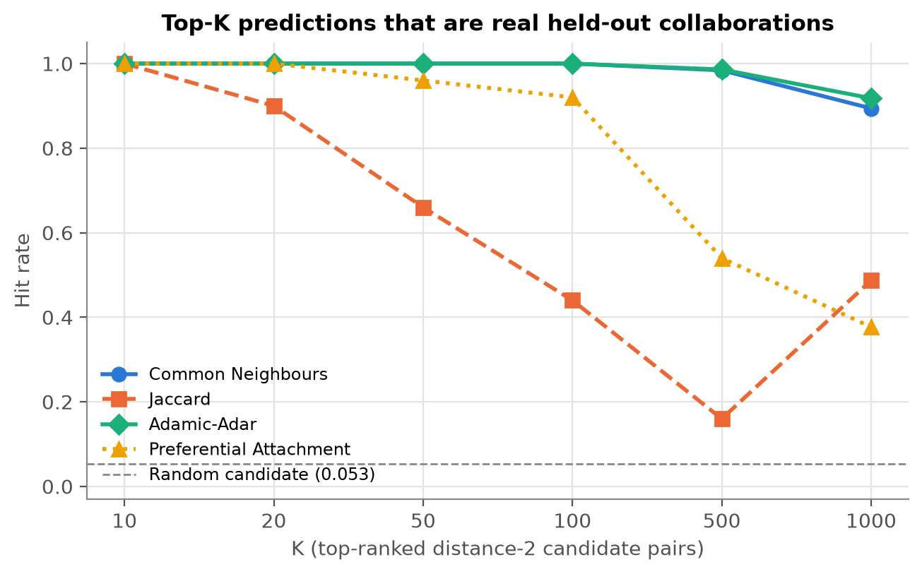
Top-K Comparison
Hard negatives | ROC-AUC | AP | P@10
Common Neighbours | 0.778 | 0.814 | 1.000
Jaccard | 0.759 | 0.788 | 0.600
Adamic-Adar | 0.850 | 0.900 | 1.000
Preferential Attachment | 0.644 | 0.681 | 1.000
With random negatives P@K = 1.0 for all methods (saturated).
Hard negatives (share >= 1 co-author) separate them: Adamic-Adar best.
Hit rate: 100% of Adamic-Adar's Top-100 (over 46,588 candidates) are real held-out links vs 5.3% at random.
Notes:
Precision@K measures what a user of the recommender actually sees: the top of the list.

Slide 11
Recommendations (Adamic-Adar)
# | Author u | Author v | AA score | Shared co-authors | k(u) | k(v)
1 | 45 | 46 | 10.598 | 42 | 49 | 42
2 | 4511 | 4513 | 10.592 | 42 | 45 | 43
3 | 4511 | 22691 | 10.592 | 42 | 45 | 77
4 | 46 | 4513 | 10.335 | 41 | 42 | 43
5 | 46 | 22691 | 10.335 | 41 | 42 | 77
6 | 5210 | 7444 | 6.699 | 25 | 33 | 28
7 | 7444 | 8727 | 6.699 | 25 | 28 | 33
8 | 7444 | 9869 | 6.699 | 25 | 28 | 41
9 | 7444 | 12710 | 6.699 | 25 | 28 | 33
10 | 7444 | 15245 | 6.699 | 25 | 28 | 33
Candidates: 63,288 non-adjacent pairs at distance 2 (every pair further away scores 0 for CN/JC/AA).
Filtered: no self-pairs, no existing links, no (v, u) duplicates.
Top-20 pairs share 24-42 co-authors; their groups have edge density 0.997-0.999 - missing links inside near-cliques (large multi-author papers).
Why #1? Authors 45 and 46 share 42 co-authors but have never published together.
Notes:
Full Top-20 with shared collaborators is in outputs/top20_recommendations.csv; Top-10 of every method in outputs/top10_recommendations.csv.

Slide 12
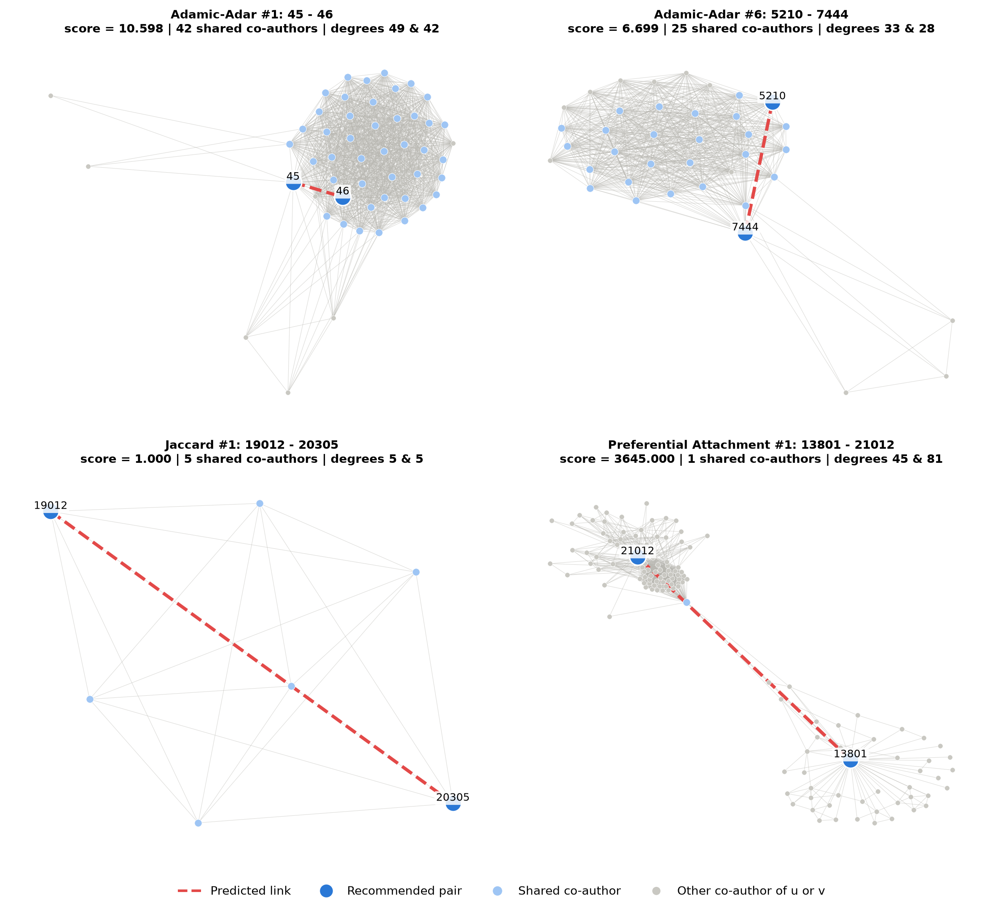
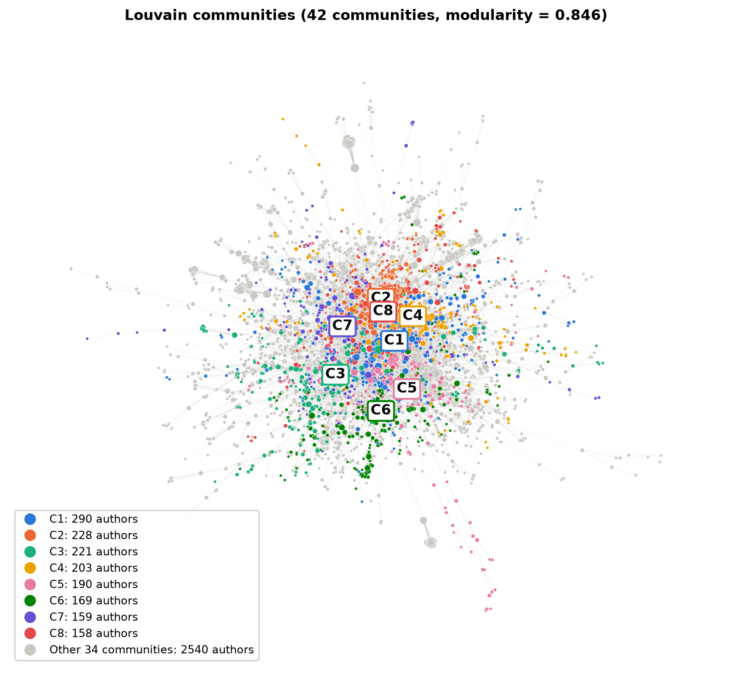
Visualization
Left: Louvain communities of the LCC. Right: ego networks of each method's #1 pair - dashed red = predicted link, light blue = shared co-authors.
Notes:
Interactive version: visualizations/recommendation_subgraph_interactive.html. Cytoscape files: visualizations/cytoscape (GraphML + CSV).

Slide 13
Insights
Clustering drives prediction: 89% of held-out links fall inside one Louvain community - new collaborations are local.
Adamic-Adar wins because it discounts shared hubs (hard-negative ROC-AUC 0.850 vs 0.778 for CN).
Jaccard over-normalises: its top scores go to tiny groups with identical co-author lists (hard-negative P@10 = 0.600).
PA favours hubs: it recommends popular authors from different groups, not close ones (ROC-AUC 0.849).
Stable: ROC-AUC std over 5 splits <= 0.0043 for every method.
Notes:
The evaluation design (split, negatives, leakage) matters as much as the algorithm: with easy negatives every local method looks perfect.

Slide 14
Limitations and Future Work
Limitations
Random, not temporal split (no timestamps in SNAP data)
Spanning-tree split favours easier (cycle) test edges
Random negatives are easy; 1:1 hides the real imbalance
Local indices cannot reach pairs at distance >= 3
Large cliques dominate the Top-K; IDs are anonymised
Future work
Katz index / Resource Allocation (longer paths)
Node2Vec embeddings or graph neural networks
Supervised classifier on CN, JC, AA, PA + community features
Temporal evaluation; weighted edges (number of papers)
Diversity-aware re-ranking of recommendations
Notes:
A supervised model can learn how to combine the four scores instead of choosing one.

Slide 15
Conclusion
Modeled ca-GrQc as an author graph (4,158 authors, 13,422 links in the LCC): sparse, highly clustered, small-world, modular.
Built a leakage-free link prediction pipeline with a connectivity-preserving split.
Adamic-Adar is the best predictor: ROC-AUC 0.9568 +/- 0.0028, hard-negative ROC-AUC 0.850, 100% hit rate in its Top-100.
Delivered explained Top-20 recommendations, visualizations, a Cytoscape export, a dataset package and a reproducible notebook.
Notes:
Network structure alone predicts collaborations well when the network is clustered.

Slide 16
Thank you !
Questions?
Notes:
Q&A - see VIVA_NOTES.md for prepared answers.

