Slide 1
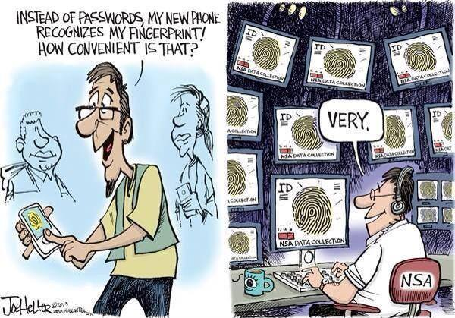
Dutch Childcare Benefits Scandal
- failing fraude systems and mis-use of data-
Thijmen Breeschoten DE21
Notes:
My data ethics case

Slide 2
Dutch Childcare Benefits Scandal
- failing fraude systems and mis-use of data-
→ Do we trust governments with our data?
Thijmen Breeschoten DE21

Slide 3
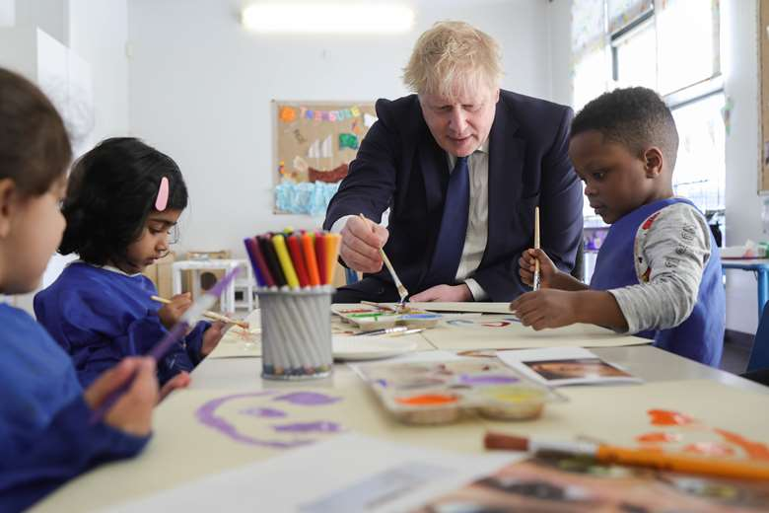
Dutch Benefits System: a brief overview
Tax authorities:
-> responsible for receiving tax
-> income based tax levels
-> check if someone is granted benefits
Income-dependant benefit (financial support) system
-> existing for multiple fields:
e.g. rent, healthcare and childcare
Notes:
In the Netherlands

Slide 4
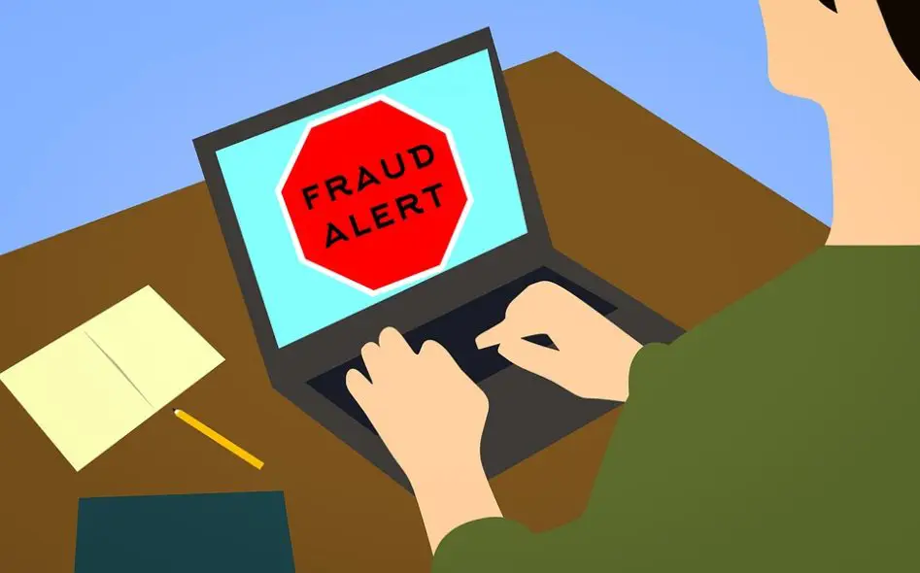
Childcare Benefits Scandal in a Nutshell
The (mis)-use of data led to the false accusations of fraud of the victims
Parents forced to pay back ALL benefits
-> children taken away by child protection
Benefits Scandal
-> 2004-2019
-> 26.000 parents, 70.000 children
-> big case involving multiple issues
-> focus on part involving (mis)-use of data

Slide 5
What happened?!
Tax authorities checks ‘at random’
-> Except those on a (potential) fraud list
Forced repayments in case of mistake/fraud
Case 1
-> registered data (e.g. 2nd nationality) used to bin people on fraud list
-> Dutch not first language: application mistakes likely
-> marked as fraud, repayment difficult due to poverty

Slide 6

Ethical challenges
Governments collect and (can) use data for the greater good
-> including sensitive data!
Issues:
- Do we trust governmental bodies with our data?
- Governments do change!
Notes:
1. use of data to improve healthcare for minorities
2. help/target groups with special needs
e.g. cancer health disparity

Slide 7

Solutions and opinion
- Data that is not recorded cannot be misused
-> France does not record personal sensitive data
-> UK?
Power of data
-> personal data should be recorded, but
stored/organised/analysed by organisations that do not have the
authority to exercise governance/ make binding decissions

