Slide 1
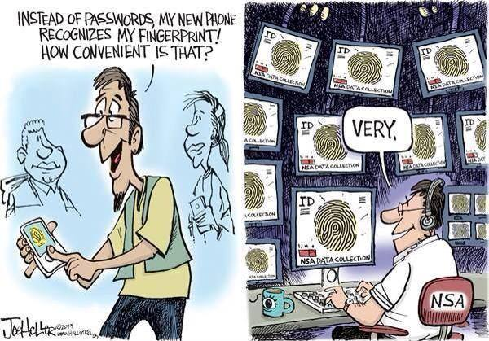
Dutch Childcare Benefits Scandal
- failing fraude systems and mis-use of data-
Thijmen Breeschoten DE21
Notes:
I want to talk about a huge scandal -currently still ongoing- in the Netherlands, which is related to the mis use of personal sensitive data by the Dutch tax authorities.
The underlying question that I want to cover here with this example is basically, do we trust Governments with our personal -sensitive- data.
This example is showing some similarities with the rough sleepers one. So I am interested what we think of this.

Slide 2
Dutch Childcare Benefits Scandal
- failing fraude systems and mis-use of data-
→ Do we trust governments with our data?

Slide 3

Dutch Benefits System: a brief overview
Tax authorities:
-> income based tax levels
-> check if someone is granted benefits
Income-dependant benefit (financial support) system
-> existing for multiple fields:
e.g. rent, healthcare and childcare
Notes:
A quick overview of the Dutch governmental tax authority system:
Like all European (or former-european) countries, the tax authorities are responsible for making sure that everyone is paying tax, for which the height is depending of someone’s income.
People with a low income can request benefits, which is financial support for basic needs like: rent, healthcare and childcare.

Slide 4
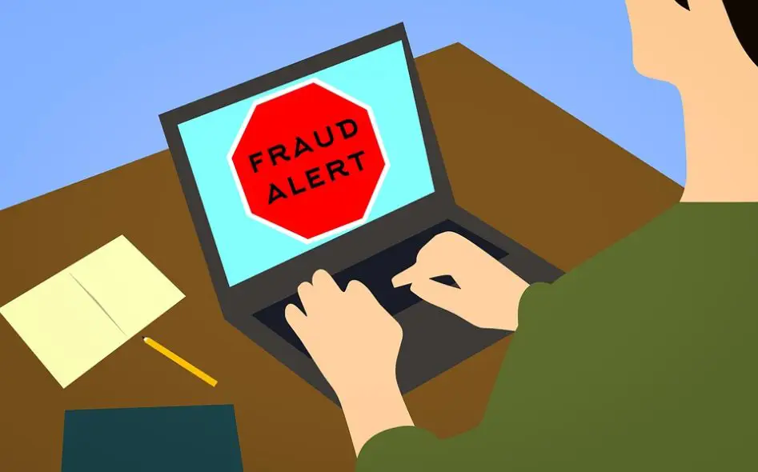
Childcare Benefits Scandal in a Nutshell
The (mis)-use of data led to the false accusations of fraud of the victims
Parents forced to pay back ALL benefits
-> children taken away by child protection
Benefits Scandal
-> 2004-2019
-> 26.000 parents, 70.000 children
-> big case involving multiple issues
Notes:
The Childcare Benefits Scandal (I will call it scandal from now) actually comprises of a lot of different issues and cases that have all been binned within one scandal. I will focus on one, where the misuse of data is most prevalent.
In short: Based on false fraud accusations, parents were forced to pay back all benefits they received in the past. Which resulted in enormous personal debts, these debts caused a cascade of social problems.
The scandal happened between 2004-2019, and 70k children and 26k parents involved.

Slide 5

What happened?!
Tax authorities checks ‘at random’
-> Except those on a (potential) fraud list
Case 1
-> registered data (e.g. 2nd nationality) used to bin people on fraud list
-> 2nd language: application mistakes likely
-> marked as fraud, repayment difficult due to poverty
Notes:
What caused these false accusations?
The tax authorities check peoples income at random to see if they are entitled benefits, and if they potentially find people committing fraud.
Except people on a potential fraud list: they are all being checked..
In case mistakes/fraud is found (wrong dates, names or numbers): benefits have to be returned.
The statistics showed that people with 2nd nationality had a higher chance of making mistakes/committing fraud.
Personal data used to bin people on a fraud list
People with 2nd nationality were more likely to make application mistakes
This was marked as fraud and forced repayment caused personal drama’s

Slide 6
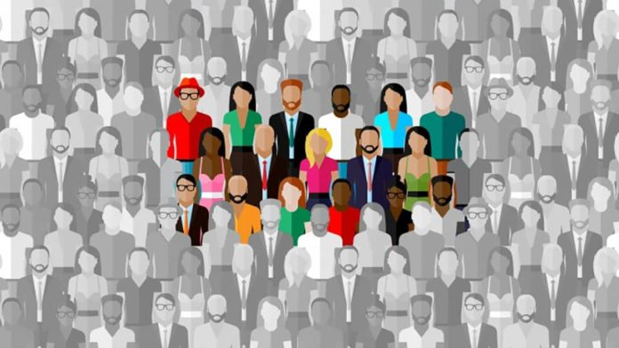
Ethical challenges
Governments collect and (can) use data for the greater good
-> including sensitive data!
Issues:
- Do we trust governmental bodies with our data?
- Governments do change!
Notes:
The ethical issues here are clear. I personally think that governments can use personal, sensitive data for the greater good. E.g. research of certain types of cancer that are more common among minorities.
Main issues: - Do we trust governments with out data, this example shows what can go wrong!
Governments do change, uncertain where we are in 100 years.

Slide 7
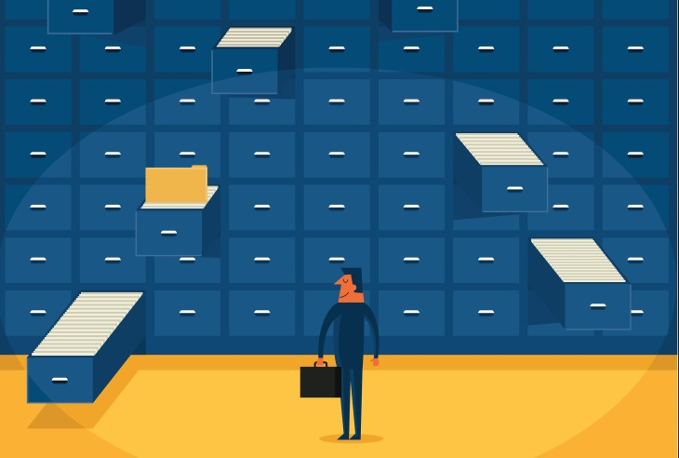
Solutions and opinion
Data that is not recorded cannot be misused
-> France does not record personal sensitive data
-> UK?
Power of data
-> personal data should be recorded, but
stored/organised/analysed by organisations that do not have the
authority to exercise governance/ make binding decissions
Notes:
Solutions:
Data that is not recorded cannot be misused, e.g. France..
I personally believe in the power of data, personal (sensitive) data can be used for important and useful research. But this data should not be stored/used by organisations that have the authority to exercise governance and/or make binding decisions.

