Slide 1
Hierarchical clustering (aka HCA)
HCA: method of cluster analysis
Agglomorative (bottom-up)
Divisive (top-down)

Slide 2
Hierarchical clustering (aka HCA)
HCA: method of cluster analysis
Agglomorative (bottom-up)
Divisive (top-down)
Greedy algorithm (heuristic search) = complex!
Single-linkage clustering (bottom-up) – nearest neighbour
Complete-linkage clustering (top-down) – farthest neighbour

Slide 3
Hierarchical clustering (aka HCA)
HCA: method of cluster analysis
Agglomorative (bottom-up)
Divisive (top-down)
Greedy algorithm (heuristic search) = complex!
Single-linkage clustering (bottom-up) – nearest neighbour
Complete-linkage clustering (top-down) – farthest neighbour
HCA’s results usually presented in dendrogram

Slide 4
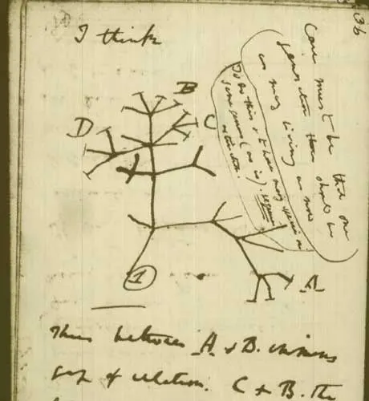
Hierarchical clustering (aka HCA)
HCA: method of cluster analysis
Agglomorative (bottom-up)
Divisive (top-down)
Greedy algorithm (heuristic search) = complex!
Single-linkage clustering (bottom-up) – nearest neighbour
Complete-linkage clustering (top-down) – farthest neighbour
HCA’s results usually presented in dendrogram
Application – evolutionary biology!:
Phylogenetic analyses: evolutionary relationships!

