Slide 1


Slide 2

Hybrid Listing Search & Ranking
search
filter_alt
Search Strategy
Build a real-estate search system mapping natural queries to high-quality results.
Hard Criteria
Identify hard criteria, such as price, rooms, and location, to filter listings.
check_circle
star
info
Validation
Retrieve and validate; only results satisfying all strict constraints are returned.
Soft Ranking
Rank valid listings by interpreting soft preferences (e.g., "bright," "modern").
Explainability
Provide a short explanation detailing why top results rank highly.
Datathon 2026 Challenge: Focus on search quality, robustness, and hybrid retrieval logic.

Slide 3

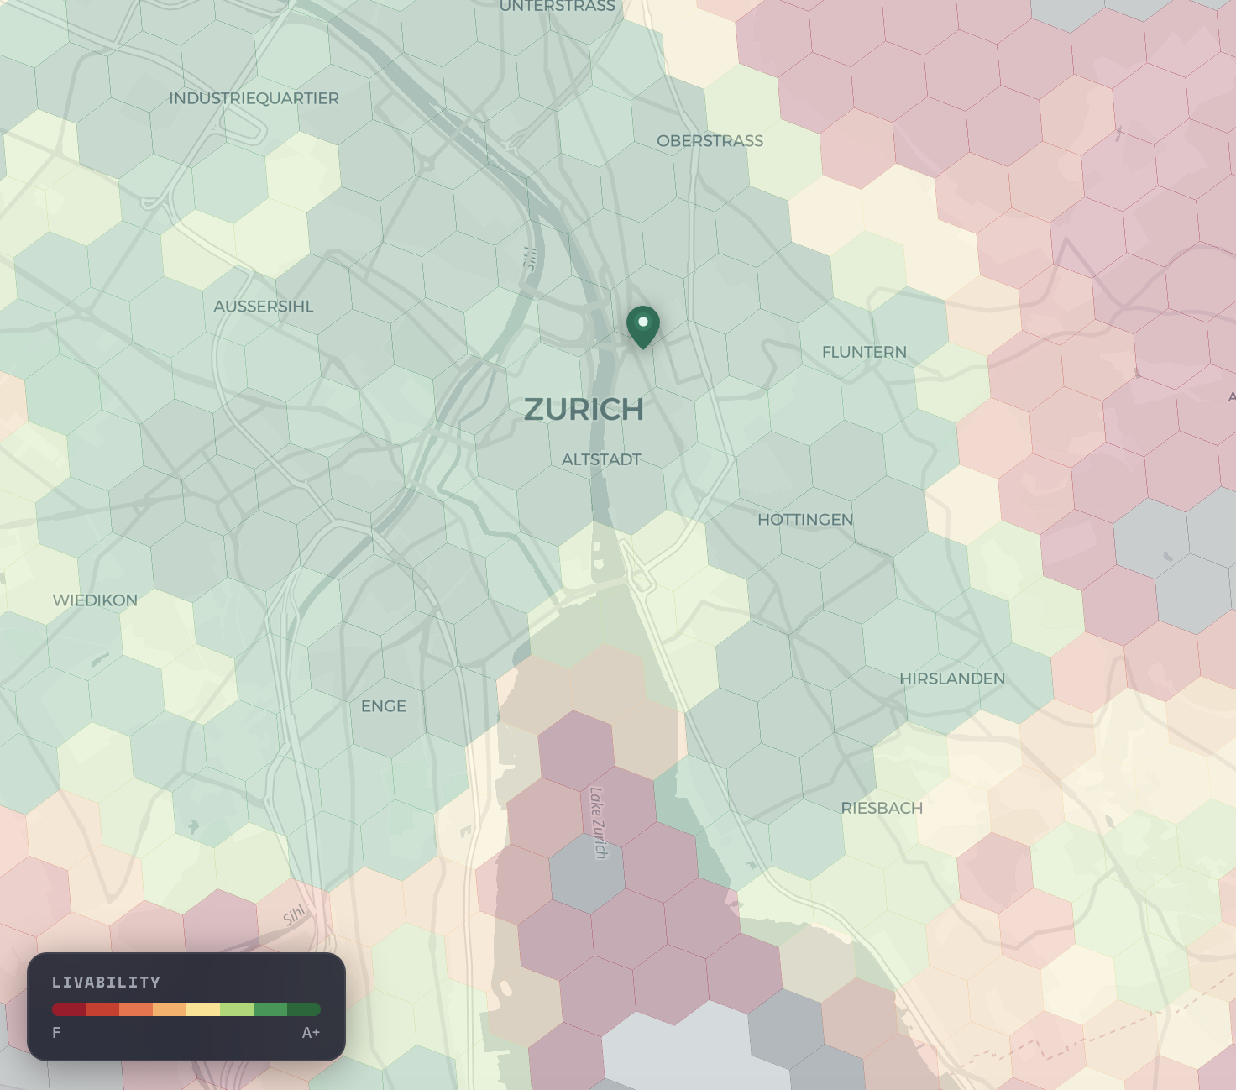

Data Normalization & Enrichment
Strado.info
Livability Index
OpenStreet Map
Geospatial, public transport info
Crime Statistics
In Zürich
Quotes for illustration purposes only

Slide 4
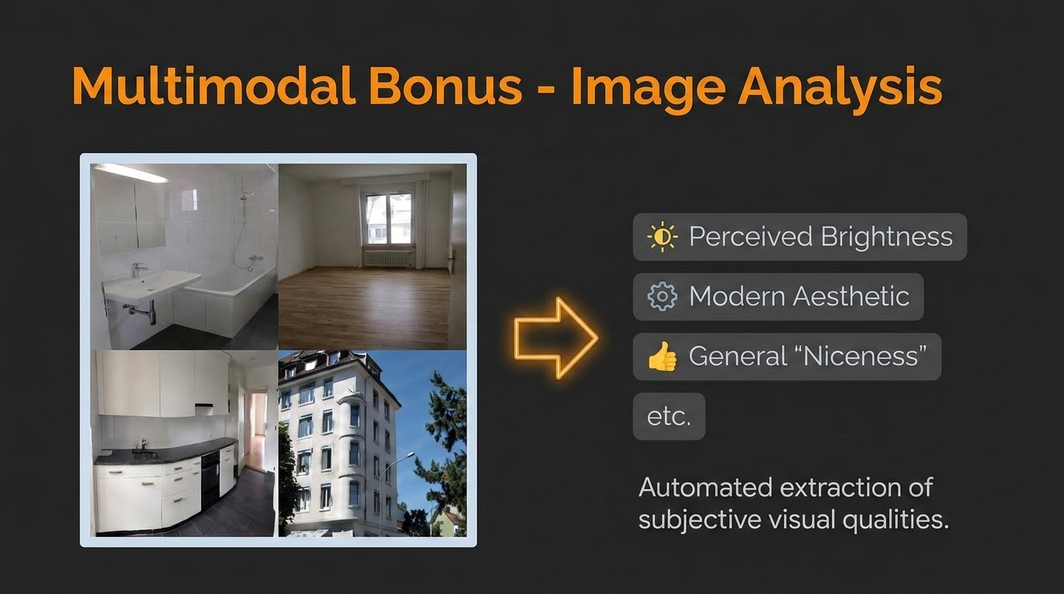
Process attributes for each listing based on the images uploaded
View type (mountain, greenery)
Brightness
Size of rooms
Modernity
Summary of rooms visible

Slide 5
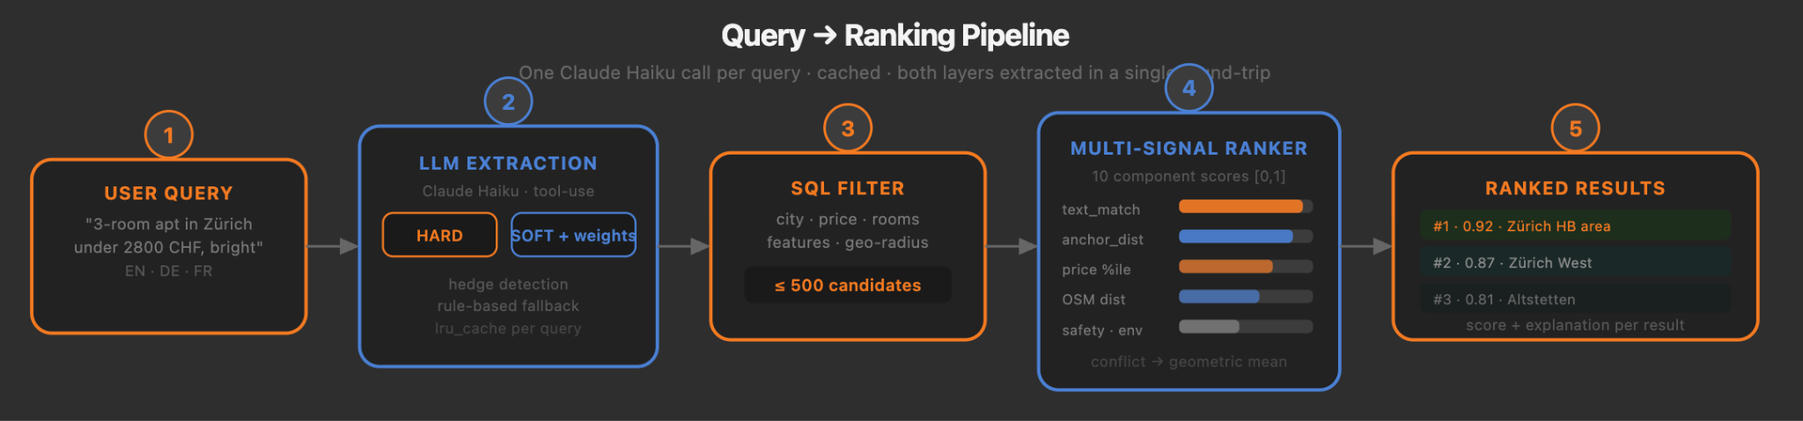
Our Pipeline at a Glance

Slide 6
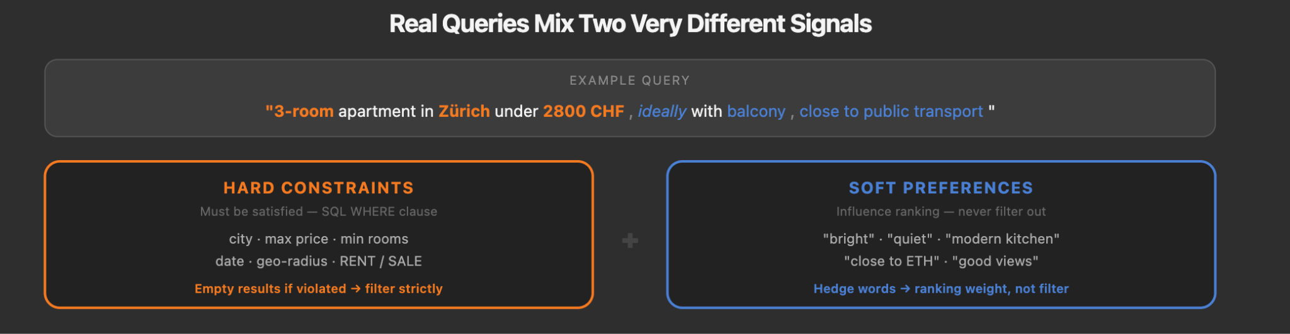
Query Understanding
Extracts both hard filters and soft preferences.
Primary path: structured LLM extraction with Claude
Fallback path: rule-based parser.

Slide 7
Soft Filtering
Conservative filtering before ranking.
Removes obvious mismatches, such as parking-only objects when the user wants an apartment.
Optionally trims expensive listings when the user explicitly asks for the cheapest option.
Avoids over-filtering so good candidates are not lost too early.

Slide 8
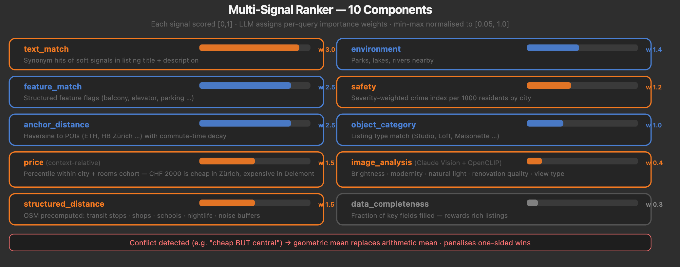
Multi-Signal Ranking
Translating user’s desire to hard and soft constraints in the

Slide 9

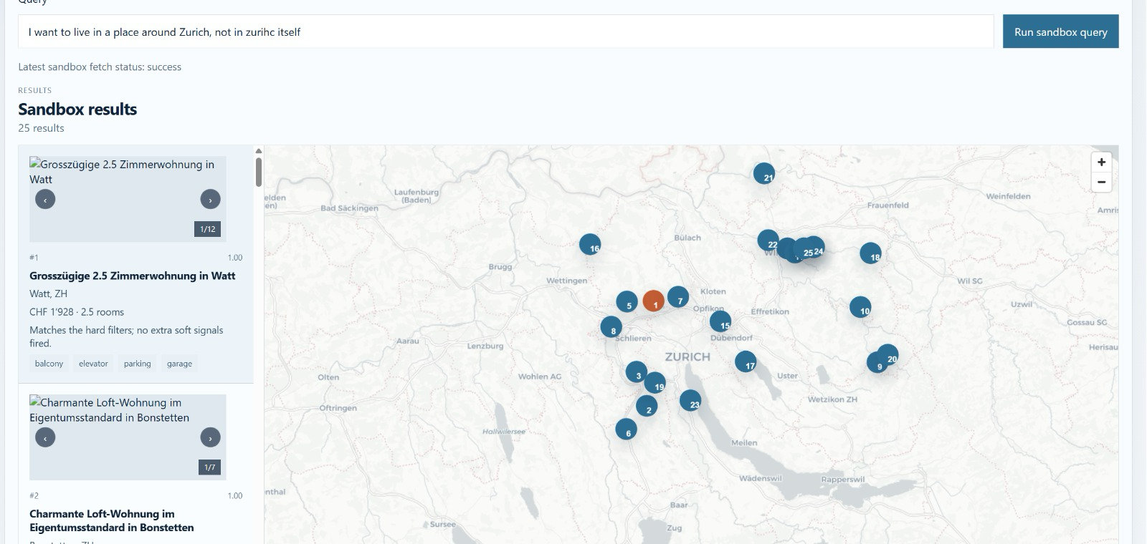
Special Cases
Implicit Preferences
Cues pointing to preferred features without explicit statement
“Affordable” → differs in context
Conflicts
Conflicting preferences handled by choosing the “midpoint”
Central vs cheap
Negations
“Near Zurich, not in Zürich”

Slide 10
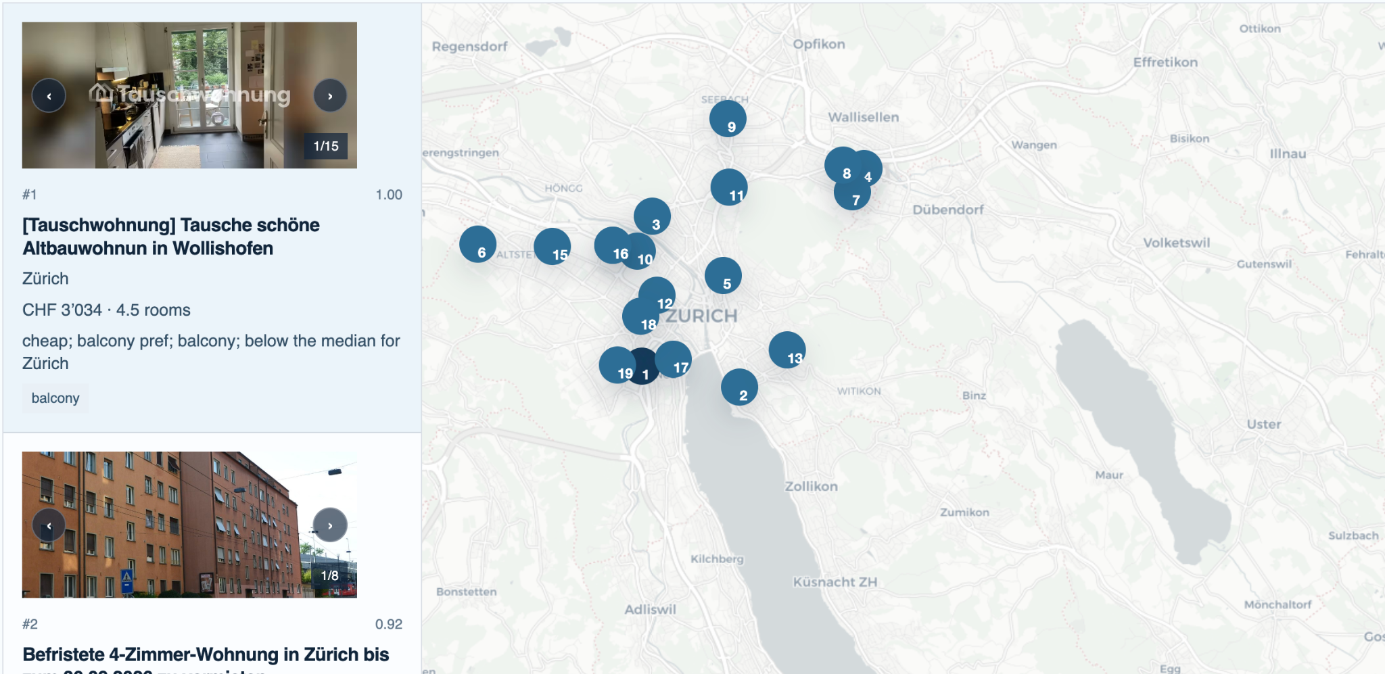
Final Takeaway
Fully deployed FastAPI + React widget + MCP bridge
Hard-filter precision is the primary metric — hedge detection is our main contribution
System is transparent: every result includes score breakdown + evidence strings

Slide 11
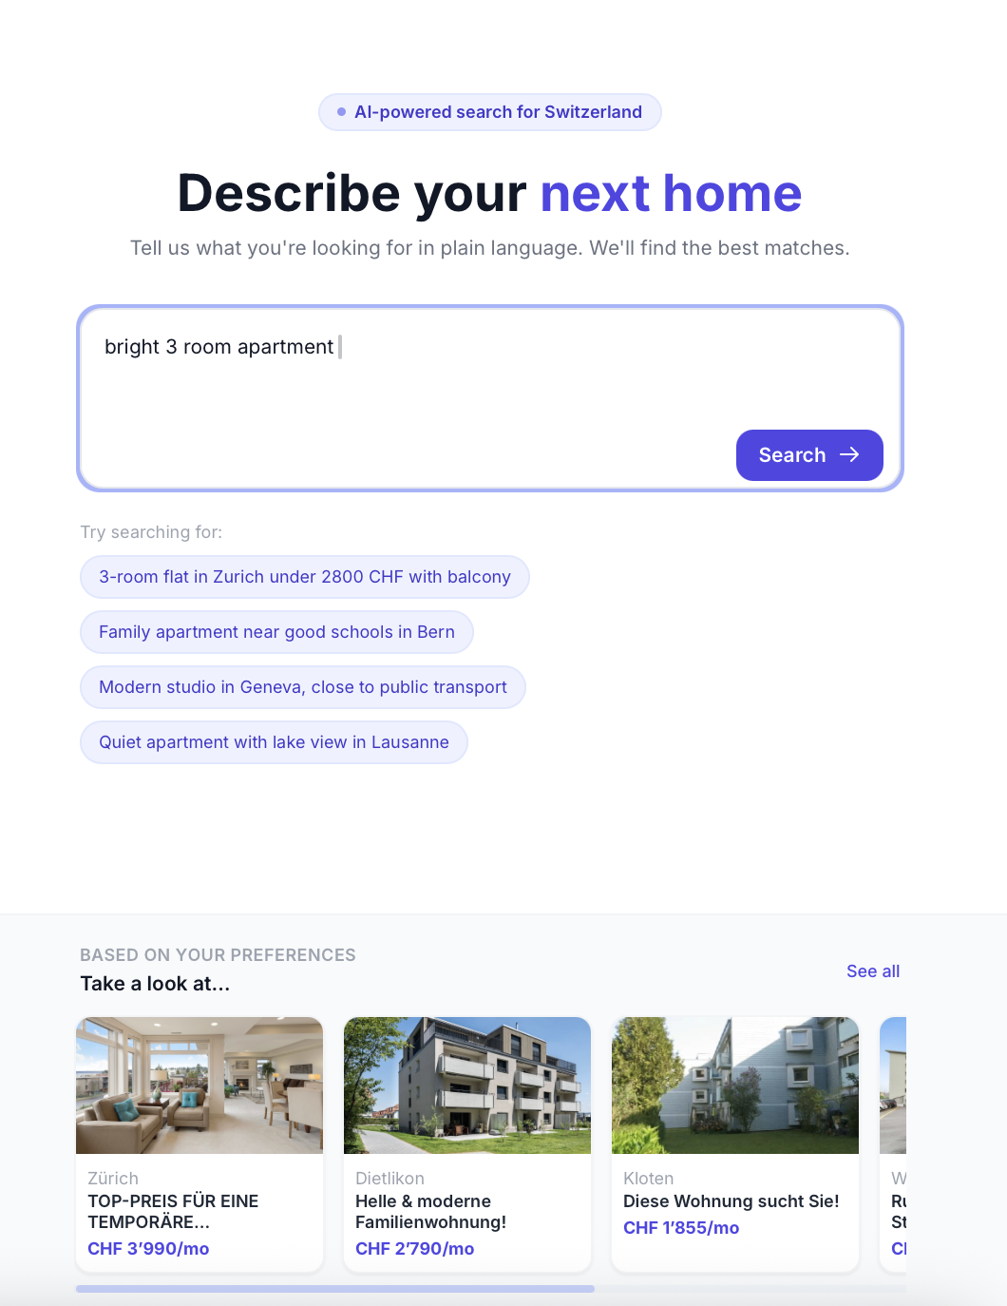
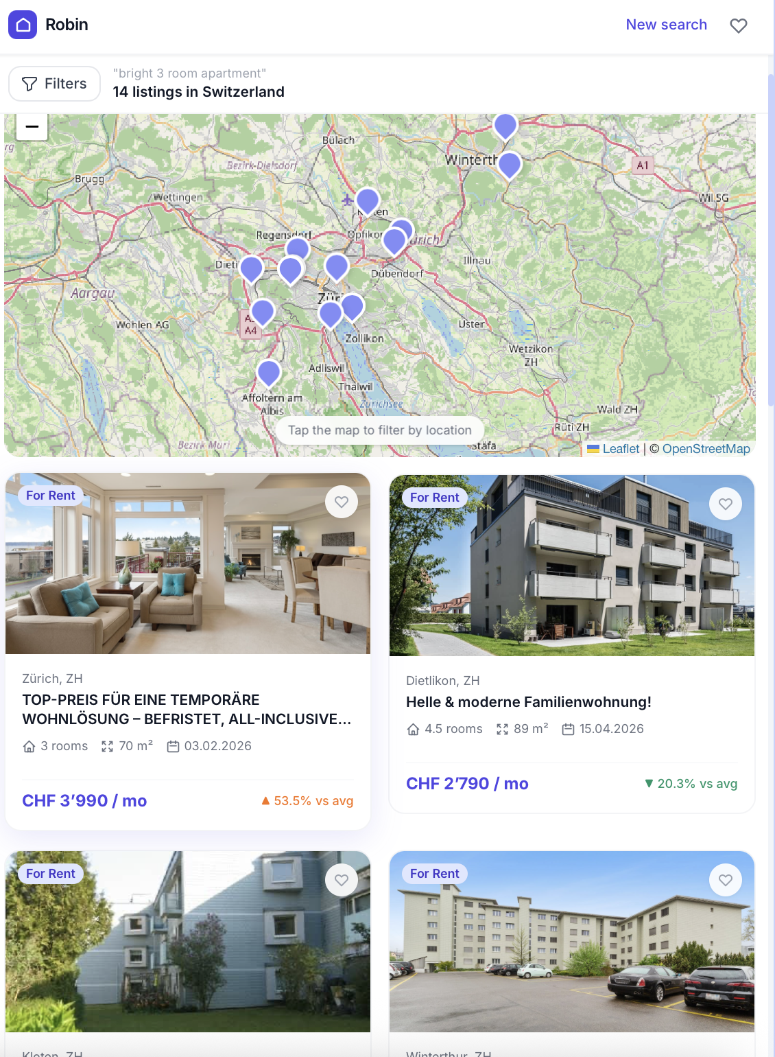
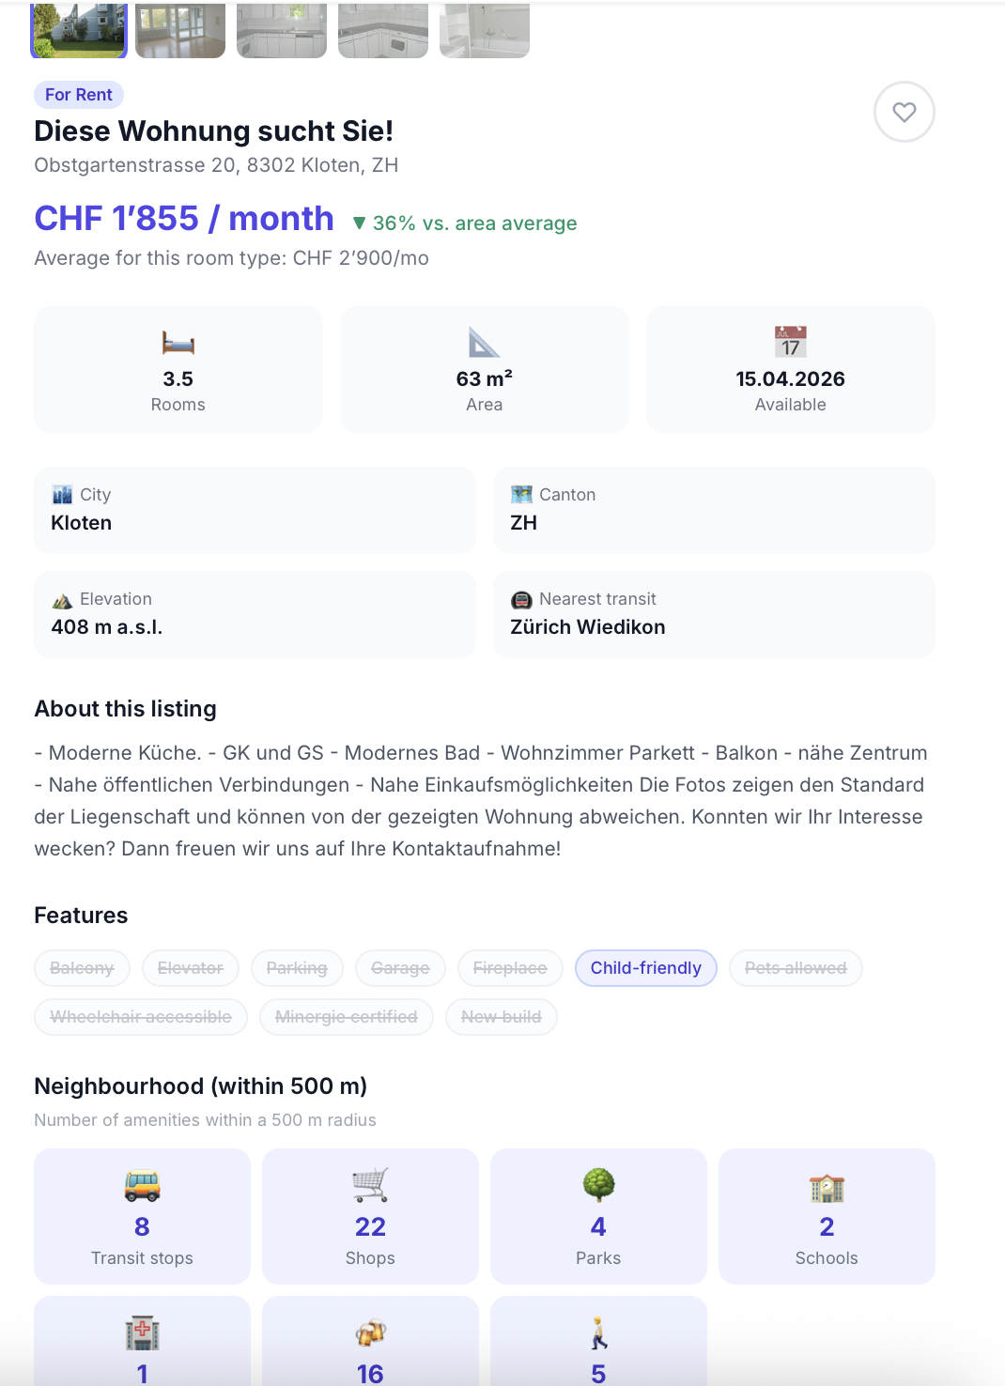
Possible UI interface

