Slide 1
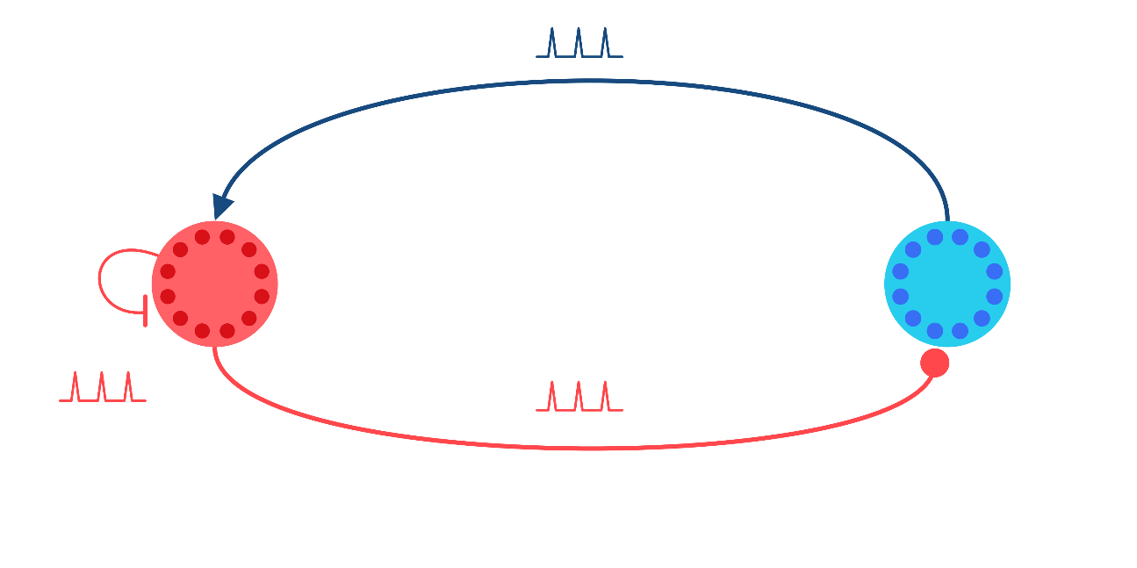




Closed-loop Control of Neural Activity Dynamics
$$+$$
Thijs Lenssen
Supervisor: Amritam Das
$$−$$
P₂
P₁
$$−$$

Slide 2
Sensing – Neural – Actuation Modeling
Single Neural Dynamics
Neural Population Dynamics
Dynamical Models in Neuroscience From a Closed-Loop Control Perspective, Martinez et. Al. (2023)

