Slide 1
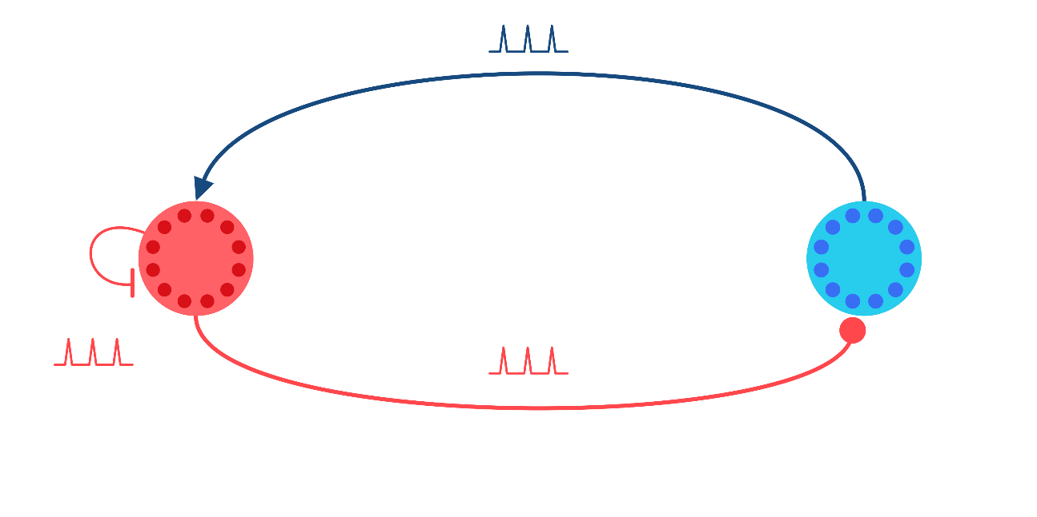




Closed-loop Control of Neural Activity Dynamics
$$+$$
Thijs Lenssen
Supervisor: Amritam Das
$$−$$
P₂
P₁
$$−$$

Slide 2
Sensing – Neural – Actuation Modeling
Single Neural Dynamics
Neural Population Dynamics
Dynamical Models in Neuroscience From a Closed-Loop Control Perspective, Martinez et. Al. (2023)

Slide 3
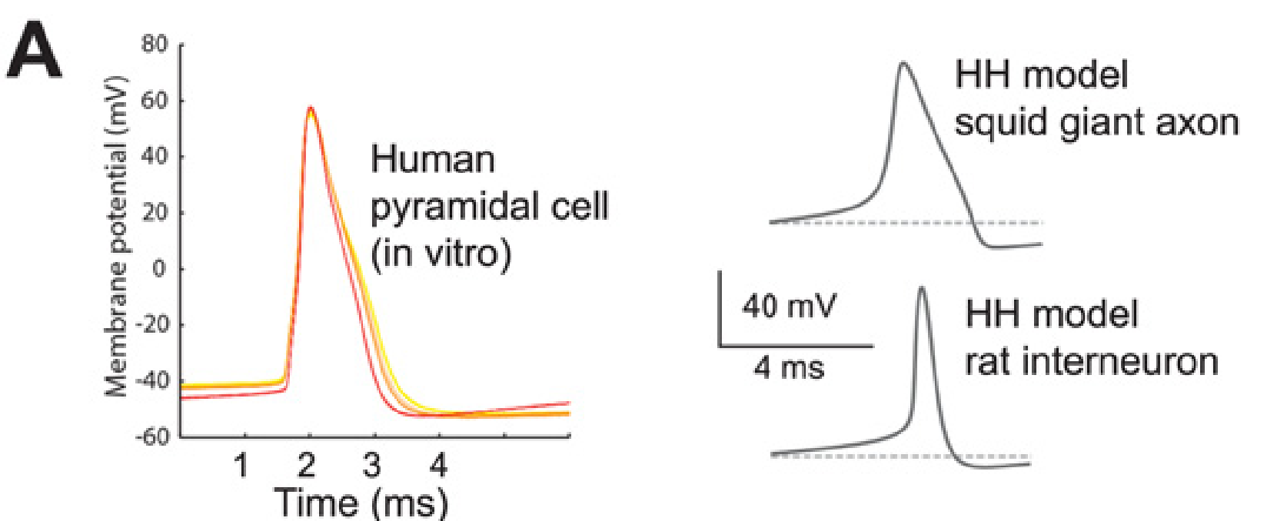
Hodgkin Huxley Model
Spike-onset comparison across different preparations; not a fit to the same cell.
Brette (2015), Fig. 3A; adapted from Testa-Silva et al. (2014) and Sengupta et al. (2010). CC BY.
Notes:
Brette (2015), What Is the Most Realistic Single-Compartment Model of Spike Initiation?, PLoS Computational Biology 11:e1004114, Figure 3A (PDF page 6). https://doi.org/10.1371/journal.pcbi.1004114
Left: recorded human pyramidal-cell action potentials in vitro. Right: single-compartment HH examples for squid giant axon and rat interneuron. These are different preparations, not a model fitted to the recorded cell. The comparison concerns spike-onset shape, not a validation of the distributed HH cable model.
Brette credits Testa-Silva et al. (2014), https://doi.org/10.1371/journal.pbio.1002007, and Sengupta et al. (2010), https://doi.org/10.1371/journal.pcbi.1000840. Figure reproduced under the article Creative Commons Attribution license. The original plotted data, labels and scale bars are retained.

